Slide 1
Alpha Beta Gamma
2022 Expectations for Excellence

Slide 2
Presentation Outline
About us
Equity
Accountability and Harm Reduction
Leadership
Belonging
Questions

Slide 3
About Us
We were founded in 2018 by a group of women who wanted to make a difference in the world
We have 15 active members
Our mission is to save the world
We have won awards such as…

Slide 4
Leadership
President-Maxine Waters
VP- Reba McIntyre
Treasurer- Julia Roberts
Secretary- Soledad O’Brien
DEI Officer- Wendy Wu

Slide 5
Our Pillars
Community Service
Community Outreach
Community Development

Slide 6
Equity
We commit to diversity, inclusion, and access while working to deconstruct systems of power and privilege in our organizations and community. Our members develop skills, knowledge, and understanding to demonstrate cultural humility, value and respect diverse and intersectional experiences, become aware of implicit bias and privilege, and take action to create change.

Slide 7
Equity
We believe we achieved ”Accomplished”
Unacceptable | Minimum | Accomplished | Excellent
☐ | ☐ | X | ☐
The organization holds one conversation or program related to diversity, equity, and inclusion.
The organization identifies at least one initiative to celebrate, support, or explore the experiences of BIPOC students and/or other minoritized groups (ex. LGBTQ+ members, international support) in the chapter. They can explain why they selected that initiative and how it enhances the chapter’s work in equity.
The organization has policies/bylaws in place to discuss diversity, equity, and inclusion. These policies include a process for addressing incidents of bias.
If the chapter was involved in any bias-related incidents processed through the university (ex. a student filed a bias-related incident report for the chapter), the chapter describes its investigation and follow-through of that report regardless of the university’s finding.

Slide 8
Equity
“How to be Anti-Racist” by Ibram Kendi Book Club
FSA Greek Life biases talks by Casey
Safe Zone training by our DEI Chair

Slide 9
Equity
We connected with various organizations on campus and collaborated on DEI events
We celebrated each member’s ethnicity and holidays that are specific to their culture.
Additional Accomplishments

Slide 10
Equity
Chapter Performance as of January 2022 | 5
Expected End-of-Year Rating When Writing Goals in January | 10
Actual Chapter Performance as of November 2022 | 6
Ratings are on a scale of 1-10 (1 = poor; 10 = excellent)

Slide 11
Accountability and Harm Reduction
We employ strategies to resolve issues of inappropriate conduct, including violations of college or inter/national organization policy, and we hold members accountable to our stated values as well as the values of the institution. We conduct ourselves with honesty, dedication, and fairness and are responsible for making our community ever better through our actions, our words, and our dealings with others. We take responsibility and initiative for reducing and preventing harm to our members by promoting their physical, mental, and spiritual wellness.

Slide 12
Accountability and Harm Reduction
We believe we achieved ”Accomplished”
Unacceptable | Minimum | Accomplished | Excellent
☐ | ☐ | X | ☐
75% of members participate in SWARM training annually (not required in 2022)
The chapter holds at least one program related to mental or physical wellness.
The organization is not found responsible for any violations of the standards of student conduct; if that occurs, the organization should describe the violation and provide a reflection with a detailed plan for improvement. This plan should include a description of the incident(s), a thorough reflection on what the chapter has learned, and concrete steps the chapter will take to make sure this behavior is not repeated in the future.
The organization has policies/bylaws in place to address and resolve misconduct (ex. Standards Board, Accountability Chair).

Slide 13
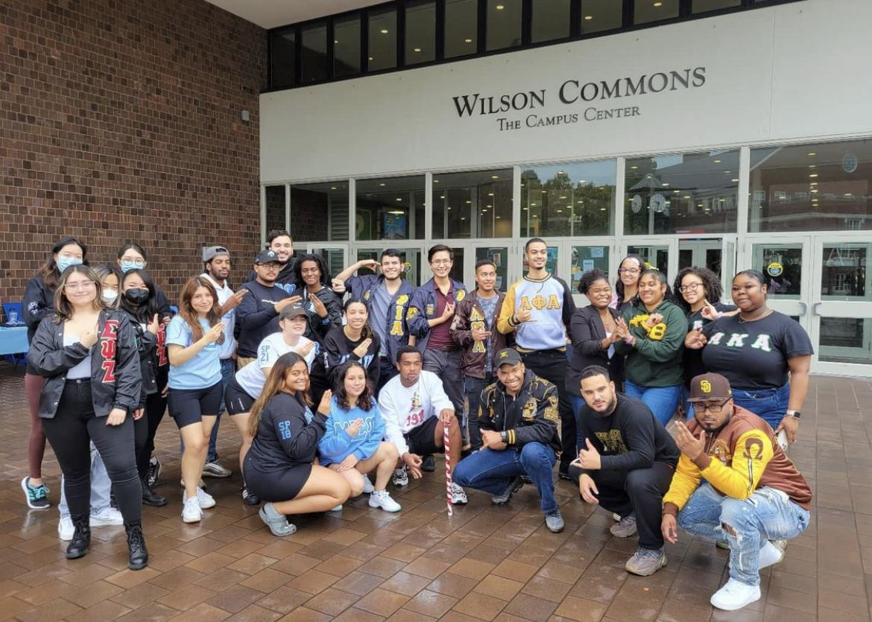
Accountability and Harm Reduction
Safe drinking seminar
Dry party training
Campus and community Biggest Loser
Sexual harassment training

Slide 14
Accountability and Harm Reduction
We did an on-campus safety awareness enrichment at a local high school senior class
We made several workshops mandatory and about our point system
We had no incidents with public safety
Additional Accomplishments

Slide 15
Accountability and Harm Reduction
Chapter Performance as of January 2022 | 5
Expected End-of-Year Rating When Writing Goals in January | 10
Actual Chapter Performance as of November 2022 | 6
Ratings are on a scale of 1-10 (1 = poor; 10 = excellent)

Slide 16
Leadership
We encourage the development of strong leaders within our chapter by promoting leadership training opportunities for our officers and our members. Through formal and informal positions, everyone in our organization can be a leader. Members leverage the strengths of the community to reach common goals and use interpersonal skills for coaching and development. Members also engage meaningfully outside their organization, learning about diverse and intersectional experiences in the campus and city communities. Through a process of learning and applying skills, members can accomplish measurable and meaningful change.

Slide 17
Leadership
We believe we achieved ”Excellent”
Unacceptable | Minimum | Accomplished | Excellent
☐ | ☐ | ☐ | X
90% of new members have completed all components of the new member orientation program.
At least two members of the organization (or one for a single member chapter) participate in the fall leadership training.
The organization has a leadership transition process (ex. Shadowing period, shared google doc, transition event).
The organization has a representative at 75% or more of the monthly fraternity and sorority president’s meetings.
The organization has a representative at 75% or more of their governing council meetings.

Slide 18
Leadership
We attend the Motivating the Middle Medallion workshop on September 20th
We encourage each member to attend trainings by the FSA
We had 4 members attend the 34th national convention in October in Las Vegas

Slide 19
Leadership
We have 4 members who are officers on the regional and national level
6 of our members are on the E-board of clubs and organizations on campus
We were able to host a chapter meeting where we received a training on succession planning from our regional VP
Additional Accomplishments

Slide 20
Leadership
Chapter Performance as of January 2022 | 5
Expected End-of-Year Rating When Writing Goals in January | 10
Actual Chapter Performance as of November 2022 | 6
Ratings are on a scale of 1-10 (1 = poor; 10 = excellent)

Slide 21
Belonging
We promote a positive community within our organization by creating and participating in programs that enhance our members’ experience. Members feel connected, building mutually beneficial relationships that allow us to test ideas, challenge assumptions, and navigate conflicts. We value our differences, our environment, and our individual and collective contributions. Through our shared experience, members enjoy their time with one another.

Slide 22
Belonging
We believe we achieved ”Accomplished”
Unacceptable | Minimum | Accomplished | Excellent
☐ | ☐ | X | ☐
The organization identifies at least three initiatives that are important for creating a sense of belonging and community in the chapter. For each initiative, they can explain why they selected that initiative and how it contributes to the chapter’s sense of belonging.

Slide 23
Belonging
Support all cultures through activities and celebration of members such as the cultural potluck
Support members who are in other clubs and organizations by giving to their fundraisers and attending their events
Encourage participation in all areas of campus (ie: clubs, sports, intramurals, etc.)

Slide 24
Belonging
Our process of electing officers is fair and gives every member an opportunity to serve
We developed an internal communication process where we notify each other of the activities we are doing on campus so we can coordinate schedules and show support
Additional Accomplishments

Slide 25
Belonging
Chapter Performance as of January 2022 | 5
Expected End-of-Year Rating When Writing Goals in January | 10
Actual Chapter Performance as of November 2022 | 6
Ratings are on a scale of 1-10 (1 = poor; 10 = excellent)

Slide 26
Recap
Strengths & Challenges
Organization Priorities
We want to more members to take part in the medallion program
We can work harder on belonging and equity
We did great work with Accountability & Harm Reduction
We plan to prioritize fostering a sense of belonging among the member, especially new members.
We plan prioritize making a comprehensive transition manual for each chapter leadership role
We plan to prioritize recruitment

Slide 27
Questions

