Slide 1
New York State Grants Reform
Laurie Naber
Office of Research and Project Administration

Slide 2
New York State Grants Reform www.grantsreform.ny.gov
Streamlining State Grant Processes

Slide 3
New York State Grants Reform
Four Components
NYS Master Contract for Grants
Multi-Year Contracting
Grants Gateway
Prequalification

Slide 4
NYS Master Contract for Grants
A Master Contract for Grants has been adopted
Standard Statewide Terms and Conditions
The benefits include:
•Streamlines approvals at both the State and grantee levels
•Creates a known quantity; recipients know what to expect
•Reduces discrepancies and inconsistencies

Slide 5
Multi-Year Contracting
reduce paperwork and processing time
reducing cash flow problems for vendors
State agencies will review grant programs as they implement the 2013-14 budgets
Migrate as many as possible to a multi-year contract format.

Slide 6
Grants Gateway
Primary outlet for State agencies to post upcoming and available funding opportunities.
Grant Opportunity Portal is now operational
  search for available and anticipated grant opportunities,
  download grant opportunities, and
  register to receive email notifications when specific types of grant opportunities are posted.

Slide 7
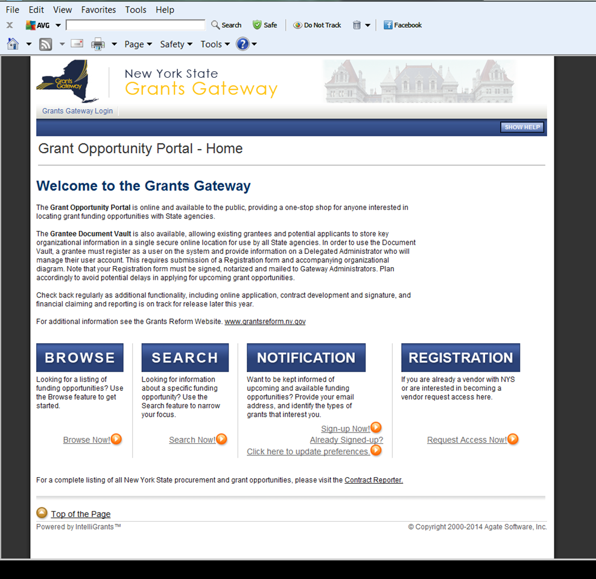

Slide 8
Grants Gateway
Beginning January 1, 2014
State agency funding opportunities will be posted on the Grants Gateway for online applications.
Guidance on Registration and Online Application processes
  Videos
  Grantee User Guide

Slide 9
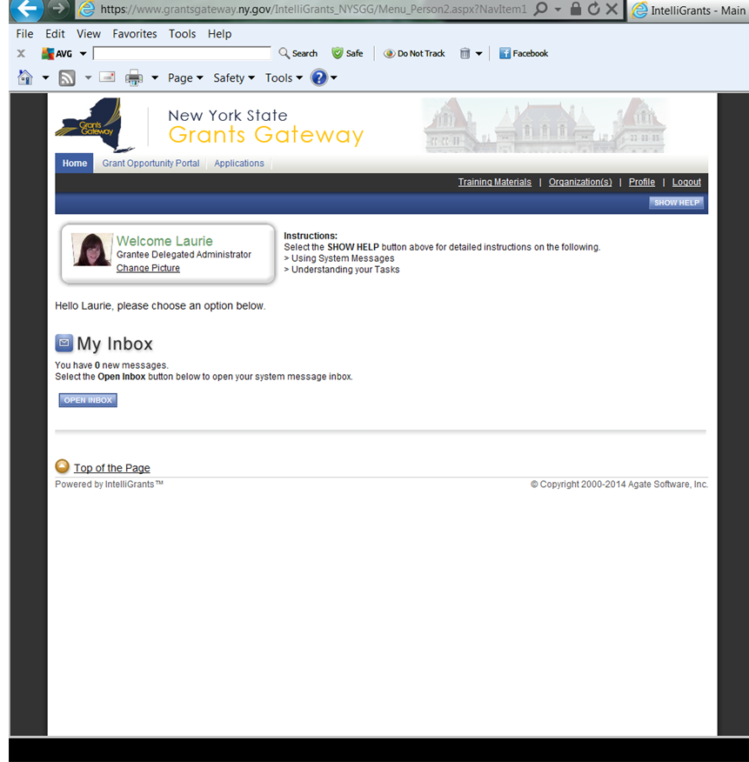

Slide 10
Grants Gateway
Grantee Document Vault
provides ORPA a secure online repository to store and share commonly requested documents with State agencies.
ORPA submitted registration materials and has upload documents into the Document Vault.
In addition, ORPA has completed the prequalification questionnaire and is
PREQUALIFIED TO DO BUSINESS WITH NYS.

Slide 11
Grants Gateway
Current
  Posting grant opportunities
  on-line submission
Future
  Issuing contracts on-line
  Multi year contracts
Beyond
  Payments and vouchers

Slide 12
Prequalification
not-for-profits - only
interact more directly with State agencies before they compete for State contracts
Enable not-for-profits to provide required information prior to entering into a competitive bid process
Once registered with the Gateway, not-for-profits can fill out an online Prequalification Application

Slide 13
Prequalification
The process is simple.
Requires upload of basic organizational documents and asks straightforward questions about a not-for-profit’s capacity and integrity.
Not-for-profits can secure their application materials in the Document Vault where they will be accessible to all State agencies, thereby reducing redundancy and conserving resources.
Most importantly, not-for-profits will only have to prequalify once every three years, with responsibility to keep their information current throughout the three year period.

Slide 14
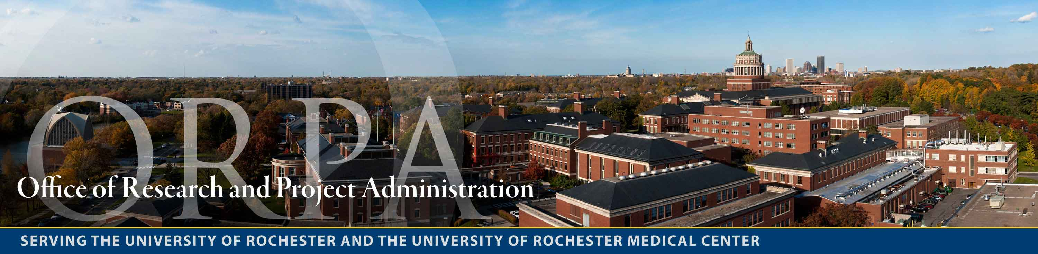
How do UR users register?

Slide 15
3 Ways To Register – one online form
  What’s New
    New York State Grants Gateway
      Request to Establish a NYS Grants Gateway User Account link
  Proposal Development
    Electronic Registration
      NYS Request to Establish a NYS Grants Gateway User Account link
  Forms
    Request to Establish a NYS Grants Gateway User Account link

Slide 16
Additional Information
NYS Ten Digit Vendor ID – 1000007489 (included on Proposal Information Sheet)
ORPA Research Administrators will submit applications for their respective departments
NYS Help Desk: 1-800-820-1890

Slide 17
Websites
www.grantsreform.ny.gov
www.grantsgateway.ny.gov

Slide 18
Questions?
Thank you!

