Slide 1
UR Financials Project
Workday Fundamentals for the Sponsored Research Administrator

Slide 2
Agenda
Key Terms
Summary of Process Changes
Create Awards/Grants
Financial Reporting – Internal
Billing and Revenue Recognition
End of Life Reporting - External

Slide 3
Key Terms – WD Organizational Terms
Company – Previously known as Divisions (010 Central Admin, 030 ESM, 040 SON, 050 SMH, etc).
Division – No longer used in WD.
Department – No longer used in WD.
Cost Center – Business Unit of Companies, previously known as Department.
FAO – Previously known as Account. Worktag, has related worktags and is applied to financial transactions.
Worktag - An FAO has worktags pre-defined or “related”, the transaction then has a Spend Category applied based on what the transaction was for, and Worktags are reportable dimensions.

Slide 4
Key Terms – WD Financial Specific
Ledger/Account – Line name on financial statements, or some sublevel of such accounts. A typical balance sheet begins with Cash, cash is a ledger account. There are several Ledger Accounts that roll up to Cash, they are in a range of 10000 to 10300.
Spend Category – An expense description required for manual and operational journals. Previously a subcode.
Revenue Category – A revenue description, previously a subcode.
Object Class Set – A collection of Spend Categories, defined to align with Sponsor defined budget/billing lines. Object Class is what appears on bills generated for Sponsored Projects.

Slide 5
Key Terms – Grant Specific
Sponsor – External granting agency; one sponsor per award
Award – Captures all the sponsor’s terms and conditions; purpose of the award is to create the business rules to correctly bill, collect and report activities related to the award. (No Expenses/Revenues go to an Award)
Award Line – breaks down the funding: type of funding (cost reimbursement, fixed amount, prepaid), links to grant, specifies date ranges
Grant – Primary costing organizations in Workday; the grant worktag will be used to capture costs and revenue for the award line. Previously Ledger/Account.
Award Schedule – Life of the award (how is it broken down into budget periods), configured each time for each award

Slide 6
Summary of Process Changes
Subcontracts – a unique Award Line/Grant is required, elimination of 2968 and 2969 (WD calculates indirects to $25K basis).
Master/Sub – Subs are simply another Award Line/Grant on the Award
Indirect Expenses – Applied to individual transactions, operational delayed until payment of expense occurs (at this time, expect fix from WD), manual applied at time of approval.
Billing to Sponsors – Occurs in WD, creates receivable.
Application of Cash – Occurs in WD, applies against receivable.
Letter of Credit – Draw is applied individually to Award, no longer a pooled method, good news since pooled method is going away.

Slide 7
Summary of Process Changes
Transaction vs. Budget Dates - To be eligible for Revenue Recognition and Facilities and Administration (F&A) the transaction must have a “budget date” between the start and end dates on the corresponding award line of the specific grant.
Cost Sharing – Functionally able to record expense on two FAO’s, paid for by one.
Mod’s/Amend’s – Versioning of Awards is available, and reviewable.

Slide 8
Create Awards/Grants
ORPA
Initiate Award/Grant in WD including data attributes consistent with previous File Maintenance Form
Create Award Schedule
ORACS
Review/Approve Award/Grant
Perform Mod’s/Amend’s during life of Award
Maintain Budget
Review/Approve Journals

Slide 9
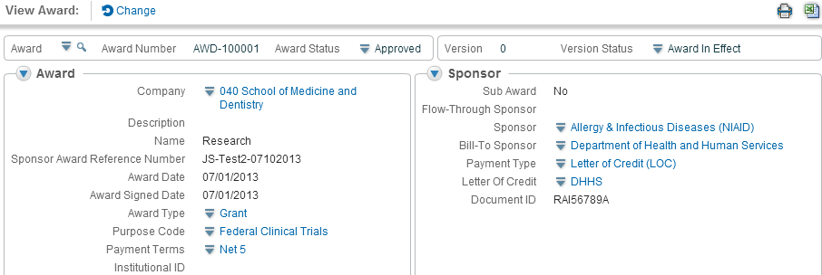
Award Setup Process
Receive NOGA
ORPA Creates Award
ORACS Approves Award
Award Header Information

Slide 10
Financial Reporting - Internal
Group training Sessions for “Non-Company Level” users. November 17 through mid February. See URFinancials website to sign-up.
Reporting is not for the faint of heart, users need to understand what data criteria they have requested, a lot like COGNOS in that reports return different information, sometimes unexpected.
Reporting is reporting, FAO reporting for GR’s is no different than for GF’s or OP’s (Gifts or Operating FAO’s).
Notes:
Day 2 and Day 3

Slide 11
Billing and Revenue Recognition
Invoices are now in WD
Cash Application is performed against a true receivable
Bad debt expenses are processed against Ledger 2’s, unless otherwise directed
Overspend adjusted via Spend Category for F&A tracking
Revenue is included in WD when expense is recognized
Notes:
Add flowchart

Slide 12
End of Life Reporting - External
ORACS performs final financial reporting
Grant(s) moved to Inactive Status
Once all cash posted then Grant(s) moved to Complete Status
History remains in WD, Forever?
Notes:
Add flowchart

