Slide 1
High Tech Rochester
And
The Entrepreneurs Network
Mike Riedlinger
Director, Rochester BioVenture Center &
Manager, Technology Commercialization Initiatives
585-413-9061
www.HTR.org
Jean Kase
TEN Executive Director
585-214-2423
http://TEN-NY.org
www.htr.org (585) 214-2400 February 9, 2012
Notes:
2/8/2012
www.htr.org, 585 214-2400
1

Slide 2



HTR is a U of R Affiliate
Technology
Mentors and Manufacturing Experts
Entrepreneurs and Manufacturers
Capital

Slide 3
HTR Overview
Mission
  To be a catalyst for entrepreneurship and economic development by applying business expertise & network connections to aid in the formation and profitable growth of companies in the Greater Rochester, NY Region.
    Technology start-up companies
    More mature manufacturing companies

Slide 4



























HTR Partners
Finger Lakes
Works
Additional connections across Upstate NY and beyond…

Slide 5
What We Do…
Technology Commercialization
  Identify, recruit and commercialize the most promising technologies
Business Incubation
  Provide intensive mentoring for high-growth-potential startups
  Become a vital and extended part of their teams to execute the business plan and grow
Manufacturing Growth Consulting
  Work with companies up to 500 employees to develop new products, markets, productivity/profitability improvement

Slide 6
HTR Programs and Services
Innovation & Growth across all stages of company life cycle
New Products and IP
Company
Stages
Concept
Pre-Seed
Seed
Early
Stage
Growth
Mature
Idea
Prototype
Customer
Validation
Revenues
Profitability
Sustainability
Technology
Commercialization
Business
Incubation
Manufacturing
Growth
HTR
Services
Network Connections, Management Talent, Capital Raising

Slide 7
Technology
Commercialization
Business
Incubation
Manufacturing
Growth
Source technologies, evaluate market potential, connect resources (including prototyping), seek funding, form businesses
  Technologies are typically from universities or corporations
Methods:
  HTR Market Opportunity Assessment
    Customer Need, Addressable Market Size, Value Proposition, Competitive Advantage, Business Model, Management, Go/No-Go Recommendation
  Pre-Seed Workshops
    Intense 2-day workshop to assess Go/No-Go on new technologies
Results from past five years:
  251 opportunities screened
  58 business & marketing plans developed
  $40M raised by client companies
    $12.7M in SBIR and other grants

Slide 8
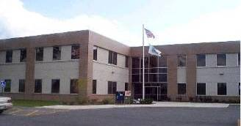
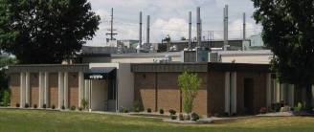
Technology
Commercialization
Business
Incubation
Manufacturing
Growth
Lennox Tech Enterprise Center
  Advanced Technology
  50,000 square feet
Rochester BioVenture Center
  Medical Devices and Life Sciences
  42,000 square feet
  Wet labs and biotech infrastructure
In-depth coaching/mentoring from CxO level talent
Assistance with business plan execution, sales/ marketing strategy, fundraising, connections, etc.
75 startup companies incubated to date

Slide 9
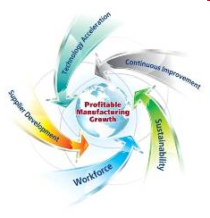

Technology
Commercialization
Business
Incubation
Manufacturing
Growth
Part of national MEP network (US Dept. of Commerce)
New product development
Technology “Infusion”
“Virtual Prototyping” resources
Waste and energy reduction
Quality (ISO 9000, etc.)
And more….

Slide 10
The Entrepreneurs Network
Economic development initiative launched by Monroe County Executive Maggie Brooks
  Small business, especially NEW ventures, is where most job growth is occurring
  Long-term, sustainable growth built on retaining existing employer base AND improving the success ratio of entrepreneurial start-ups
Vision for economic development – leverage Upstate assets
  High tech industries
  Academic institutions
  Diverse base of small & medium-size businesses
  Entrepreneurs

Slide 11
TEN Strategic Partners
Monroe County – Maggie Brooks
COMIDA – Judy Seil
Excell Partners – Theresa Mazzullo
High Tech Rochester & Rochester Angel Network– Jim Senall
Insyte Consulting & Western New York Venture Association – Jack McGowan
Derby Management – Jack Derby & George Simmons

Slide 12
Derby Management
Jack Derby
  Co-founded 9 companies; current director of 7
  Raised $645 million in venture & private equity
  Common Angels (Boston)
George Simmons
  25-year veteran of early stage, entrepreneurial companies
  Currently President of Laser company in NH
  Launchpad (Boston) & Cherrystone (Providence)

Slide 13
What is TEN?
Training – interactive, intense boot camps provide real-time feedback from expert coaches, peer learning, confidential atmosphere.
Educating – experts provide tools & best practices relevant to early stage companies launching a new product/service & existing firms seeking to increase profitability.
Networking – top regional & national speakers provide contacts critical to success. TEN alumni stay connected.

Slide 14
TEN’S 4 Boot Camps
Entrepreneurship Boot Camp Led by Derby Management | Building Blocks Boot Camp Led by Upstate business & technical experts
Sales Optimization Boot Camp Led by Derby Management | Investor Presentation & Sales Presentation Boot Camp Led by Upstate business & technical experts Final Presentations Judged by Bankers, Angels & Venture Capitalists

Slide 15
Who’s eligible for TEN?
Founders, CEOs, senior executives, serial entrepreneurs
Early stage technology
Life sciences
Scalable, high-growth potential
Family owned
Ownership transition
TEN Statistics
  200 entrepreneurs from 180 firms in Upstate NY

Slide 16
Sample of TEN success stories
SBIR / STTR – About half of WNY firms awarded are TEN alumni
2011 business plan contest finalists – 3 of the 8 semifinalists = TEN alumni
RAN, WNYVA and Excell Partners investment portfolios include TEN members
And many more...

Slide 17
TEN Class 12
Looking to recruit 15-20 of Upstate New York’s “best & brightest”
Apply today!
http://TEN-NY.org/membership

Slide 18

Commercialization Program
PreSeed Workshop
precede [prɪˈsiːd] vb
to go or be before (someone or something) in time, place, rank, etc.
2. (tr) to preface or introduce
[via Old French from Latin praecēdere to go before, from prae before + cēdere to move]
Collins English Dictionary – Complete and Unabridged
© HarperCollins Publishers 1991, 1994, 1998, 2000, 2003

Slide 19
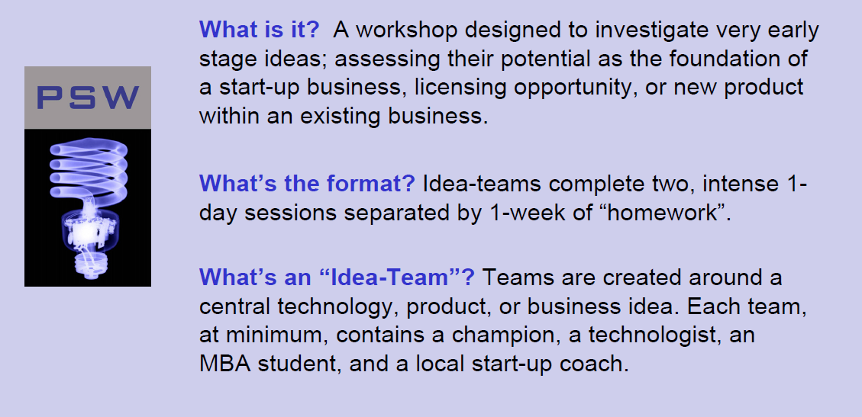
PreSeed Workshop

Slide 20
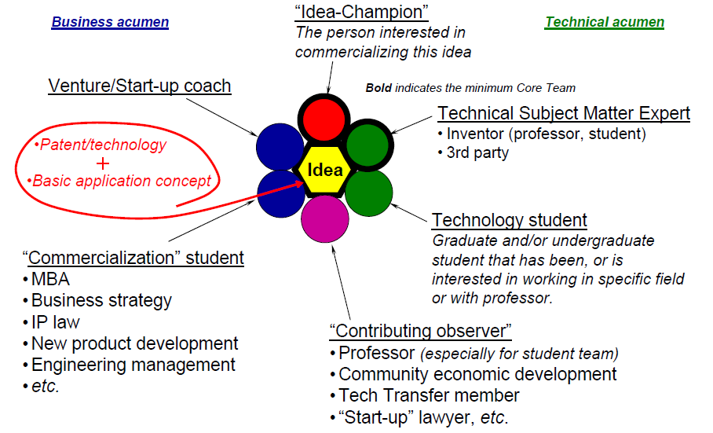
PreSeed Workshop

Slide 21
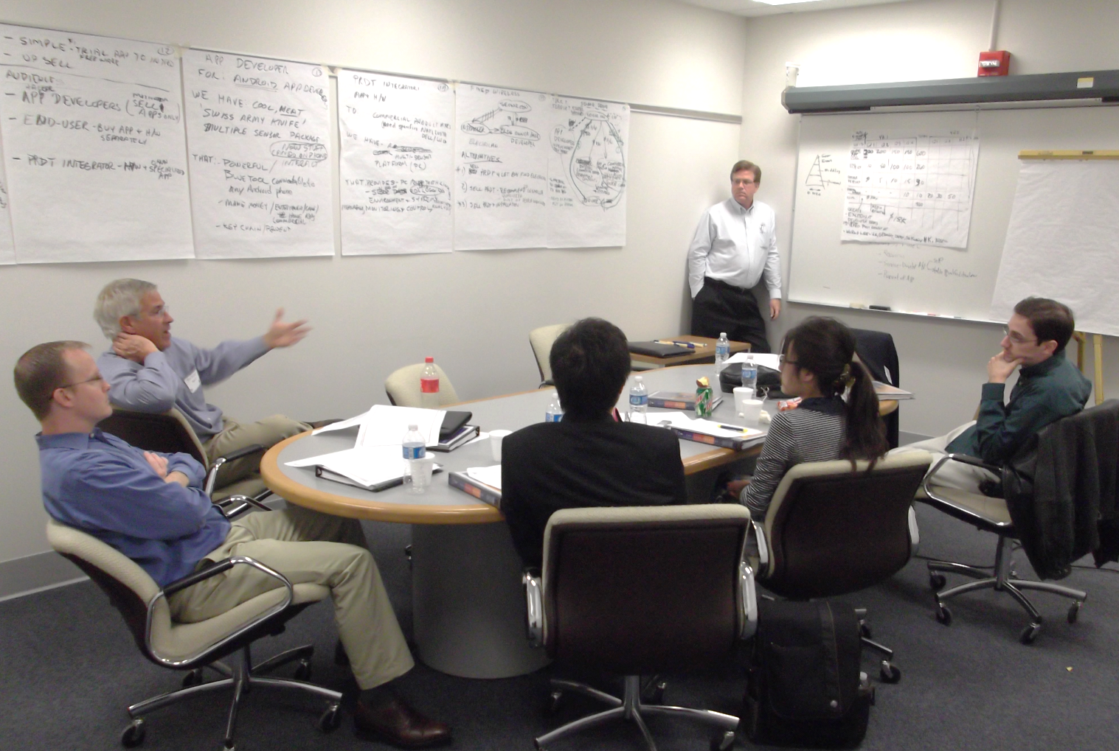
PreSeed Workshop
Idea Team at Work

Slide 22
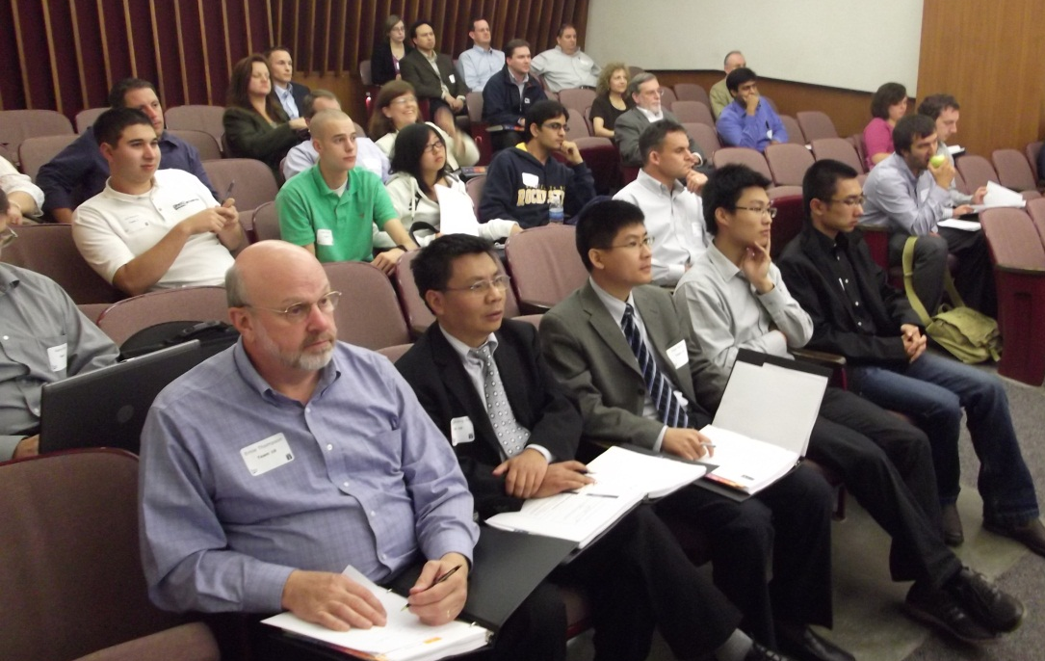
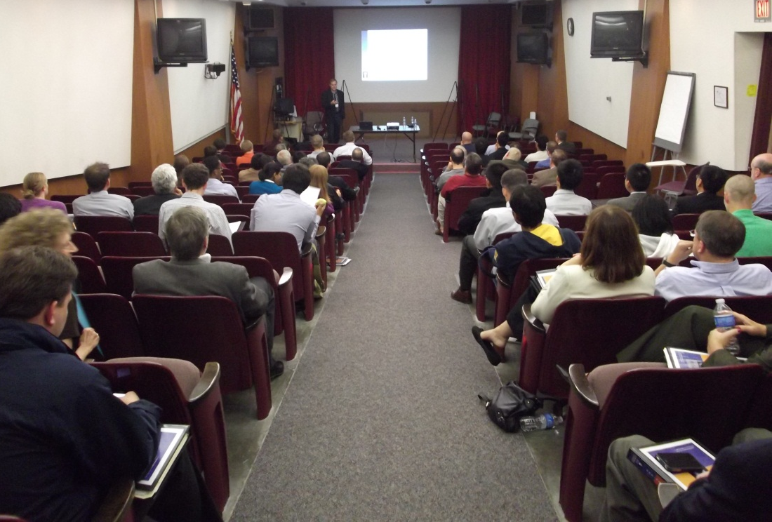
PreSeed Workshop

Slide 23
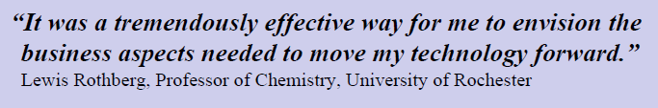
PreSeed Workshop
“I never expected to learn so much in 2 1/2 days. I would recommend the PSW to any of my colleagues thinking about commercializing their technology.” James Mohler, MD
                Chief of Prostate Oncology
                Senior VP for Translational Research
                Roswell Park Cancer Institute
                Co-Founder, AndroBioSys
“The PSW was time well-spent and enabled several members of my group, from an undergraduate to my long-time laboratory manager, to take the first steps toward forming a company.”
    George Hess, Ph.D.
                Biochemistry, Molecular and Cell Biology
                Cornell University
                Co-Founder, ADispell

Slide 24
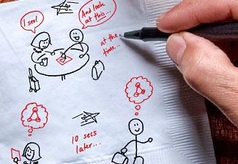
PreSeed Workshop
If you have some of these….
You really should participate in a PreSeed Workshop!
Next workshop in Rochester planned for October 2012
Contact your TTO or HTR
about your interest
as soon as possible
Idea teams are recruited based on Idea Champion’s technology
Maximum of 10 teams in a workshop

Slide 25


More HTR Programs
Rochester Regional Business Plan Contest
  $50,000 in cash prizes awarded!
  Application deadline - February 17
  Celebration of Entrepreneurship Luncheon – April 19
HTR Grant Alert Service
  Monthly notifications of available grant opportunities suited to the specific needs of each subscriber
Entrepreneur Affiliate Program
  Access to mentoring and business services for entrepreneurs and start-ups that are not full-time residents at an HTR incubator
TEC Forum
  Business information & community program for HTR clients & TEN alumni
NYSERDA EIR
  HTR manages statewide Cleantech program
  Access to industry/business experts
TECForum
Entrepreneur-in-Residence Program

Slide 26
Call to Action
Get involved!
  Rochester Regional Business Plan Contest
  TEN Class 12
  PreSeed Workshop
Help spread the word!
  Share this information with friends & colleagues

Slide 27
Thank You!
www.htr.org (585) 214-2400
Notes:
2/8/2012
www.htr.org, 585 214-2400
27

