Slide 1
Patenting Biomarkers and Diagnostic Methods
Neil P. Shull, Ph.D., J.D.
Sterne, Kessler, Goldstein & Fox P.L.L.C.
F.I.R.E. Series LXIX
March 8, 2012

Slide 2
Overview of issues
What can be patented?
Is it useful?
How much data is needed?
Potential prior art issues
What should be claimed?
Who would infringe?

Slide 3
Biomarkers
Proteins and their isoforms
Gene expression products (mRNA)
Genetic abnormalities (mutations, SNP’s, chromosomal anomalies)
Metabolites (drugs, endogenous)
Small RNAs

Slide 4
Focus On Claims
“The U.S. is strictly an examination country and the main purpose of the examination, to which every application is subjected, is to try to make sure that what each claim defines is patentable. To coin a phrase, the name of the game is the claim.”
Giles Sutherland Rich*, Extent of Protection and Interpretation of Claims, American Perspectives, 21 Int’l Rev. Indus. Prop. & Copyright L. 497, 499 (1990) (emphasis added).
* Born in Rochester

Slide 5
What to claim
The biomarker itself, in isolated form
Nucleic acid, peptide, small molecule
Methods of diagnosis
Correlate the presence/absence of a biomarker with a diagnosis
Apparatus
Arrays
Computer readable medium

Slide 6
Examples
U.S. Patent 8,114,590 – Regents of University of California
1. A method for determining a prognosis of a patient with chronic lymphocytic leukemia (CLL) comprising:
(a) obtaining a biological sample of the patient comprising lymphocytes;
(b) determining the sample expression level of phosphodiesterase 7B (PDE7B);
(c) comparing the expression level of PDE7B in the patient sample relative to a baseline expression level of said PDE7B; and
(d) associating a higher relative patient PDE7B expression level with a higher risk course of CLL, thereby determining the prognosis of the patient with CLL.

Slide 7
Examples
U.S. Patent 8,076,089 - Industrial Technology Research Institute (TW)
1. A method of detecting liver cirrhosis or liver cancer in a subject, comprising the steps of:
(a) providing a specimen of serum from a subject suspected of having liver cirrhosis or liver cancer;
(b) using a biomarker consisting of SEQ ID NO:23 to identify and capture autoantibodies in the specimen by contacting the biomarker with the specimen to form a biomarker-autoantibody complex;
(c) detecting the biomarker-autoantibody complex in step (b): and
(d) correlating the presence of the biomarker-autoantibody complex with liver cirrhosis or liver cancer, wherein the presence of the biomarker-autoantibody complex indicates that the subject has liver cirrhosis or liver cancer.

Slide 8
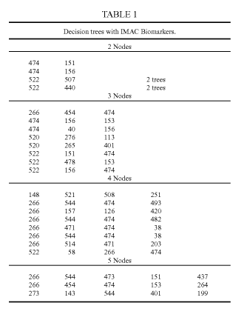
Examples
U.S. Patent 8,014,952 – Queen Elizabeth Hospital and Vermillion, Inc.
1. A tangible computer-readable medium having computer-executable instructions for performing a method of qualifying lung carcinoma status in a subject, which method comprises:
(A) transforming data extracted from a spectrum generated by mass spectroscopic analysis of a biological sample taken from the subject to identify component peaks of the spectrum; and then
(B) matching the peaks to biomarker sets listed in Table 1 or Table 2, wherein positive matches to the biomarker sets are useable to qualify lung cancer.

Slide 9
What can be patented?
Whoever invents or discovers any new and useful
process
machine
manufacture
or composition of matter
or any new and useful improvement thereof, may obtain a patent therefor, subject to the conditions and requirements of this title.
35 U.S.C. § 101

Slide 10
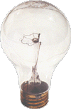
What can be patented?
An invention can be patented if:
The invention is eligible for patenting (“statutory subject matter”)
And
The invention is “new” and “unobvious” as measured against the “prior art”
Notes:
Need to meet two requirements. The first prong is what we’re discussing today.

Slide 11
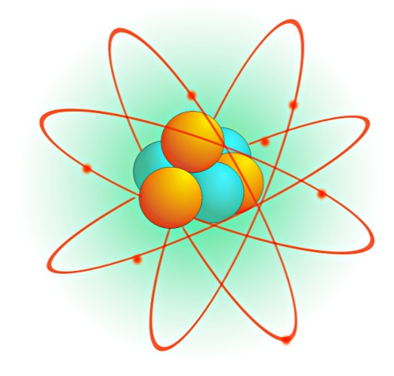
What cannot be patented?
Inventions that cannot be patented
Abstract ideas
Mental processes
Abstract mathematical formulas
Laws of nature
Inventions that clearly do not work (e.g., perpetual motion machines)
Inventions that are illegal
Notes:
Difference between invention and discovery

Slide 12
The Machine-or-Transformation Test
In October 2005, the USPTO issued a set of examiner guidelines indicating that a method claim must either transform physical matter or be tied to a specific machine in order to be patent-eligible.
The Federal Circuit repeated this machine-or-transformation test as a mandate in In re Bilski (545 F.3d 943 (Fed. Cir. 2008))

Slide 13
Bilski at the Supreme Court
The U.S. Supreme Court disagreed, saying that the machine-or-transformation test was not the only test for patent eligibility
Abstract ideas are not patent eligible
Although the Bilski case involved a business method patent, the case has ramifications for biotechnology

Slide 14
Prometheus v. Mayo
Representative Claim
1. A method of optimizing therapeutic efficacy for treatment of an immune-mediated gastrointestinal disorder, comprising:
(a) administering a drug providing 6-thioguanine to a subject having said immune-mediated gastrointestinal disorder; and
(b) determining the level of 6-thioguanine in said subject having said immune-mediated gastrointestinal disorder,
wherein the level of 6-thioguanine less than about 230 pmol per 8X10⁸ red blood cells indicates a need to increase the amount of said drug subsequently administered to said subject and
wherein the level of 6-thioguanine greater than about 400 pmol per 8X10⁸ red blood cells indicates a need to decrease the amount of said drug subsequently administered to said subject.

Slide 15
Prometheus v. Mayo
Court said this is patentable subject matter
“The Supreme Court’s decision in Bilski did not undermine our preemption analysis of Prometheus’s claims and it rejected the machine-or transformation test only as a definitive test.” Prometheus, slip op. at 14.
The Supreme Court decided to review and a decision is expected soon.

Slide 16
Utility
The claimed invention must have a specific, substantial and credible use
A biomarker must have an associated biological function
Experimental data
Association/homology with known biomarker
Animal models for a specific disease are usually enough
Cell culture assays may or may not be enough
Depends on the correlation

Slide 17
How much data?
Enablement
A person of skill in the art would have been able to make and use the invention
Correlation between experiments and claimed invention
The less predictable – the more you need to show

Slide 18
How much disclosure?
Written description
Need to show possession of the invention
If claiming a genus, need to set forth “a representative number of species” of the genus
For multiple biomarker panels, try and recite as many combinations as possible

Slide 19
How much disclosure
Written description
Need to provide the “thing” you are claiming (i.e., mutation, protein sequence) (Billups-Rothenberg, Inc. v. ARUP)
Claims required “detecting a mutation” in a gene
Sequence of the gene and mutations were not provided
Only a method for detecting mutations in the future was disclosed
Just providing a research plan to obtain that “thing” is not enough

Slide 20
How many inventions are claimed?
Inventors should try and identify which biomarkers have better predictive value than others
Claims are supposed to be directed to one invention
Example – claimed method of detecting 5 of a list of 50 genes
Examiner may require restriction
Required to choose one group of 5 genes
Is it possible to narrow down the discovery to the best combination?
Can you afford to file divisional applications?

Slide 21
Is it novel?
The sequence information now publicly available makes it more difficult to find novel biomarkers
If the sequence is not publicly available, should consider composition claims
Even if the sequence is publicly available, if this is the first association of the biomarker with a specific diagnosis, it is likely novel

Slide 22
Is it obvious?
Have similar biomarkers been used for similar diagnoses?
What makes the claimed biomarkers better than those already public?
Unexpected results

Slide 23
Who would infringe?
To prove infringement of a patented process, the Patentee must show that the Defendant has performed each step of the claimed process (BMC Resources v. Paymentech)
If a third party collects a sample or does the analysis, it may not be infringement
Independent conduct of multiple actors via “arms-length cooperation” is not infringement

Slide 24
Non-legal considerations
How crucial are the biomarkers to the assay?
Is it possible to diagnose without them?
Are they only part of the panel?
Will anyone need to license the patent?
Especially and issue with SNPs
The more important the marker is to the diagnosis, the more valuable it should be

Slide 25
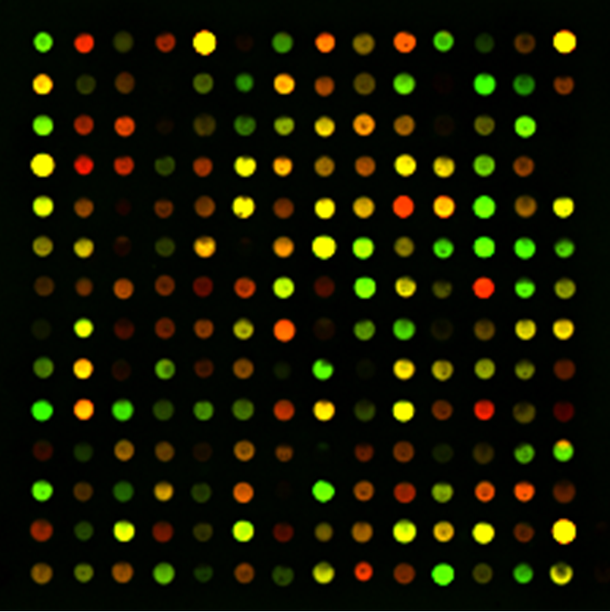
Non-legal considerations
Will someone need to license multiple patents to perform the assay?
Will it be worth it to license multiple patents?

Slide 26
Questions ? Comments?
nshull@skgf.com
Thank You

