Slide 1
The Importance of Material Transfer and Confidential Disclosure Agreements in Shared Research
Presented by:
Aeisha Salem
Gila Balman
Material Transfer Administrators for
the University of Rochester

Slide 2
Our Background:
Gila Balman
Industrial background with over 33 years at Eastman Kodak Company in Patent Legal
Tele: 585.273.4512
gila.balman@rochester.edu
Aeisha Salem
Technical background, BS in Biomedical Engineering; current MBA program at Simon School of Business
Tele: 585.275.5115
aeisha.salem@orpa.rochester.edu

Slide 3

The Parties involved when the University of Rochester receives Materials:
Principal Investigator:
Very busy, exceptionally brilliant Principal Investigator who is overcommitted, overworked and totally focused on his (or her) research objectives, having no time to deal with the paperwork and processing involved with receiving and providing research materials.

Slide 4

MTA Administrator:
Material Transfer Administrator whose main goal is to monitor all activities relating to incoming and outgoing research materials to assure all shared research materials are handled by the letter of the law.

Slide 5
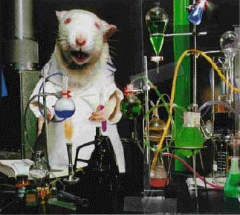
Provider of Materials:
Rats Unlimited, overseen by CEO, Dr. Rodenté who is responsible for the excellent reputation of his Company.

Slide 6
MTA Scenario:
Hi, I was told your office could help me. I wish to receive a pair of mice from Rats Unlimited. They sent me a Material Transfer Agreement. I’ve already signed and need to have it executed by our authorized representative ASAP. How long will this take?

Slide 7
So you want these mice? Well, you’ve come to the right place, but you won’t get them unless you follow the University of Rochester’s rules and regulations for receiving materials and do what is required! It’s sinful how some people treat rules and regulations!

Slide 8
What is a Material Transfer Agreement (MTA) and why the heck do I need one?

Slide 9
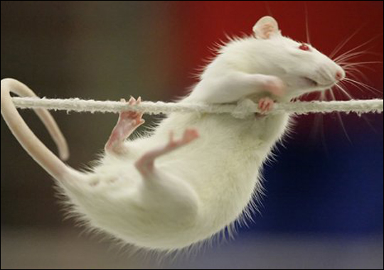
Hang in there and you’ll find out!

Slide 10
What is a Material Transfer Agreement (MTA)?
An MTA is the contractual instrument used to define the terms and conditions for the exchange of research materials.
The MTA typically sets forth rights to use the materials and allocates the rights that result from their use.

Slide 11
Reason for an MTA:
The material and/or information is proprietary or confidential.
The provider wants to restrict how the material is to be used.
The material is infectious, hazardous or subject to special regulations.
The provider wishes to protect against any potential liability.
The provider wishes to obtain rights to the results of the research for which the material or information is to be used.
The provider wishes to ensure that correct and appropriate acknowledgement is included in any publication regarding the use of the material.

Slide 12
MTAs may involve the following Parties:
Industry to Academic
  Pfizer, Merck
Academic to Academic
  Harvard, New York University
Non-Profit to Academic
NIH
International
INSERM, University of Bonn (Germany)

Slide 13
Some of the Companies we deal with frequently are:
Genentech
Eli Lilly and Company
AstraZeneca Pharmaceuticals
Bristol-Myers Squibb Company
Addgene and MMRRC (repositories for materials)

Slide 14
Different Names of MTAs:
Electronic Material Transfer Agreement
Simple Letter Agreement (SLA)
Uniform Biological Material Transfer Agreement (UBMTA)
Institutional based MTA (drafted by the providing institution)

Slide 15
MTAs that usually have a “quick turnaround” time:
Electronic MTAs – “Click and Submit”: Mutant Mouse regional Resource Center (MMRRC) and Addgene Plasmid Repository for Life Sciences.
Uniform Biological Material Transfer Agreement (UBMTA) – Developed by NIH and Association of University Technology Managers for the purpose of transferring materials among NIH funded research and academic institutions. Over 3400 signatories to the UBMTA.
Simple Letter Agreement (SLA) – Transfer research materials that do not have special restrictions of use or intellectual property terms involved.
Use of the UBMTA and SLA is highly recommended.

Slide 16
Institutional based MTA (drafted by the providing institution):
Used when the material is of a unique or proprietary nature and the Provider wishes to preserve control of how the material is used and limit further distribution.
Often the most difficult to review and negotiate.
Agreement contains more restrictive terms and conditions.
More commonly used by Industry.

Slide 17
Where does ORPA’s MTA Office fit into the equation?
How to get started:
A request must be submitted by the Principal Investigator (PI) using one of the following checklists:
Checklist for Sending Materials
Checklist for Receiving Materials
The Checklist is a requirement for the MTA Office to process a request.
A checklist may be accessed at the ORPA website: http://www.rochester.edu/ORPA/MatTransfer/index.htm

Slide 18
Review the Checklist
Receiving Checklist
Sending Checklist

Slide 19
Process for obtaining a fully executed MTA:
Checklist
MTA Admin
Draft and/or Review
Fully executed Agreement
Negotiate
the Terms of
Agreement

Slide 20
MTA Office Statistics:
369 MTAs processed in 2009
457 MTAs processed in 2010 (24% increase)
435 MTAs processed in 2011 (5% decrease)
494 MTAs processed in 2012 (14% increase)

Slide 21
Part 1 of the MTA:
Parties
Materials
Definitions
Effective Date
Research Plan

Slide 22
Parties - Identifies the institution/company involved in the Agreement.
Materials - Identifies the research materials and amounts being provided for the designated research.
Definitions - Uniquely defined terms used in the Agreement.
Effective - Date on which the terms of the Agreement take Date effect.
Research - Specific work scope to be followed in using the Plan Materials.

Slide 23
Part 2 of the MTA:
Data
Publication
Intellectual Property
Confidential Information

Slide 24
Data
The University of Rochester’s policy is to provide only a summary of the data obtained from the research conducted using the Materials to the Provider.
Data should not be defined as a modification to the Materials or a part of any invention resulting from the use of the Materials, as this could be claimed by the Provider.
University of Rochester researchers should benefit from results of the data obtained through their research, so as not to prevent the results from being used in future research.

Slide 25
Publication
MTA should enable the Recipient of the Materials to publish or present results of the Recipient’s research using the Materials without the approval of the Provider. The University of Rochester requires that there should be no restriction for publications involving Federally funded research.
Recipient may send Provider a copy of any proposed publication for their review of confidential information and/or for filing of a patent application based on intellectual property of the Provider.
Recipient may be required to acknowledge the Provider in publications as scientifically and academically appropriate, based on their contribution.

Slide 26
Intellectual Property
IP is probably the most challenging to negotiate.
MTA may contain overreaching IP language which can claim a researcher’s past and future inventions. This could impact researcher’s ability to continue doing related research.
For any intellectual property or patent issues that are beyond standard MTA IP language, we contact Office of Technology Transfer and Senior Counsel for their assistance.

Slide 27
Intellectual Property, cont.
Types of Licenses:
Non-Exclusive Royalty Free License (NERF) – Rochester may grant to the provider a non-exclusive license to the intellectual property owned by Rochester for internal research and regulatory purposes only. This license cannot be used for any commercial purposes by the provider of the material.
Exclusive License – Rochester may also grant an option to the provider to negotiate an exclusive license to the intellectual property for any purpose , usually after negotiating favorable terms between the parties.

Slide 28
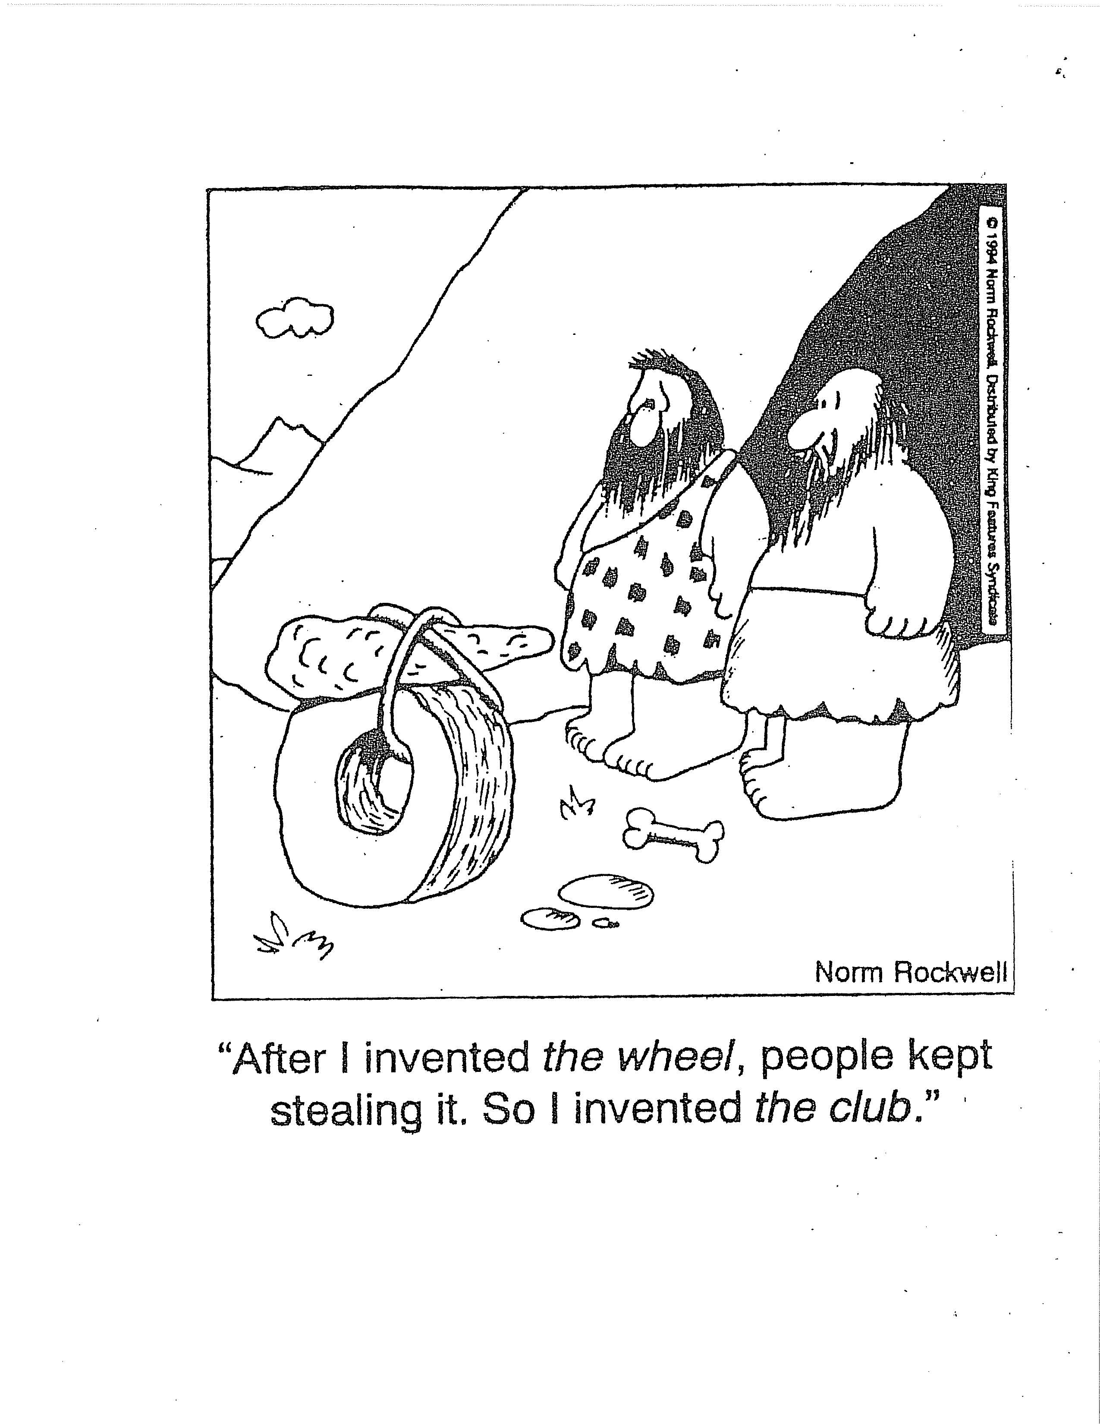
A little IP Humor

Slide 29
Confidential Information:
The use of proprietary or confidential information may be included in an MTA.
MTA may contain a provision to protect Provider’s confidential information.
Confidential Information can be defined as information, data or Material in written or other tangible form, related to the Material that is identified as “Confidential” at time of disclosure.
MTA may also specify that Recipient of confidential information treat it as confidential and maintain in confidence for a certain period of time.

Slide 30
Part 3 of MTA:
Indemnification
Export Control Regulations
Governing Law
Termination
Shipping and Handling Costs
Signature of Authorized Representatives
PI – Read and Acknowledged

Slide 31
Indemnification:
Indemnification means the action of compensating for loss or damage sustained.
An MTA usually stipulates that Recipient of the Materials assumes all liability for damages that may arise from Recipient’s use, storage or disposal of Materials or modification.

Slide 32
Export Control Regulations
Do I need to be concerned if I am shipping technology or materials overseas?
Yes.
www.rochester.edu/ORPA/policies/ExportAppRef.pdf

Slide 33
Governing Law:
MTA may specify that it is governed by the laws of a particular jurisdiction, state or country.
Rochester’s preference is New York State Law or neutral venue.
Rochester can agree to remain silent on legal venue, if unable to come to an agreement on neutral venue.

Slide 34
Termination:
When possible/appropriate, an MTA should specify a termination date for the Agreement.

Slide 35
Shipping and Handling Costs:
Rochester will not normally charge for Materials. There would be a tax implication if we did.
Rochester may only be reimbursed for the cost of:
Preparation of the Material
Shipping and Handling

Slide 36
Signature of Authorized Representatives:
Signatory is required to be recognized as an “authorized representative” of the University of Rochester (not a PI).
May be executed by the Material Transfer Administrators if:
  Outgoing MTA to a non-profit institution, including institutions of higher learning.
  Incoming and outgoing UBMTAs with signatories and SLAs with institutions of higher learning.

Slide 37
PI – Read and Acknowledged:
Principal Investigator (PI) is not an “authorized representative” or party to an MTA.
PI may only sign as having “read and acknowledged” the terms of the MTA.
Reason: if a PI signed as an authorized representative and there was a breach of the Agreement, it could place the PI at risk of being personally liable and sued in a court of law.

Slide 38
What is a Confidential Disclosure Agreement (CDA)?
A Confidential Disclosure Agreement (or a Nondisclosure Agreement) is an agreement under which one or both parties agree to maintain confidentiality regarding proprietary information (“Confidential Information”) that one party receives from the other party (“Information Owner”).

Slide 39
Reasons for a CDA:
A company may wish to share information for the purpose of determining whether an academic institution might be interested in establishing a clinical trial to test the company’s drug(s),
A company or academic institution may wish to discuss a possible collaboration in research which would require a Collaborative Agreement, Material Transfer Agreement, Testing Agreement, etc.
A company or academic institution desiring to share their product information/research plans with another party would want to protect their confidential information from disclosure by the receiving party to a third party.

Slide 40
Types of CDAs:
One-way CDA:
Only the Receiving Party is bound by
obligations of confidentiality.
Two-way (Mutual):
Both Parties are bound by obligations of confidentiality to confidential information received from the other Party.

Slide 41
Where does ORPA’s MTA Office fit into the equation (Part II):
How to get started:
A CDA Checklist should be completed and sent to the MTA.
CDA CHECKLIST

Slide 42
Areas of Concern in a CDA:
CDAs regarding clinical trials should only be for the purpose of “discussions” between the parties in order to determine whether or not the University wishes to participate in a clinical trial.
CDAs should NOT include terms involving any generated intellectual property by the receiving party.
The CDA should be executed by the institution’s authorized representative. To avoid any possible liability, the principal investigator (PI), should not be a party to the Agreement, but may sign as having “Read and Understood” the Agreement.

Slide 43
Areas of Concern, Cont.
Some CDAs require that the receiving party adhere to export regulations. However, the University of Rochester reserves the right to refuse receipt of any “export controlled” information.
A Confidentiality Agreement should consist of terms that are amicable to both parties.

Slide 44
Areas of Concern, Cont.
The term preferred in most instances for CDAs is one (1) year from the Effective Date for discussions.
The term for obligations of confidentiality involving confidential information is preferred to be five (5) years from the Effective Date and not to exceed seven (7) without obtaining authorization from senior counsel for the University of Rochester.

Slide 45
When a PI Leaves the University of Rochester:
When a principal investigator leaves the University of Rochester, it is highly suggested that the Administrator or PI contact our office to see whether or not there are any active MTAs/CDAs involving the PI.
The PI should notify us whether or not they plan to:
1) continue using materials they received from another institution at their new place of employment;
2) transfer material made while at the University of Rochester to their new place of employment;
3) transfer materials and research to another PI within the University of Rochester; or
4) no longer use materials in an existing Agreement(s).

Slide 46
Helpful Reminder:
We receive a weekly listing of faculty roster changes. This listing identifies new employees as well as those who have chosen to leave employment at the University of Rochester. Unfortunately, we receive this information “after” the fact.
If it is known that a person is planning to leave the University of Rochester that has Material Transfer Agreements or Confidentiality Agreements, please notify our Office . We would then be able to provide a list of the Agreements involving that individual’s research, to assist in determining the outcome of the materials and whether or not new Agreements would be required by us or their new place of employment.

Slide 47
We know how to negotiate Agreements and know what is commonly acceptable as well as the problem areas that could potentially be harmful. Understand that we are experts in negotiating Agreements in order to successfully establish terms that are of mutual interest to the parties involved and support advancement in research.

Slide 48

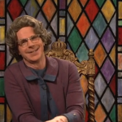
Thank you for attending our presentation.
Please submit any questions you might have to:
ORPA-MTA@ur.rochester.edu

Slide 49


