Slide 1
The Myriad Controversy and the Patentability of Genes
Joanna T. Brougher
Senior Counsel, Vaccinex Inc.
Adjunct Lecturer, Harvard School of Public Health
August 8, 2013

Slide 2
Today’s Discussion
Overview of Gene Patenting
AMP v. Myriad Genetics
Unanswered Questions
Implications

Slide 3
Source of IP Rights
U.S. Constitution, Art. I, sec.8:
  Congress has broad power to “Promote the Progress of Science and Useful Arts, by securing for limited Times to Authors and Inventors the Exclusive Right to their respective Writings and Discoveries.”

Slide 4
Requirements for Patentability
Patentable subject matter (35 U.S.C. § 101)
Utility: usefulness (35 U.S.C. § 101)
Novelty: not anticipated in “prior art” (35 U.S.C. § 102)
Non-obviousness: non-trivial extension of the known (35 U.S.C. § 103)
Disclosure and enablement: must describe invention with sufficient particularity to enable one skilled in the art to “practice” it (35 U.S.C. § 112)

Slide 5
Patentable Subject Matter
Section 101 of Title 35 U.S.C.:
  Whoever invents or discovers any new and useful process, machine, manufacture, or composition of matter, or any new and useful improvement thereof, may obtain a patent therefor, subject to the conditions and requirements of this title.
“Anything under the sun that is made by man”
  Patentable if made, modified, or transformed by man
  No morality component in US
Cannot patent:
  Laws of nature, natural phenomena, abstract ideas, mental processes

Slide 6
What are Gene Patents?
Definition: Patents directed to certain nucleotide sequences, i.e., DNA or RNA, protein that is encoded by those sequences, or cells or biological entities that express the gene encoded by the nucleotide sequences.
About 20,000 genes in human genome
About 50,000 “gene patents”
  database includes patents having claims mentioning terms specific to nucleic acids, such as, DNA, RNA, nucleotide, and plasmid

Slide 7
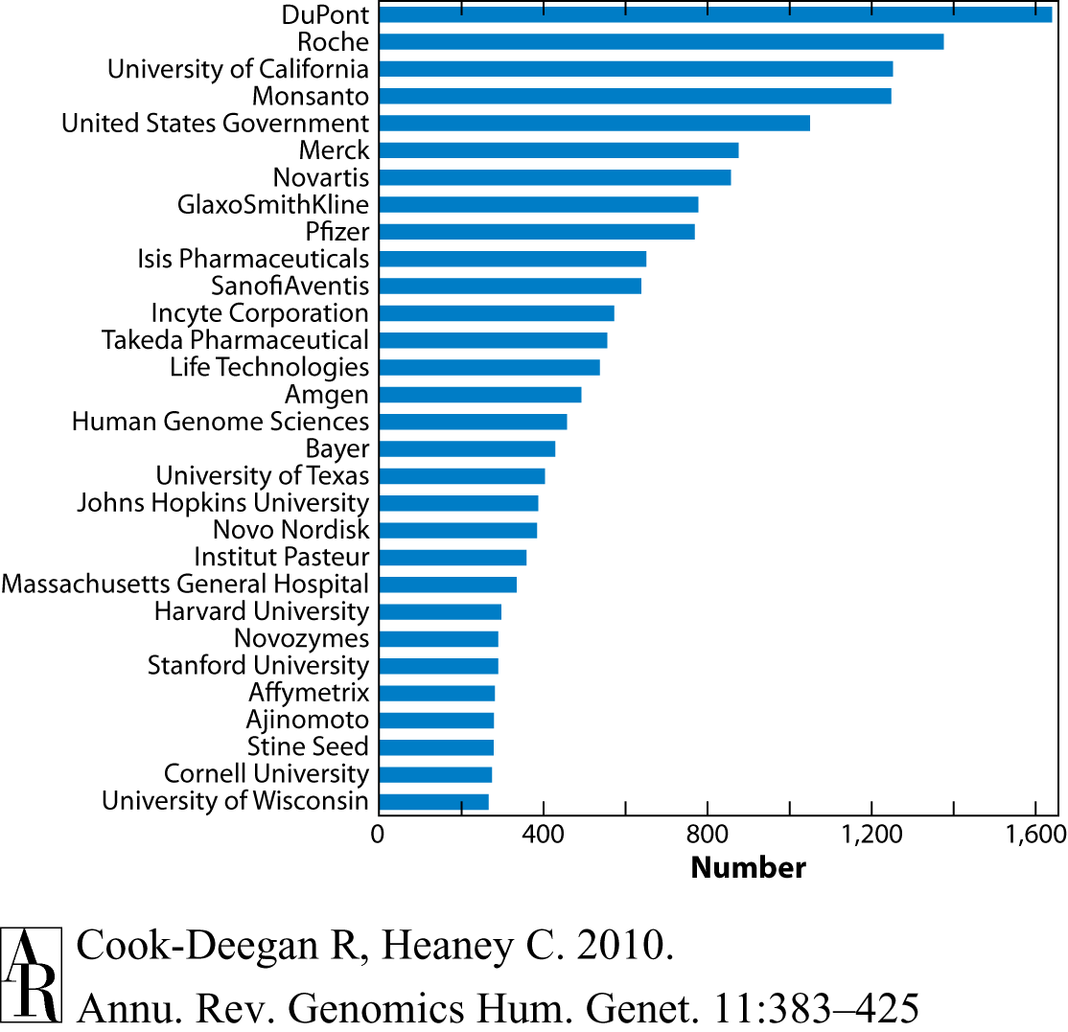

Slide 8
Products of Nature
Product of Nature Doctrine - one may not obtain a patent on something that is indistinguishable from a product of nature
1889 - U.S. commissioner of patents rejected an application for a patent to cover a fiber identified in needles of a pine tree (Ex parte Latimer)
  "not a patentable invention, recognized by statute, any more than to find a new gem or jewel in the earth would entitle the discoverer to patent all gems which should be subsequently found.“

Slide 9
Purified Substances
Parke Davis v. H. K. Mulford, 189 F 95 (S.D.N.Y. 1911):
  Product: purified adrenaline to treat patients with low blood pressure
  Prior treatment: dried and powdered suprarenal glands were used to treat patients with low blood pressure
  Southern District of New York upheld the validity of the patent
    become substantially more useful than their non-extracted or less-pure states
    purified material exhibits properties and utilities not possessed by the unpurified material

Slide 10
Purified Substances
Merck & Co. v. Olin Mathieson Chemical Corp., 253 F.2d 156 (4th Cir. 1958)
  Product: vitamin B12 concentrate to treat pernicious anemia - an incurable condition that killed 50,000 people in the U.S. every year prior to 1926
  Prior treatment: eating large amounts (nearly one pound daily) of fresh, raw cow liver every day
  Fourth Circuit upheld patent
    Purified vitamin B12 was not found in nature
    Purified vitamin B12 was much more than just a cleaner version of a naturally-occurring substance - Merck’s preparation was also free of the harmful contaminants that exist in raw liver and the prior liver extracts

Slide 11
Genetically Engineered Organisms
Diamond v. Chakrabarty, 447 U.S. 303 (1980)
  Facts:
    Patent to a genetically-engineered bacterium capable of breaking down multiple components of crude oil
  Legal issue:
    Whether a genetically modified micro-organism constitutes a “manufacture” or “composition of matter” within the meaning of 35 U.S.C. Section 101
  Holding:
    Genetically modified microorganism was patentable subject matter
      “[t]he patentee has produced a new bacterium with markedly different characteristics from any found in nature and one having the potential for significant utility. His discovery is not nature's handiwork, but his own.”

Slide 12
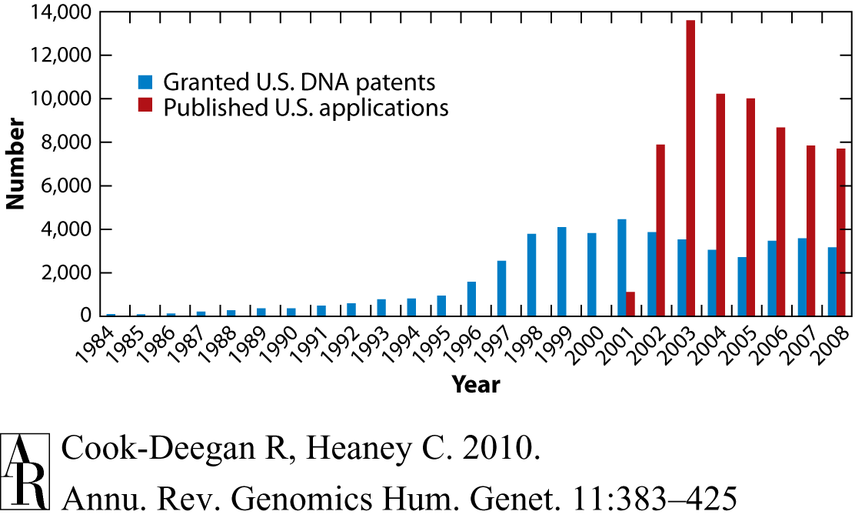

Slide 13
Chakrabarty’s Legacy
Genes patentable if:
  Isolated and purified by human action
  Specific utility (beyond research utility) shown
Examples:
  Amgen obtained a patent to isolated DNA molecules that encoded for erythropoietin - Epogen® (treatment for anemia)
  Genentech obtained a patent to the human insulin gene, which Eli Lilly eventually licensed to develop Humulin® (human insulin for treatment of diabetes)
  Monsanto obtained patents to genes that make crops more resistant to insects, disease, and climatic stress

Slide 14
Isolated Gene Sequences
    Definition: DNA sequences that were purified from their natural forms through the use of artificial tools and processes
      USPTO Guidelines: isolated and purified naturally occurring DNA is patent eligible because the isolations and purification constitute sufficient human intervention to distinguish it from DNA as it exists naturally in the body
Section 101 of Title 35 U.S.C.:
  Whoever invents or discovers any new and useful process, machine, manufacture, or composition of matter, or any new and useful improvement thereof, may obtain a patent therefor, subject to the conditions and requirements of this title.
Or
Not patent-eligible: Laws of nature or natural phenomena

Slide 15
Gene Patents on the Line
Association for Molecular Pathology et al. v. Myriad Genetics, Inc
Claim 1 of U.S. Patent 5,747,282 (the ’282 patent):
  An isolated DNA coding for a BRCA1 polypeptide, said polypeptide having the amino acid sequence set forth in SEQ ID NO:2.
Effect of Patents
  Patents on BRCA1 and BRCA2 genes
  Right to prevent anyone else from testing, studying, or even looking at these genes.
  Exclusive rights to any mutations
  No one is allowed to do anything with the BRCA genes without Myriad's permission

Slide 16
Myriad Genetics
(District Ct, March 29, 2010)
Facts:
  Patent to isolated DNA sequences in BRCA1 and BCRA2 genes
Issue:
  Whether an isolated DNA sequence constitutes a “manufacture” or “composition of matter” within the meaning of 35 U.S.C. Section 101
Holding:
  Isolated DNA sequences held not to be patentable subject matter
    “Isolated” DNA not “markedly different” in structure and function

Slide 17
Myriad
(Federal Cir, July 29, 2011)
Reversed District Court
  “BRCA1 and BRCA2 in their isolated state are not the same molecules as DNA as it exists in the body; human intervention in cleaving or synthesizing a portion of a native chromosomal DNA imparts on that isolated DNA a distinctive chemical identity from that possessed by native DNA.”

Slide 18
Myriad
(Federal Cir, August 16, 2012)
Reversed District Court
  “Natural DNA exists in the body as one of 46 large, contiguous DNA molecules. Each of those DNA molecules is condensed and intertwined with various proteins, including histones, to form a complex tertiary structure known as chromatin that makes up a larger structural complex, a chromosome... Isolated DNA, in contrast, is a freestanding portion of a larger, natural DNA molecule. Isolated DNA has been cleaved (i.e., had covalent bonds in its backbone chemically severed) or synthesized to consist of just a fraction of a naturally occurring DNA molecule.”

Slide 19
Myriad
(Supreme Ct, June 13, 2013)
The U.S. Supreme Court unanimously ruled that a naturally occurring DNA segment is a product of nature and not patent eligible merely because it has been isolated
  Court found that Myriad did not create anything new when it merely isolated the BRCA1 and BRCA2.
  Isolating genes, although labor intensive and involving the severing of chemical bonds, is not enough to impact the informational component of DNA relative to its naturally occurring state.
Court upheld the patentability of synthetic complementary DNA (“cDNA”) because it is not naturally occurring
  cDNA is synthetically created DNA that only includes exons, the nucleotides that code for amino acids, but not introns, the nucleotides that do not code for amino acids

Slide 20
Unanswered Questions
What is the effect of the ruling on claims directed to other isolated natural products?
  Remember Parke Davis v. H.K. Mulford
  U.S. Patent No. 7,341,750 is directed to a compound isolated from the bark of Ginkgo biloba, a type of tree
    useful anti-platelet activity that may prove important in treating vascular diseases
  U.S. Patent No. 7,307,057 is directed to an antibiotic isolated from a microorganism
    effective against some of the most dangerous multi-drug resistant bacteria in existence today

Slide 21
Unanswered Questions
How much structural difference between a final product and its native counterpart is necessary?
Scalia concurrence:
  “I am un-able to affirm those details on my own knowledge or even my own belief. It suffices for me to affirm, having studied the opinions below and the expert briefs presented here, that the portion of DNA isolated from its natural state sought to be patented is identical to that portion of the DNA in its natural state; and that complementary DNA (cDNA) is a synthetic creation not normally present in nature.”

Slide 22
Unanswered Questions
What about synthetic DNA molecules that are identical to the naturally occurring DNA sequence?
  Identical v. not normally present in nature (Scalia concurrence)
  “synthetically created” v. “naturally occurring DNA isolated from the rest of the human genome”

Slide 23
Implications for Biotechnology
Effect on research
Effect on innovation
Effect on access

Slide 24
Effect on Research
Hinder research :
  Companies will stop researching genes because they will not be able to obtain patents to them
        They may have to wait until they have a final product that is different from the original naturally occurring substance, but they will still be able to obtain patent protection.
  Simulate research :
    With fewer intellectual property obstacles, research of genes may actually increase, allowing researchers to gain new insight into the biology of those specific genes, and possibly even into other genes.

Slide 25
Effect on Innovation
Hinder Innovation:
  Without basic patents to DNA sequences, early-stage companies will struggle to attract the necessary funding for conducting research and development and many potentially life-saving technologies will never come to fruition
Stimulate Innovation:
  The Court's protection of cDNA is still valuable for biotech companies
  However, cDNA patents are also easier to design around

Slide 26
Effect on Access
Increase Access
  Stimulate competition and lower prices
    the day the Supreme Court decision was announced, Ambry Genetics launched its own BRCA1/2 diagnostic test at $2200, a 30% price cut from Myriad’s test
Reduce Access
  cDNA serves as the basis of many biotechnology-based inventions so patent protection for these inventions will still be important
  Companies have multiple patents protecting different aspects of an invention

Slide 27
Thank you!

