Slide 1
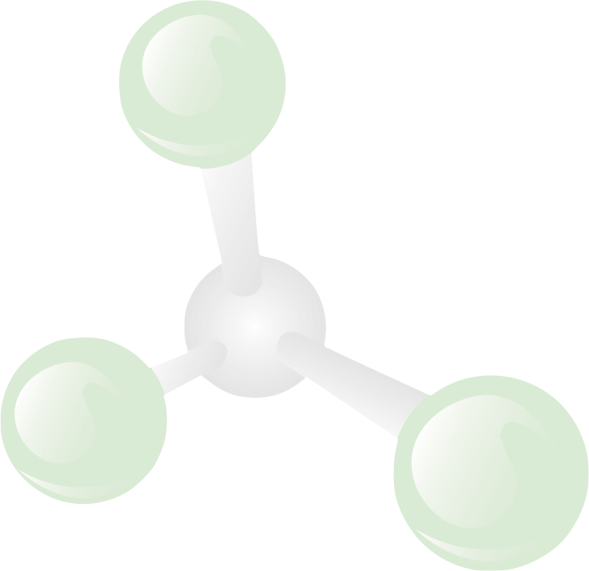


Introducing UR Ventures – the Future of Technology Transfer at the University of Rochester
F.I.R.E. Series
21 October 2013

Slide 2
Rob Clark
Senior Vice President for Research
&
Dean, Hajim School of Engineering

Slide 3
The Origins of New Medicines
& The Importance of Academic Research & Discovery
Steve Dewhurst

Slide 4
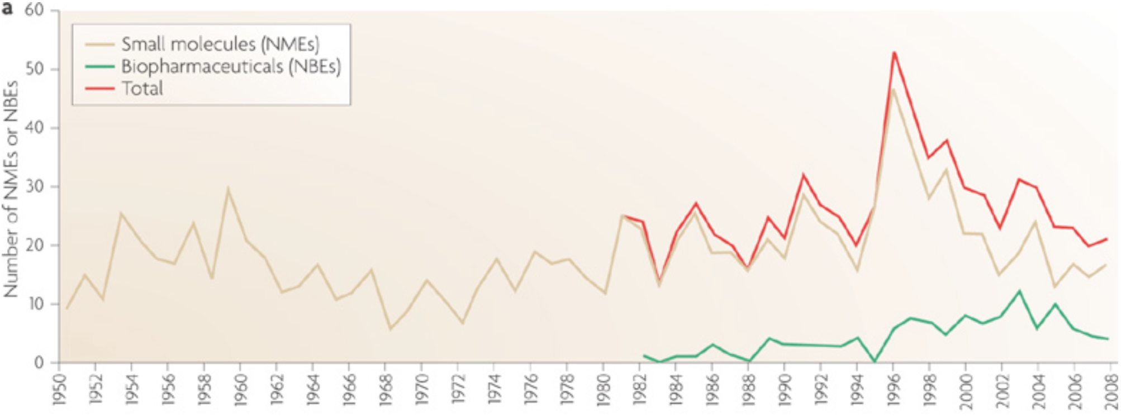
The Problem: Annual NME Output is Stagnant
1-time FDA clearance of an application backlog
Munos B. Lessons from 60 years of pharmaceutical innovation. Nature Reviews Drug Discovery 8, 959-968, 2009

Slide 5
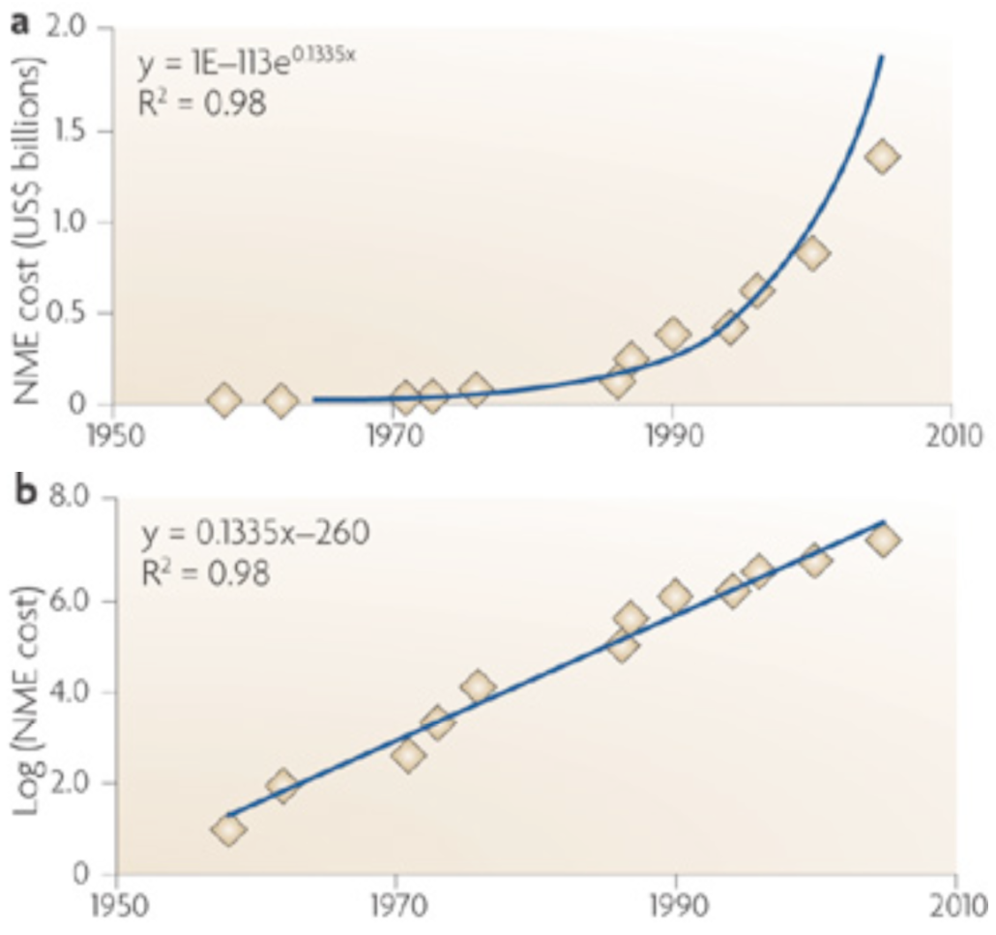
While NME Cost is Accelerating
Munos B. Lessons from 60 years of pharmaceutical innovation. Nature Reviews Drug Discovery 8, 959-968, 2009

Slide 6
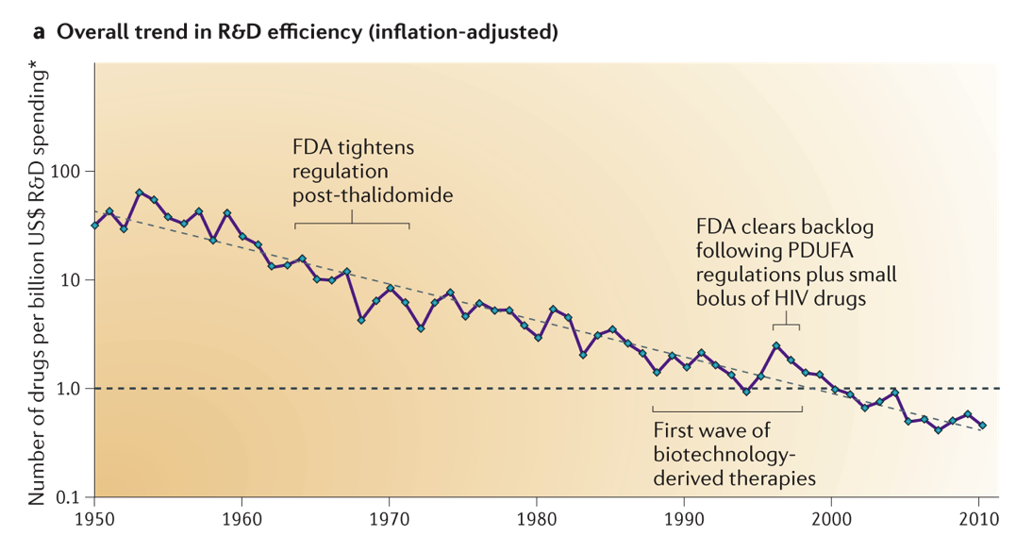
Result: An Exponential Decline in R&D Efficiency
Scannell JW, Blanckley A, Boldon H & Warrington B . Nature Reviews Drug Discovery 11, 191-200, 2012
Notes:
This is Moore’s law, backwards (contrasting it to technologies that improve exponentially over time)

Slide 7
NME Development: The Numbers
Output
• Annual output has not changed in 60 years! (20-30 approvals/yr)
Success rate
• Only 11.5% of drugs that enter clinical trial reach NME status.
Cost
Estimated ~$5Bn per NME (2013).
Erooms Law: # of new drugs approved per $1bn spent on R&D has halved roughly every 9 years since 1950
This is Moore’s law, backwards (contrasting it to technologies that improve exponentially over time)
Munos B. Lessons from 60 years of pharmaceutical innovation. Nature Reviews Drug Discovery 8, 959-968, 2009
Scannell JW, Blanckley A, Boldon H & Warrington B . Nature Reviews Drug Discovery 11, 191-200, 2012
Herper, M. Forbes, 2013. http://www.forbes.com/sites/matthewherper/2013/08/11/how-the-staggering-cost-of-inventing-new-drugs-is-shaping-the-future-of-medicine/

Slide 8
The Current Model is Not Sustainable
Cost of New Drug Discovery is Too High:
• Globally, companies spend $135bn on R&D each year, to yield 25-30 new drugs – many of which are marginally effective and sold at huge prices
And Pharma is Facing a Patent Cliff:
• Over $290bn of sales at risk from patent expiration in 2012-2018
• Results from a wave of successful products discovered in the late 1980s reaching the end of their patented life
Munos, B. Sci. Transl. Med. 5, 168ed1 (2013); Munos, B. & Chin, W.W. Sci. Transl. Med. 3, 89cm16 (2011)

Slide 9
…And Pharma is Struggling to Respond
Responses include:
Acquisitions & mergers
Increased R&D spending: > $1.1 trillion over the last 10 years
Issue: “too much money chasing too few quality R&D assets”
EvaluatePharma, Embracing the Patent Cliff (2012); www.evaluatepharma.com/worldpreview2018.aspx.
Munos, B. Sci. Transl. Med. 5, 168ed1 (2013); http://www.bioworld.com/content/pharma-summits-patent-cliff-2012-290b-sales-risk-through-2018

Slide 10
How Did We Get Here?
Pharma Stopped Doing Risk-Taking, Breakthru Science:
• Pharma “walked away from the translational research model that made it great: risk-taking and breakthrough science”
A risk-averse course of “marginal innovation” failed - in part because marginal compounds are themselves risky
Munos, B. Sci. Transl. Med. 5, 168ed1 (2013); Munos, B. & Chin, W.W. Sci. Transl. Med. 3, 89cm16 (2011)

Slide 11
We Need New Models: Role of NIH
• Bolder innovation. Key role of NIH-funded research and academic partners.
• Faster innovation. Drug repurposing is one approach (NCATS).
• Speedier R&D. Developing shared tools and common standards (NIH), including better evidence-based medicine and use of EMR (PCORI).
• More collaboration. Avoid repeating the same mistakes.
Munos, B. Sci. Transl. Med. 5, 168ed1 (2013)

Slide 12
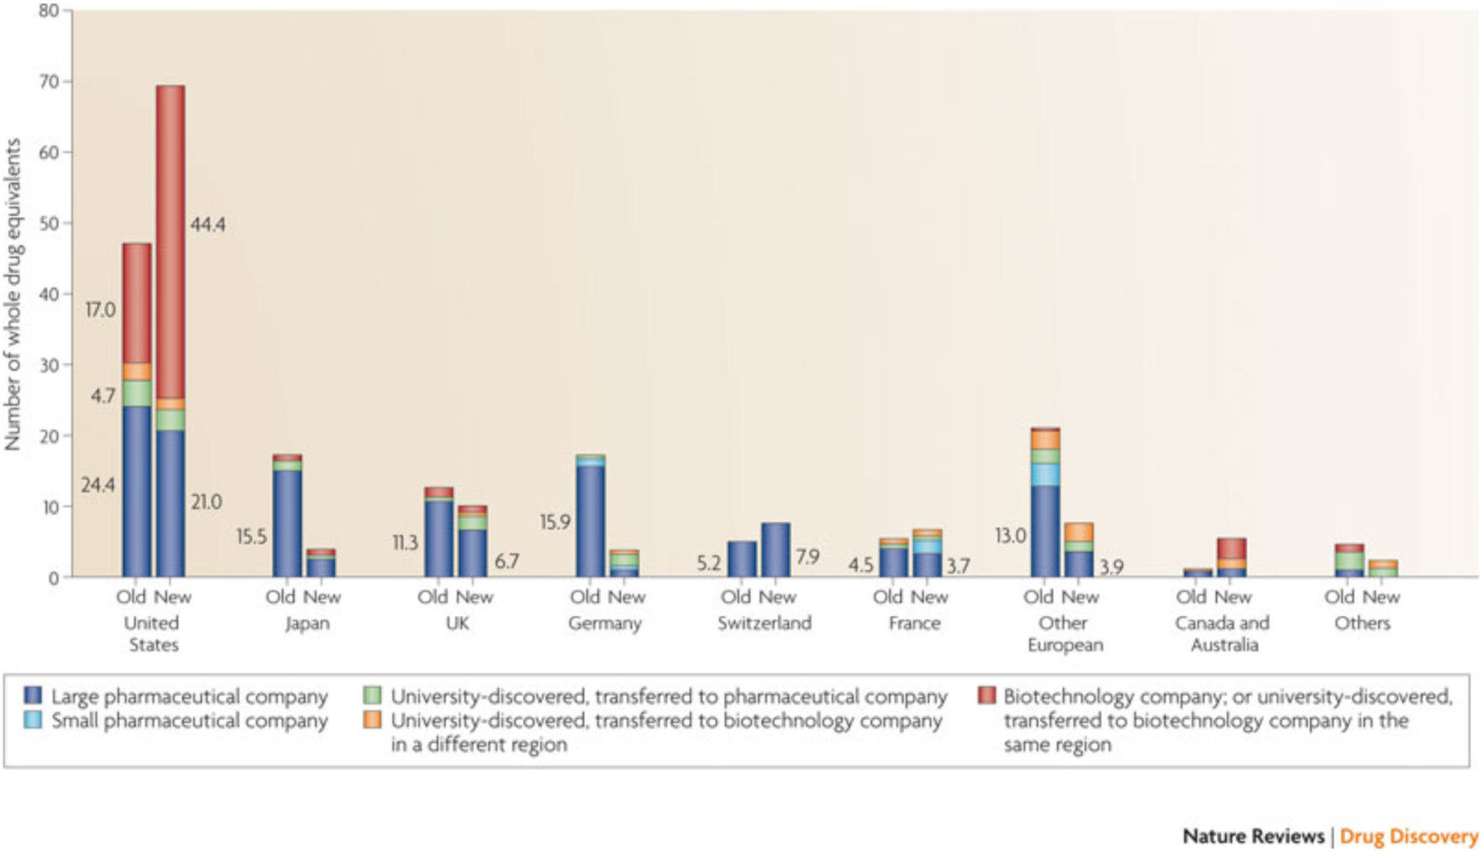
Academia is a Major Driver of New Drugs
Distribution of the discovery of the 252 new drugs approved by the US FDA (1998-2007), classified by whether are scientifically novel (new) or follow-on (old).
Kneller, R. The importance of new companies for drug discovery: origins of a decade of new drugs. Nat. Rev. Drug Disc. 9, 867-882, 2010.

Slide 13
Universities & Biotechs Drive Innovation
• ~50% of scientifically innovative new drugs came from Univs & Biotechs
• ~50% of drugs responding to unmet medical needs also came from this source
• Most of the Biotechs were located in the U.S.
Kneller, R. The importance of new companies for drug discovery: origins of a decade of new drugs. Nat. Rev. Drug Disc. 9, 867-882, 2010.

Slide 14
And Innovation is Led by U.S. Institutions
Reasons include:
• Government funding: U.S. spends a ~2x higher fraction of GDP on academic biomedical research
• Peer review: U.S. uses a rigorous peer review system to award research funds (less so in Japan)
• Career flexibility: More accepted to move between academia and biotechs in the U.S.
• Pro-entrepreneurial climate: Immigration policies; financing; Bayh-Dole Act encourages licensing of university discoveries
Kneller, R. The importance of new companies for drug discovery: origins of a decade of new drugs. Nat. Rev. Drug Disc. 9, 867-882, 2010.

Slide 15
Academia Leads in Rare & Orphan Diseases
Orphan Drug Market is Expanding:
• Expected to account for $127bn in sales in 2018 (or 16% of the global prescription drug market, excluding generics)
Reasons:
Smaller disease populations require smaller (cheaper) trials
Well-defined subpopulations more likely to respond to an investigational drug
Improved patient outcomes raise economic value of new drugs
EvaluatePharma, World Preview 2013, Outlook to 2018 (2013); www.evaluatepharma.com/worldpreview2018.aspx.

Slide 16
Conclusions
Universities have a key role in the innovation economy and the development of new drugs, diagnostics & devices. This includes:
Serving as the Engine of New Discovery: Resulting in half of new drugs and biologics
Addressing Unmet Needs and Orphan Diseases: Accounting for half of new drugs for previously unmet needs
Seeding New Businesses: University biotechs create jobs and conduct early phase product development
De-risking New Targets and Approaches: Public-private partnerships will be increasingly key to lowering costs

Slide 17
What Does This Mean for UR?
Fund Early-Phase Development of New Ideas & Technologies
Drug Development Pilot Award (DDPA): $4-8k, $25k
http://ddpa.urmc.edu
Technology Development Fund (TDF): $40-100k (needs to be expanded)
  https://www.rochester.edu/TechnologyDevelopment/
Provide Access to Expert Management Expertise
URVentures Project Management: Develop technologies more fully “in house”; leverage internal resources to do so

Slide 18
Drug Development Pilot Awards (DDPA)
Status
Started mid 2012; addresses a Key Gap: access to HTS & medicinal chemistry
# of Supported Projects: 10 (Early Exploratory); 3 (Lead Finding)
Funds Awarded: $148K to date, out of $250K committed
Outcomes: Manuscripts: 1 pub, 6 sub; Grants: R01 (Dunman), American Lung RG (Rahman); pending R21 (Pang)
ROI to date: $1.2 million in total costs (new grants); ~8:1

Slide 19
Technology Development Fund (TDF)
Status
Supports technology development (which NIH will not fund)
# of Supported Projects: 11 (since 2009)
Funds Awarded: $766K to date, out of ~$1M raised
Increasing Interest: 22 applications in current round
Outcomes: 8 moving forward; several have achieved either follow on funding or increased business interest; 3: have proved their concept does not work

Slide 20
Internal Resources: CTSI, cGMP Facility
CTSI
Broad regulatory knowledge (e.g., FDA)
Center for Human Experimental Therapeutics (CHET): Supports first-in-human studies (IND prep., clinical trial design/support)
Access to partners with key resources (e.g., GMP chemistry)
Upstate cGMP Stem Cell Facility
Opened 2012; produces cells, proteins (Mabs) under GMP, for first-in-human studies
Supporting projects with a total of $26 million in funding – including major programs on macular degeneration, M.S.

Slide 21
Summary
UR life science technologies have enormous potential for societal good & commercial impact. Realizing this potential depends on:
Early Phase Funding: To develop new technologies. We need to increase support for TDF and explore new models.
The Internal UR Ecosystem: We have access to many of the assets necessary to develop life science technologies.
Our External Ecosystem: We need business & project management expertise, and early-stage investors. May also be value to a “WNY Biotech Consortium”, like the New York Academic Consortium formed by the 7 NYC biomedical schools.

Slide 22
Brand Launch and New Approach
Scott Catlin
AVP, Technology Ventures
October 21, 2013
Notes:
Intro self and office – brief intro – originally fro western NY, Optics UR, AFROTC RIT, AF JAG, patent attorney, start-up, small public company, M&A, licensing, project managmeent and culture change…
As alumni – saw UR from a distance – amazing research (changing lives, altering our world), an ecosystem of pieces of a great puzzle (Simon, Hajim, URMC, SMD – CTSI, CMTI, TEAM, BME senior design, Big Data, cGMP…) --- came to be part of a great adventure in re-defining Rochester’s position in the pantheon of in novation hubs – the next Silicon Valley….
How maximize the opportunity? What are the challenges…?
Idea that two former tech transfer offices are now one – Appropriate time to reflect on what we do and how we do it – Took feedback and embarking on a new direction

Slide 23
Mission
To develop UR innovations into valuable products and services to make the world ever better.
Notes:
Re-focused mission

Slide 24
Mission
To develop UR innovations into valuable products and services to make the world ever better.
Notes:
Hit high points:
“develop” – focus on moving technologies forward, developing them so that they can be licensed or taken out in a start-up company – no longer just patenting and “transferring” – more active
“innovations – not just discoveries or inventions, but all forms of innovation – we’ve worked with English professors, innovators in teaching, psychology, health care services and quality improvements
“Products and services” – not all research has a commercial outlet – it’s ok
“Value” – Royalties, economic develoment/jobs, learning (students), public relations and public good
“Meliora –make the world ever better” – bigger mission than just $$$, although bottomline needs to be part of the discussion…

Slide 25
New Name and Brand
Building a new image and approach
          Project Management – treat technologies as if we are personally building a business around them; “hand-craft” plan to fit technology
          Customer focused
          Proactive engagement with the ecosystem
Notes:
“customers” – include: fculty; companies; users
“ecosystem” – includes: campus, off-campus, upstate region; investors, angels, VCs, entrepreneurs, alumni, etc.

Slide 26
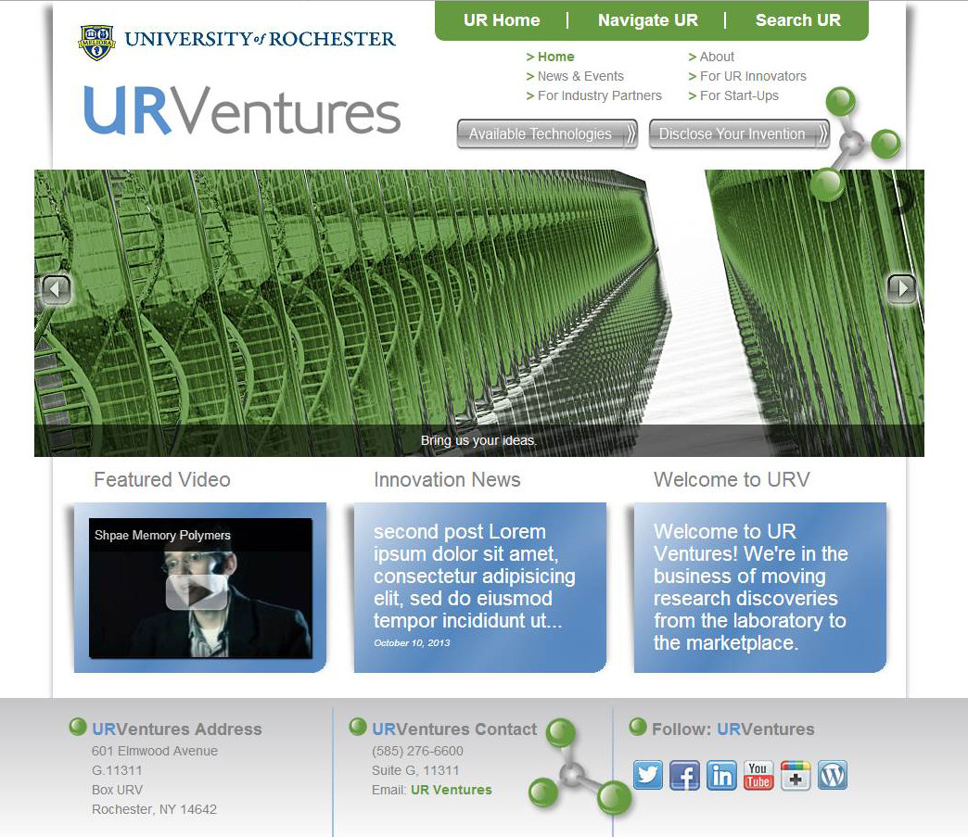
New Website
Notes:
IN PROGRESS… but here’s the idea:
Open and engaging
More navigable
Technology-centric
Building toward better presentations of our technologies (e.g., video, renderings, faculty testimonials, etc.)

Slide 27

Fundamental Challenge
University Research
Commercial Interest
Commercial Products/Services
We generally get stuck here
Ground breaking research
Driven by research, grants, publications
Limited business input and often no business partner
Development of solutions valued by the market
Customer and market driven
Sustainable growth
Seek risk mitigation and barriers to entry via IP, regulatory, cost advantages
Risks and interest depend on:
  Proof of concept
  Regulatory hurdles
  Technology and market opportunity
  Corporations vs. Start-ups and Investor types
  Researcher engagement and team development
Limited proof-of-concept investment
Notes:
Explain this
Discuss
Result --> we almost have nothing to sell!
Can call, meet, advertise, put on web… same result
Worst case is in medical and in particular biopharma, but same to some extent across all techs
And recall that NYS is not a hot spot for VC investment, or even medical companies, entrepreneurs, etc. to start
*** NEED TO GET BUSINESS ATTENTION AND PROVIDE MORE…

Slide 28

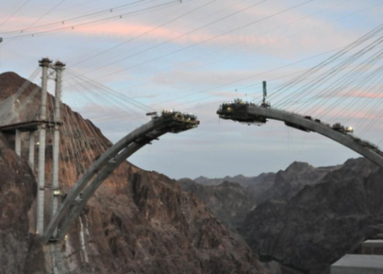
Solution and Focus
University Research
Commercial Interest
Commercial Products/Services
Prove the concept, e.g.
  Prototyping, customer feedback, market
  Earlier clinical-regulatory input
  Researcher engagement and team development
Notes:
Pause and discuss idea – approach…
Otherwise, we are largely making blind calls and hoping that someone will invest in or license a bare idea
Seeds – sapling – trees – apples
Bridge – our side needs to be started first… – gets at need to meet part way, but need for us to build or grow hopefully with business goal and input in mind, but to some extent, if we don’t start, they’ll never meet us over the valley of risk…
PATRICK will discus further
Medical – biggest gap – almost no way to license without development…
Office Re-organization and improvements
Portfolio rationalization and evaluation
Branding
Project Management, Lean Start-up, POC and Roadmap – bridging the Valley of Risk
Start-ups
Licenses
Ecosystem development: Faculty, Students, Alumni, Community

Slide 29
Ecosystem Development
Community
Faculty
Students
Alumni
Notes:
LONGER TERM…
Discuss ideas
Faculty: outreach, training, hurdles, customer service orientation, business (Lean Start-up); match right supports to individual technology/opportunity (Roadmap); yearly recognition event
Students: continue with BME and CMTI and Simon; extend training and engage PhDs/Post-docs; consider Entrepreneurial Post-doc program
Alumni: advisory counsels, outreach, experts
Community: ongoing engagement; develop understanding; create opportunities to interact between us, faculty, investors – Maybe big Jazz fest event for alumni, investors, entrepreneurs; include other locales and schools
Limited experience and/or comfort with clinical-regulatory-health economics requirements for medical technologies
Limited money for long-term returns or medical technologies
Limited entrepreneurs or managers locally with technology or medical business experience
Faculty with limited business understanding or management skills
Lots of helpful people, but result of #s 1, 3 and 4 above is often unproductive collaborations and confusion

Slide 30
Expectations
Overall: more business-based in our decisions and plans
On URVentures:
          Project management
          Roadmap – building a transparent plan for the team
          Creativity, flexibility, customer service
          Community engagement
On Faculty:
          Participation and business partnership
          Flexibility and creativity
        On Community: engagement, interest and support
Notes:
– fast to fail/survival of the fittest
STAY TUNED – give us a shot

Slide 31
Final Thoughts
We’re open for business – seeking to make the world ever better with our technologies and discoveries
“Life shrinks or expands in proportion to one’s courage.” – Anais Nin
Fortes fortuna adjuvat
Notes:
Anais Nin – French American writer of the last century (had an interesting tie to President Seligman)
FOR-tess for-TOO-nah AHD-yoo-waht - fortune favours the brave. Terence, Roman playwright, 2nd century BC
STAY TUNED – give us a shot

Slide 32

Inventions
and
Patenting
Carissa R. Childs, Ph.D. Edwin V. Merkel
70 Linden Oaks, Suite 210 70 Linden Oaks, Suite 210
Rochester, New York 14625 Rochester, New York 14625
Phone: 585.270.2134 Phone: 585.270.2104
carissa.childs@leclairryan.com edwin.merkel@leclairryan.com

Slide 33
Inventions and Patenting
The U.S. Patent System
Patentable Subject Matter
Requirements for Patentability
Notes:
LONGER TERM…
Discuss ideas
Faculty: outreach, training, hurdles, customer service orientation, business (Lean Start-up); match right supports to individual technology/opportunity (Roadmap); yearly recognition event
Students: continue with BME and CMTI and Simon; extend training and engage PhDs/Post-docs; consider Entrepreneurial Post-doc program
Alumni: advisory counsels, outreach, experts
Community: ongoing engagement; develop understanding; create opportunities to interact between us, faculty, investors – Maybe big Jazz fest event for alumni, investors, entrepreneurs; include other locales and schools
Limited experience and/or comfort with clinical-regulatory-health economics requirements for medical technologies
Limited money for long-term returns or medical technologies
Limited entrepreneurs or managers locally with technology or medical business experience
Faculty with limited business understanding or management skills
Lots of helpful people, but result of #s 1, 3 and 4 above is often unproductive collaborations and confusion

Slide 34
The U.S. Patent System
Notes:
LONGER TERM…
Discuss ideas
Faculty: outreach, training, hurdles, customer service orientation, business (Lean Start-up); match right supports to individual technology/opportunity (Roadmap); yearly recognition event
Students: continue with BME and CMTI and Simon; extend training and engage PhDs/Post-docs; consider Entrepreneurial Post-doc program
Alumni: advisory counsels, outreach, experts
Community: ongoing engagement; develop understanding; create opportunities to interact between us, faculty, investors – Maybe big Jazz fest event for alumni, investors, entrepreneurs; include other locales and schools
Limited experience and/or comfort with clinical-regulatory-health economics requirements for medical technologies
Limited money for long-term returns or medical technologies
Limited entrepreneurs or managers locally with technology or medical business experience
Faculty with limited business understanding or management skills
Lots of helpful people, but result of #s 1, 3 and 4 above is often unproductive collaborations and confusion

Slide 35
Foundation of U.S. Patent System – An
Exchange Between U.S. Gov’t and Inventors:
Issued patent affords “right to exclude” others
The term for patents issuing on applications filed prior to June 8, 1995 is the longer of 17 years from issue or 20 years from filing
The term for patents issuing on applications filed on or after June 8, 1995 is 20 years from filing
In exchange, the public receives a written disclosure of the invention so that it can practice the invention when the patent expires
Notes:
LONGER TERM…
Discuss ideas
Faculty: outreach, training, hurdles, customer service orientation, business (Lean Start-up); match right supports to individual technology/opportunity (Roadmap); yearly recognition event
Students: continue with BME and CMTI and Simon; extend training and engage PhDs/Post-docs; consider Entrepreneurial Post-doc program
Alumni: advisory counsels, outreach, experts
Community: ongoing engagement; develop understanding; create opportunities to interact between us, faculty, investors – Maybe big Jazz fest event for alumni, investors, entrepreneurs; include other locales and schools
Limited experience and/or comfort with clinical-regulatory-health economics requirements for medical technologies
Limited money for long-term returns or medical technologies
Limited entrepreneurs or managers locally with technology or medical business experience
Faculty with limited business understanding or management skills
Lots of helpful people, but result of #s 1, 3 and 4 above is often unproductive collaborations and confusion

Slide 36
Patentable Subject Matter
Notes:
LONGER TERM…
Discuss ideas
Faculty: outreach, training, hurdles, customer service orientation, business (Lean Start-up); match right supports to individual technology/opportunity (Roadmap); yearly recognition event
Students: continue with BME and CMTI and Simon; extend training and engage PhDs/Post-docs; consider Entrepreneurial Post-doc program
Alumni: advisory counsels, outreach, experts
Community: ongoing engagement; develop understanding; create opportunities to interact between us, faculty, investors – Maybe big Jazz fest event for alumni, investors, entrepreneurs; include other locales and schools
Limited experience and/or comfort with clinical-regulatory-health economics requirements for medical technologies
Limited money for long-term returns or medical technologies
Limited entrepreneurs or managers locally with technology or medical business experience
Faculty with limited business understanding or management skills
Lots of helpful people, but result of #s 1, 3 and 4 above is often unproductive collaborations and confusion

Slide 37
Patentable Subject Matter
A Process or Method
  e.g. Method of treating cancer, or method of preventing bacterial infection
Notes:
LONGER TERM…
Discuss ideas
Faculty: outreach, training, hurdles, customer service orientation, business (Lean Start-up); match right supports to individual technology/opportunity (Roadmap); yearly recognition event
Students: continue with BME and CMTI and Simon; extend training and engage PhDs/Post-docs; consider Entrepreneurial Post-doc program
Alumni: advisory counsels, outreach, experts
Community: ongoing engagement; develop understanding; create opportunities to interact between us, faculty, investors – Maybe big Jazz fest event for alumni, investors, entrepreneurs; include other locales and schools
Limited experience and/or comfort with clinical-regulatory-health economics requirements for medical technologies
Limited money for long-term returns or medical technologies
Limited entrepreneurs or managers locally with technology or medical business experience
Faculty with limited business understanding or management skills
Lots of helpful people, but result of #s 1, 3 and 4 above is often unproductive collaborations and confusion

Slide 38
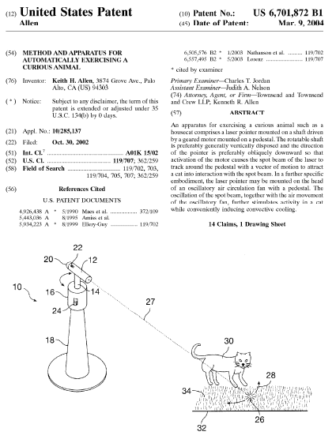
Patentable Subject Matter (cont'd)
Notes:
LONGER TERM…
Discuss ideas
Faculty: outreach, training, hurdles, customer service orientation, business (Lean Start-up); match right supports to individual technology/opportunity (Roadmap); yearly recognition event
Students: continue with BME and CMTI and Simon; extend training and engage PhDs/Post-docs; consider Entrepreneurial Post-doc program
Alumni: advisory counsels, outreach, experts
Community: ongoing engagement; develop understanding; create opportunities to interact between us, faculty, investors – Maybe big Jazz fest event for alumni, investors, entrepreneurs; include other locales and schools
Limited experience and/or comfort with clinical-regulatory-health economics requirements for medical technologies
Limited money for long-term returns or medical technologies
Limited entrepreneurs or managers locally with technology or medical business experience
Faculty with limited business understanding or management skills
Lots of helpful people, but result of #s 1, 3 and 4 above is often unproductive collaborations and confusion

Slide 39
Patentable Subject Matter (cont'd)
A Process or Method
  e.g. Method of treating cancer, or method of preventing bacterial infection
A Machine or Device
  e.g. Printing press
An Article of Manufacture
  e.g. Antibody, genetically altered cell line, wound dressing
Notes:
LONGER TERM…
Discuss ideas
Faculty: outreach, training, hurdles, customer service orientation, business (Lean Start-up); match right supports to individual technology/opportunity (Roadmap); yearly recognition event
Students: continue with BME and CMTI and Simon; extend training and engage PhDs/Post-docs; consider Entrepreneurial Post-doc program
Alumni: advisory counsels, outreach, experts
Community: ongoing engagement; develop understanding; create opportunities to interact between us, faculty, investors – Maybe big Jazz fest event for alumni, investors, entrepreneurs; include other locales and schools
Limited experience and/or comfort with clinical-regulatory-health economics requirements for medical technologies
Limited money for long-term returns or medical technologies
Limited entrepreneurs or managers locally with technology or medical business experience
Faculty with limited business understanding or management skills
Lots of helpful people, but result of #s 1, 3 and 4 above is often unproductive collaborations and confusion

Slide 40
Patentable Subject Matter (cont'd)
Notes:
LONGER TERM…
Discuss ideas
Faculty: outreach, training, hurdles, customer service orientation, business (Lean Start-up); match right supports to individual technology/opportunity (Roadmap); yearly recognition event
Students: continue with BME and CMTI and Simon; extend training and engage PhDs/Post-docs; consider Entrepreneurial Post-doc program
Alumni: advisory counsels, outreach, experts
Community: ongoing engagement; develop understanding; create opportunities to interact between us, faculty, investors – Maybe big Jazz fest event for alumni, investors, entrepreneurs; include other locales and schools
Limited experience and/or comfort with clinical-regulatory-health economics requirements for medical technologies
Limited money for long-term returns or medical technologies
Limited entrepreneurs or managers locally with technology or medical business experience
Faculty with limited business understanding or management skills
Lots of helpful people, but result of #s 1, 3 and 4 above is often unproductive collaborations and confusion

Slide 41
Patentable Subject Matter (cont'd)
A Process or Method
  e.g. Method of treating cancer, or method of preventing bacterial infection
A Machine or Device
  e.g. Printing press
An Article of Manufacture
  e.g. Antibody, genetically altered cell line, wound dressing
Composition of Matter
  e.g. Pharmaceutical compound (active agent) or formulation, vaccine, fertilizer formulation
Notes:
LONGER TERM…
Discuss ideas
Faculty: outreach, training, hurdles, customer service orientation, business (Lean Start-up); match right supports to individual technology/opportunity (Roadmap); yearly recognition event
Students: continue with BME and CMTI and Simon; extend training and engage PhDs/Post-docs; consider Entrepreneurial Post-doc program
Alumni: advisory counsels, outreach, experts
Community: ongoing engagement; develop understanding; create opportunities to interact between us, faculty, investors – Maybe big Jazz fest event for alumni, investors, entrepreneurs; include other locales and schools
Limited experience and/or comfort with clinical-regulatory-health economics requirements for medical technologies
Limited money for long-term returns or medical technologies
Limited entrepreneurs or managers locally with technology or medical business experience
Faculty with limited business understanding or management skills
Lots of helpful people, but result of #s 1, 3 and 4 above is often unproductive collaborations and confusion

Slide 42
Requirements of Patentability
Notes:
LONGER TERM…
Discuss ideas
Faculty: outreach, training, hurdles, customer service orientation, business (Lean Start-up); match right supports to individual technology/opportunity (Roadmap); yearly recognition event
Students: continue with BME and CMTI and Simon; extend training and engage PhDs/Post-docs; consider Entrepreneurial Post-doc program
Alumni: advisory counsels, outreach, experts
Community: ongoing engagement; develop understanding; create opportunities to interact between us, faculty, investors – Maybe big Jazz fest event for alumni, investors, entrepreneurs; include other locales and schools
Limited experience and/or comfort with clinical-regulatory-health economics requirements for medical technologies
Limited money for long-term returns or medical technologies
Limited entrepreneurs or managers locally with technology or medical business experience
Faculty with limited business understanding or management skills
Lots of helpful people, but result of #s 1, 3 and 4 above is often unproductive collaborations and confusion

Slide 43
Requirements for Patentability
1. Patentable subject matter
2. Utility
3. Novelty
4. Nonobviousness
Notes:
LONGER TERM…
Discuss ideas
Faculty: outreach, training, hurdles, customer service orientation, business (Lean Start-up); match right supports to individual technology/opportunity (Roadmap); yearly recognition event
Students: continue with BME and CMTI and Simon; extend training and engage PhDs/Post-docs; consider Entrepreneurial Post-doc program
Alumni: advisory counsels, outreach, experts
Community: ongoing engagement; develop understanding; create opportunities to interact between us, faculty, investors – Maybe big Jazz fest event for alumni, investors, entrepreneurs; include other locales and schools
Limited experience and/or comfort with clinical-regulatory-health economics requirements for medical technologies
Limited money for long-term returns or medical technologies
Limited entrepreneurs or managers locally with technology or medical business experience
Faculty with limited business understanding or management skills
Lots of helpful people, but result of #s 1, 3 and 4 above is often unproductive collaborations and confusion

Slide 44
Novelty and Nonobviousness
Based on “prior art”
America Invents Act (AIA) changed the definition of prior art
  Effective March 16, 2013
  But not applicable to all applications
    Some applications will be examined using the current definition (will continue for ~21 years)
    Some applications will be examined using the new definition
Notes:
LONGER TERM…
Discuss ideas
Faculty: outreach, training, hurdles, customer service orientation, business (Lean Start-up); match right supports to individual technology/opportunity (Roadmap); yearly recognition event
Students: continue with BME and CMTI and Simon; extend training and engage PhDs/Post-docs; consider Entrepreneurial Post-doc program
Alumni: advisory counsels, outreach, experts
Community: ongoing engagement; develop understanding; create opportunities to interact between us, faculty, investors – Maybe big Jazz fest event for alumni, investors, entrepreneurs; include other locales and schools
Limited experience and/or comfort with clinical-regulatory-health economics requirements for medical technologies
Limited money for long-term returns or medical technologies
Limited entrepreneurs or managers locally with technology or medical business experience
Faculty with limited business understanding or management skills
Lots of helpful people, but result of #s 1, 3 and 4 above is often unproductive collaborations and confusion

Slide 45
Prior Art – AIA
Information publicly available as of the application filing date
  Journal articles, abstracts, poster sessions, a thesis, etc., are prior art once they become publicly available
  Offers for sale, including presentations to potential licensees, are prior art under certain circumstances
Under old law – public availability was viewed with respect to date of invention, not filing date.
Notes:
LONGER TERM…
Discuss ideas
Faculty: outreach, training, hurdles, customer service orientation, business (Lean Start-up); match right supports to individual technology/opportunity (Roadmap); yearly recognition event
Students: continue with BME and CMTI and Simon; extend training and engage PhDs/Post-docs; consider Entrepreneurial Post-doc program
Alumni: advisory counsels, outreach, experts
Community: ongoing engagement; develop understanding; create opportunities to interact between us, faculty, investors – Maybe big Jazz fest event for alumni, investors, entrepreneurs; include other locales and schools
Limited experience and/or comfort with clinical-regulatory-health economics requirements for medical technologies
Limited money for long-term returns or medical technologies
Limited entrepreneurs or managers locally with technology or medical business experience
Faculty with limited business understanding or management skills
Lots of helpful people, but result of #s 1, 3 and 4 above is often unproductive collaborations and confusion

Slide 46
Prior Art – AIA (cont’d)
Grace period for inventor related publication:
  Publications by inventors available less than one year before application filing date are not prior art.
    Includes publications by others who obtained the subject matter from the inventor(s) (e.g., stolen work) or
    Subject matter that was publicly disclosed by the inventor first
  Available in U.S. and a few other countries in limited circumstances
Notes:
LONGER TERM…
Discuss ideas
Faculty: outreach, training, hurdles, customer service orientation, business (Lean Start-up); match right supports to individual technology/opportunity (Roadmap); yearly recognition event
Students: continue with BME and CMTI and Simon; extend training and engage PhDs/Post-docs; consider Entrepreneurial Post-doc program
Alumni: advisory counsels, outreach, experts
Community: ongoing engagement; develop understanding; create opportunities to interact between us, faculty, investors – Maybe big Jazz fest event for alumni, investors, entrepreneurs; include other locales and schools
Limited experience and/or comfort with clinical-regulatory-health economics requirements for medical technologies
Limited money for long-term returns or medical technologies
Limited entrepreneurs or managers locally with technology or medical business experience
Faculty with limited business understanding or management skills
Lots of helpful people, but result of #s 1, 3 and 4 above is often unproductive collaborations and confusion

Slide 47
University of Rochester
Policy on Intellectual Property and Technology Transfer
Gail Norris

Slide 48
Policy Objective
The IP Policy is intended to:
Protect the intellectual property arising out of
    University research
Provide rules on the ownership interest of the
University in intellectual property
Provide general terms for the licensing of technology owned by the University for the sharing of any revenues from the licensing

Slide 49
Who’s Covered
All faculty, employees, students, fellows, and visiting scientists conducting research using our facilities.

Slide 50
What’s Covered
Copyrights
Patents
Tangible Research Property
that is developed with significant use of University resources or as part of your job responsibilities is owned by the University and covered by this Policy

Slide 51
Significant Use of University Resources
Examples: grant funding, laboratory equipment, students, sophisticated software programs available at the University
What’s not significant use of University resources: common office equipment such as computers, telephones, consumer software programs.

Slide 52
Copyrights
Law provides that work done as part of your job is “work for hire” and owned by your employee
In keeping with academic tradition, the University generally does not claim copyright ownership in articles, textbooks, theses, poems, musical compositions and similar works which are intended to disseminate results of academic research, scholarship, artistic expression, etc.
Exceptions: significant use of university research and institutional works.

Slide 53
MOOC Controversy
Setting the stage
        On –line learning “continuum of issues”
        AAUP report on Faculty Rights
            “New AAUP report describing attempt by university administrators to claim ownership of faculty IP; educational campaign to inform faculty about their rights”

Slide 54
Licensing
        Licensing Process
            Invention Disclosure
            Patenting Determination
            Importance of Inventor/Author assistance
            Marketing
    Royalties
            1st $50,000 50%
            $50k - $250K 40%
            Above $250K 35%

Slide 55
Questions

Slide 56
The Importance of Material Transfer and Confidential Disclosure Agreements in Shared Research
Presented by:
Donna L. Beyea
Associate Director
Office of Research & Project Administration
donna.beyea@rochester.edu
Phone: 275-8037

Slide 57
What is a Material Transfer Agreement (MTA)?
An MTA is the contractual instrument used to define the terms and conditions for the exchange of research materials.
The MTA typically sets forth rights to use the materials and allocates the rights that result from their use.

Slide 58
Reason for an MTA:
The material and/or information is proprietary or confidential.
The provider wants to restrict how the material is to be used.
The material is infectious, hazardous or subject to special regulations.
The provider wishes to protect against any potential liability.
The provider wishes to obtain rights to the results of the research for which the material or information is to be used.
The provider wishes to ensure that correct and appropriate acknowledgement is included in any publication regarding the use of the material.

Slide 59
Different Types of MTAs:
Electronic Material Transfer Agreement
Simple Letter Agreement (SLA)
Uniform Biological Material Transfer Agreement (UBMTA)
Institutional based MTA (drafted by the providing institution)

Slide 60
Areas of Concern
DEFINITION OF MATERIAL
DATA PROTECTION
PUBLICATION
INTELLECTUAL PROPERTY
INDEMNIFICATION
CONFIDENTIAL INFORMATION

Slide 61
Signature of Authorized Representatives:
Signature of an Authorized Institutional Official is required. Faculty members are not authorized to legally bind the University in any type of contract.
MTAs are normally signed by ORPA.
PI can sign as “Read & Acknowledged”

Slide 62
What is a Confidential Disclosure Agreement (CDA)?
A Confidential Disclosure Agreement (or a Nondisclosure Agreement) is an agreement under which one or both parties agree to maintain confidentiality regarding proprietary information (“Confidential Information”) that one party receives from the other party (“Information Owner”).

Slide 63
Types of CDAs:
One-way CDA:
Only the Receiving Party is bound by
obligations of confidentiality.
Two-way (Mutual):
Both Parties are bound by obligations of confidentiality to confidential information received from the other Party.

Slide 64
Areas of Concern in a CDA:
TERM OF AGREEMENT vs TERM OF CONFIDENTIALITY
INTELLECTUAL PROPERTY
SIGNATORIES

Slide 65
If a PI Leaves UR:
When a principal investigator leaves UR it is highly recommended that they contact our office early so we can work with them to assure a timely resolution to any ongoing obligations pertaining to active MTAs/CDAs.
Things to consider – Do you plan to:
1) continue using materials you received from another institution at your new place of employment;
2) transfer material made while at the University of Rochester to you new place of employment;
3) transfer materials and research to another PI within UR; or
4) discontinue use of materials covered under an existing Agreement(s).

Slide 66
Questions?
Material Transfer Administrators:
Gila Balman: gila.balman@rochester.edu
ext: 3-4512
Jena Ashley: jena.ashley@rochester.edu
ext: 5-5115

Slide 67
Inventions
and
Patenting
Carissa R. Childs, Ph.D. Edwin V. Merkel
70 Linden Oaks, Suite 210 70 Linden Oaks, Suite 210
Rochester, New York 14625 Rochester, New York 14625
Phone: 585.270.2134 Phone: 585.270.2104
carissa.childs@leclairryan.com edwin.merkel@leclairryan.com

Slide 68
Inventions and Patenting
The Process for Obtaining a Patent
Inventorship
Notes:
LONGER TERM…
Discuss ideas
Faculty: outreach, training, hurdles, customer service orientation, business (Lean Start-up); match right supports to individual technology/opportunity (Roadmap); yearly recognition event
Students: continue with BME and CMTI and Simon; extend training and engage PhDs/Post-docs; consider Entrepreneurial Post-doc program
Alumni: advisory counsels, outreach, experts
Community: ongoing engagement; develop understanding; create opportunities to interact between us, faculty, investors – Maybe big Jazz fest event for alumni, investors, entrepreneurs; include other locales and schools
Limited experience and/or comfort with clinical-regulatory-health economics requirements for medical technologies
Limited money for long-term returns or medical technologies
Limited entrepreneurs or managers locally with technology or medical business experience
Faculty with limited business understanding or management skills
Lots of helpful people, but result of #s 1, 3 and 4 above is often unproductive collaborations and confusion

Slide 69
The U.S. Patent Process
What You Need to Do to Get a Patent?
Notes:
LONGER TERM…
Discuss ideas
Faculty: outreach, training, hurdles, customer service orientation, business (Lean Start-up); match right supports to individual technology/opportunity (Roadmap); yearly recognition event
Students: continue with BME and CMTI and Simon; extend training and engage PhDs/Post-docs; consider Entrepreneurial Post-doc program
Alumni: advisory counsels, outreach, experts
Community: ongoing engagement; develop understanding; create opportunities to interact between us, faculty, investors – Maybe big Jazz fest event for alumni, investors, entrepreneurs; include other locales and schools
Limited experience and/or comfort with clinical-regulatory-health economics requirements for medical technologies
Limited money for long-term returns or medical technologies
Limited entrepreneurs or managers locally with technology or medical business experience
Faculty with limited business understanding or management skills
Lots of helpful people, but result of #s 1, 3 and 4 above is often unproductive collaborations and confusion

Slide 70
Step 1: Invent Something that is Patentable
Must be patentable subject matter
Must be new and non-obvious
Must be useful
Notes:
LONGER TERM…
Discuss ideas
Faculty: outreach, training, hurdles, customer service orientation, business (Lean Start-up); match right supports to individual technology/opportunity (Roadmap); yearly recognition event
Students: continue with BME and CMTI and Simon; extend training and engage PhDs/Post-docs; consider Entrepreneurial Post-doc program
Alumni: advisory counsels, outreach, experts
Community: ongoing engagement; develop understanding; create opportunities to interact between us, faculty, investors – Maybe big Jazz fest event for alumni, investors, entrepreneurs; include other locales and schools
Limited experience and/or comfort with clinical-regulatory-health economics requirements for medical technologies
Limited money for long-term returns or medical technologies
Limited entrepreneurs or managers locally with technology or medical business experience
Faculty with limited business understanding or management skills
Lots of helpful people, but result of #s 1, 3 and 4 above is often unproductive collaborations and confusion

Slide 71
Step 2: Submit Invention Disclosure
Submit an invention disclosure to UR Ventures prior to any public disclosure
  e.g. Scientific meeting, manuscript publication, presentation to potential collaborators, etc.
Disclose early and update often
Identify competitors and relevant prior art
If possible, identify commercial applications and potential entities that would be interested
Notes:
LONGER TERM…
Discuss ideas
Faculty: outreach, training, hurdles, customer service orientation, business (Lean Start-up); match right supports to individual technology/opportunity (Roadmap); yearly recognition event
Students: continue with BME and CMTI and Simon; extend training and engage PhDs/Post-docs; consider Entrepreneurial Post-doc program
Alumni: advisory counsels, outreach, experts
Community: ongoing engagement; develop understanding; create opportunities to interact between us, faculty, investors – Maybe big Jazz fest event for alumni, investors, entrepreneurs; include other locales and schools
Limited experience and/or comfort with clinical-regulatory-health economics requirements for medical technologies
Limited money for long-term returns or medical technologies
Limited entrepreneurs or managers locally with technology or medical business experience
Faculty with limited business understanding or management skills
Lots of helpful people, but result of #s 1, 3 and 4 above is often unproductive collaborations and confusion

Slide 72
Step 3: Prepare & File Patent Application
U.S. patents are obtained by filing a written application which includes the following components:
  Specification
    Background of the invention
    Summary of the invention
    Detailed description of invention
  Claims
  Drawings
Inventor participation in patent drafting process is critical
Notes:
LONGER TERM…
Discuss ideas
Faculty: outreach, training, hurdles, customer service orientation, business (Lean Start-up); match right supports to individual technology/opportunity (Roadmap); yearly recognition event
Students: continue with BME and CMTI and Simon; extend training and engage PhDs/Post-docs; consider Entrepreneurial Post-doc program
Alumni: advisory counsels, outreach, experts
Community: ongoing engagement; develop understanding; create opportunities to interact between us, faculty, investors – Maybe big Jazz fest event for alumni, investors, entrepreneurs; include other locales and schools
Limited experience and/or comfort with clinical-regulatory-health economics requirements for medical technologies
Limited money for long-term returns or medical technologies
Limited entrepreneurs or managers locally with technology or medical business experience
Faculty with limited business understanding or management skills
Lots of helpful people, but result of #s 1, 3 and 4 above is often unproductive collaborations and confusion

Slide 73
Step 4: The Patent Process
Filing – the application is submitted to the U.S. Patent and Trademark Office (“PTO”), along with a fee and an oath executed by the inventor stating certain required facts
Wait – Up to several years!
Notes:
LONGER TERM…
Discuss ideas
Faculty: outreach, training, hurdles, customer service orientation, business (Lean Start-up); match right supports to individual technology/opportunity (Roadmap); yearly recognition event
Students: continue with BME and CMTI and Simon; extend training and engage PhDs/Post-docs; consider Entrepreneurial Post-doc program
Alumni: advisory counsels, outreach, experts
Community: ongoing engagement; develop understanding; create opportunities to interact between us, faculty, investors – Maybe big Jazz fest event for alumni, investors, entrepreneurs; include other locales and schools
Limited experience and/or comfort with clinical-regulatory-health economics requirements for medical technologies
Limited money for long-term returns or medical technologies
Limited entrepreneurs or managers locally with technology or medical business experience
Faculty with limited business understanding or management skills
Lots of helpful people, but result of #s 1, 3 and 4 above is often unproductive collaborations and confusion

Slide 74
The Patent Process (cont’d)
Examination:
  The application is reviewed by a patent examiner
  The examiner searches prior art patents and publications and decides either to allow claims or to reject them
  Written rejections are mailed out to the applicant
  Responses are filed by applicant
    Inventor input on prior art cited by PTO is often critical
  Repeat, as needed
Notes:
LONGER TERM…
Discuss ideas
Faculty: outreach, training, hurdles, customer service orientation, business (Lean Start-up); match right supports to individual technology/opportunity (Roadmap); yearly recognition event
Students: continue with BME and CMTI and Simon; extend training and engage PhDs/Post-docs; consider Entrepreneurial Post-doc program
Alumni: advisory counsels, outreach, experts
Community: ongoing engagement; develop understanding; create opportunities to interact between us, faculty, investors – Maybe big Jazz fest event for alumni, investors, entrepreneurs; include other locales and schools
Limited experience and/or comfort with clinical-regulatory-health economics requirements for medical technologies
Limited money for long-term returns or medical technologies
Limited entrepreneurs or managers locally with technology or medical business experience
Faculty with limited business understanding or management skills
Lots of helpful people, but result of #s 1, 3 and 4 above is often unproductive collaborations and confusion

Slide 75
Step 5: Pay Issue & Maintenance Fees
Issuance of a patent:
  An allowed application issues as a patent once an issue fee is paid
  Maintenance fees must be paid during the fourth, eighth, and twelfth years of the
  patent term
    Cost increases for each maintenance fee
Notes:
LONGER TERM…
Discuss ideas
Faculty: outreach, training, hurdles, customer service orientation, business (Lean Start-up); match right supports to individual technology/opportunity (Roadmap); yearly recognition event
Students: continue with BME and CMTI and Simon; extend training and engage PhDs/Post-docs; consider Entrepreneurial Post-doc program
Alumni: advisory counsels, outreach, experts
Community: ongoing engagement; develop understanding; create opportunities to interact between us, faculty, investors – Maybe big Jazz fest event for alumni, investors, entrepreneurs; include other locales and schools
Limited experience and/or comfort with clinical-regulatory-health economics requirements for medical technologies
Limited money for long-term returns or medical technologies
Limited entrepreneurs or managers locally with technology or medical business experience
Faculty with limited business understanding or management skills
Lots of helpful people, but result of #s 1, 3 and 4 above is often unproductive collaborations and confusion

Slide 76
Inventorship
Notes:
LONGER TERM…
Discuss ideas
Faculty: outreach, training, hurdles, customer service orientation, business (Lean Start-up); match right supports to individual technology/opportunity (Roadmap); yearly recognition event
Students: continue with BME and CMTI and Simon; extend training and engage PhDs/Post-docs; consider Entrepreneurial Post-doc program
Alumni: advisory counsels, outreach, experts
Community: ongoing engagement; develop understanding; create opportunities to interact between us, faculty, investors – Maybe big Jazz fest event for alumni, investors, entrepreneurs; include other locales and schools
Limited experience and/or comfort with clinical-regulatory-health economics requirements for medical technologies
Limited money for long-term returns or medical technologies
Limited entrepreneurs or managers locally with technology or medical business experience
Faculty with limited business understanding or management skills
Lots of helpful people, but result of #s 1, 3 and 4 above is often unproductive collaborations and confusion

Slide 77
Inventorship
General
  U.S. patent applications are filed in the name of the inventor(s) or the owners.
    PTO records assignments of patent rights from inventors to owners.
Definition: “Determining ‘inventorship’ is nothing more than determining who conceived the subject matter ….”
Inventorship is determined by what is claimed.
  May change during prosecution of the application
Notes:
LONGER TERM…
Discuss ideas
Faculty: outreach, training, hurdles, customer service orientation, business (Lean Start-up); match right supports to individual technology/opportunity (Roadmap); yearly recognition event
Students: continue with BME and CMTI and Simon; extend training and engage PhDs/Post-docs; consider Entrepreneurial Post-doc program
Alumni: advisory counsels, outreach, experts
Community: ongoing engagement; develop understanding; create opportunities to interact between us, faculty, investors – Maybe big Jazz fest event for alumni, investors, entrepreneurs; include other locales and schools
Limited experience and/or comfort with clinical-regulatory-health economics requirements for medical technologies
Limited money for long-term returns or medical technologies
Limited entrepreneurs or managers locally with technology or medical business experience
Faculty with limited business understanding or management skills
Lots of helpful people, but result of #s 1, 3 and 4 above is often unproductive collaborations and confusion

Slide 78
Inventorship (cont'd)
  Consequences of incorrect inventorship - a patent cannot lawfully issue to those who are not inventors.
  Inventorship dictates ownership
    No contractual obligation → the inventor is the owner.
    Contractual obligation → can change who is the owner.
      Assignment obligation
      Material transfer and technology development agreements
Notes:
LONGER TERM…
Discuss ideas
Faculty: outreach, training, hurdles, customer service orientation, business (Lean Start-up); match right supports to individual technology/opportunity (Roadmap); yearly recognition event
Students: continue with BME and CMTI and Simon; extend training and engage PhDs/Post-docs; consider Entrepreneurial Post-doc program
Alumni: advisory counsels, outreach, experts
Community: ongoing engagement; develop understanding; create opportunities to interact between us, faculty, investors – Maybe big Jazz fest event for alumni, investors, entrepreneurs; include other locales and schools
Limited experience and/or comfort with clinical-regulatory-health economics requirements for medical technologies
Limited money for long-term returns or medical technologies
Limited entrepreneurs or managers locally with technology or medical business experience
Faculty with limited business understanding or management skills
Lots of helpful people, but result of #s 1, 3 and 4 above is often unproductive collaborations and confusion

Slide 79
THANK YOU
Notes:
LONGER TERM…
Discuss ideas
Faculty: outreach, training, hurdles, customer service orientation, business (Lean Start-up); match right supports to individual technology/opportunity (Roadmap); yearly recognition event
Students: continue with BME and CMTI and Simon; extend training and engage PhDs/Post-docs; consider Entrepreneurial Post-doc program
Alumni: advisory counsels, outreach, experts
Community: ongoing engagement; develop understanding; create opportunities to interact between us, faculty, investors – Maybe big Jazz fest event for alumni, investors, entrepreneurs; include other locales and schools
Limited experience and/or comfort with clinical-regulatory-health economics requirements for medical technologies
Limited money for long-term returns or medical technologies
Limited entrepreneurs or managers locally with technology or medical business experience
Faculty with limited business understanding or management skills
Lots of helpful people, but result of #s 1, 3 and 4 above is often unproductive collaborations and confusion

Slide 80
Intermission:
We will reconvene at 11:30 a.m.

