Slide 1
Entrepreneurship at the University of Rochester
Duncan Moore
Vice Provost for Entrepreneurship
585.275.5248
moore@optics.rochester.edu

Slide 2
Our Definition
Entrepreneurship \ŏn’trə-prə-nər-ship\ n:
Transforming ideas into enterprises that create value.
Way of thinking
A unique approach to problems
Attribute of the mind
Trait of character
A Science and an Art
Some characteristics can be taught
Some characteristics must be nurtured

Slide 3
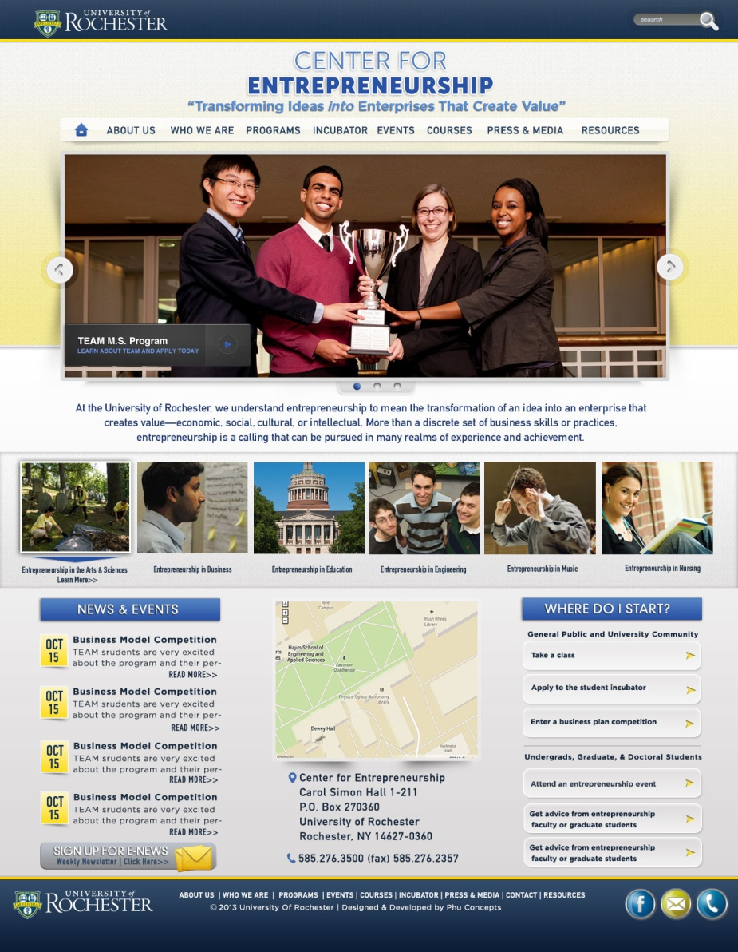
Center for Entrepreneurship
Founded in 2004
Partially funded by a grant from the Kauffman Foundation
Mission: to embed entrepreneurship throughout the University and the greater Rochester community
Homepage redesign

Slide 4
Incubation and Funding
Student Incubator at HTR
6 companies currently
Business plan competitions:
Mark Ain Business Model Competition
Charles and Janet Forbes Entrepreneurial Award
Eastman New Venture Challenge
New York Business Plan Competition (Finger Lakes Round)
Simon School Venture Capital Fund

Slide 5
On Campus
Student Organizations:
UR Entrepreneurs (undergrad)
Simon Entrepreneurs Association
Signature Programming:
Kauffman Entrepreneurial Year (KEY)
Young Entrepreneurs Academy (YEA!)
Undergrads design interdepartmental major in entrepreneurship

Slide 6
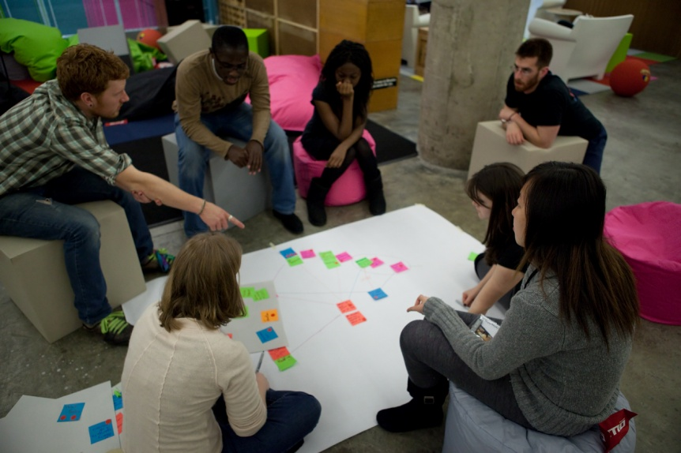
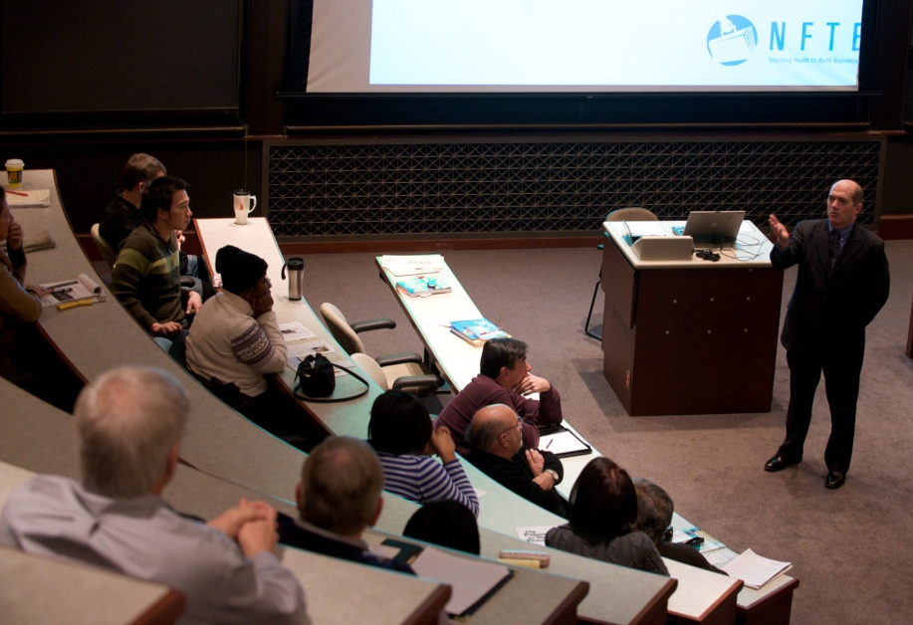
In the Community
Global Entrepreneurship Week
Mentoring youth
Rochester Startup Weekend
Students Tackle Bright Flight
CFE Lecture Series

Slide 7
Visit Us Online
Student Incubator:
rochester.edu/entrepreneurship/incubator
Events:
rochester.edu/entrepreneurship/events
rochester.edu/entrepreneurship/registration
Courses:
rochester.edu/entrepreneurship/courses
Programs:
rochester.edu/entrepreneurship/programs
facebook.com/
ur.entrepreneurship

Slide 8
MS in Technical Entrepreneurship and Management (TEAM)

Slide 9
Interdisciplinary Degree
Partnership between Simon School of Business and Hajim School of Engineering & Applied Science
Students will have the ability to speak three languages
Innovation = Invention X Market Opportunity

Slide 10
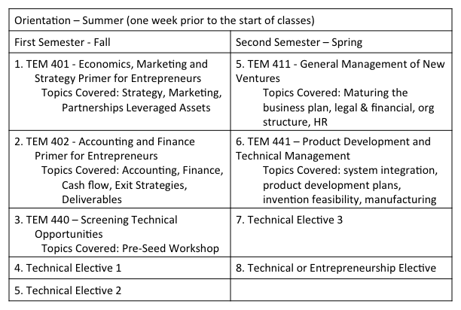
Curriculum – Two Semester

Slide 11
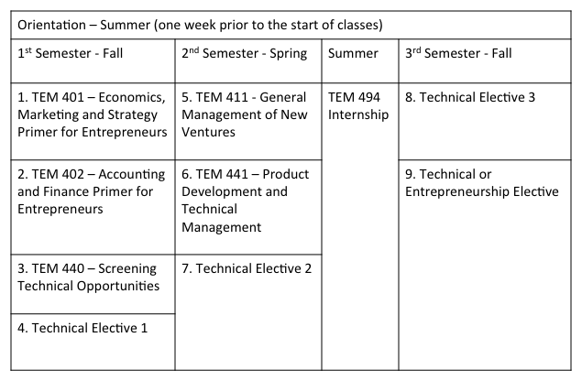
Curriculum – Three Semester

Slide 12
Engineering Concentrations
Engineering Concentration Choices
Biomedical Engineering | Materials Science
Chemical Engineering | Computer Science
Electrical and Computer Engineering | Data Science
Mechanical Engineering | Optics
Energy and the Environment
* Proposed degree program in Technical Entrepreneurship and Management in Biomanufacturing and Therapeutic Development (TEAM-BMTD) in conjunction with the School of Medicine and Dentistry set for Fall 2014

Slide 13
Class of 2014 Profile
Class Characteristics
Students Enrolled | 24
Countries Represented | 9
Average Age | 24
Female/Male | 17%/83%
Students Receiving Merit Scholarships | 92%
Test Scores
Average GRE (middle 60%) | 1350/313 (1210-1460/310-322)
Average TOEFL (middle 60% range) | 104 (101-107)
Undergraduate Characteristics
Average GPA (middle 60% range) | 3.27 (3.09-3.60)
Engineering/Science/Other Majors | 54%/38%/8%

Slide 14
Questions??
For more information please
visit our website: www.rochester.edu/TEAM
If you have questions, always feel free to contact Executive Director, Andrea Galati: andrea.galati@rochester.edu
facebook.com/UR.TEAM.MS

Slide 15
On Line Invention Disclosure – a New, Streamlined Process
Marjorie Hunter
Director, Intellectual Property

Slide 16
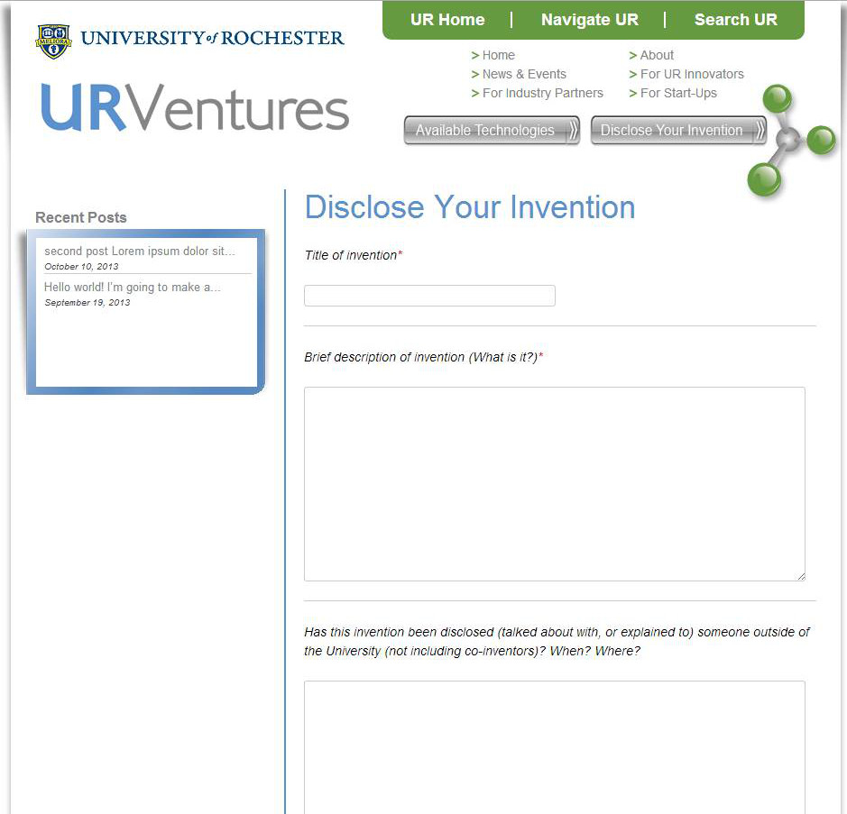
New Form

Slide 17
Questions Asked
Title of Invention

Slide 18
Questions Asked
Title of Invention
Brief Description of Invention

Slide 19
Questions Asked
Title of Invention
Brief Description of Invention
Previous Public Disclosure
Notes:
LONGER TERM…
Discuss ideas
Faculty: outreach, training, hurdles, customer service orientation, business (Lean Start-up); match right supports to individual technology/opportunity (Roadmap); yearly recognition event
Students: continue with BME and CMTI and Simon; extend training and engage PhDs/Post-docs; consider Entrepreneurial Post-doc program
Alumni: advisory counsels, outreach, experts
Community: ongoing engagement; develop understanding; create opportunities to interact between us, faculty, investors – Maybe big Jazz fest event for alumni, investors, entrepreneurs; include other locales and schools
Limited experience and/or comfort with clinical-regulatory-health economics requirements for medical technologies
Limited money for long-term returns or medical technologies
Limited entrepreneurs or managers locally with technology or medical business experience
Faculty with limited business understanding or management skills
Lots of helpful people, but result of #s 1, 3 and 4 above is often unproductive collaborations and confusion

Slide 20
Questions Asked
Title of Invention
Brief Description of Invention
Previous Public Disclosure
Pending Future Public Disclosure

Slide 21
Questions Asked
Title of Invention
Brief Description of Invention
Previous Public Disclosure
Pending Future Public Disclosure
Extramural Funding/Materials Used? (Details)

Slide 22
Questions Asked
Title of Invention
Brief Description of Invention
Previous Public Disclosure
Pending Future Public Disclosure
Extramural Funding/Materials Used? (Details)
Attach Descriptive Document (If Available)

Slide 23
Questions Asked
Title of Invention
Brief Description of Invention
Previous Public Disclosure
Pending Future Public Disclosure
Extramural Funding/Materials Used? (Details)
Attach Descriptive Document (If Available)
Inventor’s Information (Name, Department, E-Mail)

Slide 24
Questions Asked
Title of Invention
Brief Description of Invention
Previous Public Disclosure
Pending Future Public Disclosure
Extramural Funding/Materials Used? (Details)
Attach Descriptive Document (If Available)
Inventor’s Information (Name, Department, E-Mail)
Co-Inventor Information (If Any)

Slide 25
Questions Asked
Title of Invention
Brief Description of Invention
Previous Public Disclosure
Pending Future Public Disclosure
Extramural Funding/Materials Used? (Details)
Attach Descriptive Document (If Available)
Inventor’s Information (Name, Department, E-Mail)
Co-Inventor Information (If Any)
Acknowledgement that UR IP Policy is read and understood

Slide 26
On Line Disclosure
This is the information UR Ventures needs to enter the disclosure into our system

Slide 27
On Line Disclosure
This is the information UR Ventures needs to enter the disclosure into our system
It is the starting point of the process, rather than the ending point

Slide 28
On Line Disclosure
This is the information UR Ventures needs to enter the disclosure into our system
It is the starting point of the process, rather than the ending point
The assigned technology manager will follow up with a face-to-face meeting with the inventor(s)

Slide 29
Invention Disclosure Evaluation
October 21, 2013
Notes:
Intro self and office – brief intro – originally fro western NY, Optics UR, AFROTC RIT, AF JAG, patent attorney, start-up, small public company, M&A, licensing, project managmeent and culture change…
As alumni – saw UR from a distance – amazing research (changing lives, altering our world), an ecosystem of pieces of a great puzzle (Simon, Hajim, URMC, SMD – CTSI, CMTI, TEAM, BME senior design, Big Data, cGMP…) --- came to be part of a great adventure in re-defining Rochester’s position in the pantheon of in novation hubs – the next Silicon Valley….
How maximize the opportunity? What are the challenges…?
Idea that two former tech transfer offices are now one – Appropriate time to reflect on what we do and how we do it – Took feedback and embarking on a new direction

Slide 30
Basic Concepts
Initial Process
Submit invention disclosure form
Talk with UR Ventures personnel to build common understanding of the innovation
Preliminary evaluation and decision on type of intellectual property to seek, if any
Patent (provisional or non-provisional)
Copyright
Evaluation
Patentability – is it patentable subject-matter? Is it new and non-obvious? What does the prior art look like? Is it enabled?
Marketability – what are the benefits of the technology to customers? What’s the market size for this technology?
Enforceability – will anyone be able to tell if someone is infringing?
Early stage – develops over time
Notes:
Re-focused mission

Slide 31
The Technology Commercialization Process
Patrick Emmerling, PhD, MBA
Licensing Manager

Slide 32
Our Mission
To develop UR Innovations into valuable products and services to make the world ever better.

Slide 33
Our Mission
To develop UR Innovations into valuable products and services to make the world ever better.

Slide 34
The Commercialization Roadmap
?

Slide 35
A Fresh Perspective
…

Slide 36
A Fresh Perspective
…
What is the anticipated Commercial product?
What pain does it address?
The Market?
Who pays?
Regulatory Pathway?
Startup vs. License to Existing Company?
Intellectual Property Protection?
Technical Status?
Funding requirements
….and so on….

Slide 37
Requires a Concerted Effort
Just as it takes a village to raise a child, it takes a team working together efficiently to bring a new and exciting innovation to market:
• UR Ventures Team
• Licensing an IP Professionals
• ORPA Administrators
• Inventors
• Industry Experts

Slide 38
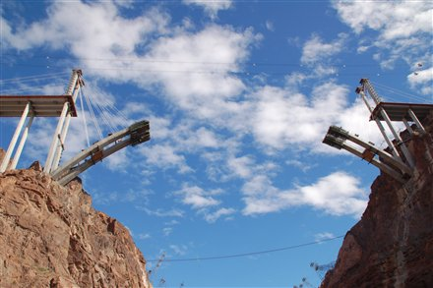
Focused, Lean Approach to Commercialization

Slide 39
A Crucial Exercise that is Germaine to All Commercialization Strategies: Testing the Business Hypothesis
Create Commercialization Hypothesis
Define the Value Proposition
What is the problem the innovation solves?
Key features required?
Who are the most important customers?
Is the pain / need real?
If, no… what is the real pain?
Key features for solution?
Who is the final decision maker?
Re-evaluate Hypothesis
Refine as needed
REPEAT

Slide 40
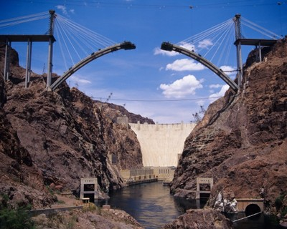
The Commercialization Pathway

Slide 41
UR Ventures Fresh Perspective on Innovation Commercialization
Focused, lean, and team oriented approach to the commercialization of UR Innovations.
Taking Innovations from the Bench-top to the Bedside to make the world ever better.

