Slide 1
Excell Partners, Inc.
Venture Capital Climate
Seed Stage Funding Options

Slide 2
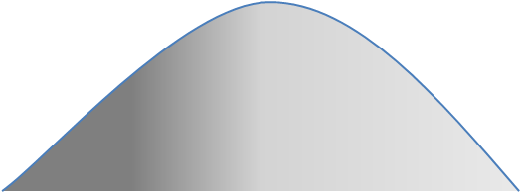

The Capital Lifecycle Commercialization Continuum
Excell Partners
VCs
Friends,
Founders, Family
Angels, Grants, Bootstrap
Equity, Markets, Banks
Venture Capital
Valley of Death ©2007 I2E, Inc.

Slide 3
Venture Capital Investment - 2009
$ Billions Invested
Source: PricewaterhouseCoopers/National Venture Capital Association MoneyTree™ Report,
Data: Thomson Reuters
Notes:
3

Slide 4
Preferred VC Stage of Investment
Source: PricewaterhouseCoopers/National Venture Capital Association MoneyTree™ Report, Data: Thomson Reuters

Slide 5
Most Popular Industries
  Biotech
  Computers and Peripherals
  Financial Services
  Industrial Energy
  IT Services
  Media and Entertainment
  Medical Devices and Equipment
  Semiconductors
  Software
  Telecommunications
  All Other
Notes:
5

Slide 6
Most Popular Industries
Venture Capital Investments for 2009 by Industry
In Millions
Source: PricewaterhouseCoopers/National Venture Capital Association MoneyTree™ Report, Data: Thomson Reuters

Slide 7
Where Does the Money Go?
Region | Investment ($M) | % Tot | Deals
Silicon Valley * | $6,990 | 39.5% | 866
New England | $2,161 | 12.2% | 348
NY Metro | $1,413 | 8.0% | 246
Southeast | $986 | 5.6% | 138
LA/Orange County * | $943 | 5.3% | 157
San Diego * | $903 | 5.1% | 107
Midwest | $740 | 4.2% | 221
Northwest | $705 | 4.0% | 133
Texas | $645 | 3.6% | 111
DC/Metroplex | $546 | 3.1% | 119
Colorado | $468 | 2.6% | 72
Philadelphia Metro | $424 | 2.4% | 89
North Central | $377 | 2.1% | 58
SouthWest | $310 | 1.8% | 69
South Central | $24 | 0.1% | 37
Upstate NY | $18 | 0.1% | 13
Sacramento/N.Cal * | $17 | 0.1% | 8
Unknown | $13 | 0.1% | 8
AK/HI/PR | $7 | 0.0% | 2
Total | $17,691 | 100% | 2,802
2009 Total Annual VC Investment ~$18B
>50% to California
Source: PWC MoneyTree

Slide 8
VC Investments in NYS - 2009
Downstate NY Total = $1,416 M
Upstate NY Total = $18 M
NOTE: NO Seed or Early Stage recorded by VC in
Upstate NY in 2009!!
Source: PWCmoneytree.com

Slide 9
The Capital Lifecycle Commercialization Continuum
Excell Partners
VCs
Friends,
Founders, Family
Angels, Grants, Bootstrap
Equity, Markets, Banks
Venture Capital
Valley of Death ©2007 I2E, Inc.

Slide 10

Angels

Slide 11
The Power of Angels
Significant contributors to job growth
Responsible for creation of 250,000 new jobs in US in 2009 (4.4 jobs per angel investment)
Represents 5% of new jobs in nation in 2009
Source: Center for Venture Research

Slide 12
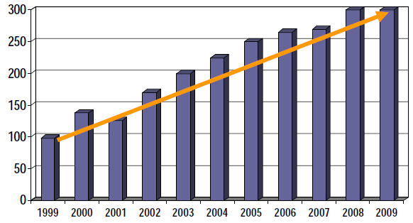
Growth in Number of American Angel Groups
Sources: Center for Venture Research (pre ‘03 data) and Kauffman Foundation/ACEF (‘04-’09 data)

Slide 13
Angel Investments
 | 2005 | 2006 | 2007 | 2008 | 2009
Total | $23.1 B | $25.6 B | $26.1 B | $19.2 B | $17.6 B
# of Ventures | 49,500 | 51,000 | 57,120 | 55,480 | 57,225
Active Angels | 227,000 | 234,000 | 258,000 | 260,000 | 259,480
Avg Deal Size (K) | $ 467 K | $ 502 K | $ 455 K | $ 346 K | $ 308 K
Avg $ per Investor (K) | $101,762 | $109,402 | $101,084 | $73,846 | $67,828
2009: VC $18B + Angel 18B = $36B
Source: Center for Venture Research

Slide 14
NYS Angel Networks
Western NY Venture Association, Buffalo Upstate
Rochester Angel Network (RAN) Upstate
Seed Capital Partners, Syracuse Upstate
Tech Valley Angel Network, Albany Upstate
Orange County Angels Downstate
New York Angels Downstate
Long Island Angels Downstate
Positive Trends but …
Once organized, some Angels move downstream to Early Stage
Shy away from Life Sciences, unfortunate because
  76% of Downstate R&D is Bio
  56% of Upstate R&D is Bio
Not all staffed to lead due diligence, deal syndication, negotiation
Excellent syndication partners and source of co-investor capital!
Can’t be expected to shoulder entire burden for hundreds of start-ups!

Slide 15
Upstate Angels - 2009
# of Deals 2 2 6
Total Amount Invested $1,345,000 $302,000 $1,000,000
SUMMARY: 10 DEALS $1.3 MILLION (Cash) AVG DEAL: $130,000
 Investment commitment represents a loan guarantee by the Angels. Non- cash transaction.
Category/Industry Biotech Biotech Mems
Medical Device Green Materials
Saas
Nanotech/Clean Energy
Functional Foods
Biochemical
Average Size Investment $672,500 $151,000 $166,666
Adjusted $172,500
ROCHESTER BUFFALO SYRACUSE

Slide 16
Excell Partners, Inc.
A 501(c) (4) Not for Profit
Wholly owned by the University
Upstate Footprint
Until recently, Excell was the only seed stage fund in Upstate

Slide 17
Excell’s Footprint

Slide 18
Excell Partners Inc.
Since inception, invested $2.4 million in 21 companies
Portfolio includes technologies in:
  Medical Devices, Biotechnology, Industrial/Energy, IT, Consumer Products
Source of Deals: 50% from University/50% from Community
Investment Size
  Pre-Seed $50,000 - $100,000
  Seed $100,000 - $250,000 Physical Science
  $250,000 - $750,000 Life Science
Deal Terms
  Convertible Note, Accrued Interest, 2 Year Maturity, Converts to Equity at a Discount to the Next Investment Round
  OR
  Equity
        $

Slide 19
Activity Flow

Slide 20
EXCELL
TRILLIUM

Slide 21
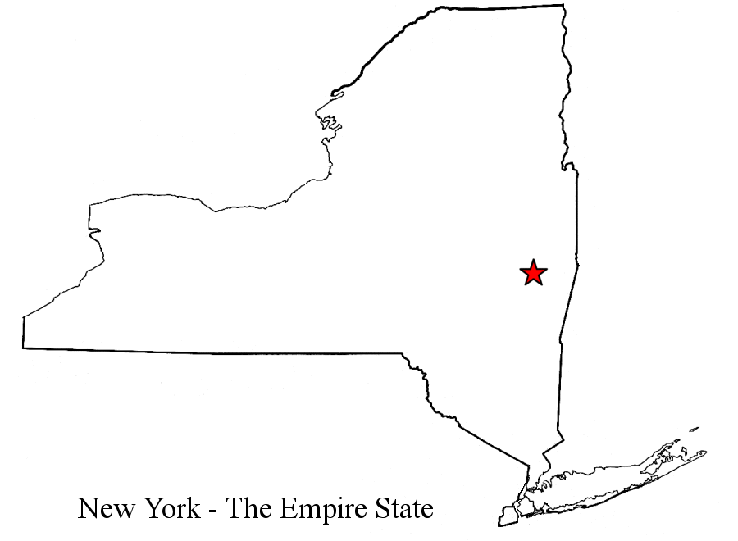
Local & Regional VCs
Rand Capital
Summer Street Capital
Excell Partners Trillium Group
Onondaga Ventures
Rochester
Syracuse
Buffalo
Albany
Ithaca
FA Tech Ventures
High Peaks Venture Group
NYS SBTIF
Advantage Capital
Alfred
Corning
Cayuga Venture Fund
BR Ventures
Enhanced Capital
Stonehenge Capital

Slide 22
Venture Capital Exits 1997 - 2009
Source: Thomson Reuters/National Venture Capital Association
Notes:
22

Slide 23

What are your odds for funding?

Slide 24
Vetting Deals
VC stats suggest that for every hundred opportunities assessed …
100
40
15
5
3
More than half rejected after 20 minute scan or conversation
40% might make it to a longer review e.g. hour meeting
15% are investigated in-depth; due diligence
Only 5% deemed “investable” and engaged in negotiation
Less than 3% agree on terms and an investment is made
Most presenters tank this meeting
Ref: Pratt’s Guide to Venture Capital Sources, 1997, pp 23-28

Slide 25
The Race is on!

Slide 26
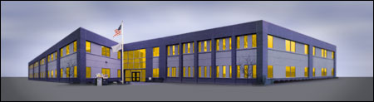
From Research to Incubator

