Slide 1
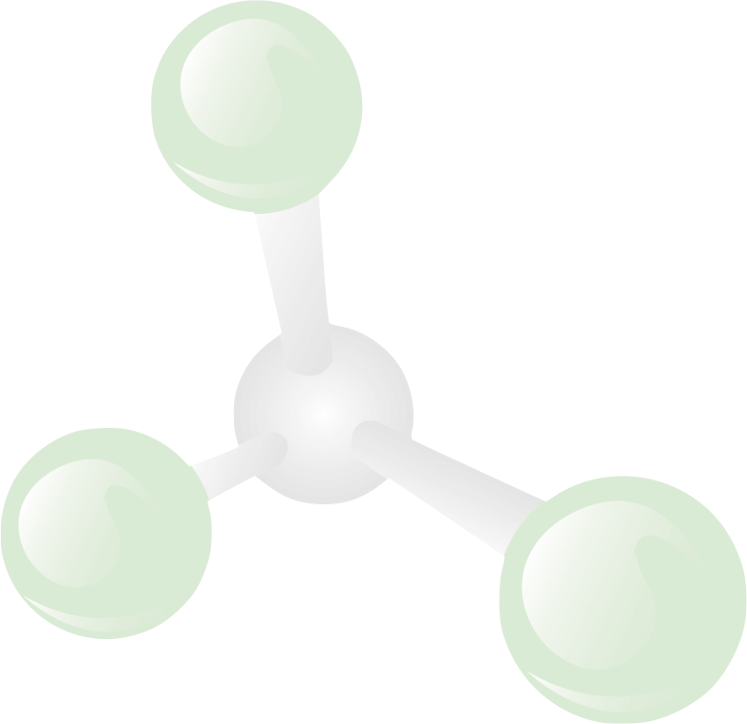


Finding and Evaluating Inventions, Prior Art
How to Find Inventions, How to Evaluate Inventions, Finding Prior Art

Slide 2
Preparing for the New Reality
Fall
Sept. 23
Fundamentals of IP
Oct. 21
Patents and Patenting Process
Nov. 11
Technology Commercialization and UR
Dec. 9
How to Find Inventions, Good Inventions and How to find Prior Art
Spring
Jan. 20
Assessing Market Opportunity of New Tech
Feb. 10
Working with Third Parties
Mar. 17
Risk Assessment for Tech Investments
April 14
Software and Open Source Software
12:00-1:00 Wilson Commons, 2nd Floor Gowen Room Lunch Provided

Slide 3

Finding Inventions
I want to invent!
Where do I look?

Slide 4
Inventions are often a result of your regular work.
Regular Work
Every time a problem is solved there is a potential for an invention
Differences in what you have produced compared to prior versions can be inventions
Inventions that are in the end product or service are often the most valuable

Slide 5
Alternate solutions to problems overcome are also good sources of inventions.
Alternatives that arise as problems are overcome
Filing on alternatives can block competitors
Advances in technology can make alternatives more viable in the future
Reductions in cost can make alternatives more viable in the future.
Alternatives that were not pursued for business, market or technology reasons can also be good inventions.

Slide 6
Improvements, additional features, functions, etc. are all good places to look for inventions.
Additions to your work are good areas to look for inventions
Added Features
Additional Functions
Improved Performance
Features, functions and improvements that were not pursued for business, market or technology reasons can also be good inventions.

Slide 7
Taking a technology or solution and placing or adapting it to a new environment can create an invention.
New Environments
Placing or adapting an existing technology in a new environment can create an invention
New uses for existing technology can be inventions.

Slide 8
Speculative
Inventions
Inventions not related to your work.
Working in technologies outside of your normal responsibilities
Brainstorming sessions
Future-casting

Slide 9
Value of Inventions
While valuable inventions can come out of any category….
The more the invention is related to your work, the more likely it is to be valuable!

Slide 10

What makes a good invention?
Newness (Novelty)
Advantages over the prior art
Feasibility
Applicability
Alternatives
Detectabililty
Business Relevance

Slide 11

Newness
What Makes a
Good Invention?
Is the invention a:
revolutionary concept, or
an incremental advance, or
somewhere in between?
Is the invention already known?
A new use for a previous invention?

Slide 12

Advantages
What Makes a
Good Invention?
How well does the invention work?
What benefits or advantages does it provide over current methods?
Speed
Cost (UMC)
Reliability
Avoiding competing intellectual property
For design inventions, how well does the appearance convey any intended message?

Slide 13
Feasibility
What Makes a
Good Invention?
How difficult or expensive is it to implement?
Is it more costly?
Would it require a change in manufacturing process, qualification, customer acceptance?
What else has to occur or to be done?
Is the invention dependent on technological advancement?
Is use dependent on licensing other IP?
Does it require government approval?

Slide 14
Applicability
What Makes a
Good Invention?
How broadly is it applicable?
One field of use or many?
Is it a solution to a specific problem or can be use more broadly?
How broadly can it be licensed?
One product?
One company?
One industry?
One country?

Slide 15

Alternatives
What Makes a
Good Invention?
Are there other methods of accomplishing a similar result?
How easy is it to work around by alternative means?
How difficult, costly, timely to use an alternative?
Can we patent the alternatives?
Can we block design arounds?

Slide 16

Detectability
What Makes a
Good Invention?
How difficult would it be to detect use by others?
Can I tell if someone is infringing?
Does it require access to:
manufacturing site;
confidential materials;
source code?

Slide 17

Business Relevance
What Makes a
Good Invention?
What is the potential for commercialization?
Starting a company?
Licensing to established businesses?
Potential revenue?
Relevance to an interested business
What are their product plans?
How does the invention fit in a company’s R&D strategy?
What licensing or new business potential does it have?

Slide 18
Searching State of the Art Technology with Patents
How to use the international patent systems to find prior art and the state of the art for particular technologies

Slide 19
Patents as a resource of technology
The patent offices around the world are a vast resource of technology.
With online access, it is much easier to access the databases of the patent offices (and surrogate sources such as Google Patents) to research:
-The state of the art for a particular technology
-Prior art for a particular technology
-Research solutions that other inventors have used for problems.

Slide 20
Too Many Answers
The difficulty is now however, not finding the answers, but finding too many answers!
Data is the garbage of the twenty first century.
How can you find a manageable answer?

Slide 21
Finding the State of the Art for a Technology
The technology search process to obtain manageable results:
Key word searching to find patents in broad categories
Filter results to find several patents related to the search request
Analyze Patent Classification Numbers of patents
Select relevant Patent Classification Numbers
Search by Patent Classification Number(s)
Narrow within a classification if necessary
Employ alternate search criteria if necessary
        By Company
        By Inventor
        Patents cited in or cited by

Slide 22

Starting a Search
Key word searching to find patents in broad categories
  Google is a good place to start for key word searching
  Over inclusive – Typically brings back far too many possible patents.
  Under inclusive – The same item can be referred to with different words (Paper vs. Sheet Material vs. Printing Medium, etc.)
Filter results to find several patents related to the search request.
  Quickly scan results to find a couple of patents that are in the area of your search.

Slide 23

Patent Classification
System
3. Analyze Patent Classification Numbers of patents
The patent classification systems (there is a US and an International version) are a highly detailed breakdown of every area of technology.
4. Select relevant Patent Classification Numbers
If you use Google Patents, it will provide links to the US PTO description of each classification.
Useful source:
http://www.uspto.gov/web/patents/classification/

Slide 24
Patent Classification
Example
VEHICLE CONTROL, GUIDANCE, OPERATION, OR INDICATION
2 .Remote control system
3 .Aeronautical vehicle
4 ..Altitude or attitude control or indication
5 ...Rate of change (e.g., ascent, decent)
6 ....Angle of attack
7 ...Air speed or velocity measurement
8 ...Threshold or reference value
9 ....Warning signal or alarm
10 ...Compensation for environmental conditions
11 ...Auto pilot
12 ....Inner/outer loop
13 ...Spacecraft or satellite
14 ..Flight condition indicating

Slide 25

Using the Patent
Classification System (cont.)
5. Search by Patent Classification Number(s)
The EPO and USPTO sites allow searches by classification number.
If you used Google Patents to get to the US classification or went there directly, there is a link on the site for all patents in the classification (very helpful!)
6. Narrow within a classification if necessary
Further search within results (possible on EPO) or at least look at titles if have USPTO site classification listing.

Slide 26

Alternative Search
Strategies
Employ alternate search criteria if necessary
        By Company – For a company in a narrow field, searching for the Assignee will give good results
        By Inventor – Most inventors work in a narrow field
        Search patents cited in the patents that are relevant. (back in time)
        Search patents that cited the patents that are relevant. (forward in time)
        Good searching is often a combination of strategies!

Slide 27
Example:
1. Search Google Patents: One Wheeled Vehicle
38,000 results!
2. Patent 3,876,025 Looked interesting
3. Reviewed Patent – Classifications
180/21 – Vehicle, special wheel base
180/7.4 – Special drive device – Impeller
280/206 – Occupant Propelled – Occupant within Wheel
4. Searched 280/206
102 Results! (Much, much better)
5. Found patent 4,729,446 on a rolling sphere which is what I was interested in, plus a number of closely related patents to understand the art.

Slide 28

Sources
Google Patents - www.google.com/patents/
US Patent and Trademark Office - http://www.uspto.gov/
European Patent Office - http://www.epo.org/

Slide 29

Attend all the Seminars!
NEXT!
Fall
Sept. 23
Fundamentals of IP
Oct. 21
Patents and the Patenting Process
Nov. 11
Technology Commercialization & UR
Dec. 9
How to Find Inventions, Good Inventions and How to find Prior Art
Spring
Jan. 20
Assessing Market Opportunity of New Tech
Feb. 10
Working with Third Parties
Mar. 17
Risk Assessment for Tech Investments
April 14
Software and Open Source Software
a
12:00-1:00 Wilson Commons, 2nd Floor Gowen Room Lunch Provided

