Slide 1
Assessing the Commercial Potential of New Technologies
Patrick Emmerling, PhD, MBA
Licensing Manager
01/20/2015

Slide 2
Attend all the Seminars!
NEXT!
Fall
Sept. 23
Fundamentals of IP
Oct. 21
Patents and the Patenting Process
Nov. 11
Technology Commercialization & UR
Dec. 9
How to Find Inventions, Good Inventions and How to find Prior Art
Spring
Jan. 20
Assessing Market Opportunity of New Tech
Feb. 10
Working with Third Parties
Mar. 17
Risk Assessment for Tech Investments
April 14
Software and Open Source Software
a
12:00-1:00 Wilson Commons, 2nd Floor Gowen Room Lunch Provided

Slide 3
Objectives:
Overview of the Process of Assessing Commercial Value of Nascent Technologies
Apply to current UR Technology

Slide 4
UR Ventures Mission:
Develop UR Innovations into valuable products and services to make the world ever better.

Slide 5
UR Ventures Mission:
Develop UR Innovations into valuable products and services to make the world ever better.

Slide 6
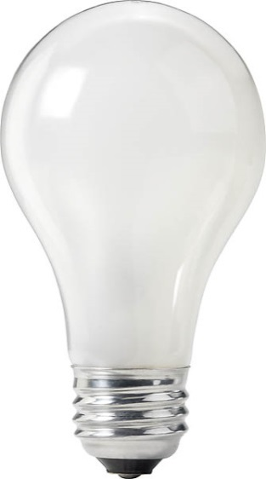
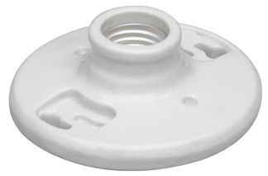
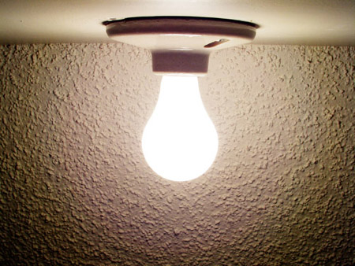
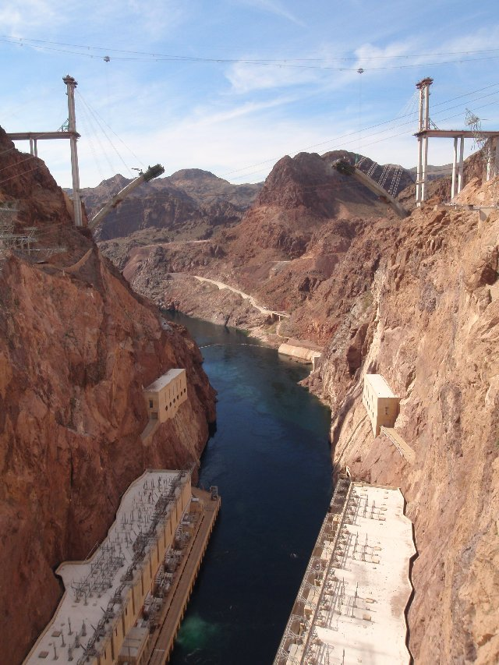
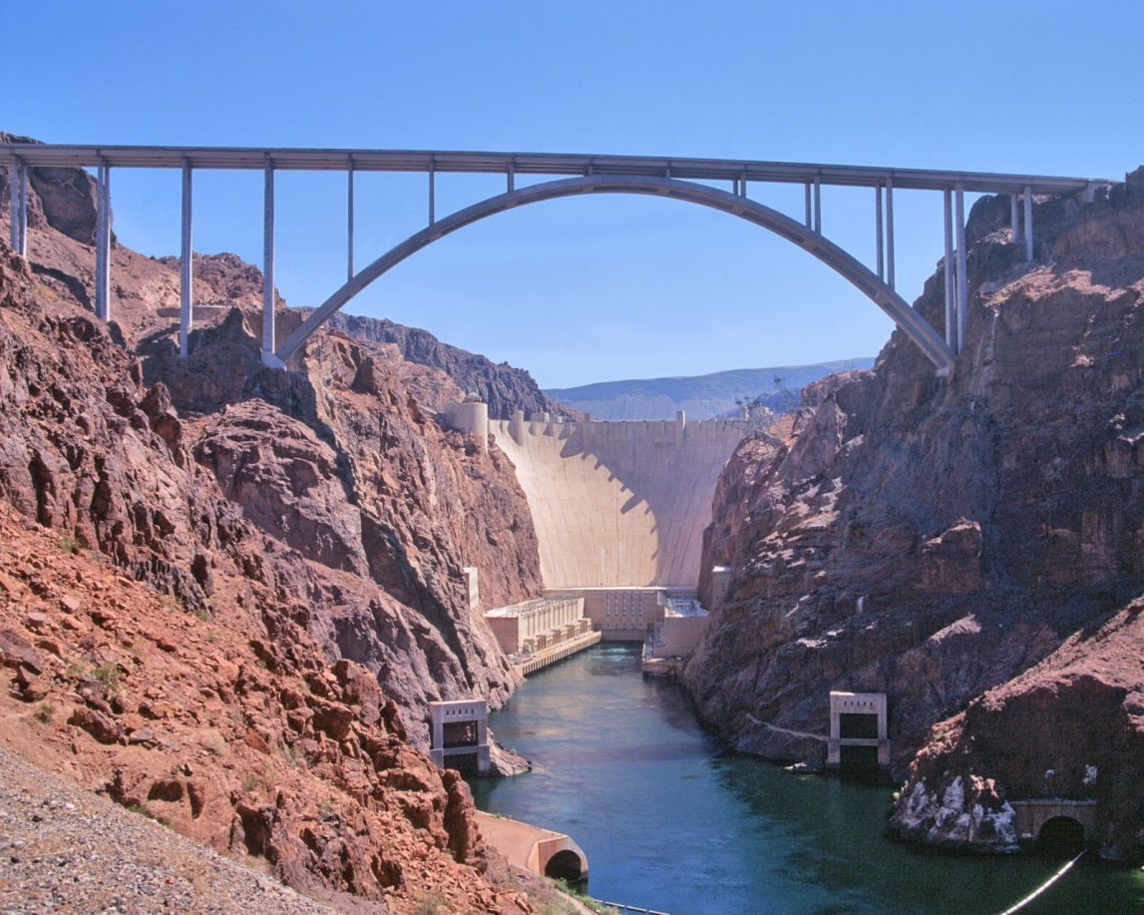
?
Unmet Market Pain
Viable commercial Product
Interesting New Technology

Slide 7
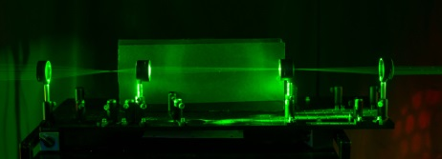
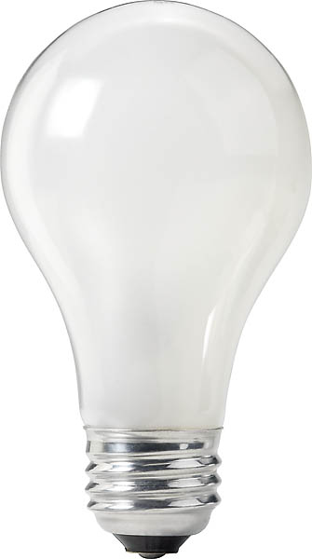
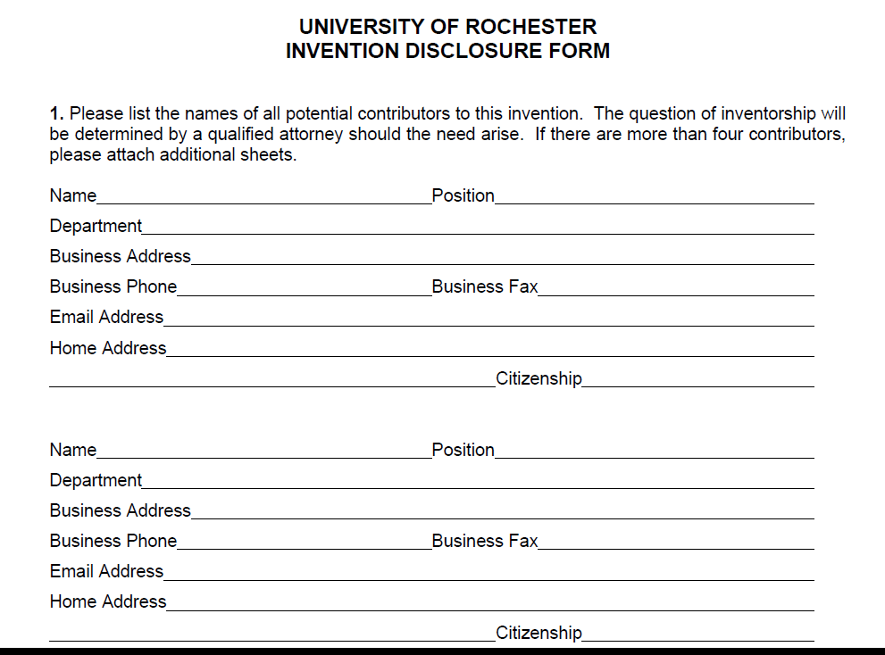
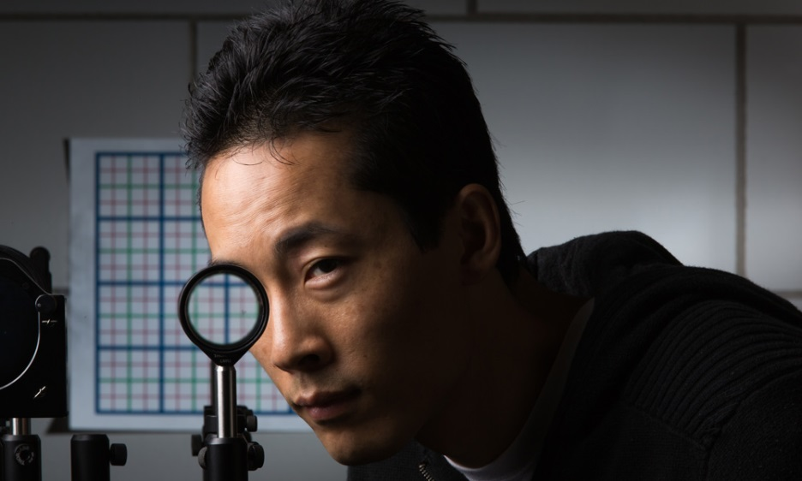
The Process

Slide 8
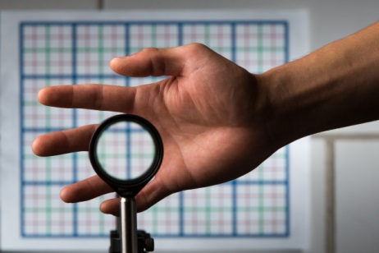
Perfect Paraxial Cloak Design and Device

Slide 9
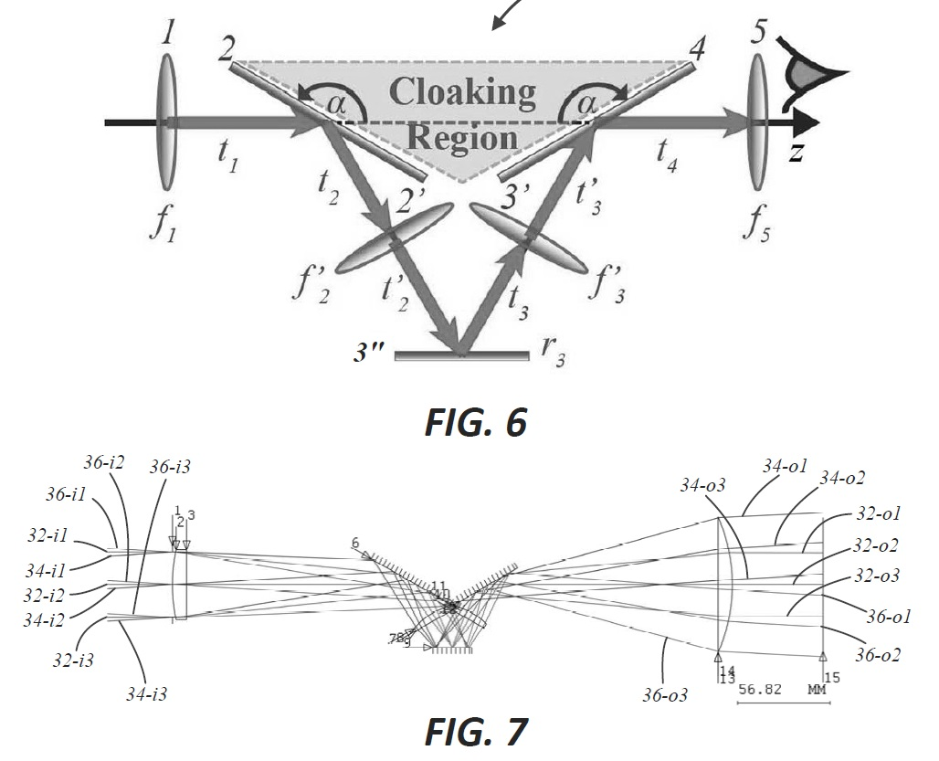
Perfect Paraxial Cloak Design and Device
The Invention
Provide a cloaking volume
an object can be hidden from view
relative to a continuous range of viewing directions.
Constructed with readily available off-the-shelf isotropic optical components.

Slide 10
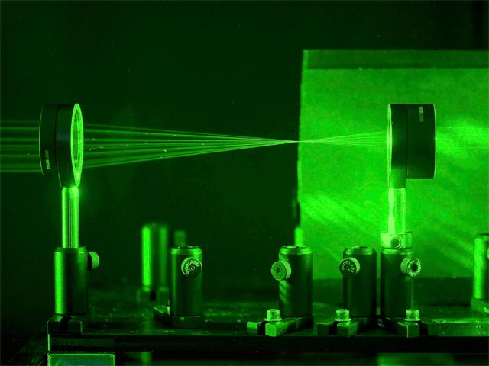
Upfront Due Diligence
Technical
Status
Competition
Funding
Market
Pain / applications
Competition
Size
Development
Protection of IP

Slide 11
Technical Questions
Stage of Development?
Theory
Proof of Concept
Prototype
Technical problems still need to be addressed?
Minor or potentially major issues?
Time frame?

Slide 12
Technical Questions
What is the current bleeding edge of the technology?
Who else is researching in this arena?
Same / similar approach?
What sets this apart from the rest of the pack?

Slide 13
Technical Questions
Current research funding?
Who has funded this research to date?
Any Strings Attached?
Future funding needs?
Already lined up or still unclear?
How much needed?

Slide 14
Interesting New Technology
Unmet Market Pain

Slide 15
What are some real world applications?

Slide 16
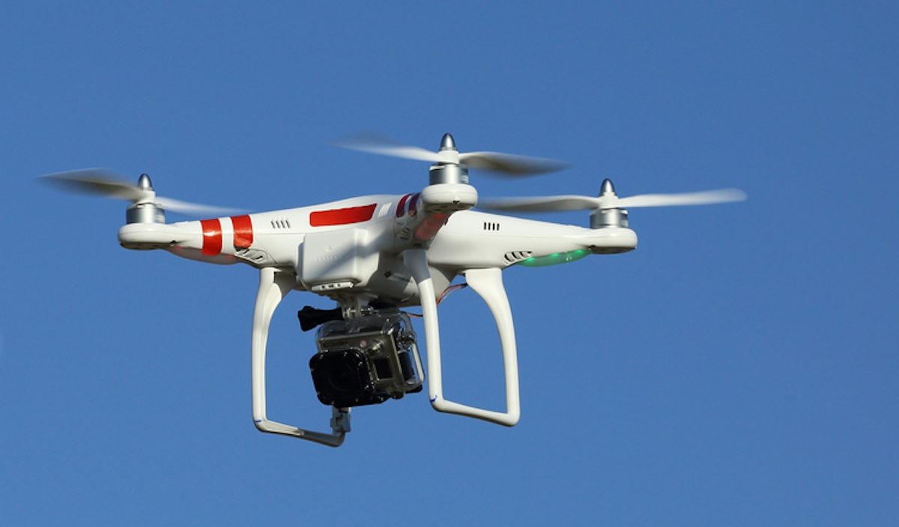

Slide 17
OK… what are the current alternatives?
Who else is trying to solve this problem?

Slide 18
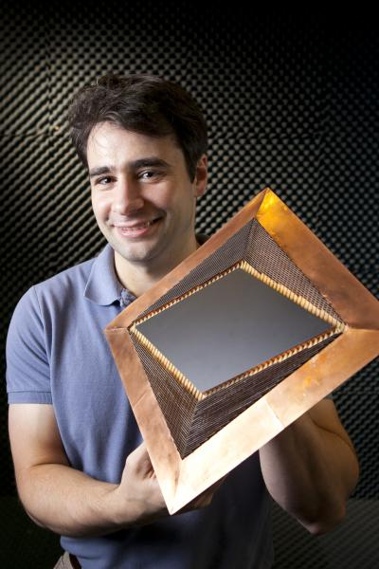
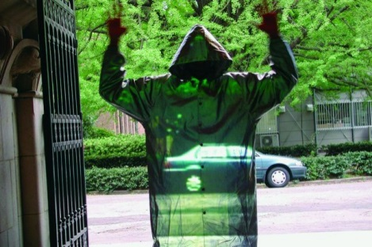
Alternative Cloaking Technologies
Digital Camouflage
MARPAT
Metamaterials
Duke, MIT, Berkley, etc.
Active (or Adaptive) Camouflage
University of Tokyo
Retro-reflective Projection

Slide 19
What sets this technology apart from the crowd of competing technologies?

Slide 20
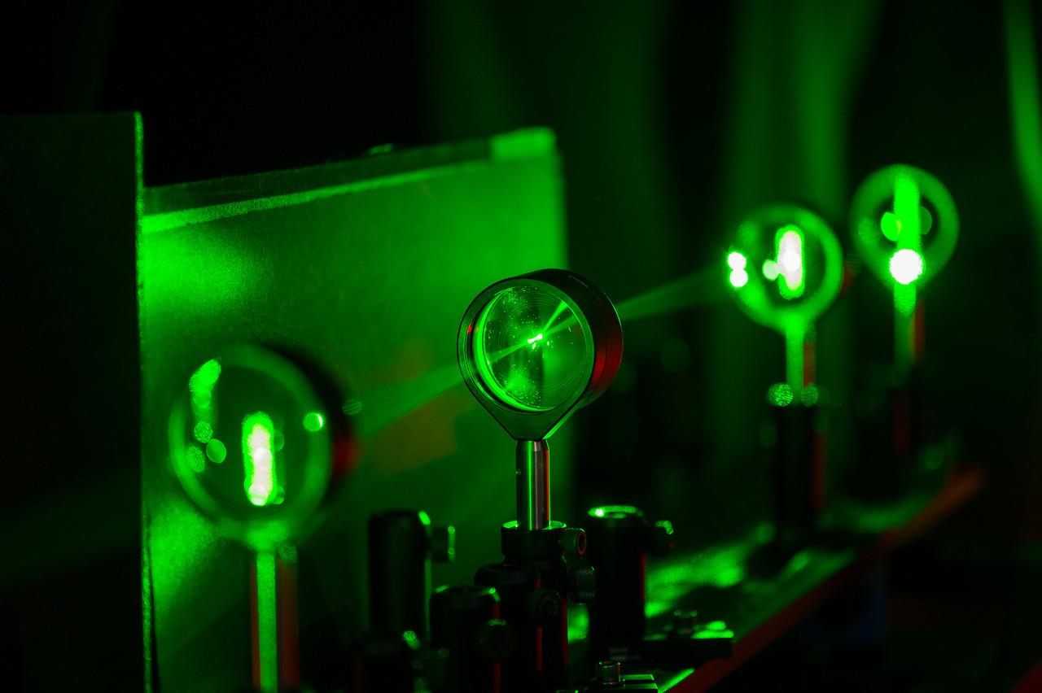
Perfect Paraxial Cloak Design and Device
Advantages
Cloaking volume with continuous range of directions in three dimensions.
Scalable
Uses inexpensive, readily available materials in a novel configuration.
Overcomes some of the limitations of previous devices such as background discontinuity

Slide 21
Are there any other potential applications?

Slide 22
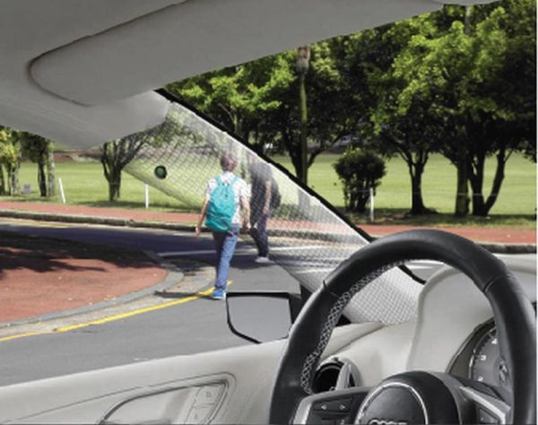

Slide 23
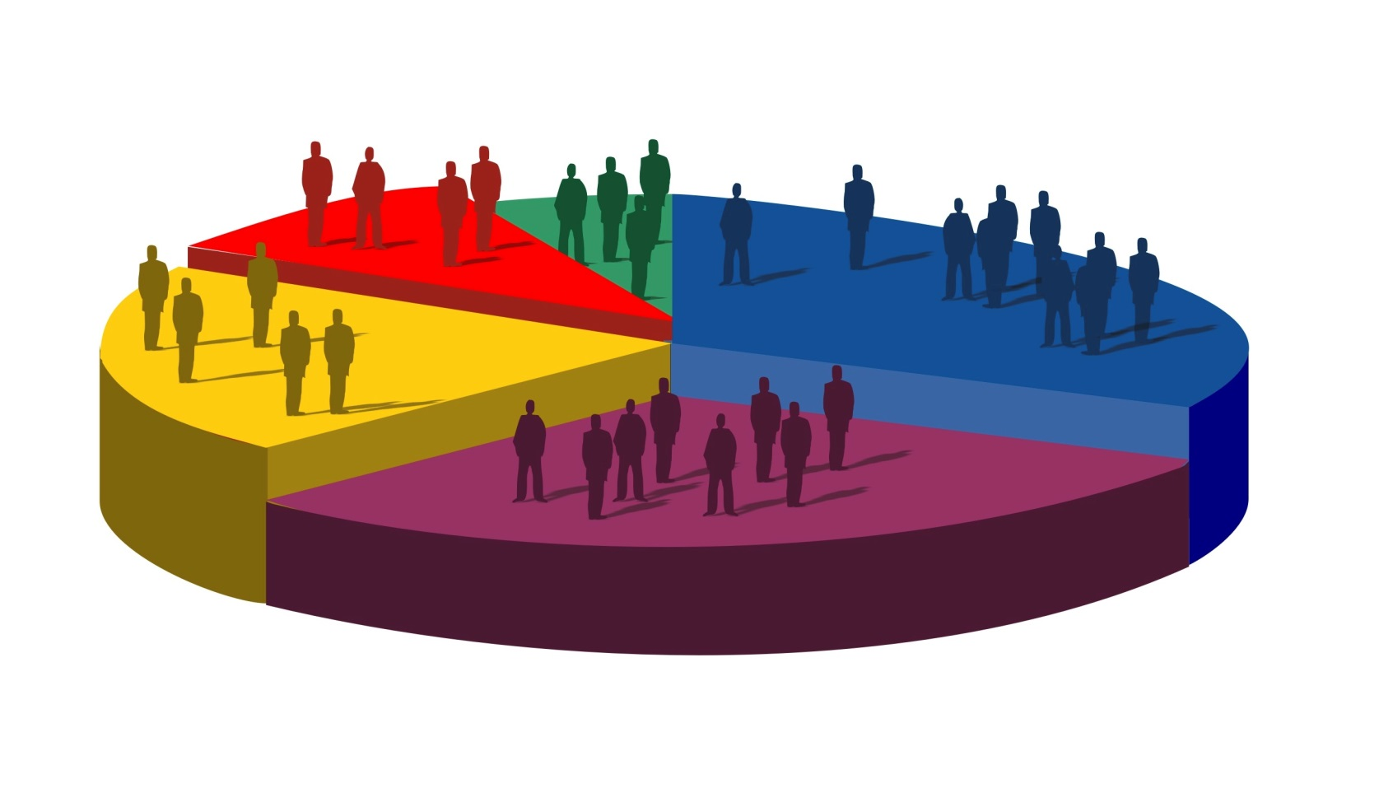
Interesting… is there a market need?

Slide 24
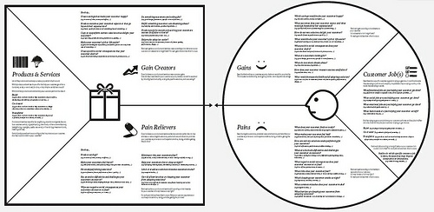
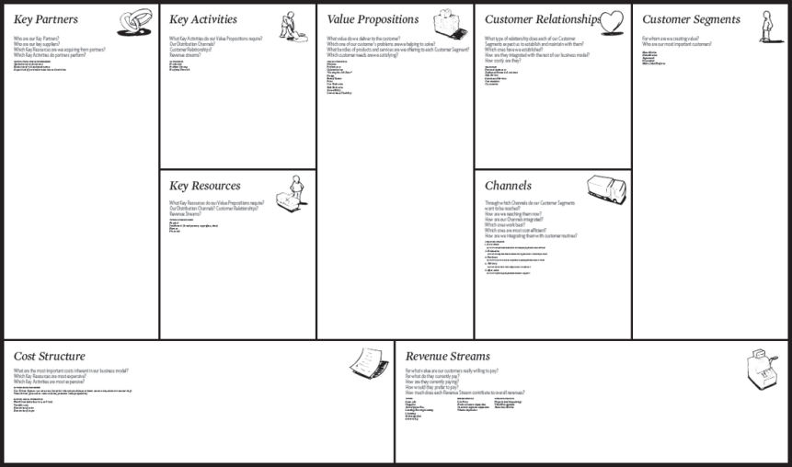
Research

Slide 25
A Crucial Exercise that is Germaine to Technologies: Test the Market Hypothesis and Value Proposition
Create non-confidential Value Proposition
and Market Hypothesis
Identify and Contact Outside Expert
Ask about the identified market pain
Is the pain / need real?
If, no… what is the real pain?
What is the current Gold Standard?
Propose and discuss Value Proposition
Re-evaluate Value Proposition and Market Hypothesis
Refine as needed
REPEAT

Slide 26
Unmet Market Pain
Viable commercial Product
Interesting New Technology

Slide 27
Development
What needs to be done to take technology from current state to ______________?
Proof of Concept
Prototype
Full product
How much will that cost?
Where will that work be done?
By Whom?

Slide 28
What is the best way to protect the intellectual property?

Slide 29
Intellectual Property
Copyrights
Trademarks
Trade Secrets/Know How
Patents

Slide 30
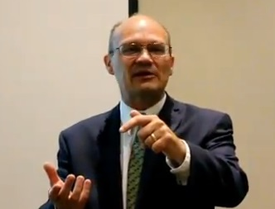
Check out Reid’s IP presentations on the UR Ventures YouTube page!

Slide 31
Decision Point!
Technical
Market
Development
Protection of IP

Slide 32
Report findings and conclusions to the inventor(s)

Slide 33
Questions?

Slide 34
Attend all the Seminars!
NEXT!
Fall
Sept. 23
Fundamentals of IP
Oct. 21
Patents and the Patenting Process
Nov. 11
Technology Commercialization & UR
Dec. 9
How to Find Inventions, Good Inventions and How to find Prior Art
Spring
Jan. 20
Assessing Market Opportunity of New Tech
Feb. 10
Working with Third Parties
Mar. 17
Risk Assessment for Tech Investments
April 14
Software and Open Source Software
a
12:00-1:00 Wilson Commons, 2nd Floor Gowen Room Lunch Provided

