Slide 1
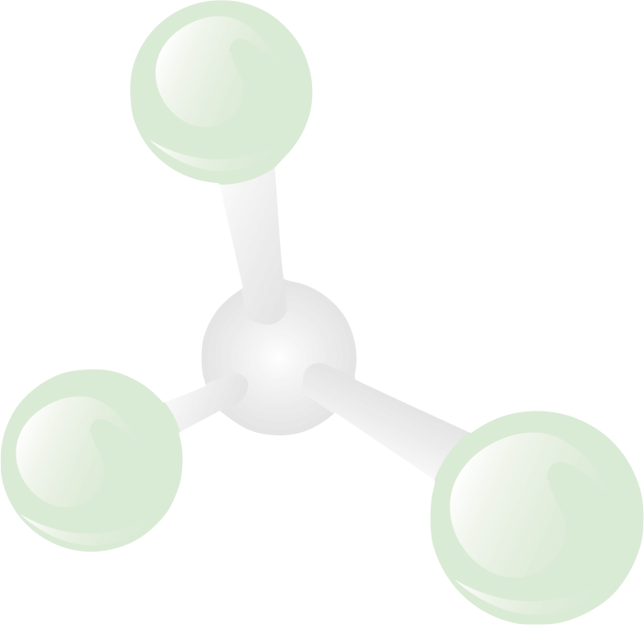
IP and Commercialization Seminar Series
Working with Third Parties:
Agreements and Issues

Slide 2
Preparing for the New Reality
Fall
Sept. 23
Fundamentals of IP
Oct. 21
Patents and Patenting Process
Nov. 11
Technology Commercialization and UR
Dec. 9
How to Find Inventions, Good Inventions and How to find Prior Art
Spring
Jan. 20
Assessing Market Opportunity of New Tech
Feb. 10
Working with Third Parties
Mar. 17
Risk Assessment for Tech Investments
April 14
Software and Open Source Software
12:00-1:00 Wilson Commons, 2nd Floor Gowen Room Lunch Provided

Slide 3
Overview
Commitment
Liability
Performance Requirements
IP Terms
Confidentiality
Other Related Issues

Slide 4
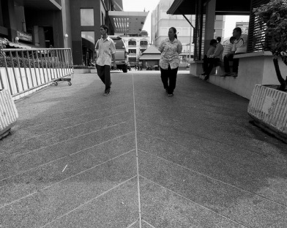
Who or What is a 3rd Party?
A “third party” is any separate legal entity.
What is a legal entity?
You, me, UR are all separate legal entities.
However, (in general) as staff, faculty and graduate students of UR, we all have a contractual relationship with the University. (But not undergraduates!)
For our purposes today, 3rd party means contractors, companies, government entities, other universities, etc.

Slide 5
Commitment
Commitment is when you have an enforceable agreement. (Offer + Acceptance = Agreement)
Commitment triggers obligations and liabilities
Commitment does NOT require a written agreement.
How NOT to contract with third parties:
“We will figure that out later…”
“Legal review will slow us down…”
“No one will know…”
Reliance and estoppel (“if you build it, we will come”)

Slide 6
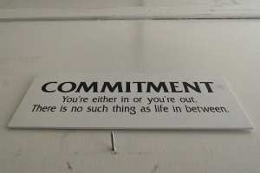
Commitment Best Practices
Avoid inadvertent agreements
All negotiations are “subject to final agreement”
Have a written agreement
Commitments only from authorized persons
Appropriate review of all agreements (General Counsel’s office, ORPA, etc.
Only certain people can bind the University
Have an out – Termination
Things change, have the ability to terminate the agreement.

Slide 7
Liability (Risk)
Indemnification
A guarantee in the event of certain occurrences.
Limitations and Disclaimers of Liability
Exclusions of certain kinds and amounts of liability.
Warranty
A guarantee to repair or replace in the event of certain failures

Slide 8
INDEMNIFICATION
[THIRD PARTY] agrees to defend, indemnify, and hold buyer harmless from and against any and all costs, liability, loss, damage, suit, action or legal proceeding of any kind arising out of or in connection with [THIRD PARTY]’s performance (including without limitation personal injury, property damage, environmental damage, and infringement or misappropriation of intellectual property rights), together with reasonable attorneys’ fees incurred in connection with any of the foregoing. [THIRD PARTY] shall, at Buyer’s option and [THIRD PARTY]’s expense, intervene in or defend any such proceedings upon notice from Buyer.
And note:
EXCEPT FOR THE PARTIES’ OBLIGATIONS OF INDEMNIFICATION, WHICH SHALL BE GOVERNED BY THEIR TERMS, NEITHER PARTY SHALL BE LIABLE FOR (A) INDIRECT, INCIDENTAL, CONSEQUENTIAL, SPECIAL, OR PUNITIVE DAMAGES OR (B) DIRECT DAMAGES IN EXCESS OF [$X] …

Slide 9
Limitations and disclaimers of liability
Come in lots of flavors:
Disclaimer or cap
Indirect, incidental, consequential, special, punitive damages
Direct damages
Can be tailored:
Third party exposure versus internal exposure
What kind of performance obligations does each party have?
Redistributable versus internal use
Interplay with indemnification
IP concerns
Retrofit/field upgrade obligations

Slide 10
Warranty
FUNDAMENTAL: title, free of liens/security interests, non-infringement, meets specs/functionality/samples/drawings/performance standards, fit for intended use
PRODUCTION: consists of new parts
SERVICES: performance consistent with industry standards
LICENSING/RESELLING: right to engage in transaction
*Focus should be on meaningful warranties and associated remedies

Slide 11
Liability Best Practices
A company provides indemnities and warranties to customers or suppliers to encourage an agreement.
Can assess and reduce liabilities
Profit covers the potential liabilities.
The University does not provide or provides very limited indemnities and warranties.
Not in a position to measure liabilities
No profit margin to cover potential liabilities.

Slide 12
Performance Requirements
WHAT IS THE DELIVERABLE?
Specifications, performance/ functionality requirements, drawings/ prints
WHEN IS THE DELIVERABLE DUE?
Phase gates, timelines, delivery dates
WHAT DOES THE DELIVERABLE COST?
Cost caps; beware of estimates/forecasts/ reconciliation's of actual costs
WHAT ARE THE ACCEPTANCE CRITERIA?
What constitutes acceptance?
Is payment contingent upon acceptance?

Slide 13
Performance Requirements Best Practices
If you want the other party to do something, it must be in the agreement!
(make sure everything is in the agreement)
If the agreement says you are to do something, you must do it!
(be sure you can do everything you have promised)

Slide 14
Intellectual Property
In absence of a written agreement, IP rights will remain with the creator. (There is a small exception for works for hire in copyright)
This applies even if you have paid to create the IP.
In the absence of an agreement to cooperate, for joint inventions both parties can license independently.

Slide 15
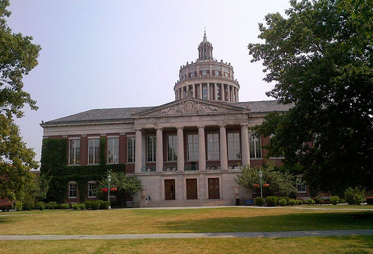
UR and IP
As employees of UR (staff, faculty, graduate students, etc.) we have assigned our IP to the University.
For tax reasons, UR must receive “fair value” for all IP licensed to a third party.
IP Royalties support the University as a whole, departments (and inventors too!).

Slide 16
Have an IP plan
With an IP plan you can:
Determine IP ownership
Coordinate patent prosecution
Allocate IP procurement costs
Coordinate licensing
Cross-licence as needed
Publish!
Collect a royalty!
Without an IP plan you may end up committed to a supplier and at risk of:
Losing IP rights
Infringement
Competing with coinventors for licencees
Covering all the IP costs
Not receiving fair value
Notes:
4

Slide 17
Factors that affect the IP plan:
Identity of the third party
Competitive landscape
University requirements
Use internally or by others?
Who hosts or supports?
Criticality of IP?
Customization versus off-the-shelf
Continuity of supply/support
University policy
Funding Sources (Govt. for example)
Availability of funds
Notes:
5

Slide 18
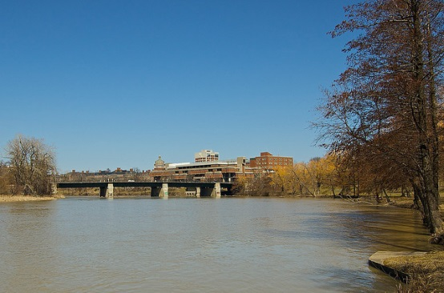
“Fair Value for IP”
Can’t just give the IP away from a project.
Typically the value of the IP can’t be determined before it’s created (in other words, at the time of agreement).
The typical solution is an option for IP rights, the value determined at the later time.

Slide 19
Additional IP Thoughts
That which is not explicitly licensed is retained.
IP can be created without an agreement, but at least work on getting one in place later!
Let URVentures know when you have created IP with 3rd parties, it is much harder to fix later (Not everyone is ethical, we have had cases where companies filed for IP without letting us know)

Slide 20
IP Best Practices
Always have a written agreement in place before the IP is created.
Receive “fair value” for university IP licensed out.
License in sufficient rights to conduct the work expected.
Protect your right to publish.

Slide 21
Licensing: When you can’t own but can use…
Licensing concerns:
Off-the-shelf product or customized to your specifications?
For internal or external use?
Who funds development/modification/enhancement?
Useful to your competitors?
What rights do you need --
Research or Commercial?
Perpetual or terminable license?
Sublicense?
Make/outsource making of derivative works?
Perform/outsource maintenance, enhancements?
Royalty-free? Worldwide?
Notes:
13

Slide 22
Confidentiality
An agreement for one party to maintain the confidentiality of another party’s trade secrets.
They can be called confidentiality agreements (CDA’s), non-disclosure agreements (NDA’s) and other similar names. They are the same.

Slide 23
Key Terms
Confidential Material – What will be considered confidential material, it will be limited to a particular subject.
Term of Confidentiality – How long will the material be maintained in confidence?
Standard of Confidentiality – To what lengths a party must go to maintain the confidence of the designated materials.
What can be done with the confidential material.

Slide 24
Benefits of CDA’s
Open discussions
Maintains ability to file for patents – not a public disclosure
Maintain the value of Trade Secrets

Slide 25
Risks of CDA’s
Confidentiality is counter to an open academic environment.
Confidentiality can interfere with publication
Potential contamination by being exposed to confidential materials.
No further work in that field
Liability for inadvertent disclosure of confidential material.

Slide 26
Confidentiality Cont.
One Way- One party agrees to keep the other party’s information confidential
Two Way- Both parties agree to keep the other party’s information confidential
Stand Alone – Independent agreements
Embedded – In a larger agreement

Slide 27
CDA best practices
Do not sign a CDA without proper authorization.
Maintain and follow gatekeeping procedures for disclosure and receipt of confidential information
Avoid any appearance of cross-contamination
Be aware of hidden CDA’s, for example on visitor passes
Do not receive third party information in confidence
Avoid conduct which may mislead a third party concerning your intent on confidentiality
Notes:
23

Slide 28
Summary
Commitment
Liability
Performance Requirements
IP Terms
Confidentiality
Other Related Issues

Slide 29
Attend all the Seminars!
NEXT!
Fall
Sept. 23
Fundamentals of IP
Oct. 21
Patents and the Patenting Process
Nov. 11
Technology Commercialization & UR
Dec. 9
How to Find Inventions, Good Inventions and How to find Prior Art
Spring
Jan. 20
Assessing Market Opportunity of New Tech
Feb. 10
Working with Third Parties
Mar. 17
Risk Assessment for Tech Investments
April 14
Software and Open Source Software
a
12:00-1:00 Wilson Commons, 2nd Floor Gowen Room Lunch Provided

