Slide 1
Business Expense and Travel Reimbursement Policy and Procedures
Notes:
Welcome to the Business Expense and Travel Reimbursement training. Also referred to as the BETR policy.

Slide 2
Topics that will be covered
Buying & Paying Guide
Cashier/Bursar reimbursements
Roles
Expense report submission deadline
Documentation details/requirements
Missing receipt form
Fly America Act
International travel
Review of new F3 and F34
Business Purpose
Per Diem
Mileage Log form
Slide: 2:
Notes:
During this session we will
Highlight important information that has not changed
Review key updates to the new policy and
Review the new forms
Those submitting expense reports, preparers and approvers must review the entire “Business Expense and Travel Reimbursement” policy to familiarize themselves with all of the content.
Your department may also create stricter rules and procedures to meet their specific needs.
Each Department is responsible for monitoring their own rules and procedures.

Slide 3
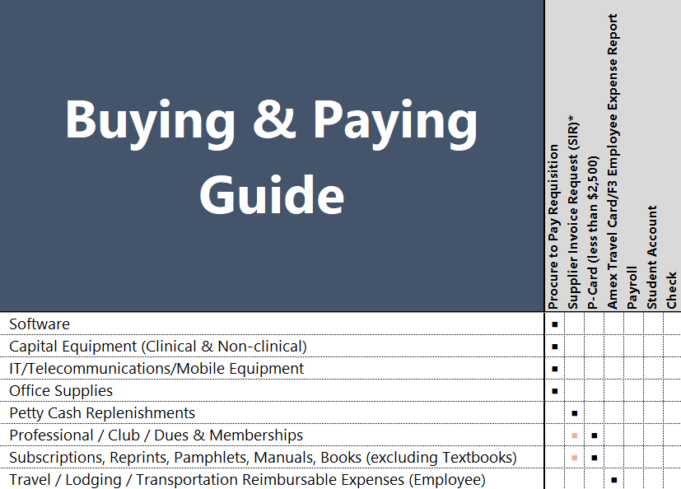
Buying & Paying Guide
Preferred payment method
Conference/Registration fees | PCard, or F4 (Supplier Invoice Request)
Subscriptions, Membership fees/dues, Conference registrations | Pcard
Computers / Equipment | UR Tech Store, otherwise Purchase Order
Airfare | F2 Advanced Airfare
Office Supplies | Preferred supplies is Staples via Requisition/Purchase Order
Slide: 3
Notes:
The University , employee, or student should not profit from reimbursements.
The University offers several purchasing methods so that you do not have to use personal funds for business expenses.
The Purchasing department created a buying and paying guide as a reference for the primary method of payment.
Memberships, subscriptions, and conference registration fees that are less than $2500 should be paid for by a Pcard.
Airfare should be reserved by submitting a F2 advanced airfare form to one of the University's preferred travel agencies (Deprez or Town and Country)
Computers and equipment should be purchased through the UR Tech Store or Purchase order.
Under the new policy, If capital equipment is purchased using personal funds Sales tax IS NOT reimbursable.

Slide 4
Cashier/Bursar Reimbursements
What’s changed
EMPLOYEES
Employees can no longer receive reimbursement from the Cashier.
Approved F3’s (Employee Business Expense Reports) must be submitted to Accounts Payable
at Box 278958 for reimbursement.
STUDENTS
Amounts up to $75 and expenses are no more than 30 days old reimbursement can be received at the Cashiers Office (cash received immediately)
Monday – Friday 9 a.m. to 4 p.m. at the Bursar's Office on the River Campus
Monday – Friday 8:30 a.m. to 3:30 p.m. at the Cashier's Office in the Medical Center
By appointment only at Eastman School of Music
Amounts $75 or more must be submitted to Accounts Payable for reimbursement
Approved F34 (Student Business Expense Reports) must be submitted to Accounts Payable at Box 278958.
Slide: 4
Notes:
As of July 1st Employees can no longer receive immediate reimbursement from the Cashier’s office. All employees must submit approved F3’s to Accounts Payable to be processed.
Student’s can still go to the Cashier’s office for immediate reimbursement if the approved F34 amount is less than $75 and the purchase date of the expense is less than 30 days old.
When the Students expense is $75 or more the approved F34 must be submitted to Accounts Payable.

Slide 5
Roles
Initiator
Approver
The initiator must:
Ensure the expense has an allowable business purpose.
Is in compliance with appropriate University policies and procedures and Department guidelines.
Submit appropriate documentation in a reasonable period of time.
Individuals authorized to approve business expenditures must:
Attest the expense is valid and directly related to University business.
Request additional documentation/explanation for excessive or unusual expenses.
Ensures business expenses are reasonable
Accounts Payable may review the expenses, the primary responsibility for the appropriateness of expenditures rests with the employee and approver.
Slide: 5
Notes:
The three roles involved in reimbursements are the Initiator, the Approver, and Accounts Payable.
The Initiator or Purchaser is the individual seeking reimbursement. They are responsible to:
Obtain proper documentation for all business expenses purchased
Ensure the expense has an allowable business purpose and
The expense complies with University and department policies and procedures
The Approver must
Ensure the expense is reasonable, valid, and directly related to University business
If an expense appears to be excessive or unusual they must request additional documentation or explanation from the Initiator
Lastly, Accounts Payable reviews expense reports to ensure the business expenses are reasonable, advances are appropriately accounted for, and the expense report is completed with the required information. It is ultimately the responsibility of the initiator and approver to ensure the expense is allowable and appropriate.

Slide 6
Expense Report Submission
What’s changed
F3 (employee) or F34 (student) expense report must be submitted to the Department for review and approval within 60 days of the date of event, return from trip, or date of expenditure if no event or trip involved.
Slide: 6
Notes:
The new policy takes effect on October 1st. You may submit either the old or new F3 and F34 forms from now until September 30th. Beginning October 1st the new form should be submitted. There will be a grace period between October 1st and December 31st. During this period AP will not return old forms that are received. After the first of next year old forms will be returned and should be redone on the new form and resubmitted.
Under the new policy expense reports must be submitted to the department for approval within 60 days of:
Returning from the trip
Date of the event
Purchase date

Slide 7
Documentation Details
Documentation Details: Documentation must include
name of the vendor,
location,
date,
dollar amount of the expense, and
description of the goods
Best practice: Include information needed to clarify or to establish the accuracy or reliability of information contained in your records.
For meals involving people other than the person being reimbursed, a list of attendees or the invitation must accompany the receipt. Where it is impractical to obtain a listing of individual names, include an estimated count for attendance and affiliation(s).
Slide: 7
Notes:
Acceptable documentation must include the vendor name, location, purchase date, purchase amount, and description of the goods purchased. For meal receipts a list of attendees or the invitation must be provided. When the meal is for the person being reimbursed no additional information is required.

Slide 8
Documentation Requirements
Receipt Documentation: Electronic or scanned documentation, including photo image of receipt, is acceptable, provided the image is clear and complete. Employees and departments should take necessary precautions and implement procedures to ensure the same expense is not submitted multiple times.
Receipt Threshold: Detailed receipts must be provided for expenses of $50.00 or greater. For expenses less than $50.00, receipts are not required, the employee is still required to provide:
name of the vendor
location
date
dollar amount of the expense
description of the goods purchased.
Slide: 8
Notes:
Under the new policy electronic, scanned, and photo receipts are acceptable forms of documentation. The receipts must be clear, legible and complete.
Employees and the Department are responsible to ensure that the same expense is not submitted multiple times. For example, when an employee submits a F3 form for their monthly cell phone plan, the initiator and approver must verify that the billing dates on the backup have not been previously submitted.
The receipt threshold under the new policy has been increased to $50. Receipts are longer required for business expenses that are less than $50. The physical receipt is not required but the purchaser is required to provide the details of the purchase on the expense report. The required details are the vendor name, location, date of expense, dollar amount and description of goods purchased.

Slide 9
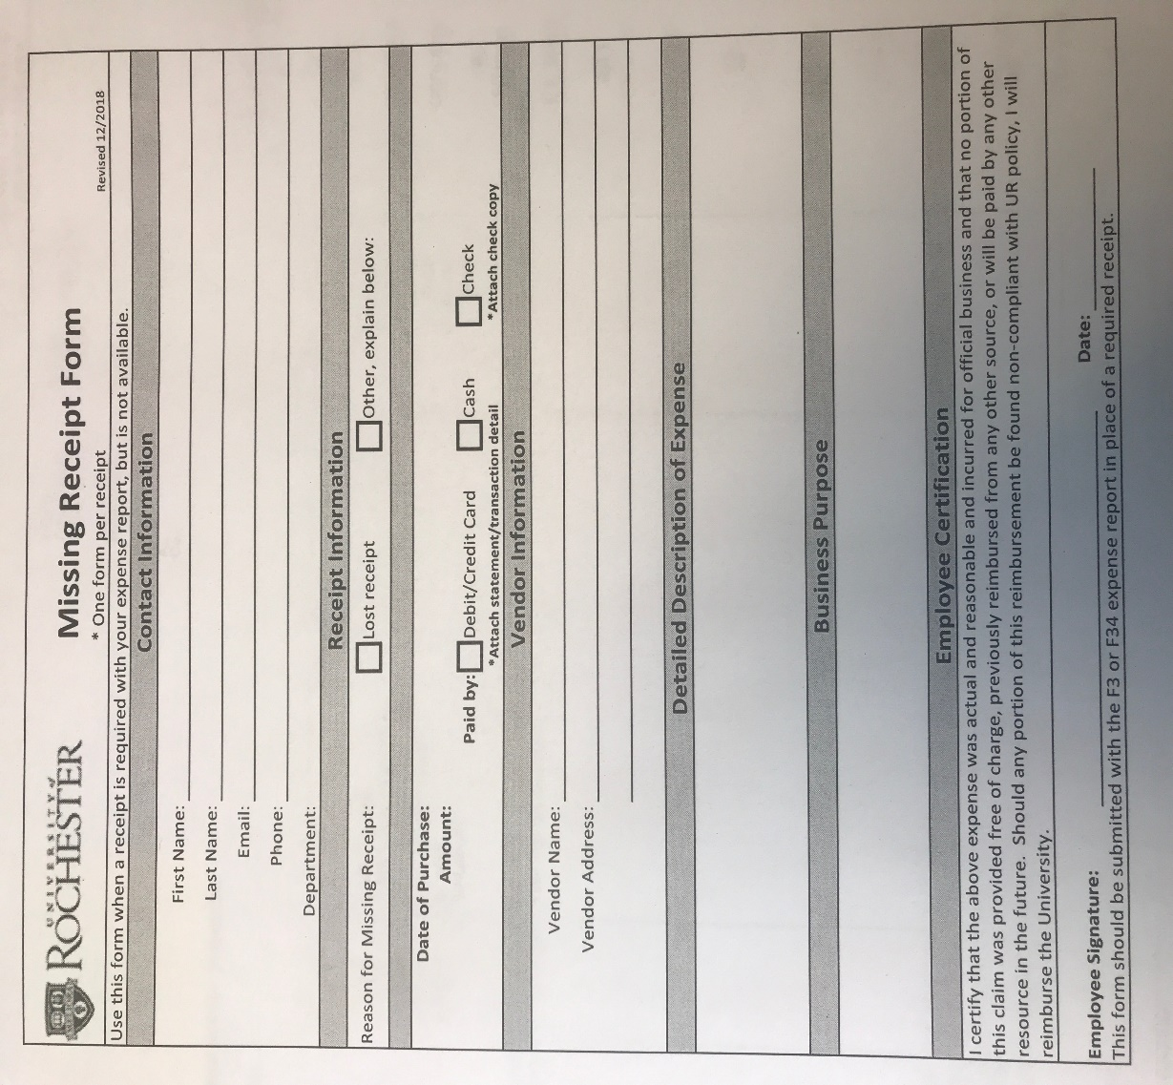
Missing Receipt Form
Missing Receipt: If a receipt is lost, first try to obtain a copy from the vendor. When a detailed receipt is required but not available, a Missing Receipt Form must be completed.
Slide: 9
Notes:
When a receipt is required, expenses that are $50 or more, but not available, a Missing Receipt Form must be completed and submitted with the expense report. The Missing Receipt form must be completed with the required documentation details, vendor name, location, date of expense, dollar amount, and description of goods purchased. Once the form is completed it should be printed and the Employee must sign it.
Bank or credit card statements are not a substitute when a receipt is required. Statements do not provide a description of the goods purchased so a Missing Receipt form must be completed and submitted with the expense report.

Slide 10
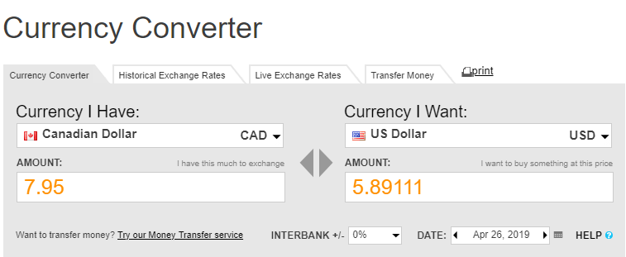
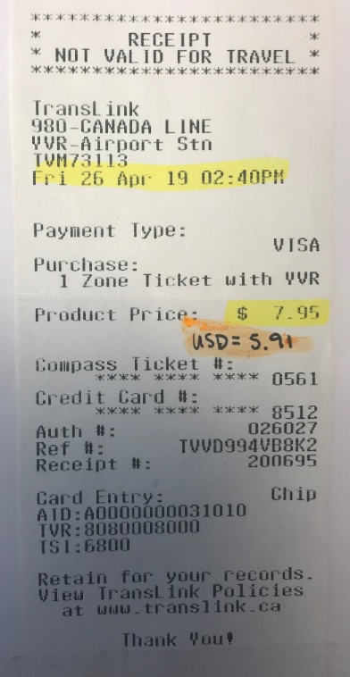
Receipt documentation must be listed in US dollars
If your receipt is in foreign currency, you must convert it to US dollars as shown.
Check your credit card statement
Use an online currency converter
www.oanda.com used for this example
.
Slide: 10
Notes:
The purchase amounts listed on Business Expense reports must be in US dollars. When the dollar amount on a receipt is listed in foreign currency you can find the USD equivalent on your debit or credit card statement. When cash is used, an online currency converter should be used to find the US dollar amount. Currency rates are updated daily, make sure you are selecting the date of purchase to ensure the most accurate conversion. Foreign transaction fees are reimbursable when proper documentation is submitted with the expense report.

Slide 11
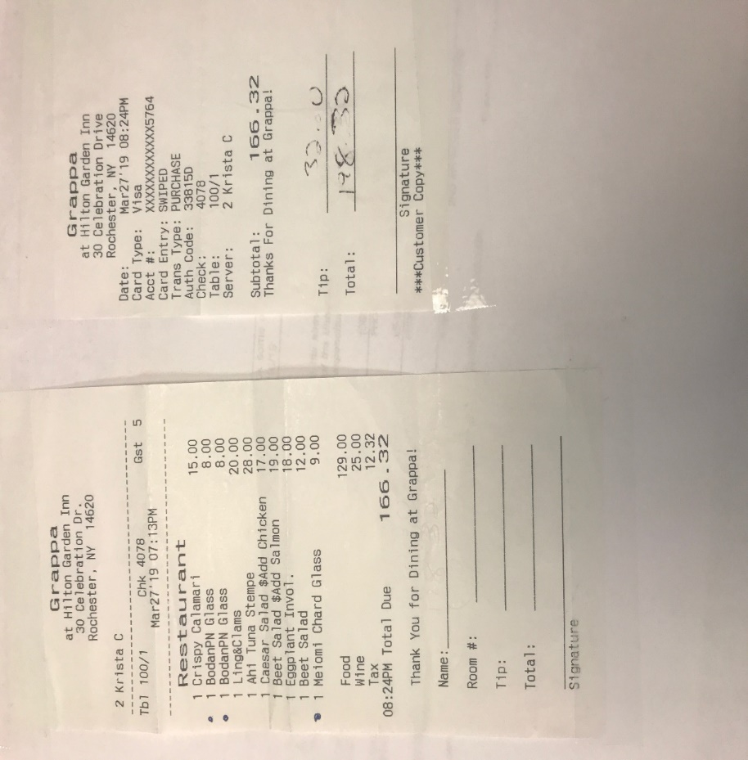
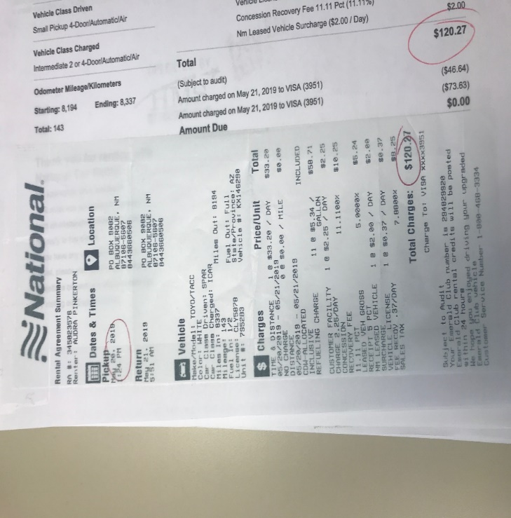
Examples of Proper Documentation
Air: Ticket receipt and refund/exchange notice if applicable. If travel includes personal side trips, a quotation for incremental costs must be provided.
The emailed confirmation from UR’s preferred travel agent meets these requirements.
Meals: An itemized receipt and the credit card transaction receipt
Rental car: Rental agreement and paid receipt.
Slide: 11
Notes:
Now we will review examples of proper documentation. When airfare is purchased online, the traveler receives a confirmation with the itinerary, payment method and amount. This is acceptable backup for airfare.
For rental cars the rental agreement and proof of payment should be submitted. Please note that this information may not be on one document.
Acceptable backup for meals is the itemized receipt AND the credit card transaction. The itemized receipt shows the food and beverages ordered and the credit card transaction receipt shows the amount paid (with tip) and how the payment was made. The purchaser can take a picture of both receipts before leaving the restaurant, photo’s are acceptable documentation under the new policy. When the itemized receipt is not available and required (purchases of $50 or more) a Missing Receipt form should be completed and submitted with the expense report.

Slide 12
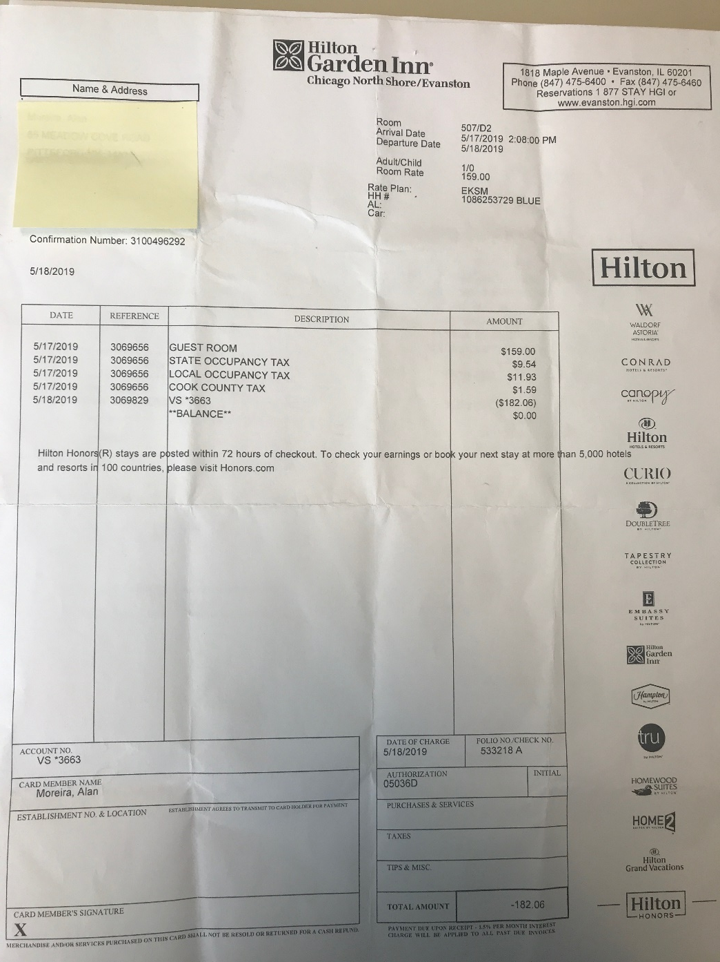
Examples of Proper Documentation
Hotel: An itemized bill or folio that shows payment.
Slide: 12
Notes:
Proper documentation for lodging is the hotel folio (bill) that lists the dates of the stay, payment method, and payment amount. The balance due should be zero. AirBnB’s are acceptable for lodging accommodations. Receipts are emailed to the individual who submits payment. Be aware that some AirBnB’s require a deposit payment and a separate payment for the balance. When this occurs the traveler must submit proof of both payments.

Slide 13
F2 Advanced Airfare
What’s Changed?
The traveler(s) is a UR employee: reservations must be made at least 21 days in advance of the departure date with the completed and approved F2 submitted to the travel agent.
The traveler(s) is a student reservations can be made at any time (no 21 day requirement).
The traveler(s) is a Non-Employee or UR business guest reservations must be made by a University employee, reservations can be made at any time (no 21 day requirement).
Slide: 13
Notes:
The F2 Advanced Airfare reservation timing has changed from 30 days in advance of departure to 21 days. This applies to employees only. Students and non-employees can make reservations at any time. For approval to use a F2 form when the departure date is less than 21 days email the Accounts Payable mailbox with a brief description of the delay in booking for approval. Once the approval is received it should be sent to DePrez or Town & Country along with the approved F2 form.

Slide 14
F2 Advanced Reconciliation
Employees
Must “reconcile” F2 advanced airfare within 60 days of return by submitting an F3 form, a copy of the F2 form, and the itinerary with airfare amount to the Department for approval.
When the F2 is “reconciled” the department is charged for the airfare
If the F2 Advanced Airfare is not reconciled within 120 days of return it may be reported to the IRS as taxable income.
Students and Non-Employees
No further action is required, the airfare amount will be charged to the FAO listed on the F2 advance on the Monthly Journal Entry
***This information is listed on the F2 form in the “Additional guidelines/information:” section***
Slide: 14
Notes:
UR employees must account for the F2 advanced airfare amount within 60 days of return from the trip. To account for an F2 advance the traveler must submit a copy of the F2 form, and a copy of the itinerary with airfare amount along with the F3 Employee expense report. The department (FAO) will be charged for the airfare but the employee will NOT receive the airfare amount as a reimbursement. Changes to a reservation will result in additional fees that will also need to be reconciled.

Slide 15
Traveling Under Federal Funds
Federally funded travelers are required to use U.S. air carrier service for all air travel that is funded by the U.S. government (FAO= GR grant). This is commonly referred to as the "Fly America Act"
Federal Travel Regulation (FTR) for details and exceptions
Fly America Act
**Any exceptions require the Fly America Act Exception Form to be completed, the exception form should be retained by the Department**
Travel for Grants can also be made through DePrez or Town & Country. The travel agencies are up-to-date on all Federal regulations.
Slide: 15
Notes:
The Fly America Act states that all flights, domestic and international, that are supported with federal funds must be taken on a U.S. air carrier, regardless of cost or convenience. This act applies to air travel for Grants. Exceptions are listed in the Federal Travel Regulations and the Open Skies Agreements. Acceptable exceptions require the Traveler to complete a new form called the Fly America Act exception form. The form should be retained by the department. A traveler can also make arrangements for grant travel through DePrez or Town & Country. The travel agencies are up to date on all Federal regulations.

Slide 16
International Travel
Slide: 16
Notes:
Faculty, Staff, and Students that are traveling abroad on University supported activity are required to register their trip with the Office for Global Engagement. International travelers are strongly encouraged to review the information available from the Office for Global Engagement. Global Engagement has resources to support employees and students traveling on University business during emergencies.

Slide 17
Rental Cars
Preferred Suppliers
Enterprise Rent-a-Car
National Car Rental
Hertz
The UR’s Purchasing website contains detailed information on rental cars. https://www.urmc.rochester.edu/purchasing/contract.cfm
If you have any questions, such as what is the University’s Corporate Acct number with the rental agency, contact the Purchasing Services team at 273-4465 for more information.
Slide: 17
Notes:
The University’s preferred suppliers for car rentals are Enterprise, National, and Hertz. When renting from one of the listed agencies you should secure the vehicle under University’s Corporate Account number. The Purchasing website contains the corporate account numbers that should be used when you rent a vehicle for business use. DePrez and Town & Country also have this information and reservation can be made by them.

Slide 18
Car Rental Insurance
For Domestic Travel:
When a preferred rental car supplier is used with the corporate account number, the renter must decline additional insurance. The rental car companies provide physical and liability insurance to the rental car and any other vehicle involved in an accident when you book the car using the University’s corporate account number with that agency.
Additional auto insurance is not reimbursable for domestic car rentals.
For International Travel: Insurance laws vary outside the US and because of this the University recommends purchasing the liability and physical damage offered by the rental car agencies while traveling on international business. International rental car insurance is reimbursable.
Fuel for rental cars, tolls, and parking are reimbursed when paid receipts are submitted.
Slide: 18
Notes:
The University’s agreement with the preferred suppliers for rental cars includes insurance on domestic rental cars. Traveler’s who rent a vehicle for use in US should not purchase additional insurance. Additional insurance is not reimbursable for domestic car rentals. Traveler’s who rent vehicles for use outside of the US should purchase insurance which is reimbursable with proper documentation. Additional costs such as tolls, fuel, and parking for the rental car are reimbursable when proper documentation is required and submitted with an expense report.

Slide 19
Business Purpose
Each receipt must have a business purpose!
It should explain why the expense was incurred and how it has a business connection.
Use the 5 “W’s” (Who, What, Where, When, and Why) can help determine if the expense meets the criteria of a University business purpose.
Who: John Smith and Susie Cardinal, prospective employee
What: dinner, drinks, and dessert
Where: GRAPPA-Rochester, NY
When: 06/30/19
Why: This was a recruitment dinner meeting with a prospective employee. We discussed the many benefits of employment, and their experience.
Slide: 19
Notes:
The new expense report forms require a business purpose for each receipt, a blanket statement for all expenses listed on the form is no longer required. This change was implemented to comply with IRS guidelines.
The business purpose for each receipt should explain why the expense was incurred and how it has a connection to University business.
The 5 “W’s” who, what, when, where, and why can be used to determine if the expense meets the criteria.

Slide 20
What’s the difference between the new F-3 and the F-34?
Slide: 20
Notes:
The new expense report forms have been updated help transition users to an electronic expense report system. Expenses will be no longer be entered by day. On the new form expenses are entered individually by receipts. The only difference between the new F3 and F34 forms is in the Header detail. Since employees can no longer receive reimbursement at the Cashier’s the Cashier’s box was removed from the F3 form. For F34 forms Accounts Payable needs additional information from students to ensure the reimbursement check is received.
Before the preparer begins entering information on the expense report form, receipts should be taped to a piece of paper that is 8 1/2 by 11.

Slide 21
Required information on the new form
Slide: 21
Notes:
I’m going to switch to excel and go through the required information using the F3 employee expense report. Switch to excel and go through the required information using a blank F3 form. Now that I’ve reviewed the required information on this F3 form I will switch between the slide deck and the excel form.

Slide 22
Per Diem Option When Traveling
The new BETR policy allows a traveler to elect to use federal per diem rates instead of actual receipts.
The federal per diem rates can be used for:
Meals and incidental (tips) expenses for individual travelers when overnight stay/travel is involved
Lodging for international travel only
Per Diem rates for localities may change at any time. To be sure you have the most current rate, check GSA.gov/Perdiem.
Slide: 22
Notes:
The new policy allows a traveler to elect to use the Federal per diem rates for meals (domestic and international) and lodging (international only).
You still have the option to submit actual receipts for reimbursement. The traveler must use either actual receipts or the per diem rate for the entire trip. You can not submit receipts for Monday and use the per diem rate for Tuesday. To get the current rates go to www.GSA.gov/Perdiem and select your destination state and city.
Switch to internet, show how to select the destination, review the breakdown.

Slide 23
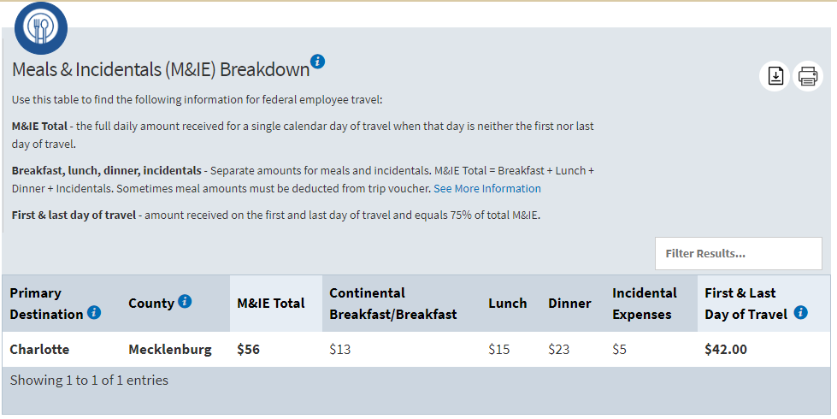
Per Diem Rate by Destination
Slide: 23
Notes:
To find the per diem rate for your destination you are traveling to, go to www.gsa.gov/Perdiem.
International per diem rates are set by the State Department, scroll down to the bottom of the home page and select the link to the state departments international rates to select your country of destination.
The Department of Defense sets the domestic rates. After you select your domestic state and city you’ll see the rates. This slide is a snapshot of the results for Charlotte, NC Meals and Incidentals breakdown.

Slide 24
Example: How to find the per diem rate and enter on the expense report form
Jesse James travels to Charlotte, NC on 10/1 to attend the AAA Conference. He returns to Rochester on 10/4. (First and last day of travel) $42 for 1st and last day
On 10/2 while at the conference a non-employee buys Jesse dinner. (Meal hosted by a non-employee) Employee is not out-of-pocket for this meal so the dinner portion must be deducted. $56-$23=$33
On 10/3 while at the conference, John Johnson (a UR employee) who is also attending the conference pays for a group meal that Jesse attends. (Meal hosted by a UR employee) Jesse is not out-of-pocket for this meal so the dinner portion must be deducted. $56-$23=$33
How does John Johnson (UR employee) get reimbursed for the group meal when he opts to use per diem.
The dinner portion of the per diem must be deducted from the daily per diem rate. Remember per diem is for individual meals. $56-$23=$33
John still need to be reimbursed for the group meal he paid for. The cost of the group meal is $175 which includes tip.
Slide: 24
Notes:
Using this example I will show you how to find a per diem rate and how to enter it on the expense report form.

Slide 25
How to enter Per Diem on an expense report form
Slide: 25

Slide 26
How to enter Per Diem and a Group meal
Slide: 26

Slide 27
Mileage Reimbursement
Business mileage is the travel an employee incurs with their personal vehicle beyond the normal commute (from home to the office and home again).
Standard (Annual) Mileage rates
2019 = $.58 per mile
2018 = $.545 per mile
The IRS mileage rate includes wear/tear & gas.
Slide: 27
Notes:
Business mileage is the travel an employee incurs with their personal vehicle beyond their normal commute mileage on a workday, for business purposes. Verify with your department administration if there are any thresholds, limitations, or other departmental mileage reimbursement policies that you must comply with. The IRS mileage rate covers wear and tear on the personal vehicle and gas.
Parking and tolls are reimbursable when proper documentation is submitted on the expense report.

Slide 28
Mileage Log form
 |  | Mileage Log and Reimbursement Form
Use of this form: Employees that use their personal vehicle for business travel should complete this form and attach it to a F3 (Employee Expense Report) form
Review the Mileage Policy for starting location and destination locations
Employee ID
Employee Name
** Mileage in excess of your normal commute are reimbursable (HOME to PRIMARY WORK LOCATION-round trip) |  |  | 2019 Rate Per Mile |  | $0.58
Employee's home address |  |  | For Period | From 1/0/00 to 1/0/00
Employee's primary work address |  |  | Total Mileage |  | 0
Number of miles home to work (round trip) |  |  | Total Reimbursement |  | $0.00
Date | Starting Location | Destination | Business Purpose | Allowable Mileage | Reimbursement
 |  |  |  |  | $0.00
 |  |  |  |  | $0.00
 |  |  |  |  | $0.00
 |  |  |  |  | $0.00
 |  |  |  |  | $0.00
 |  |  |  |  | $0.00
 |  |  |  |  | $0.00
 |  |  |  |  | $0.00
 |  |  |  |  | $0.00
 |  |  |  |  | $0.00
 |  |  |  |  | $0.00
 |  |  |  |  | $0.00
 |  |  |  |  | $0.00
 |  |  |  |  | $0.00
 |  |  |  |  | $0.00
 |  |  |  |  | $0.00
 |  |  |  |  | $0.00
 |  |  |  |  | $0.00
 |  |  |  |  | $0.00
 |  |  |  | 0 | $0.00
Slide: 28
Notes:
A new form called the Mileage Log form has been created to capture all of the necessary information and reduce paper usage. Google maps printouts are no longer required.
The completed Mileage Log form is required as proper documentation for all mileage reimbursements and must be submitted with the expense report. The required information on the mileage form is:
Employee ID
Employee name
Employee’s home address
Employee’s primary work address
# of normal commute miles
Date of travel
Starting location, ending destination, business purpose, and allowable # of miles for reimbursement

Slide 29
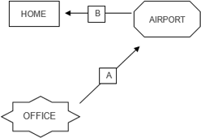
Mileage Reimbursement Example
On 10/7 Tim Applebee leaves from the office to go to the airport for a conference in Phoenix. On 10/10 he returns to Rochester and drives from the airport to his home.
10 miles
4 miles
6 miles
Mileage Reimbursed: A + B – normal commute
A+B-normal commute(one-way)
6+10-4= 12 allowable miles
A+B-normal commute(roundtrip)
6+10+4-8= 12 allowable miles
Slide: 29
Notes:
In this example an employee leaves from the office to go to the airport for a business trip, after the trip, the employee returns home from the airport.
To calculate the allowable number of miles for reimbursement:
A+B-normal commute (one-way), 6+10-4=12 miles allowable for reimbursement
A+B-normal commute(roundtrip), 6+10+4-8=12 miles allowable for reimbursement
Now that the allowable mileage has been calculated I’ll show you how to enter it on the expense report
(switch to Mileage Log form)

Slide 30
Mileage Log form entry
Slide: 30

Slide 31
How to enter mileage on the expense report form
Slide: 31

Slide 32
Summary
Review the Buying & Paying Guide to reduce the use of personal funds.
Employees can no longer receive reimbursement at the Cashier/Bursar.
Expense reports must be submitted to the department for approval within 60 days.
A Business Purpose is required for each receipt.
Traveler’s may now choose to use Per Diem rates or Actual receipts.
Mileage Log is required for all mileage reimbursements.
Slide: 32
Notes:
To summarize……….
Review the Buying & Paying Guide to reduce the use of personal funds, and familiarize yourself with the Universities primary method of payment.
Employees can no longer receive reimbursement at the Cashier, all F3 forms must be submitted to AP for processing.
Expense reports must be submitted to the department for approval within 60 days of the date of purchase, date of an event, or return from a trip.
A Business Purpose is required for each receipt.
Traveler’s may choose to use Per Diem rates or Actual receipts.
Mileage Log form is required for all mileage reimbursements.

