Slide 1
Procure to Pay Project
EUAT Weekly Communication and Training Meeting
June 6, 2018
Last Updated: June 5, 2018

Slide 2
Agenda
Gate 3 - Go / No Go Gate Review
Problems/Bug Fix
Decision Update
New Decisions
Where to go for Support
Questions

Slide 3
Gate 3 Go/No Go - PASS
Pass
Move forward with a June 11 start

Slide 4
Problem/Bug Fixes
Multiple Approvers on one FAO
Currently Workday doesn’t perform as we would like for multiple approvers sharing the same role on an FAO.
One instance for this EUAT – Physics and Astronomy Grant GR506827 PHY-1725178-059919-002
IT – several instances
Workaround – can assign one approver who can then “Add” the second. Both would be required to “Approve”.
Working resolve during the EUAT

Slide 5
Decisions update
Update and Solution
Requisition fields to be completed in the entirety, “see attached” is not sufficient.
UIT is developing a tool that will allow Requisitioners to upload multiple line items into a draft requisition.
Notes:
To keep you up to date on the design of the system, the next several screens contain decisions that have been made.

Slide 6
New Decisions
Will not add Accounting Splits to the PO PDF
This is an internal requirement that suppliers do not need.
A report will be available for internal use
Procurement will have the ability to add freight if necessary
Procurement does not have a need to Deny or “Kill” an order
Will send back to the Requisitioner with the reason
Activate all employees in Workday, will allow individuals to go into Workday to receive.
Will only have access to the specific modules for which they are activated
Notes:
To keep you up to date on the design of the system, the next several screens contain decisions that have been made.

Slide 7
EUAT Support, Training, Tools, Guidance
Complete
May 2 Kickoff and Overview meeting
Overview of Workday in MyPath
May 8 or 9 four hours hands on training
System Testing - Requisition and Supplier Invoice Requests 4 hours, May 21 or 23
Ensure requisitions and SIRs flow correctly through the processes
Opportunity to continue to test
Ongoing
Weekly meetings - Wednesdays 10-11 am
Daily Stabilization meetings 4:00-5:00-pm, 6/11- 16 and 6/19-23 if needed to troubleshoot and develop solutions for any issues that arise during the day

Slide 8
New Decisions
Daily Stabilization Meetings
4-5pm first 1 to 2 weeks or as needed
Monday, Thursday and Fridays
Weekly Communication and Training meetings
Wednesdays 10-11am
Standard Agenda:
New decisions
Issues and solutions
Share learnings
Will cancel Tuesday and Wednesday Daily Stabilization meetings
Notes:
To keep you up to date on the design of the system, the next several screens contain decisions that have been made.

Slide 9
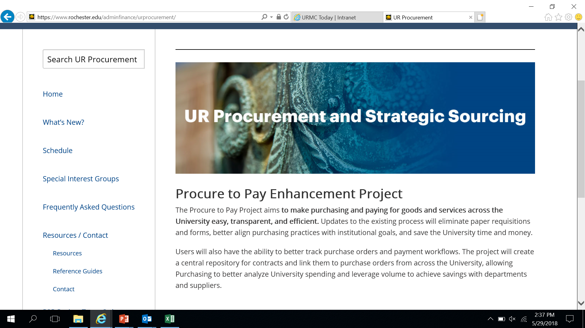
Website https://www.rochester.edu/adminfinance/urprocurement/
All information will be posted on the Procure to Pay website: https://www.rochester.edu/adminfinance/urprocurement/

Slide 10
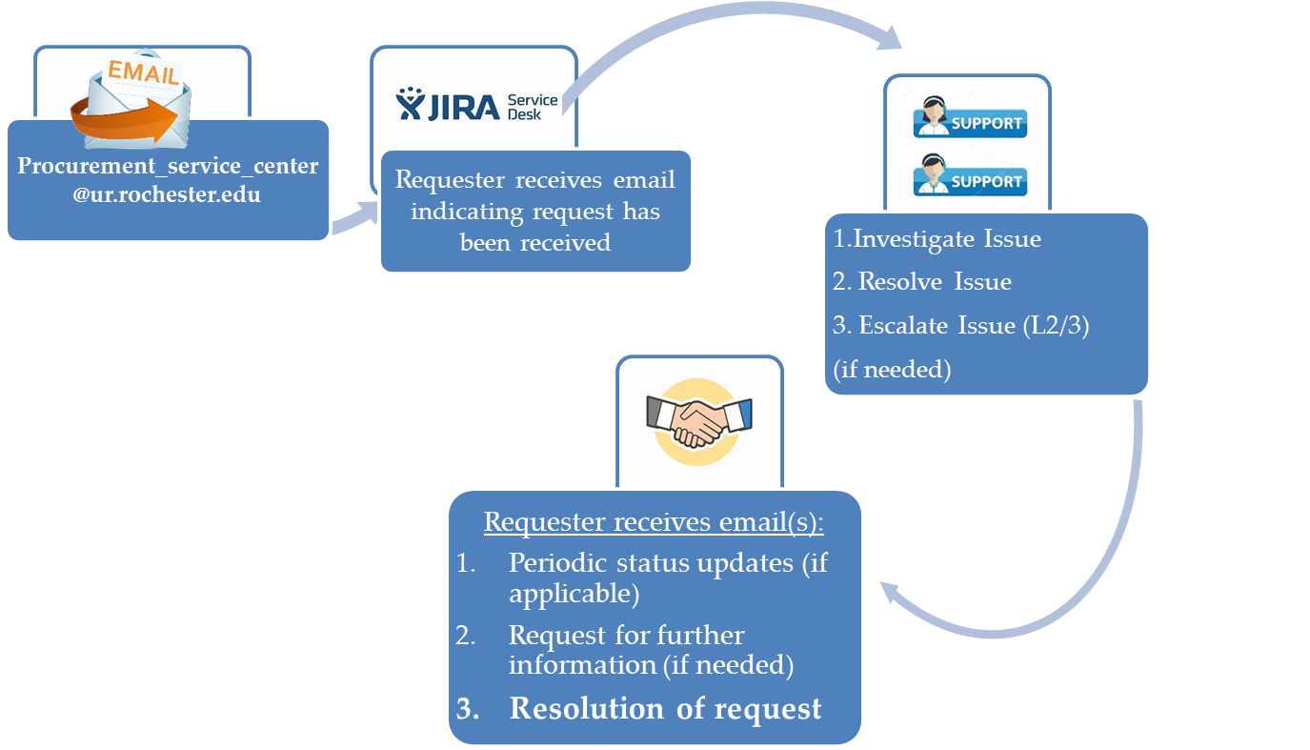
For Procure to Pay Access & Issues
Procurement_service_center@ur.rochester.edu
P2P Service Center 275-2012

Slide 11
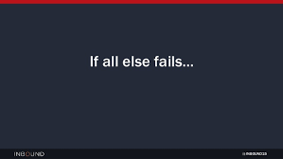
If All Else Fails??
As a last resort, you can create a 312 Requisition or a paper F4
BUT FIRST…
Contact the P2P Service Center
Procurement_service_center@ur.rochester.edu
P2P Service Center 275-2012
Notes:
This slide identifies decisions regarding dates, match exception and Supplier Invoice Request

Slide 12
Questions?

Slide 14
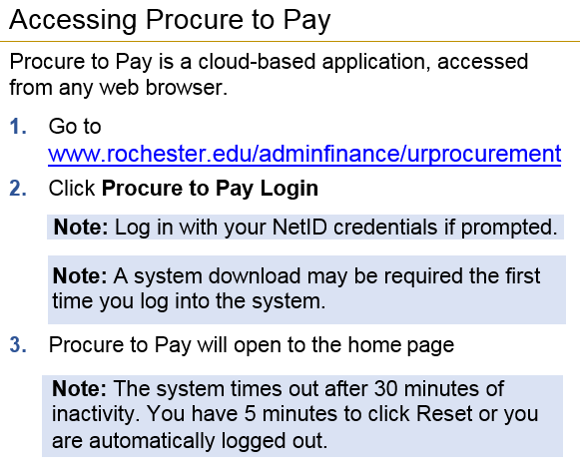
Logging Into Workday - https://wd5.myworkday.com/rochester or
Will be live 6/11

