Slide 1

Procure to Pay Project
Invoice Match Exception Overview
October 30, 2018 – P2P Staff Meeting

Slide 2
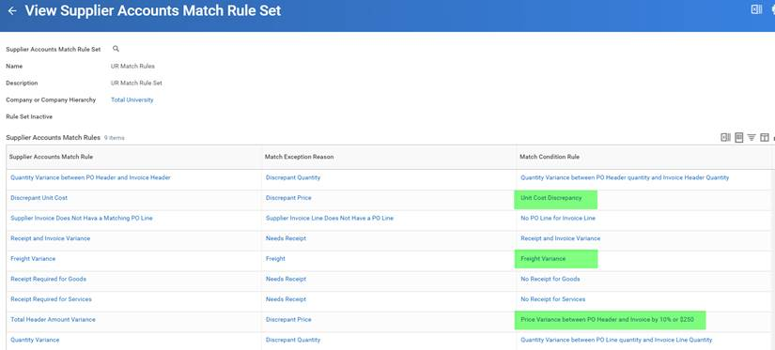
Workday Invoice Match Exception Rules
October 30, 2018 – P2P Staff Meeting
There are currently 9 match exception rules in Workday. 3 of the 9 rules relate to Purchasing.
2

Slide 3
Invoice Match Exception Rules
October 30, 2018 – P2P Staff Meeting
Invoice Match Exceptions
What type of invoice match exceptions should Purchasing expect to see?
Freight or Miscellaneous (Other – I.e. Restocking Fee)
Unit Price
If there is only a quantity discrepancy or receipt discrepancy (and no price discrepancy), the supplier accounts match exception is sent to the requester to take action. However, when there is a price discrepancy in addition to a requester match exception, the exception will be sent to the Purchasing CM first.
System Tolerances
Only exceptions outside of the system tolerances outlined below will be sent to Purchasing:
Freight Variance > $25
Miscellaneous (Other) >$25
Unit Price – 10% or $250 per line, whichever is less
Total Header Amount Variance – Header Price 10% or $250 total, whichever is less
3

Slide 4
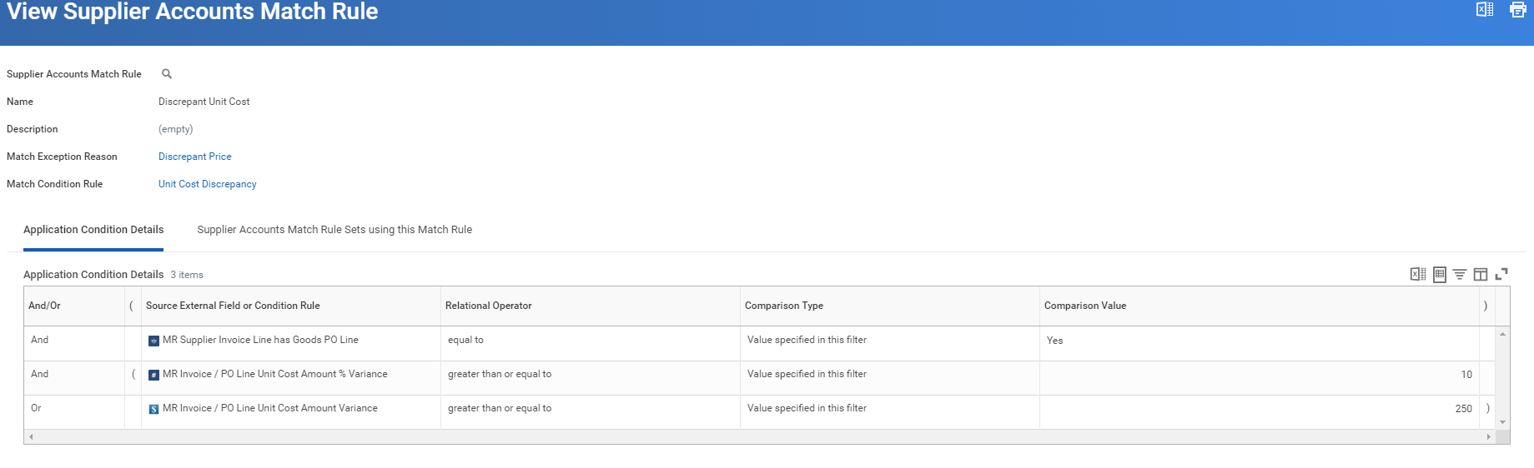
Discrepant Price Rule
October 30, 2018 – P2P Staff Meeting
4

Slide 5
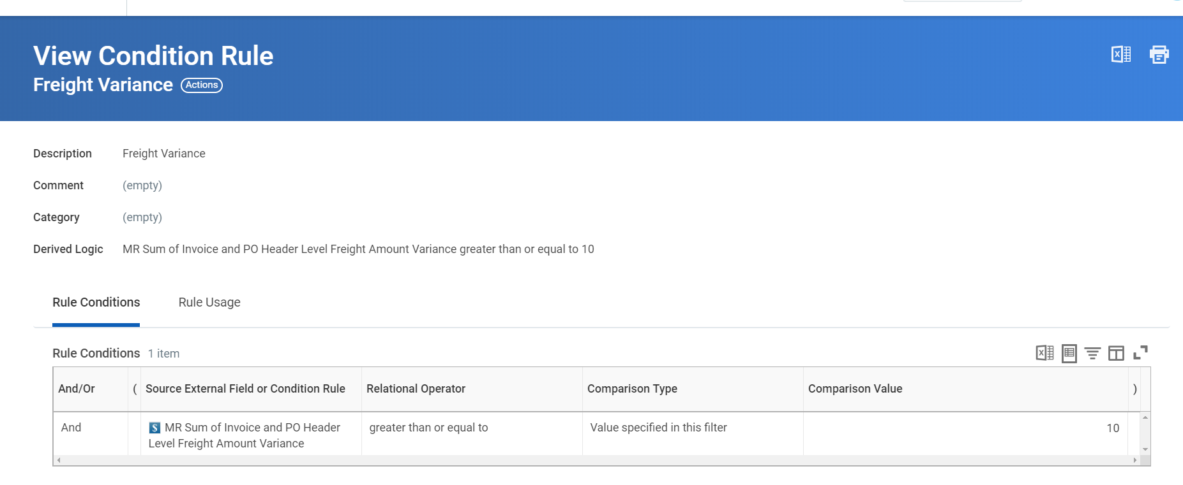
Discrepant Freight/Miscellaneous Rule
October 30, 2018 – P2P Staff Meeting
Note: Freight tolerance is being updated from $10 to $25
5

Slide 6
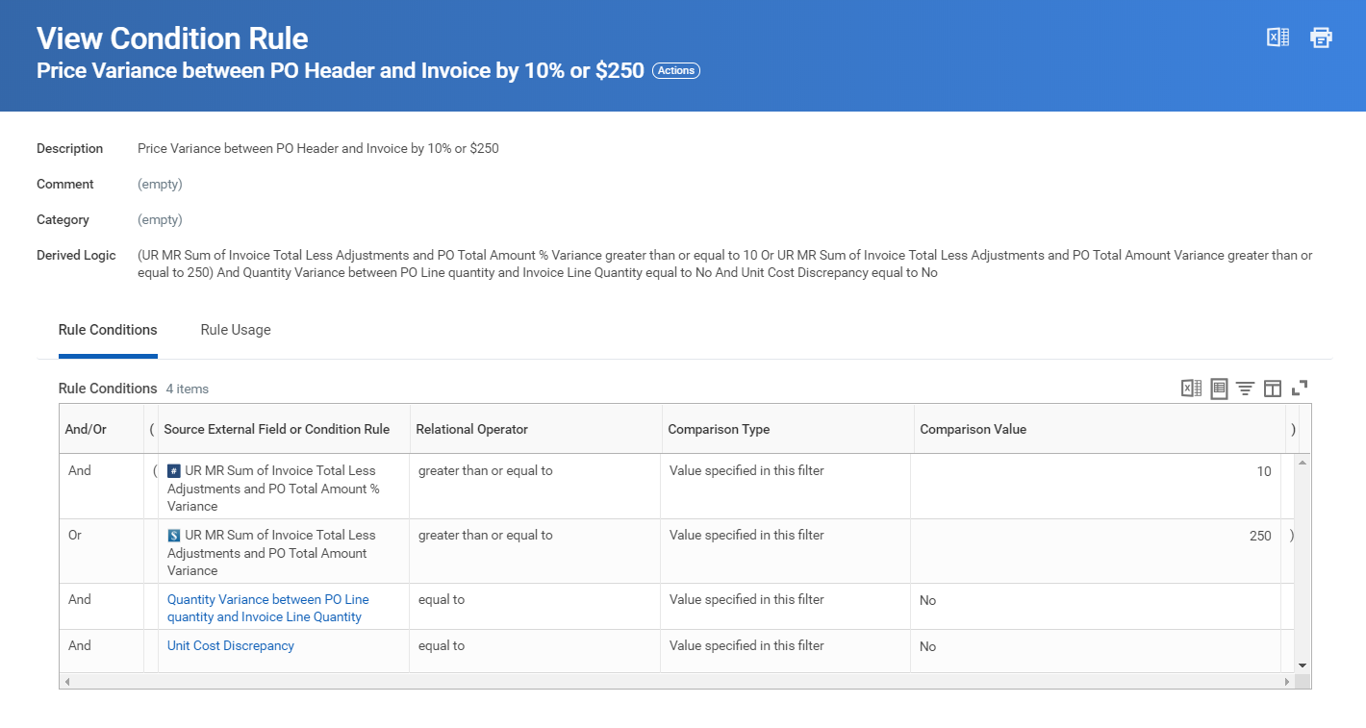
Price Variance between PO Header and Invoice Rule
October 30, 2018 – P2P Staff Meeting
6

Slide 7

Match Exception Review Steps
October 30, 2018 – P2P Staff Meeting
Purchasing Reference Guide:
UR Procurement – Purchasing Match Exceptions Reference Guide
Review Steps:
Review the Match Exception Worklet on your dashboard to identify any match exceptions assigned to you and what the match exception is.
An email notification will let you know that you have a supplier account match event awaiting your review.
Review the unit cost on a goods line and determine if the invoiced unit cost is correct.
Review the total amount for a services line compared to the invoice total and determine if the requisitioner needs to add more money to the PO in order to pay the overage.
Review the freight charge or miscellaneous charge and determine if it is appropriate and if the P2P Service Center needs to add more money to the PO in order to pay the overage.

Slide 8
Price Discrepancy Steps
October 30, 2018 – P2P Staff Meeting
Price Discrepancy
Price variance between PO and Invoice greater than 10% or $250 tolerance.
Additional Funds Needed?
If additional funds need to be added to the purchase order, Purchasing CM will need to reassign the supplier match exception to the requisitioner so they can do a Change Order to add funds to the purchase order.
Cancel Invoice if Supplier will not send in a credit memo and UR should Not Pay Invoice Price
If UR should not pay the invoice and the supplier will not send in a credit memo to correct the invoice, Purchasing CM will need to use <Send Back> to AP with reason to “Cancel this Invoice.”
Unit cost line item variance greater than 10% or $250 tolerance.
Pay Invoice As Is?
If UR should pay it the invoice as is, Purchasing CM will need to request an override. Overrides will route to the next level up manager for approval.
Cancel Invoice if Supplier will not send in a credit memo and UR should Not Pay Invoice Price
If UR should not pay the invoice and the supplier will not send in a credit memo to correct the invoice, Purchasing CM will need to use <Send Back> to AP with reason to “Cancel this Invoice.”

Slide 9
Freight Discrepancy Steps
October 30, 2018 – P2P Staff Meeting
Freight or Miscellaneous Variance
Freight or Miscellaneous Variance greater than $25 tolerance
Ok to Pay Freight or Miscellaneous Charge?
If UR should pay the freight or miscellaneous charge, Purchasing CM will need to reassign the supplier match exception to the P2P Service Center through Service Desk so they can do a Change Order to add the charge to the purchase order.
Not ok to Pay Freight?
If UR should not pay the freight or miscellaneous charge, Purchasing CM should use the <Send Back> to AP with reason: “Do Not Pay the freight or Miscellaneous charge. Adjust the invoice to remove freight/miscellaneous charge.”

Slide 10

Match Exception Approval Steps
October 30, 2018 – P2P Staff Meeting
Purchasing Reference Guide:
UR Procurement – Purchasing Match Exceptions Reference Guide
Approval Options:
Request Match Exception Override
If the invoiced amount is correct and the invoice is ok to be paid
Send Back
If the invoice should not be paid and should be cancelled by AP, select this option and type “Cancel this Invoice due to …….”
Reassign Task
This should be used when an invoice needs to be reassigned to a requestor to update the purchase order.

Slide 11

Match Exception
October 30, 2018 – P2P Staff Meeting
Demo:
Setup Match Exception Worklet on Dashboard
Find Supplier Invoices
Review Unit Price Exception
Match Exception Override – ok to pay
Reassign match exception to requisitioner to create a PO Change to add money
Freight Match Exception
Create a Ticket in Service Desk for the P2P Service Center, include PO# and Invoice # so freight can be added and the invoice approved for payment.
Send invoice back to AP with instructions to short pay and exclude freight

Slide 12
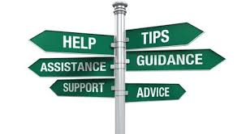
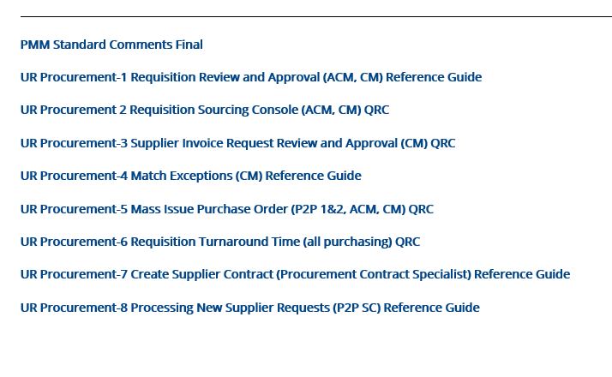
Invoice Match Exception Resources
October 30, 2018 – P2P Staff Meeting
UR Procurement Website
https://www.rochester.edu/adminfinance/urprocurement/p2p-project-team-only/resources-2/ (use NetID to Login to the Resources Section of P2P Project Team Only Section)
Purchasing Reference Guides
P2P Service Center
https://service.rochester.edu/login.jsp
WalkMe

