Slide 1

Procure to Pay Project
Demo Days
January 15, 2019
Notes:
Jim Dobbertin – Introduction and Kick Off

Slide 2
Are You On the Zoom?
Information for Zoom Participants
For those joining the Zoom:
1) Phones will be muted. Due to the volume of content to be shared, we may not have time for questions.
Send your questions to URProcurement@Rochester.edu They will be summarized and posted to the UR Procurement Website
3) P2P Frequently Asked Questions can also be found on the UR Procurement Website.
2
Notes:
Jim Dobbertin Note: If we do not have time to address questions submitted, they will be summarized and posted to the UR Procurement Website.

Slide 3
Topics
Overview of the Procure to Pay (P2P) project
Objectives
Benefits
Project Phases
Project Scope
P2P Methods and Systems
Introducing Workday and the P2P Marketplace
Roles & Responsibilities
Financial Approval Hierarchy
Training Overview
P2P Special Interest Groups
P2P Support Organization
3
Notes:
Carl Tietjen and Liz Milavec

Slide 4
Procure to Pay Objectives
The objective of the P2P implementation is to:
Transition from paper-based to electronic transactions
Provide full transparency and visibility into all P2P transactions from entry to payment (procure-to-pay!)
Streamline entry and approval activities to enable better internal controls
Standardize purchasing activity
Improve cycle and approval times
Enable data driven price negotiations and strategic sourcing
https://youtu.be/JMeVA-7LZnw
4
Notes:
Katherine Sadoff-Herrick Are we sure we want to include the P2P Video?

Slide 5
P2P Benefits for Departments
For Users:
Increased transparency
Quicker turn around time
Improved internal controls
Email and mobile approval capabilities
For The University and Medical Center:
Enable strategic sourcing and data driven price negotiations
Reduced paper and manual work processes
Support the ability to negotiate discounted payment terms
5
Notes:
Katherine Sadoff-Herrick

Slide 6
Prepare
User Acceptance Test 1, 2
Pilot Groups
1 and 2
System Roll Out
1, 2, 3, …
P2P Project Phases
Nov 2017 - May 2018 June - Dec 2018 Feb - June 2019 July - Dec 2019
June 11, 2018: Early Users - Workday for non-catalogue goods and services
November 19, 2018: Adds Marketplace (Jaggaer) for creating shopping carts for catalogue items and purchase order distribution (Amazon look and feel)
February 18, 2019: Pilot 1 – Add additional departments/users, refine P2P design
April, 2019: Pilot 2 – Add additional departments/users, refine P2P design
June/July 2019: Start phased roll out to remaining departments and users
6
Notes:
Katherine Sadoff-Herrick

Slide 7
In Scope / Out of Scope Summary
What is In Scope:
Blue Requisitions (312s) that create an external P.O.
Supplier Invoices (F4s)
Catalogue and non-catalogue items
Goods and Services
Supplier Online Ordering (SOLO)
Ordering (currently in PMM):
Administrative/non-catalog requisitioning
University divisions 10 – 92
What is Out of Scope:
FAMIS System
Supplier Qualification
Supplier Registration
Supplier Contract Mgmt.
Internal transfers / purchases
Ordering (currently in PMM):
Supply Chain Managed Inventory locations:
Custom Requisitions
Par Forms
Highland Hospital and Affiliates
7
Notes:
Katherine Sadoff-Herrick

Slide 8

P2P Purchasing Methods and Systems
The following purchasing methods and systems are only applicable for FAOs that are currently live on the P2P implementation.
Type of Purchase | Workday | Jaggaer | PMM
Non-Catalogue Items (Goods and Services) | Non-Catalogue/Jaggaer Enabled Suppliers
Catalogue Items | Requisition begins in Workday and transitions to Jaggaer Marketplace for shopping | Enabled Catalog Suppliers (Example: Staples)
Inventoriable Items (Includes recalls, expirations, and chargebacks)
Invoices Only (In accordance with existing policy http://www.rochester.edu/adminfinance/finance/FinanceForms.html) | Acceptable Use Items for Invoice Payments
PCard | Current – US Bank Website Future - Workday
Note: As of November 19, 2018, requisition processes for Medical Center under discussion with Medical SIG
8
8
Notes:
Katherine Sadoff-Herrick

Slide 9
P2P Workday and Jaggaer Marketplace Solution
Workday
Contract Management
Goods / Services Receipt
Contract Management
Request Purchase
Purchase Requisition
Financial Approval
Purchasing Approval
Purchase Order
3 Way Match
Payment
PO Dispatch
Jaggaer Marketplace
Supplier
Create Shopping Cart
Purchase Order
Invoice
This enables more efficient operational processes, improved customer experience, significant costs savings and data accessibility.
9
Notes:
Debbie Flotteron

Slide 10
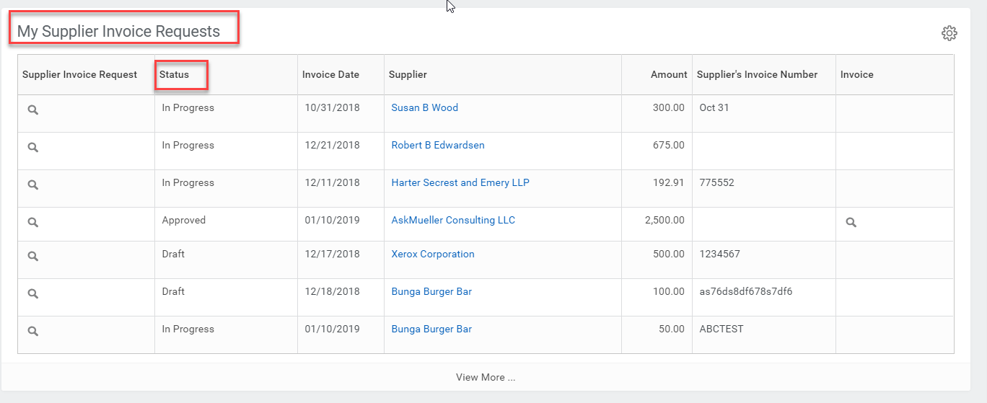
Workday Procurement Dashboard
My Supplier Invoice Requests (Previously F4)
10
Notes:
Debbie

Slide 11
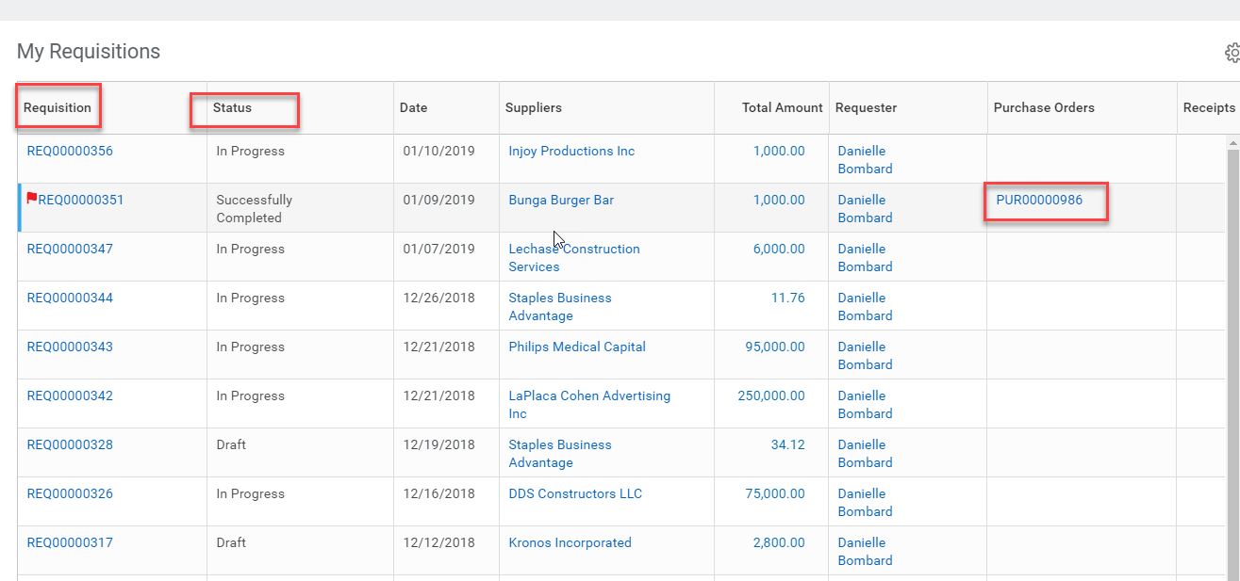
Workday Procurement Dashboard
My Requisitions
11
Notes:
Debbie

Slide 12
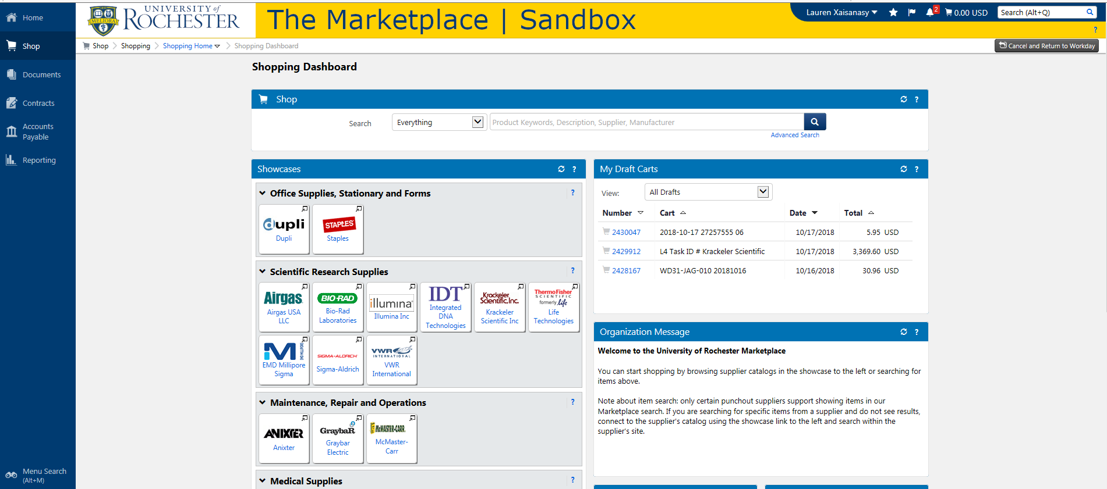
Procure to Pay: Marketplace
Search Products
Supplier Websites
12
Notes:
Debbie Flotteron

Slide 13
P2P: Supplier Catalogues the in Marketplace
Supplier catalogues reside in the Marketplace
Where applicable, university contract pricing will be available
Provide users with a streamlined and consolidated shopping experience
Additional suppliers will be added as validation is complete
Workday will continue to be used for non-catalogue items such as services and specialty goods
13
Notes:
Debbie Flotteron

Slide 14
Procure to Pay: Supplier Catalogues
Airgas USA LLC Beckman Coulter Bio-Rad Laboratories EMD Millipore Corp Dupli Graphics Fisher Scientific Hill and Markes, Inc. Integrated DNA Technologies Inc. Johnston Paper | Krackeler Scientific Inc Laboratory Products Sales Life Technologies McMaster-Carr Supply Company Sedgwick Sigma-Aldrich Staples VWR International Workplace Interiors
14
Notes:
Debbie Flotteron

Slide 15
Roles and Responsibilities
Purchase Requisitioner
Complete purchase requisition
Build shopping cart for catalogued items
Supplier Invoice Requester
Complete supplier invoice requests
Answer questionnaire
FAO Manager
Approve all purchases
Cost Center Manager
Approve all purchases above the FAO manager’s threshold
Company Financial Approver
Approve all purchases above the Cost Center manager’s threshold
If no approver is assigned at a lower level (i.e. FAO Manager), the next level up becomes the approver
15
Notes:
Jim Dobbertin

Slide 16
Financial Approval Hierarchy Guidelines
Used for electronic routing of transactions for approval
In concert with current, but soon to be revised, signature authority for contracts
Data driven thresholds based on 6 months of spend transactions
Benchmarked with other university approval policies
The financial hierarchy guidelines is an evolving document
Final approval by Holly Crawford and Adam Anolik on September 12, 2018
16
Notes:
Jim Dobbertin

Slide 17
P2P: Simplified Financial Approval Routing
Purchase Requisition / Supplier Invoice Request Created
Expedited Spend Category Approval
Capital Asset Approval
Grant Approval
Special Spend Category Approval
Examples:
Legal Fees
Audit Fees
Construction
IT Spend
Hazardous Goods
Etc.
FAO Manager Approval
Examples:
Payroll Taxes
Benefit Plans
Investments Debt Service Sinking Fund
Etc.
Cost Center Manager Approval
Company Financial Approval
Legend:
Red outlined boxes are based on specific thresholds.
Send back capabilities exist at every approval step.
CFO Approval
Approved
Purchasing Review
President
Approval
Last Updated: August 30, 2018
17
Notes:
Jim Dobbertin

Slide 18
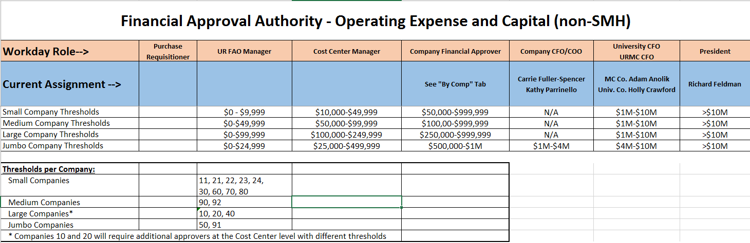
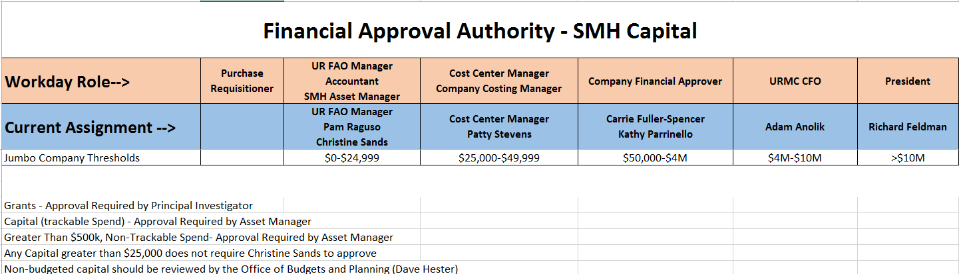
P2P: Financial Approval Thresholds
18
Notes:
Jim Dobbertin

Slide 19

Training
Required Online training mini-courses available in MyPath
Optional additional training to include:
In person classroom sessions
Recordings of in person classroom events
Additional Job Aids
Quick Reference Cards
Newsletters
19
Notes:
Jill Brock

Slide 20
Training Curriculum
Role | Required Module(s) | Duration (minutes)
Requisitioner (Blue 312 Reqs) | Buying and Paying Guide Overview P2P: UR Procurement Basic Navigation P2P: Create Requisition Overview P2P: Marketplace Overview | 15 15 20 20
SIR Requestor (F4 Payments) | Buying and Paying Guide Overview P2P: UR Procurement Basic Navigation P2P: Supplier Invoice Request (SIR) Overview | 15 15 20
Approver | P2P: UR Procurement Basic Navigation P2P: UR Procurement Approver Overview | 15 15
20
Notes:
Jill Brock

Slide 21
Self Paced MyPath Training
Course | Description | Duration
Buying and Paying Guide Overview | This module provides an overview of the various procurement and payment methods at the University of Rochester. After completing this module, you will be able to use the buying & paying guide to determine the appropriate method. | 15 minutes
P2P: UR Procurement Basic Navigation | This module provides an overview of the Procure to Pay (P2P) process and UR Procurement, the University of Rochester’s procurement and payment system. After completing this module, you will be able to login and navigate the system, search for information and transactions, and run basic reports. | 15 minutes
P2P: UR Procurement Approver Overview | This module provides an overview of the approval process for UR Procurement, the University of Rochester’s procurement and payment system. After completing this module, you will be able to view and act upon transactions waiting for your approval using a computer, tablet, or mobile device; configure your preferences; set up delegations; and find online resources and support information. | 15 minutes
21
Notes:
Jill Brock

Slide 22
Self Paced MyPath Training (Continued)
Course | Description | Duration
P2P: Create Requisition Overview | This module provides an overview of the process to create a requisition for non-catalog items in UR Procurement, the University of Rochester’s procurement and payment system. After completing this module, you will be able to create a requisition, search for requisitions, and investigate status of requisitions. | 20 minutes
P2P: Marketplace Overview | This module provides an overview of the process to shop for catalog items in the Marketplace which is part of UR Procurement, the University of Rochester’s procurement and payment system. After completing this module, you will be able to shop for catalog items, checkout or assign a cart, and submit the requisition. | 20 minutes
P2P: Supplier Invoice Request (SIR) Overview | This module provides an overview of the Procure to Pay (P2P) process using a Supplier Invoice Request for making payments when Purchase Order or P-card are not preferred. | 20 minutes
Purchasing Card Training | This module provides an overview of the P-card process which allows staff to purchase low-dollar items using a US Bank VISA credit card. | 20 minutes
22
Notes:
Jill Brock

Slide 23
Hands On Testing
Hands-on sessions with subject matter experts available to assist
Available after Instructor Led classroom and/or MyPath training
Capability to enter real purchase requisitions and Supplier Invoice Requests (SIRs) in a test environment
23
Notes:
Jill Brock

Slide 24
Support Organization
Procure to Pay Customer Service Center is available to answer questions or provide assistance
UR Procurement website: rochester.edu/adminfinance/urprocurement
P2P Service Center: 275-2012
Email: URProcurement@rochester.edu
Service Desk Requests: https://service.rochester.edu/procurement
For System Access & Issues
Help Desk: UnivIT: 275 - 2000, UnivITHelp@ rochester.edu
Help Desk URMC: 275-3200, helpdesk_ISD@ urmc.rochester.edu
24
Notes:
Jill Brock

Slide 25

Special Interest Groups and Leaders
Special Interest Groups Leader
Requisition and Receiving Debbie Flotteron
Invoicing Matching Marta Herman
Medical Center Carl Tietjen, Katie Oleksyn
Research Debbie Flotteron, Mike Ritz
Capital Mike Altobelli, Carrie Ballou
If you are interested in participating in one of the Special Interest Groups, please contact the leader for the group.
25
Notes:
Jim Dobbertin

Slide 26
Next Steps
Monthly Demo Day meetings
Medical Center
River Campus
Visit the P2P Website UR Procurement Website
Questions? Please reach out to:
URProcurement@Rochester.edu
Future Demo Day Topics
Catalog Orders (Formerly SOLO)
Non-Catalog Order
Service Order
Supplier Invoice Request (Formerly F4)
26
Notes:
Jim

Slide 27
Questions?
When do we get our Login ID’s to access Workday after training? You will be granted rights on your go live date. Your NetID will be required to access Workday.
I use 312 requisitions internally. How will P2P affect this? This is out of scope. You will continue to use 312 requisitions for internal purchases.
If I have an existing role in Workday, will I have another role based on Procure to Pay? Yes
Could people have multiple roles in Procure to Pay? Yes, someone could have multiple roles. As an example, someone could be a Requisitioner and a Supplier Invoice Requestor.
Will my P2P login be the same as UR Financials login? Yes, it will be your NetID
If there are multiple FAO’s in a department, could someone prepare the information (requisition or SIR) and leave the FAO information for someone else to complete? No, the Requisitioner or Supplier Invoice Requestor are required to complete all information including FAO and Spend Category before they can submit the request.
Can you have multiple people assigned to an FAO as a Requisitioner or Supplier Invoice Requestor? Yes
Will approvals be needed for approval of all transactions currently in SOLO (i.e. Dupli – Business Cards)? This is currently under review.
27

Slide 28
Questions?
What are my options for ordering if I use blanket purchase orders today?
 | Workday Function
PMM Blanket Order | Workday Non-Catalog Goods Requisition | Workday Catalog Goods Requisition | Workday Non-Catalog Service Requisition | Create Requisition Against Contract
Clinical Supply (i.e. medical supplies) Blanket Order
Non Clinical Supply (i.e. lab supplies) Blanket Order
Consultant/Independent Contractor Blanket Order
Equipment Maintenance/Service Blanket Order
27

Slide 29
Questions?
Will there be different training for Supplier Invoice Requestors from Workday Training? Yes, there is MyPath Training and Instructor Led Training specific to roles.
If the FAO Manager does not agree with the FAO or Spend Category assigned by the requestor, can they change it? No, they can send it back with a note indicating to change it to a different FAO or Spend Category.
How do I request a supplier catalog be created in the Marketplace? Submit an ticket to the P2P Service Center https://service.rochester.edu/procurement
Will Principal Investigators have to be trained to do approvals for Research Grants? Yes
What if the supplier is not in Workday, will I be able to create a requisition? Yes, you can create a requisition without a supplier; however, the current Supplier Qualification process will not change and will delay release of the purchase order.
Can a Principal Investigator assign a delegate? Yes, a permanent or temporary delegate can be assigned in Workday; however, in assigning a delegate they are assuming fiduciary responsibility for the transaction.
27

Slide 30
Questions?
If you have a Supplier Invoice Request (SIR) or Requisition with multiple FAO’s, will it route to the individual FAO Manager for approval? Each FAO will route to the assigned FAO Manager for approval.
How many FAO splits are allowed on a line? There is no limit.
Will the Supplier Price Justification Conflict Information Form (SPJCI) still be required if transaction is > $25,000? Yes, this form will still be required. A form within Workday is being developed in place of the paper form and will be available sometime in 2019.
Will access to the Marketplace Suppliers be restricted to specific departments? Not at this time
27

