Slide 1
Procure to Pay Project
Tips and Tricks – How to create Receipts.

Slide 2
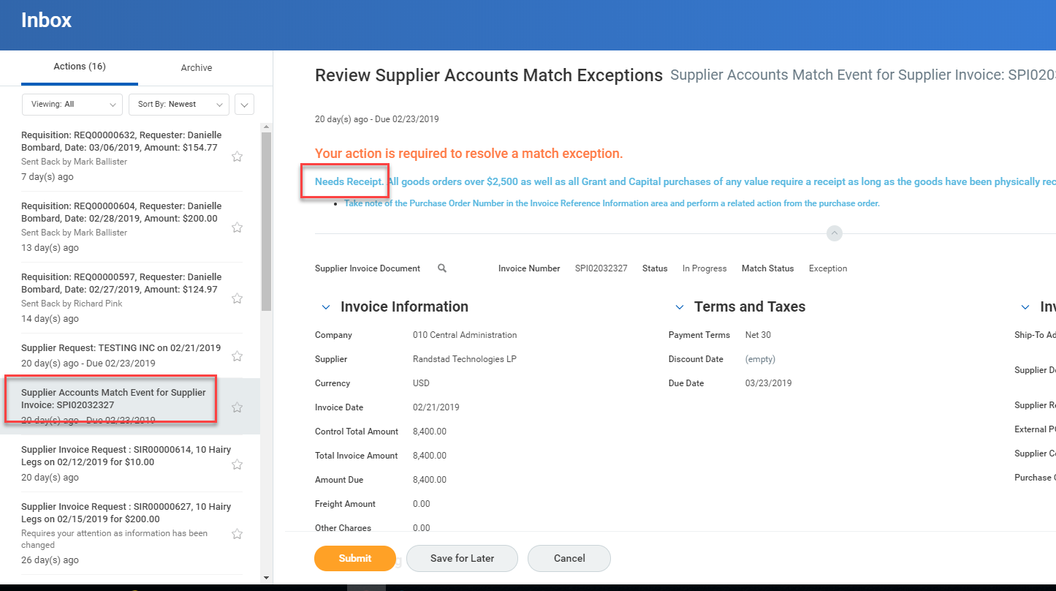
Tips and Tricks-How to create Receipts.
You will receive an email notification telling you a Supplier Accounts Match Exception has been assigned to you. Inside the email you will see that it is telling you a receipt is needed. To find the Purchase Order number you can look at the Match Exception Worklet on your Procurement dashboard.

Slide 3
Tips and Tricks – How to create Receipts.
Creating Receipts in Workday is required for many transactions. If you do not create receipts your invoices may not get paid.
Of course, it is a best practice to go in and create receipts as soon as you receive a good or can verify a service has been completed.
Type Create Receipt in the global search bar and select the task.

Slide 4
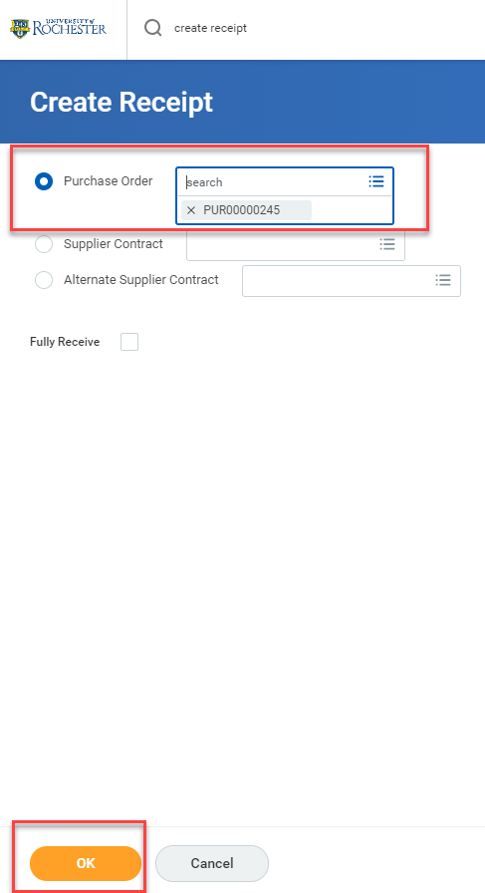
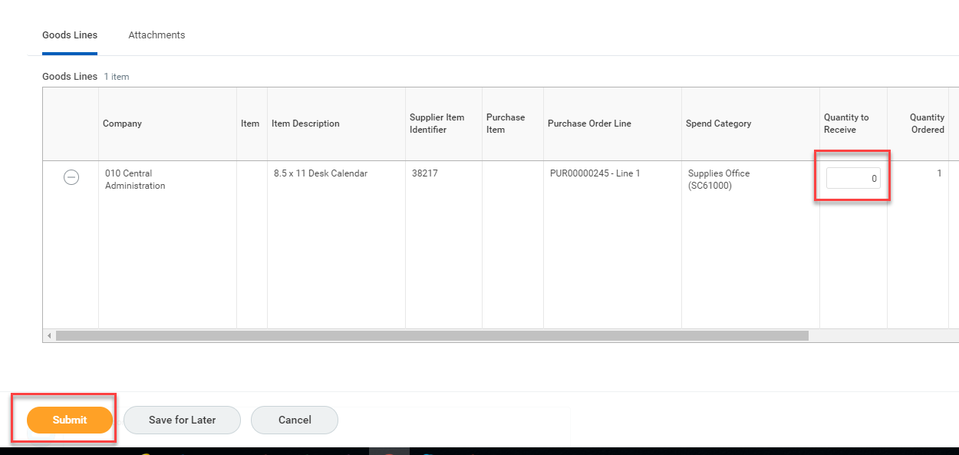
Tips and Tricks – How to create Receipts.
Type in your Purchase Order number and select OK.
When the Purchase Order opens up you will have a column for Quantity to Receive for a Goods line or Amount to Receive for a Service line. After filling in the correct amount, click Submit.

Slide 5
Questions?

