Slide 1

Procure to Pay Project
Tips and Tricks – How to preview a supplier record (before you create your SIR).

Slide 2

Tips and Tricks – Preview your supplier record before you start your SIR
Before initiating a supplier invoice request (SIR), it is recommended to search for and preview the supplier record. This will help you understand if the supplier already exists in UR Procurement or if there is more than one similarly named supplier record, which record to use.
In the global search box, use the prefix 'supplier:' along with at least three or more characters to begin your search. For example, to search on a supplier called Elsevier, enter the search as follows: supplier:elsevier and press enter. Take note that twelve results are returned but your search is narrowed to suppliers containing that name.

Slide 3
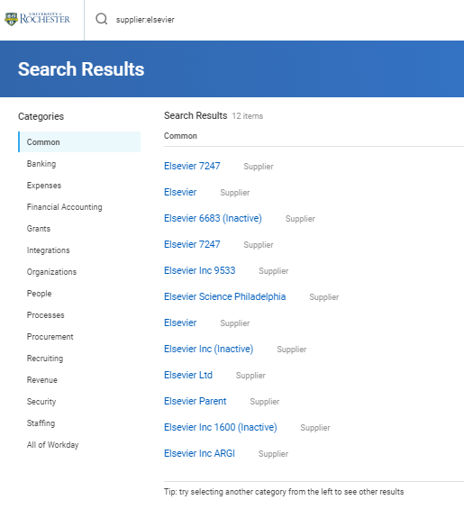
Tips and Tricks – Preview your supplier record before you start your SIR cont’d

Slide 4
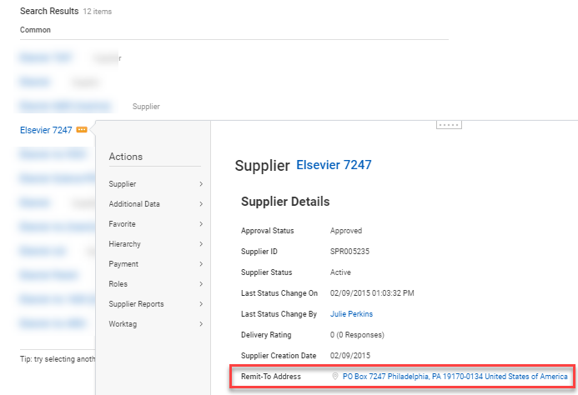
Tips and Tricks – Preview your supplier record before you start your SIR cont’d
When you hover your mouse over each supplier name, the orange 'related actions' button becomes available directly to the right of the name. Select the related actions button to preview the supplier information. For example, shown is the preview of Elsevier 7247.

Slide 5
Tips and Tricks – Supplier records rules to remember
Parent supplier records cannot be used for SIRs (or requisitions). Do not select any supplier record with the word Parent in the title.
Do not select any supplier record with Inactive in the title.
If the name and address are those of your supplier but it indicates Inactive, contact the P2P Service Center to have the Supplier re-Activated.
For a SIR, the supplier record you select must have a Remit-To address that matches the invoice or current payment address.
If you find your Supplier with a name match but the address is different and you believe the company or individual has moved, initiate a change to update the Supplier record address by selecting the Related Action Change Supplier Contact Information and entering the new address. Contact the P2P Service Center for additional help if needed.
If you think you see a duplicate supplier record, the same supplier with the same address as 2 or more separate listings, contact the P2P Service Center to ask that they inactivate any duplicates.
Keep in mind that some Suppliers have multiple valid remit to addresses and that students sometimes want to use a local address for some payments and their home address for others. That is, even if the name appears multiple times, the addresses may be different and valid.

Slide 6

Questions?

