Slide 1
Procure to Pay Project
Tips and Tricks – How to view a list of available spend categories.

Slide 2
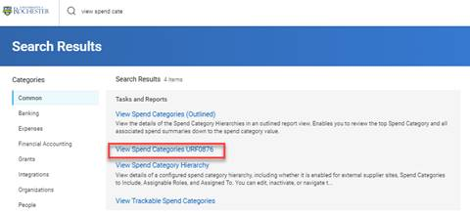
How to view a list of available spend categories
If you would like to review a list of spend categories and whether they are enabled for requisitions usage and also whether a category is trackable (capital) vs non-trackable (non-capital), you may wish to view a spend category report.
Using the global search box, search for View Spend Categories URF0876 report.
B
yes

Slide 3
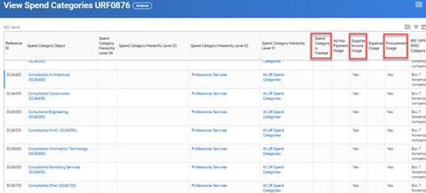
How to view a list of available spend categories
If the spend category is for capital, the column called "Spend Category is Tracked" will have a Yes.
For use with a Supplier Invoice Request (SIR), the column called "Supplier Invoice Usage" must have a Yes.
For use for requisitions, the column "Procurement Usage" must have a Yes.
F

Slide 4
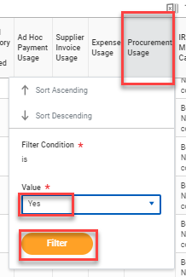
How to view a list of available spend categories
Can also use filters located in the column headings. For example, you can filter to show all spend categories enabled for Procurement by clicking in the Procurement Usage heading and selecting the value Yes then <filter>.
H

Slide 5
Questions?

