Slide 1
Procure to Pay Project
Tips and Tricks – Purchase Order Accounting Distribution.

Slide 2
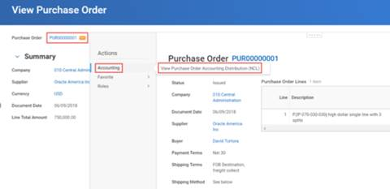
Tips and Tricks – PO Accounting Details
Locate and select the Purchase Order from the Procurement Dashboard or by using the global search using the purchase order number.
Select the Related Actions (orange) button as shown below. Under actions, hover your mouse over Reporting and then select <View Purchase Order Accounting Distribution (NCL).

Slide 3
PO Accounting Details cont’d

Slide 4
Questions?

