Slide 1
Procure to Pay Project
Tips and Tricks – Understanding the Match Exception Worklet

Slide 2
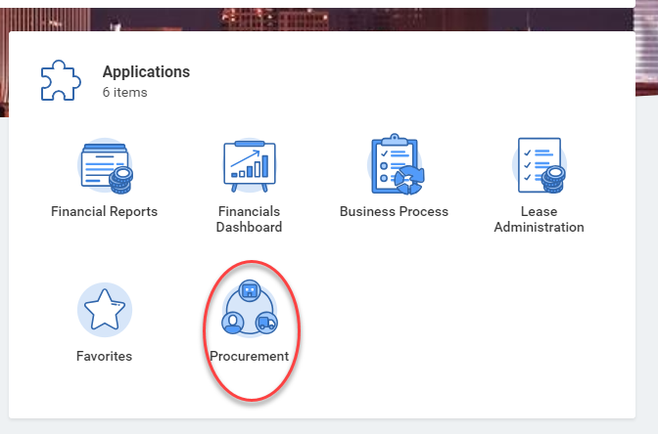
Tips and Tricks – Understanding the Match Exception Worklet
Your Match Exception Worklet is located in the Procurement Dashboard.
Click on the Procurement option on your Workday Home Screen.
Scroll down to the Worklet labeled Supplier Invoices in Match Exception.
If your Worklet has an orange triangle you will need to click the gear icon and select edit. Then you can put in your name so the Worklet will only show your Match Exceptions.

Slide 3
Tips and Tricks – Understanding the Match Exception Worklet
Your Worklet will give you specific information. You can see the invoice number, the exception reason, who the exception is waiting for and the Purchase Order number.
The most common Match Exception reason is Needs Receipt.

Slide 4
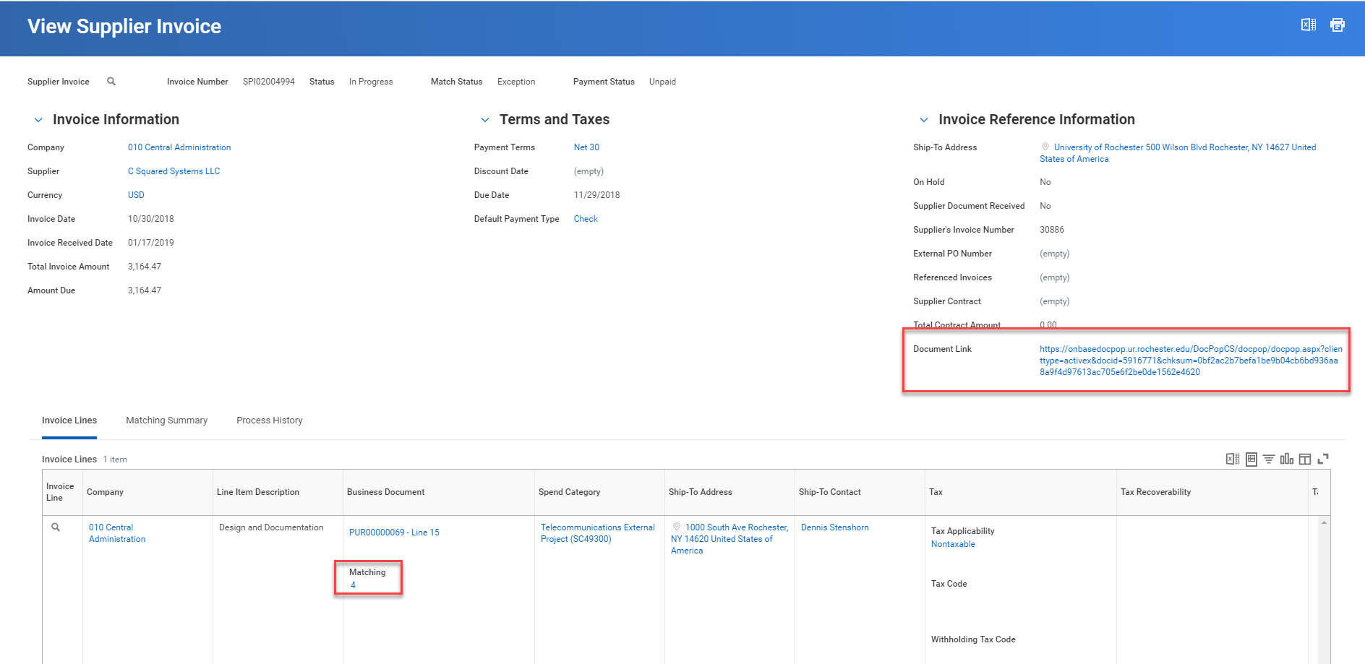
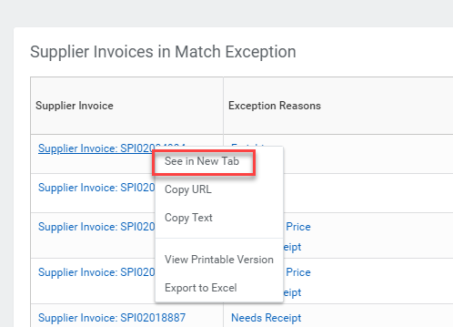
Tips and Tricks-Understanding the Match Exception Worklet
You can right click on any blue item and ask to see the details in a New Tab.
This will allow you to see greater detail when determining what action you should take.

Slide 5
Tips and Tricks-Understanding the Match Exception Worklet
After you take action to resolve your Match Exception you can click on the gear icon and Refresh the data in your Worklet. The Match Exception you resolved should disappear.

Slide 6
Questions?

