Slide 1
Procure to Pay Project
Tips and Tricks – View Requisition Line Split Details via Mobile Device.

Slide 2
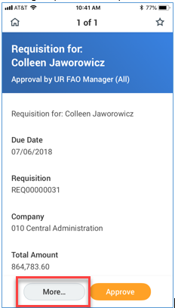
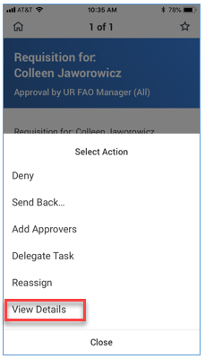
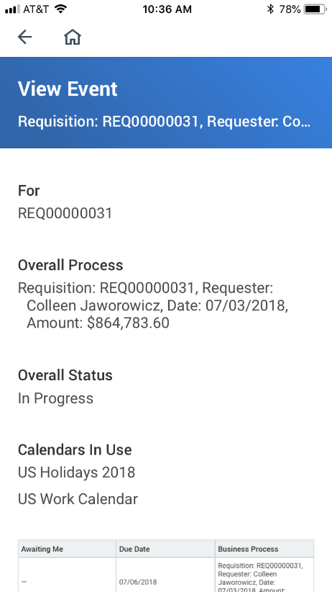
Viewing Requisition Line Split Details via Mobile Device
Scroll down to goods or services area
====➔

Slide 3
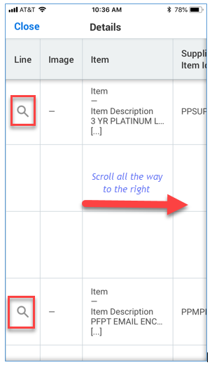
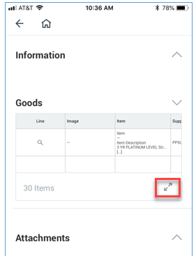
Viewing Requisition Line Split Details via Mobile - continued
Expand the goods (or services) detail by selecting the arrows (highlighted below).
====➔

Slide 4
Questions?

