Slide 1
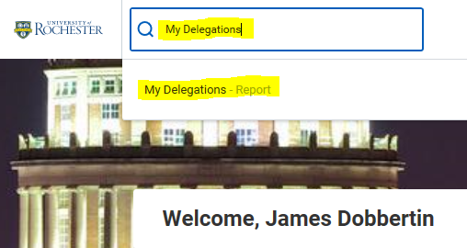
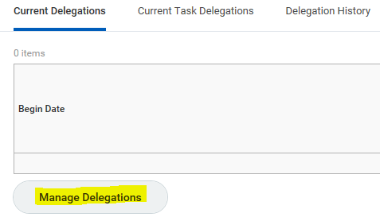
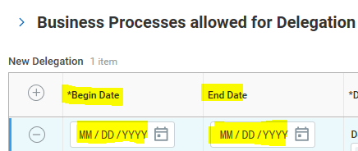
Workday Delegation Instructions
Delegation Guidelines:
Delegations can only be performed to another user that has the same role as the current user
Delegating an approval task does not absolve the person delegating the task of their responsibilities. They are still accountable for the delegate’s actions as it related to the delegated task.
Delegates will start receiving the delegated tasks only when new transactions are initiated. Any transactions already initiated will continue to flow to the original user.
Attach any supporting files, such as an email message accompanying the requested delegation change, to be included as part of the business process event.
Both you and either the delegate or the alternate delegate receive confirmation notifications when the delegations go into effect.
Delegates can also request reassignment for any delegated tasks, but they cannot delegate any delegated tasks to another worker.
Any delegated tasks will be recorded in the Process History with the words “On Behalf of”, followed by the name of the delegator.
My Delegations (continued):
To view current delegations or to create new delegations, search on “My Delegations” in the search box in Workday
Select the “Manage Delegations” button
Delegations require a specific date range, enter the start and end date. To delegate for a single day, enter the same Begin Date and End Date.

Slide 2
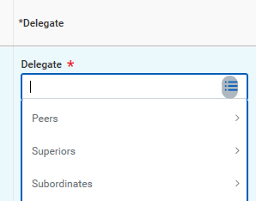
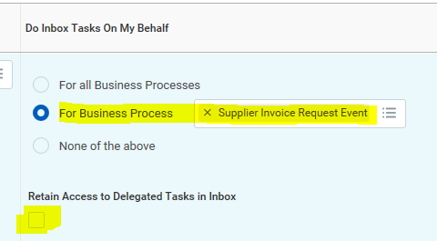
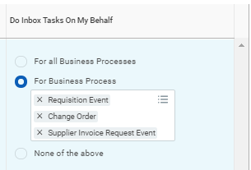
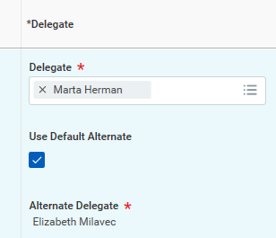
Workday Delegation Instructions
My Delegations (continued)
Delegates can be one of three types:
  Peers – anyone that reports to the same manager as you
  Superiors – anyone from your manager and up in the same management chain of command
  Subordinates – anyone that reports to you or anyone that reports to any of your peers
Select the delegate. Uncheck the “Use Default Alternate” unless you wish for your tasks to be sent to the Alternate Delegate listed.
My Delegations (continued)
Select the business process that you want to delegate. You can select “All Business Processes” or selected business processes (as displayed). Select “Retain Access to Delegated Tasks” in Inbox if you want to get notifications and access the tasks from your own Inbox as usual. If you retain access, then either you or your delegate can complete each task.
For Procurement tasks, select the following:

Slide 3
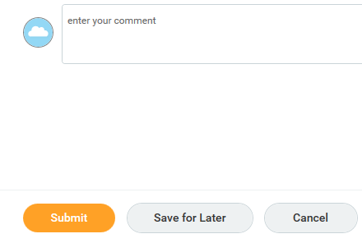
Workday Delegation Instructions
Press the “Submit” button to process the delegation, or press “Save for Later” in the event that you are not ready to have the delegation in effect at that time

