Slide 1
Procure to Pay Project
Demo Days
April, 2019
Notes:
Jim Dobbertin – Introduction and Kick Off

Slide 2
Are You On the Zoom?
Information for Zoom Participants
For those joining the Zoom:
1) Phones will be muted. Due to the volume of content to be shared, we may not have time for questions.
Send your questions to URProcurement@Rochester.edu They will be summarized and posted to the UR Procurement Website
3) P2P Frequently Asked Questions can also be found on the UR Procurement Website.
2
Notes:
Jim Dobbertin Note: If we do not have time to address questions submitted, they will be summarized and posted to the UR Procurement Website.

Slide 3
Topics
Project Review
Changes to Design Based on Pilots
Overview of P2P Methods and Systems
Blanket Order Options in P2P
Pilot 2 Participants
P2P Status Report
Supplier Invoice Request
Demonstration: Supplier Invoice Request (F4 Replacement)
Draft Roll Out Schedule
Roles and Responsibilities
Training, SIGs, Support Organization
Next Steps
Questions
3
Notes:
Carl Tietjen and Liz Milavec

Slide 4
Procure to Pay Objectives
Transition from paper-based to electronic transactions
Provide full transparency and visibility into all P2P transactions from entry to payment (procure-to-pay!)
Streamline entry and approval activities to enable better internal controls
Standardize purchasing activity
Improve cycle and approval times
Enable data driven price negotiations and strategic sourcing
4
Notes:
Katherine Sadoff-Herrick Are we sure we want to include the P2P Video?

Slide 5
Prepare
User Acceptance Test 1, 2
Pilot Groups
1 and 2
System Roll Out
1, 2, 3, …
P2P Project Phases
Nov 2017 - May 2018 June - Dec 2018 Feb - June 2019 July - Dec 2019
June 11, 2018: Early Users - Workday for non-catalogue goods and services
November 19, 2018: Adds Marketplace (Jaggaer) for creating shopping carts for catalogue items and purchase order distribution (Amazon look and feel)
February 18, 2019: Pilot 1 – Add additional departments/users, refine P2P design
April 15, 2019: Pilot 2 – Add additional departments/users, refine P2P design
June/July 2019: Start phased roll out to remaining departments and users
5
Notes:
Katherine Sadoff-Herrick

Slide 6
P2P Design Changes Based on Pilots
Moving purchasing review and approval for requisitions after cost center manager approval
Removing purchasing review and approval completely for Supplier Invoice Requests
Additional validations for data entry screens
Provisioning initiators at the cost center level rather than FAO level
Implementing a minimal threshold for purchase requisition and change orders where approvals aren’t required (except for Warner, ESM, SON, and MAG)

Slide 7
P2P Design Changes Based On Pilots
7
Notes:
Debbie Flotteron

Slide 8
Pilot 2 Participants
Pilot 2 – Wave 1 Go-Live 4/15/19
Advancement
Athletics and Recreation
Cancer Center – remaining FAO’s not included in Pilot 1
Center for Entrepreneurship
School of Nursing – Remaining FAO’s not included in Pilot 1
Memorial Art Gallery
University General
Warner School
Pilot 2 – Wave 2 Go-Live 4/22/19
Biochemistry and Biophysics
Biomedical Engineering
Earth and Environmental Science
Eastman Institute of Oral Health (EIOH)
Electrical and Computer Engineering
Radiation Oncology
Student Health Insurance Plan (University Health Services Student Program)
10
Notes:
Jim Dobbertin

Slide 9
UR Procurement Update
Requisitions -- Avg TAT 2.58 Days
Week 39 Total
New 78 1,066
Completed 65 1,017
In process/Draft 52 52
Cancelled /Denied 0 52
Supplier Invoice Request (SIRs) -- Avg TAT 1.61 Days
Week 39 Total
New 65 1,087
Completed 48 1,054
In process/Draft 19 19
Cancelled/Denied 2 47
11
Notes:
Jim Dobbertin

Slide 10
P2P Purchasing Methods and Systems
The following purchasing methods and systems are only applicable for FAOs that are currently live on the P2P implementation.
Type of Purchase | Workday | Jaggaer | PMM
Non-Catalogue Items (Goods and Services) | Non-Catalogue/Jaggaer Enabled Suppliers
Catalogue Items | Requisition begins in Workday and transitions to Jaggaer Marketplace for shopping | Enabled Catalog Suppliers (Example: Staples)
Inventoriable Items (Includes recalls, expirations, and chargebacks)
Invoices Only (In accordance with existing policy http://www.rochester.edu/adminfinance/finance/FinanceForms.html) | Acceptable Use Items for Invoice Payments
PCard | Current – US Bank Website Future - Workday
Note: As of November 19, 2018, requisition processes for Medical Center under discussion with Medical SIG
8
10
Notes:
Katherine Sadoff-Herrick

Slide 11
Blanket Order Options in P2P
 | Workday Function
PMM Blanket Order | Workday Non-Catalog Goods Requisition | Workday Catalog Goods Requisition | Workday Non-Catalog Service Requisition | Create Requisition Against Contract
Clinical Supply (i.e. medical supplies) Blanket Order
Non Clinical Supply (i.e. lab supplies) Blanket Order
Consultant/Independent Contractor Blanket Order
Equipment Maintenance/Service Blanket Order
9

Slide 12
Supplier Invoice Requests (SIRs)
12

Slide 13
Acceptable Use - Employees
Use the Acceptable Use List as a guide
http://www.rochester.edu/adminfinance/finance/FinanceForms.html
Employees can only receive a limited list of payments via the Supplier Invoice Request (SIR):
Royalty payments
Study subject payments
Performance fees
13
Notes:
Employees can be paid via a SIR for a limited list of transactions including royalty payments, study subject payments, and performance fees.
Performance fees are payments to someone who sings, plays an instrument, or DJs for a holiday party or similar event.

Slide 14
Not Acceptable Use
SIR cannot be used for payment of physician services
Employee physicians are paid for services via Payroll
Nonemployee physician services must be paid via Purchase Order (PO)
SIR cannot be used for purchase of capital items (Items of equipment or furnishings > $1000 with a life expectancy > one year)
Refer to UR's Capitalization policy for more details
14
Notes:
The SIR cannot be used for payment of physician services. Employee physicians are paid for services via Payroll and nonemployee physician services must be paid via Purchase Order.
And, the SIR process cannot be used for purchase of capital items which generally cost more than $1000, and have a life expectancy greater than one year. All capital purchases must be on a Purchase Order.

Slide 15
Payments in UR Procurement
Supplier Invoice Request
Questionnaire
Approval
Workflow
Payment
Header info
Line detail
Attachments
Capital Asset
Grant Principal Investigator/ORACS
Financial*
Special: IT, Pharmacy, Audit fees, Animals, EHS
Accounts Payable: 1099 reporting review and submission
Based on invoice due date
*Financial approval always required, other approvals based on meeting certain conditions
15
Notes:
Let’s review the Supplier Invoice Request (SIR) process in more detail. It starts with entry of data traditionally associated with invoices and related Questionnaire to gather additional detail as well as ensure appropriate use of the SIR.
Once the SIR and Questionnaire are complete, they are submitted into the approval process which is very similar to the Requisition approval process. Financial approval is always required and there may be multiple financial approvals needed depending on the dollar amount of the SIR.
Other approvals may be required based on the spend category or FAO utilized or if tax reporting information needs verification.
Once all required approvals are obtained the invoice is available to be settled and paid according to the Due Date.

Slide 16
Supplier Invoice Request (SIR)
Best Practice: To help prevent duplicate payment, search for invoice/payment prior to creating a SIR
Find Supplier Invoice Requests – Report
Find Supplier Invoice Lines (NCL) URF0992 – Report
Search for your supplier. Supplier: supplier name
To Create a Supplier Invoice Request:
Task is available from with Supplier Accounts Dashboard
In the global search box type “create supplier inv”
Refer to the Supplier Invoice Request (SIR) Reference Guide for detailed instructions.
16
Notes:
Now that you are sure the supplier is available to be entered on your SIR, in order to prevent duplicate payments it is best to search for invoices and payments to that supplier prior to creating a supplier invoice request. Use both the Invoice Requests and Invoice Lines reports to search for other activity already entered.
Once you are certain the invoice or payment has not already been entered, you can access the Create Supplier Invoice Request task from either the Supplier Accounts dashboard or by searching for the task in the global search box. The Create Supplier Invoice Request Guide contains additional screenshots that demonstrate entry of the required information.

Slide 17
SIR Sections
Header
Lines
Attachments
Splits
Fill in:
Invoice Date
Company
Supplier
Control Total Amount
Supplier’s Invoice Number or Memo,
Handling Code: Enclosure or Pick Up if appropriate
Goods or Service
Item Description
Spend Category
Quantity/Unit of Measure
Extended Amount
Additional Worktags
Memo = Line Memo
Internal Memo = Business Purpose
Attachments: Almost always required
Multiple files can be attached
Supported file types: pdf, excel, word, email, jpg, etc.
Exception: study participant (human subject) payment
W9s should be attached to Supplier Requests, NOT SIRs
Additional lines can be added for different items or to charge different FAOs or Spend Categories by clicking on the Add button
17
Notes:
Click on each section to view additional information.

Slide 18
SIR Actions
Action bar
Submit: to advance to the Questionnaire
Save for Later: if you do not have time to complete the required fields or need to research something before finishing
Cancel: if you determine the SIR should not be submitted, or want to start over
Validations
Custom validations ensure proper entry
Red bar: click on View All for guidance on the fields that need to be addressed
18
Notes:
After all the required information is entered you have 3 options. Selecting submit will prompt you to complete the questionnaire which is usually required. Or, you can save your progress to be completed at a later time or you cancel what you’ve entered. Save for Later will save your SIR in a status of Draft. Selecting Cancel will end the task you have started and none of your progress will be saved. Later we will show you how to search for your SIRs so that you can resume entry.
Upon submission custom validations a red error bar may pop up. You will need to resolve the problems identified before your work can be submitted.

Slide 19
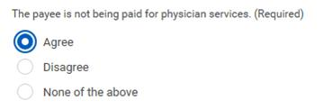
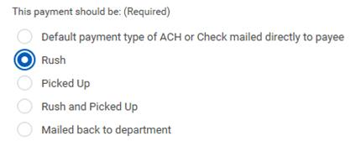
SIR – Questionnaire
Ensure SIR being used properly
Gather additional details
19
Notes:
The SIR Questionnaire questions help to ensure proper usage of the SIR process captures additional instruction on handling (payment urgency Due Date, Rush/Pick Up, Enclosure, etc.) You are prompted to explain/justify your use of the SIR for most responses of Disagree and sometimes you will be prompted to add an additional attachment, for example when you are requesting an Enclosure to be mailed with a Check payment. Branching questions may appear depending on your responses to prior questions.

Slide 20
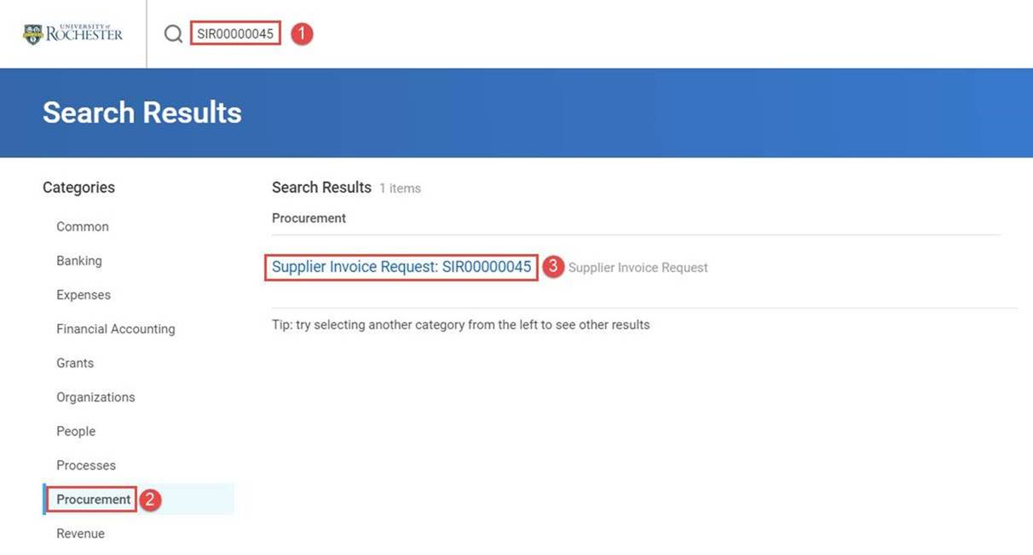
Finding SIRs
20
Notes:
You can access, edit, and submit a draft SIR where you are a Supplier Invoice Requester for the same FAO or cost center.
Enter the SIR number in the global search box and press Enter
Select the Procurement search category
Click on the SIR
Access the Edit task via related action
Note: The Requester remains the user who created the draft SIR, but the questionnaire routes to the user who just edited and submitted the SIR.

Slide 21
P2P Demonstration – Supplier Invoice Request (F4 Replacement)
21
Notes:
Debbie Flotteron

Slide 22
General Roll Out Strategy
Draft
22
Notes:
Jim Dobbertin

Slide 23
Roles and Responsibilities
Initiator (Purchase Requisitioner / Supplier Invoice Requester)
Complete purchase requisition
Build shopping cart for catalogued items
Complete supplier invoice requests
Answer questionnaire
FAO Manager
Approve all purchases over $500 (division specific)
Generally, only 1 user should be assigned the FAO Manager role If more than one is assigned, all FAO Managers need to approve every transaction for the FAO
Cost Center Procurement Manager
Approve all purchases above the FAO manager’s threshold
Company Financial Approver
Approve all purchases above the Cost Center manager’s threshold
If no approver is assigned at a lower level (i.e. FAO Manager), the next level up becomes the approver
23
Notes:
Jim Dobbertin

Slide 24
Training Options and Resources
Required Online training mini-courses available in MyPath
Optional additional monthly training to include:
In person classroom instruction and hands on session (Requisitions and Supplier Invoice Requests)
Job Aids
Quick Reference Cards
Video Snippets
Newsletters
Daily post go-live calls include a Tips and Trick Training Topic
24
Notes:
Jill Brock

Slide 25
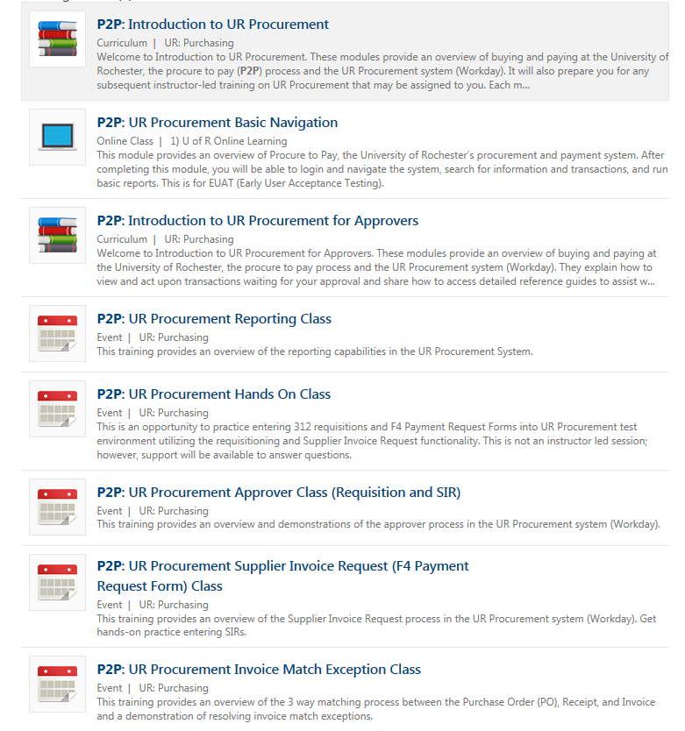
P2P Training – MyPath Courses
MyPath training courses now available to everyone. Search on P2P when in MyPath
P2P MyPath courses are available for all employees however, P2P team will continue to send email to targeted users as part of roll out schedule

Slide 26
MyPath Training Curriculum - Required
Role | Required Module(s) | Duration (minutes)
Initiator Requisitioner (Blue 312 Reqs) SIR Requestor (F4 Payments) | Buying and Paying Guide Overview P2P: UR Procurement Basic Navigation P2P: Create Requisition Overview P2P: Marketplace Overview P2P: Supplier Invoice Request (SIR) Overview | 15 15 20 20 20
Approver | P2P: UR Procurement Basic Navigation P2P: UR Procurement Approver Overview | 15 15
26
Notes:
Jill Brock

Slide 27
P2P Training Schedule
Offering Zoom instructor led monthly training option for:
Approver
Match Exception
Reporting
Offering classroom instructor led monthly training option for:
Requisitioner
Supplier Invoice Requester

Slide 28
Instructor Led Training (Optional)
Course | Description | Duration
UR Procurement Create Requisition (312) and Marketplace (SOLO) Class | This classroom training provides an overview of the procure to pay (P2P) process and the UR Procurement system (Workday). Get hands-on practice entering requisitions for goods and services as well as ordering from the Marketplace (previously SOLO). Register for the class in MyPath | 2.5 hours
UR Procurement Supplier Invoice Request (F4 Payment Request Form) Class | This classroom training provides an overview of the Supplier Invoice Request process in the UR Procurement system (Workday). Get hands-on practice entering SIRs. Register for the class in MyPath | 60 minutes
UR Procurement Approver Class (Requisitions and SIR) | This Zoom Training provides an overview and demonstrations of the approver process in the UR Procurement system (Workday). Register for the class in MyPath | 30 minutes
UR Reporting | This Zoom Training provides an overview of the reporting capabilities in the UR Procurement System. Register for the class in MyPath | 45 minutes
28
Notes:
Jill Brock

Slide 29
Instructor Led Training (Optional)
Course | Description | Duration
UR Procurement Invoice Match Exception Class | This Zoom training provides an overview of the 3 way matching process between the Purchase Order (PO), Receipt, and Invoice and a demonstration of resolving invoice match exceptions. Register for the class in MyPath | 1 hour
29
Notes:
Jill Brock

Slide 30
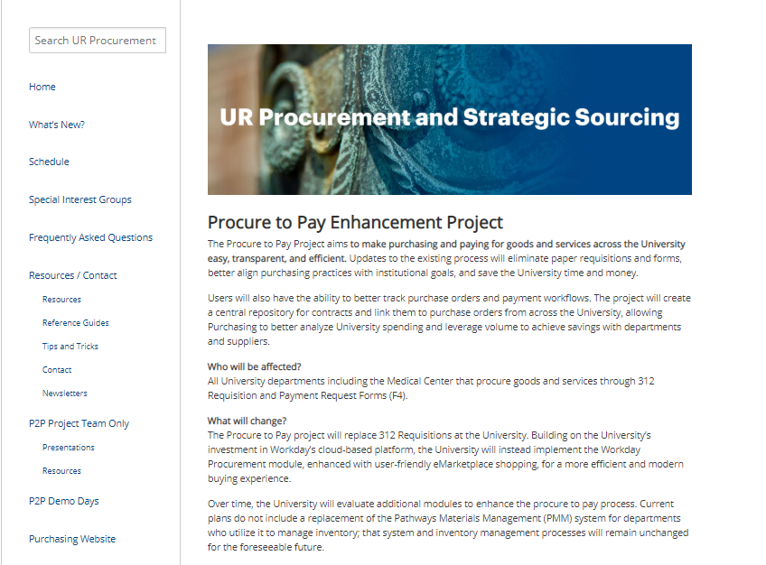
P2P Communications
Procure to Pay Website rochester.edu/adminfinance/urprocurement
Reference Guides
Newsletters
FAQs
Project Schedule and Status
New: Tips and Tricks
New : Video Snippets
Monthly P2P Demo Days
2 Sessions (Medical Center and Campus)
Project Updates, Demo of system functionality
30

Slide 31
Support Organization
Procure to Pay Customer Service Center is available to answer questions or provide assistance
UR Procurement website: rochester.edu/adminfinance/urprocurement
P2P Service Center: 275-2012
Email: URProcurement@rochester.edu
Service Desk Requests: https://service.rochester.edu/procurement
For System Access & Issues
Help Desk: UnivIT: 275 - 2000, UnivITHelp@ rochester.edu
Help Desk URMC: 275-3200, helpdesk_ISD@ urmc.rochester.edu
31
Notes:
Jill Brock

Slide 32
Special Interest Groups and Leaders
Special Interest Groups Leader
Requisition and Receiving Debbie Flotteron
Invoicing Matching Marta Herman
Medical Center Carl Tietjen, Katie Oleksyn
Research Debbie Flotteron, Mike Ritz
Capital Mike Altobelli, Carrie Ballou
If you are interested in participating in one of the Special Interest Groups, please contact the leader for the group.
32
Notes:
Jim Dobbertin

Slide 33
Next Steps
Monthly Demo Day Meetings
Medical Center
River Campus
Visit the P2P Website UR Procurement Website
Questions? Please reach out to:
URProcurement@Rochester.edu
Future Demo Day Topics
May: Creating Receipts and Invoice Match Exceptions
June: Reporting and Ledger Reconciliation for Purchasing Transactions
33
Notes:
Jim

Slide 34
Questions?
When do we get our Login ID’s to access Workday after training? You will be granted rights on your go live date. Your NetID will be required to access Workday.
I use 312 requisitions internally. How will P2P affect this? This is out of scope. You will continue to use 312 requisitions for internal purchases.
If I have an existing role in Workday, will I have another role based on Procure to Pay? Yes
Could people have multiple roles in Procure to Pay? Yes, someone could have multiple roles. As an example, someone could be a Requisitioner and a Supplier Invoice Requestor.
Will my P2P login be the same as UR Financials login? Yes, it will be your NetID
If there are multiple FAO’s in a department, could someone prepare the information (requisition or SIR) and leave the FAO information for someone else to complete? No, the Requisitioner or Supplier Invoice Requestor are required to complete all information including FAO and Spend Category before they can submit the request.
Can you have multiple people assigned to an FAO as a Requisitioner or Supplier Invoice Requestor? Yes
Will approvals be needed for approval of all transactions currently in SOLO (i.e. Dupli – Business Cards)? This is currently under review.
34

Slide 35
Questions?
Will there be different training for Supplier Invoice Requestors from Workday Training? Yes, there is MyPath Training and Instructor Led Training specific to roles.
If the FAO Manager does not agree with the FAO or Spend Category assigned by the requestor, can they change it? No, they can send it back with a note indicating to change it to a different FAO or Spend Category.
How do I request a supplier catalog be created in the Marketplace? Submit an ticket to the P2P Service Center https://service.rochester.edu/procurement
Will Principal Investigators have to be trained to do approvals for Research Grants? Yes
What if the supplier is not in Workday, will I be able to create a requisition? Yes, you can create a requisition without a supplier; however, the current Supplier Qualification process will not change and will delay release of the purchase order.
Can a Principal Investigator assign a delegate? Yes, a permanent or temporary delegate can be assigned in Workday; however, in assigning a delegate they are assuming fiduciary responsibility for the transaction.
35

Slide 36
Questions?
If you have a Supplier Invoice Request (SIR) or Requisition with multiple FAO’s, will it route to the individual FAO Manager for approval? Each FAO will route to the assigned FAO Manager for approval.
How many FAO splits are allowed on a line? There is no limit.
Will the Supplier Price Justification Conflict Information Form (SPJCI) still be required if transaction is > $25,000? Yes, this form will still be required. A form within Workday is being developed in place of the paper form and will be available sometime in 2019.
Will access to the Marketplace Suppliers be restricted to specific departments? Not at this time
36

