Slide 1


Procure to Pay Project
Invoice Match Exception Overview
October 30, 2018 – P2P Staff Meeting

Slide 2
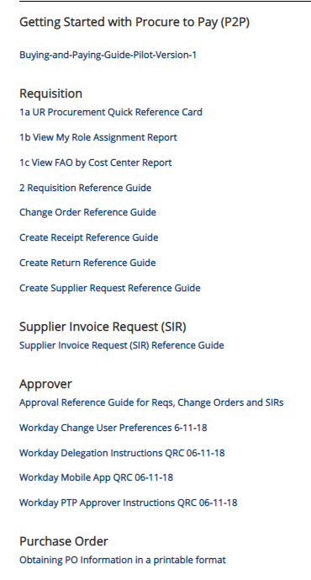
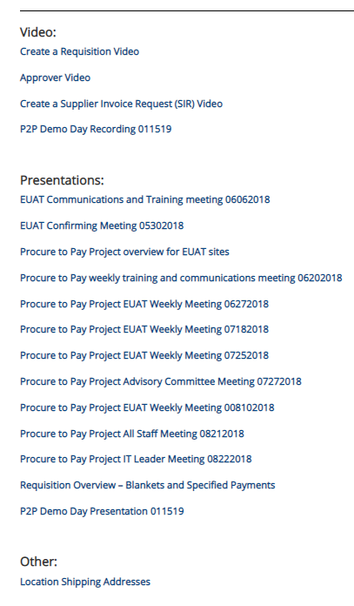

Resources
  UR Procurement Website
  https://www.rochester.edu/adminfinance/urprocurement/

Slide 3
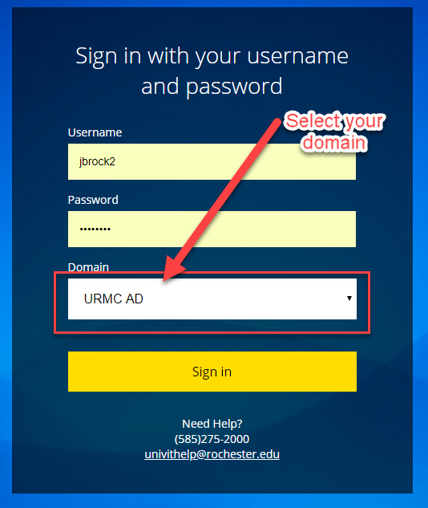
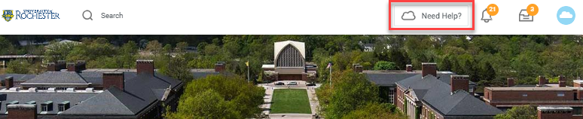
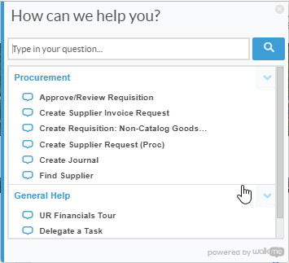
Resources cont’d
P2P Service Center
https://service.rochester.edu/procuement
Log in with your Domain Name, choose domain.
WalkMe
Select Need Help? for step-by-step on-screen help.
Smart Tips are also available
Notes:
If you don’t see the Need Help button contact the IT helpdesk at 275-2000 or Univithelp@Rochester.edu

Slide 4
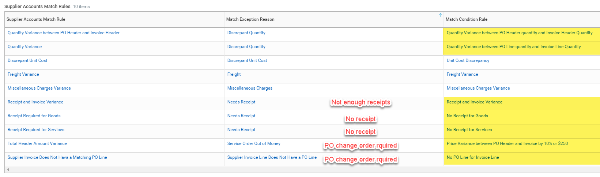
Workday Invoice Match Exception Rules
October 30, 2018 – P2P Staff Meeting
There are currently 10 match exception rules in Workday. 7 of the 10 rules will route to the Requester*
*Coming soon, requester match exceptions will also be routed to the requisitioner (when the requisitioner is different from the requester)
4

Slide 5
Invoice Match Exception Rules
October 30, 2018 – P2P Staff Meeting
Invoice Match Exceptions
What type of invoice match exceptions should the Requester expect to see?
  Lack of Receipts. Receipts are required for goods over $2500, all services, grants and capital purchases.
  Missing Purchase Order Line
  Quantity and/or Price Discrepancies
If there is only a quantity discrepancy or receipt discrepancy (and no price discrepancy), the supplier accounts match exception is sent to the requester to take action. However, when there is a unit price discrepancy in addition to a requester match exception, the exception will be sent to the Purchasing CM first.
System Tolerances
Only exceptions outside of the system tolerances outlined below will be sent to Purchasing:
  Freight Variance > $25
  Miscellaneous (Other) >$25
  Unit Price – 10% or $250 per line, whichever is less
  Total Header Amount Variance – Header Price 10% or $250 total, whichever is less
5
Notes:
Miscellaneous charges could be handling or assorted fees applied to orders.
Total Header Amount Variance means the header total is different from the line total on the invoice.

Slide 6

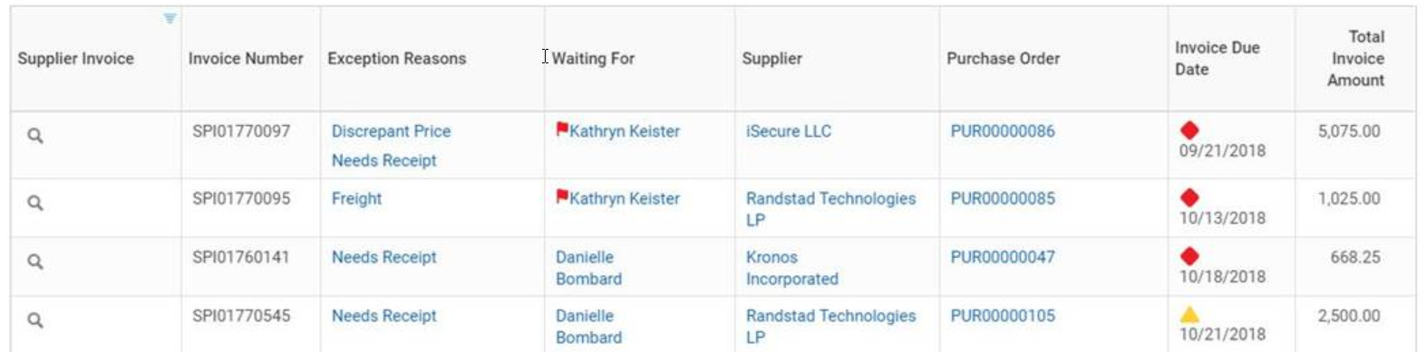
Match Exception Review Step
Reference Guide:
UR Procurement – Match Exceptions Reference Guide (Coming Soon)
Review Steps:
Review the Supplier Invoices in Match Exception Worklet in your Procurement dashboard to identify any match exceptions assigned to you. Take note of the following:
  Exception Reasons include both header and line
  Waiting For indicator for the current user to quickly see what’s awaiting their action
  Purchase Order for quick drilling and related actions (e.g. Create Receipt)
  Invoice Due Date indicator to quickly see how soon the invoice is due
    Green circle if more than two weeks until due
    Yellow triangle if due in 6 to 14 days
    Red diamond if due within 5 days or overdue

Slide 7
Match Exception Review Steps
Review Steps: Continued
An email notification will let you know that you have a match event awaiting your review.
Review the goods line and determine if the invoiced quantity is correct.
Review the total amount for a services line compared to the invoice total and determine if more money needs to be added to the PO in order to pay the overage.
Review the Purchase Order and the Invoice to determine if additional lines need to be added to the Purchase Order. Create a change order on the purchase order if required.
Create a receipt if required.

Slide 8
Discrepancy Steps
Price Discrepancy
  Price variance between PO and Invoice greater than 10% or $250 tolerance.
  Additional Funds Needed?
    If additional funds need to be added to the purchase order, a Purchasing Category Manager will reassign the supplier match exception to the requisitioner so they can do a Change Order to add funds to the purchase order. Coming soon: these notifications will go directly to the requester/requisitioner to streamline the process.
  Purchasing may cancel an Invoice if Supplier will not send in a credit memo and UR should Not Pay Invoice Price
    If UR should not pay the invoice and the supplier will not send in a credit memo to correct the invoice, Purchasing CM will need to use <Send Back> to AP with reason to “Cancel this Invoice.” The requisitioner may be asked to obtain a corrected invoice from the supplier.
Quantity Discrepancy
You received more and were invoiced for more product than you ordered.
    If you decide to keep the greater amount of product you should do a receipt and over receive for the actual amount you received. You will then need to do a Change Order on the PO and increase the quantity on the PO to match the invoice and your receipt.
    If you don’t want the extra product you should arrange with the supplier to return the extra and ask them to submit a credit memo or a corrected invoice.

Slide 9

Match Exception
  Demo:
  Setup Match Exception Worklet on Dashboard
  Find Supplier Invoice Line Distributions (NCL) URF1034
  Receipt Exception
    Create a Receipt
  Review Quantity Exception
    Over-receive on the receipt
    Do a Change Order on the PO to increase the quantity
Notes:
Proxy as Regina Shannon to demo worklet set up.
stage invoice match exceptions for No Receipt (services req). Demo: create receipt
stage invoice match exceptions for Qty discrepancy (goods req, order quantity 5, invoice for 10)
Demo: over receive and create change order (phone)

Slide 10
Questions?
October 30, 2018 – P2P Staff Meeting

