Slide 1
Procure to Pay Project
Demo Days
May, 2019
Notes:
Jim Dobbertin – Introduction and Kick Off

Slide 2
Are You On the Zoom?
Information for Zoom Participants
For those joining the Zoom:
1) Phones will be muted. Due to the volume of content to be shared, we may not have time for questions.
Send your questions to URProcurement@Rochester.edu They will be summarized and posted to the UR Procurement Website
3) P2P Frequently Asked Questions can also be found on the UR Procurement Website.
2
Notes:
Jim Dobbertin Note: If we do not have time to address questions submitted, they will be summarized and posted to the UR Procurement Website.

Slide 3
Topics
Project Review
P2P Status Report
Match Exception
Demonstration: Match Exception Process
Draft Roll Out Schedule
Resources
Training
Support Organization
Next Steps
3
Notes:
Carl Tietjen and Liz Milavec

Slide 4
Procure to Pay Objectives
Transition from paper-based to electronic transactions
Provide full transparency and visibility into all P2P transactions from entry to payment (procure-to-pay!)
Streamline entry and approval activities to enable better internal controls
Standardize purchasing activity
Improve cycle and approval times
Enable data driven price negotiations and strategic sourcing
4
Notes:
Katherine Sadoff-Herrick Are we sure we want to include the P2P Video?

Slide 5
Prepare
User Acceptance Test 1, 2
Pilot Groups
1 and 2
System Roll Out
1, 2, 3, …
P2P Project Phases
Nov 2017 - May 2018 June - Dec 2018 Feb - June 2019 July - Dec 2019
June 11, 2018: Early Users - Workday for non-catalogue goods and services
November 19, 2018: Adds Marketplace (Jaggaer) for creating shopping carts for catalogue items and purchase order distribution (Amazon look and feel)
February 18, 2019: Pilot 1 – Add additional departments/users, refine P2P design
April 15, 2019: Pilot 2 – Add additional departments/users, refine P2P design
June/July 2019: Start phased roll out to remaining departments and users
5
Notes:
Katherine Sadoff-Herrick

Slide 6
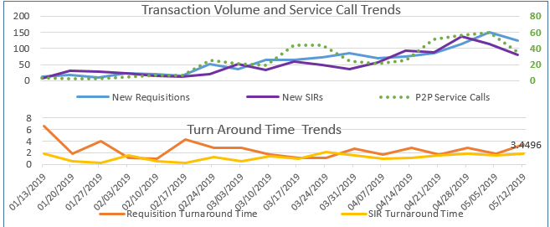
Metrics to Date – Reqs. / SIRs
Continue to increase number of requisitions (1,500) and SIRs (1,500)
Cumulative Requisition Turn Around Time at 2.6 days
Cumulative SIR Turn Around Time at 1.6 days
6

Slide 7
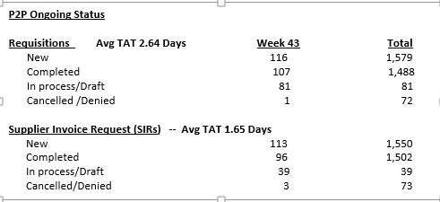
UR Procurement Update
8
Notes:
Jim Dobbertin

Slide 8
Lessons Learned from P2P Deployments to Date
Observation | Action Taken
Current procurement processes don’t require all transactions to be approved | Implement $500 approval threshold
Instructor led training desirable with majority number of P2P users being new to Workday | Contract for a dedicated training resource
Current P2P Customer Service Center calls spike at go-live | Contract for additional service center reps. Implement department project champions
Identification and provisioning of users requires significant coordination | Identification of department coordinators to consolidate user lists
Some departmental specific pricing and terms were not negotiated with Purchasing involved | Collaboration between departments and purchasing required to optimize pricing for all
Interdependence with other projects requires significant cross project communications | Bi-weekly project manager meetings
7

Slide 9
Procure to Pay Project
Invoice Match Exception Overview
October 30, 2018 – P2P Staff Meeting
9

Slide 10
Workday Invoice Match Exception Rules
October 30, 2018 – P2P Staff Meeting
There are currently 10 match exception rules in Workday. 7 of the 10 rules will route to the Requester*
*Coming soon, requester match exceptions will also be routed to the requisitioner (when the requisitioner is different from the requester)
10

Slide 11
Invoice Match Exception Rules
October 30, 2018 – P2P Staff Meeting
Invoice Match Exceptions
What type of invoice match exceptions should the Requester expect to see?
Lack of Receipts. Receipts are required for goods over $2500, all services, grants and capital purchases.
Missing Purchase Order Line
Quantity and/or Price Discrepancies
If there is only a quantity discrepancy or receipt discrepancy (and no price discrepancy), the supplier accounts match exception is sent to the requester to take action. However, when there is a unit price discrepancy in addition to a requester match exception, the exception will be sent to the Purchasing Category Manager first.
System Tolerances
Only exceptions outside of the system tolerances outlined below will be sent to Purchasing:
Freight Variance > $25
Miscellaneous (Other) >$25
Unit Price – 10% or $250 per line, whichever is less
Total Header Amount Variance – Header Price 10% or $250 total, whichever is less
11
Notes:
Miscellaneous charges could be handling or assorted fees applied to orders.
Total Header Amount Variance means the header total is different from the line total on the invoice.

Slide 12
Invoice Match Exception Review Step
Reference Guide:
UR Procurement – Match Exceptions Reference Guide (Coming Soon)
Review Steps:
Review the Supplier Invoices in Match Exception Worklet in your Procurement dashboard to identify any match exceptions assigned to you. Take note of the following:
Exception Reasons include both header and line
Waiting For indicator for the current user to quickly see what’s awaiting their action
Purchase Order for quick drilling and related actions (e.g. Create Receipt)
Invoice Due Date indicator to quickly see how soon the invoice is due
Green circle if more than two weeks until due
Yellow triangle if due in 6 to 14 days
Red diamond if due within 5 days or overdue
12

Slide 13
Invoice Match Exception Review Steps
Review Steps: Continued
An email notification will let you know that you have a match event awaiting your review.
Review the goods line and determine if the invoiced quantity is correct.
Review the total amount for a services line compared to the invoice total and determine if more money needs to be added to the PO in order to pay the overage.
Review the Purchase Order and the Invoice to determine if additional lines need to be added to the Purchase Order. Create a change order on the purchase order if required.
Create a receipt if required.
13

Slide 14
Invoice Match Exception Discrepancy Steps
Price Discrepancy
Price variance between PO and Invoice greater than 10% or $250 tolerance.
Additional Funds Needed?
If additional funds need to be added to the purchase order, a Purchasing Category Manager will reassign the supplier match exception to the requisitioner so they can do a Change Order to add funds to the purchase order. Coming soon: these notifications will go directly to the requester/requisitioner to streamline the process.
Purchasing may cancel an Invoice if Supplier will not send in a credit memo and UR should Not Pay Invoice Price
If UR should not pay the invoice and the supplier will not send in a credit memo to correct the invoice, Purchasing CM will need to use <Send Back> to AP with reason to “Cancel this Invoice.” The requisitioner may be asked to obtain a corrected invoice from the supplier.
Quantity Discrepancy
You received more and were invoiced for more product than you ordered.
If you decide to keep the greater amount of product you should do a receipt and over receive for the actual amount you received. You will then need to do a Change Order on the PO and increase the quantity on the PO to match the invoice and your receipt.
If you don’t want the extra product you should arrange with the supplier to return the extra and ask them to submit a credit memo or a corrected invoice.
14

Slide 15
P2P Demonstration – Invoice Match Exception
15
Notes:
Debbie Flotteron

Slide 16
P2P Roll Out – High Level Schedule
Completed
SHIP (011), Warner (024), SON (060), MAG (070), Univ. Gen’l (080), EIOH (092)
Roll Out 1 – July 15th
AS&E (020, 021, 022), some Simon (023), ESM (030), some SMD (040)
Roll Out 2 – September 16th
SMD
Roll Out 3 – November 18th
Some SMD, SMH/MFG
Roll Out 4 – January 20th
SMH/MFG/HSD
Roll Out 5 – March 16th
SMH/MFG/HSD
Any remaining
Draft
16

Slide 17
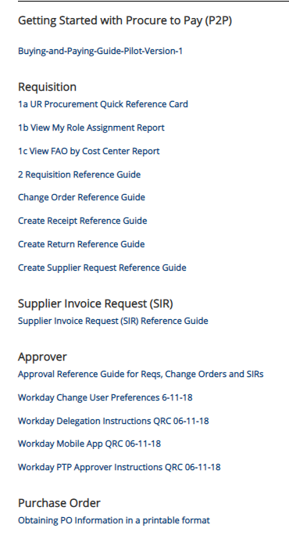
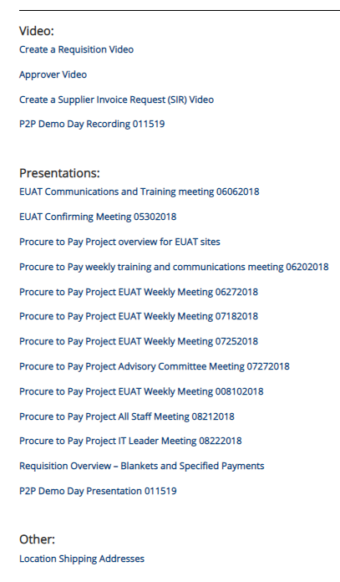
Resources
UR Procurement Website
https://www.rochester.edu/adminfinance/urprocurement/
17

Slide 18
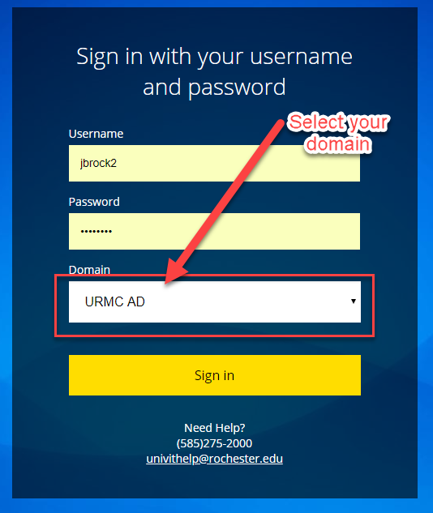
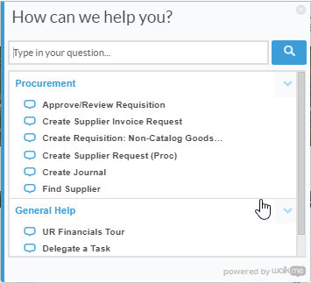
Resources cont’d
P2P Service Center
https://service.rochester.edu/procuement
Log in with your Domain Name, choose domain.
WalkMe
Select Need Help? for step-by-step on-screen help.
Smart Tips are also available
18
Notes:
If you don’t see the Need Help button contact the IT helpdesk at 275-2000 or Univithelp@Rochester.edu

Slide 19
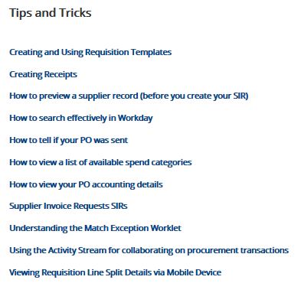
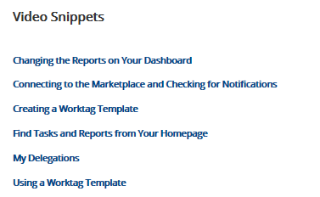
Tips & Tricks
19

Slide 20
P2P Training Options
Required Online training mini-courses available in MyPath
Offering Monthly Zoom instructor led monthly training option for:
Approver
Match Exception
Reporting
Offering monthly classroom instructor led monthly training option for:
Requisitioner
Supplier Invoice Requester
Job Aids, Quick Reference Cards, Video Snippets, Newsletters, Etc.
Daily post go-live calls include a Tips and Trick Training Topic
20

Slide 21
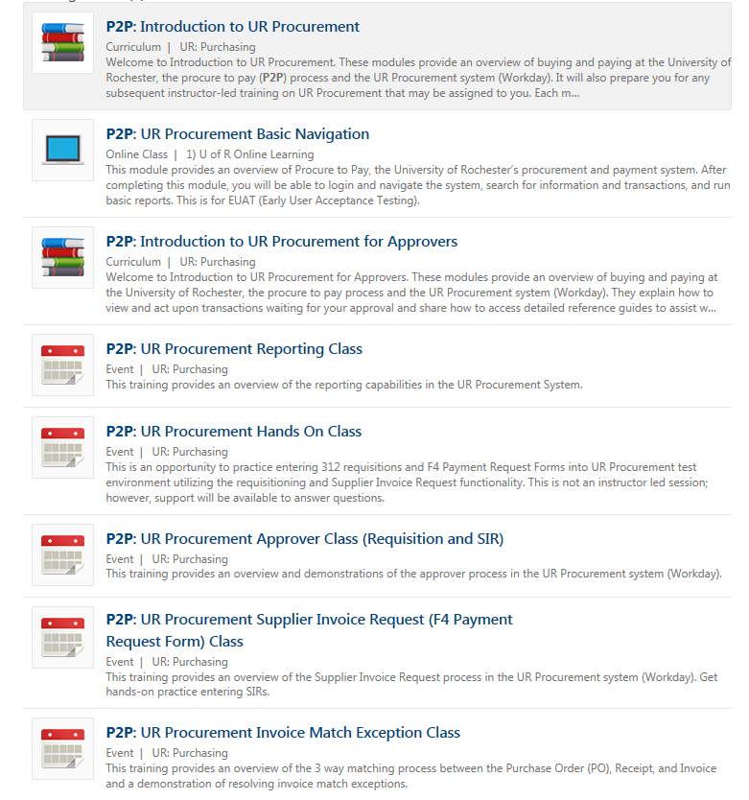
P2P Training – MyPath Courses
MyPath training courses now available to everyone. Search on P2P when in MyPath
P2P MyPath courses are available for all employees; however, P2P team will continue to send email to targeted users as part of roll out schedule
21

Slide 22
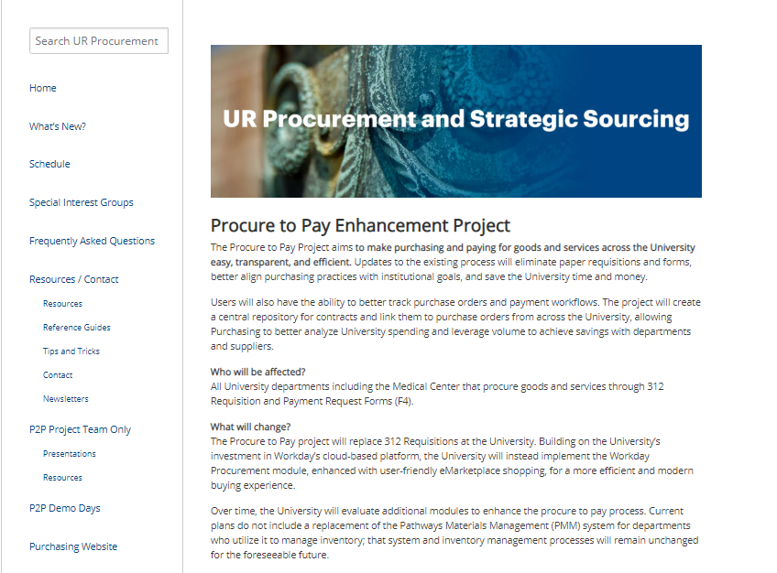
P2P Communications
Procure to Pay Website rochester.edu/adminfinance/urprocurement
Reference Guides
Newsletters
FAQs
Project Schedule and Status
New: Tips and Tricks
New : Video Snippets
Monthly P2P Demo Days
2 Sessions (Medical Center and Campus)
Project Updates, Demo of system functionality
22

Slide 23
Support Organization
Procure to Pay Customer Service Center is available to answer questions or provide assistance
UR Procurement website: rochester.edu/adminfinance/urprocurement
P2P Service Center: 275-2012
Email: URProcurement@rochester.edu
Service Desk Requests: https://service.rochester.edu/procurement
For System Access & Issues
Help Desk: UnivIT: 275 - 2000, UnivITHelp@ rochester.edu
Help Desk URMC: 275-3200, helpdesk_ISD@ urmc.rochester.edu
23
Notes:
Jill Brock

Slide 24
Next Steps
Monthly Demo Day Meetings
Medical Center
River Campus
Visit the P2P Website UR Procurement Website
Questions? Please reach out to:
URProcurement@Rochester.edu
Future Demo Day Topics
June: Reporting and Ledger Reconciliation for Purchasing Transactions
Beyond: P2P Alternatives to Blanket Orders
24
Notes:
Jim

Slide 25
MyPath Training Curriculum - Required
Role | Required Module(s) | Duration (minutes)
Initiator Requisitioner (Blue 312 Reqs) SIR Requestor (F4 Payments) | Buying and Paying Guide Overview P2P: UR Procurement Basic Navigation P2P: Create Requisition Overview P2P: Marketplace Overview P2P: Supplier Invoice Request (SIR) Overview | 15 15 20 20 20
Approver | P2P: UR Procurement Basic Navigation P2P: UR Procurement Approver Overview | 15 15
25
Notes:
Jill Brock

Slide 26
Instructor Led Training (Optional)
Course | Description | Duration
UR Procurement Create Requisition (312) and Marketplace (SOLO) Class | This classroom training provides an overview of the procure to pay (P2P) process and the UR Procurement system (Workday). Get hands-on practice entering requisitions for goods and services as well as ordering from the Marketplace (previously SOLO). Register for the class in MyPath | 2.5 hours
UR Procurement Supplier Invoice Request (F4 Payment Request Form) Class | This classroom training provides an overview of the Supplier Invoice Request process in the UR Procurement system (Workday). Get hands-on practice entering SIRs. Register for the class in MyPath | 60 minutes
UR Procurement Approver Class (Requisitions and SIR) | This Zoom Training provides an overview and demonstrations of the approver process in the UR Procurement system (Workday). Register for the class in MyPath | 30 minutes
UR Reporting | This Zoom Training provides an overview of the reporting capabilities in the UR Procurement System. Register for the class in MyPath | 45 minutes
26
Notes:
Jill Brock

Slide 27
Instructor Led Training (Optional)
Course | Description | Duration
UR Procurement Invoice Match Exception Class | This Zoom training provides an overview of the 3 way matching process between the Purchase Order (PO), Receipt, and Invoice and a demonstration of resolving invoice match exceptions. Register for the class in MyPath | 1 hour
27
Notes:
Jill Brock

