Slide 1
Procure to Pay Project
Demo Days
June, 2019
Notes:
Jim Dobbertin – Introduction and Kick Off

Slide 2
Are You On the Zoom?
Information for Zoom Participants
For those joining the Zoom:
1) Phones will be muted. Due to the volume of content to be shared, we may not have time for questions.
Send your questions to URProcurement@Rochester.edu They will be summarized and posted to the UR Procurement Website
3) P2P Frequently Asked Questions can also be found on the UR Procurement Website.
2
Notes:
Jim Dobbertin Note: If we do not have time to address questions submitted, they will be summarized and posted to the UR Procurement Website.

Slide 3
Topics
Project Review
P2P Status Report
FAO (Ledger) Reconciliation
Demonstration: FAO (Ledger) Reconciliation
Draft Roll Out Schedule
Resources
Training
Support Organization
Next Steps
3
Notes:
Carl Tietjen and Liz Milavec

Slide 4
Procure to Pay Objectives
Transition from paper-based to electronic transactions
Provide full transparency and visibility into all P2P transactions from entry to payment (procure-to-pay!)
Streamline entry and approval activities to enable better internal controls
Standardize purchasing activity
Improve cycle and approval times
Enable data driven price negotiations and strategic sourcing
4
Notes:
Katherine Sadoff-Herrick Are we sure we want to include the P2P Video?

Slide 5
Prepare
User Acceptance Test 1, 2
Pilot Groups
1 and 2
System Roll Out
1, 2, 3, …
P2P Project Phases
Nov 2017 - May 2018 June - Dec 2018 Feb - June 2019 July - Dec 2019
June 11, 2018: Early Users - Workday for non-catalogue goods and services
November 19, 2018: Adds Marketplace (Jaggaer) for creating shopping carts for catalogue items and purchase order distribution (Amazon look and feel)
February 18, 2019: Pilot 1 – Add additional departments/users, refine P2P design
April 15, 2019: Pilot 2 – Add additional departments/users, refine P2P design
June/July 2019: Start phased roll out to remaining departments and users
5
Notes:
Katherine Sadoff-Herrick

Slide 6
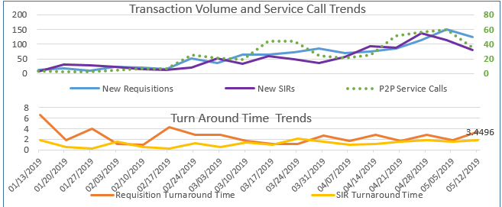
Metrics to Date – Reqs. / SIRs
Continue to increase number of requisitions (1,500) and SIRs (1,500)
Cumulative Requisition Turn Around Time at 2.6 days
Cumulative SIR Turn Around Time at 1.6 days
6

Slide 7
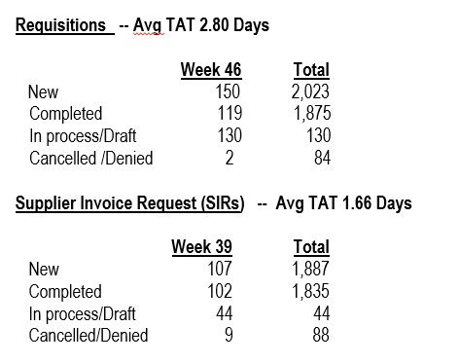
UR Procurement Update
7
Notes:
Jim Dobbertin

Slide 8
Lessons Learned from P2P Deployments to Date
Observation | Action Taken
Current procurement processes don’t require all transactions to be approved | Implement $500 approval threshold Implement $1,500 approval for grants
Goods receipts requirements aren’t understood | Goods receipts are required for: Grants Services Capital Goods catalog purchase =>$2,500 Goods non-catalog purchase => $0
8

Slide 9
Procure to Pay Project
Tips and Tricks – Monthly Ledger (FAO) Reconciliation Process
9

Slide 10
Tips and Tricks – Reconciling Your FAO
Objectives for reconciling your FAO:
Review transactions to ensure that they are valid and expected
Review for incorrect transaction posting
Verify that you are at or below the FAO budget
Verify especially any P2P transactions that are under the minimum threshold that don’t require approvals:
$500 for most companies
$1,500 for grant transactions
10

Slide 11
Tips and Tricks – Report Types
Two types of reports are necessary to verify that transactions that have been posted to the FAO are valid:
Budget to Actual Report – compare actual transactions posted against the budgeted amount
Transaction Detail Report – list of all transactions that were posted against the FAO
Reports vary based on capabilities of the report:
Drillable – allows the user to drill further into detail
Printable – fits on an 8.5x11’ landscape paper. Minimal columns
Scheduled – allows you to schedule the report with out to either pdf or Excel format
Based on the type of FAO, there are different reports for each of the above
11

Slide 12
Tips and Tricks: Budget to Actual Reports
Based on report capabilities, here are the primary reports for a budget to actual comparison:
FAO Type | Drillable | Printable | Scheduled
Grant | URF0840 | N/A | URF0987
Project | URF0916 | URF0976 | URF0991
All Other | URF0902 | URF0941 | URF0989
Quick Reference Cards available via the following link:
https://www.rochester.edu/adminfinance/urfinancials/training/training-materials/
12

Slide 13
Tips and Tricks: Budget to Actual Reports
Per each Revenue or Spend Category, verify that you are at or below the FAO budget
For the drillable reports, drill down into the actual transaction details and verify that all transactions are valid
If correcting entries are needed, please contact your divisional finance office for instructions
13

Slide 14
Tips and Tricks: Transaction Detail Reports
Based on report capabilities, here are the primary reports for transaction detail listing:
FAO Type | Drillable | Printable | Scheduled
Grant | URF0398 URF0400 | URF0943G | N/A
Project | URF0398 URF0400 | URF0943A URF0943B | URF0985
All Other | URF0398 URF0400 | URF0943A URF0943B | URF0985
Quick Reference Cards available via the following link:
https://www.rochester.edu/adminfinance/urfinancials/training/training-materials/
14

Slide 15
Tips and Tricks: Transaction Detail Reports
Review each transaction to ensure it is valid for the FAO
For the drillable reports, drill down into the actual transaction details, review any memo fields, etc. to verify that all transactions are valid
If correcting entries are needed, please contact your divisional finance office for instructions
15

Slide 16
P2P Demonstration – FAO (Ledger) Reconciliation
16
Notes:
Debbie Flotteron

Slide 17
P2P Roll Out – High Level Schedule
Completed
SHIP (011), Warner (024), SON (060), MAG (070), Univ. Gen’l (080), EIOH (092)
Roll Out 1:
July 15^{th -} AS&E (020, 021, 022)
July 29th – Complete Simon (023) and ESM (030)
August 12th – Start SMD (040)
Roll Out 2 – September 16th
SMD
Roll Out 3 – November 18th
Some SMD, SMH/MFG
Roll Out 4 – January 20th
SMH/MFG/HSD
Roll Out 5 – March 16th
SMH/MFG/HSD
Any remaining
Draft
17

Slide 18
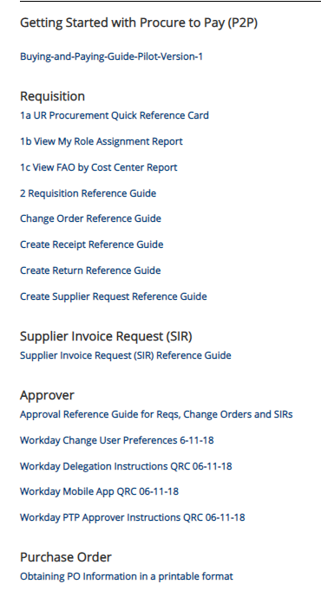
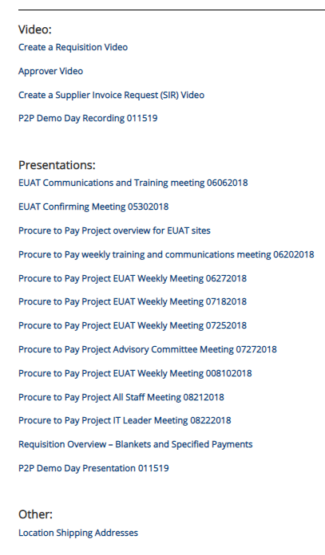
Resources
UR Procurement Website
https://www.rochester.edu/adminfinance/urprocurement/
18

Slide 19
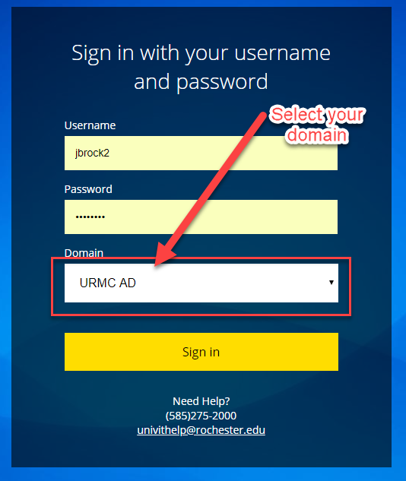
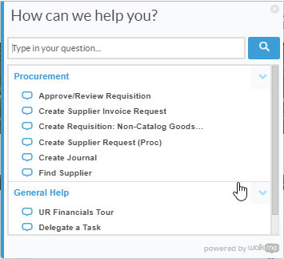
Resources cont’d
P2P Service Center
https://service.rochester.edu/procuement
Log in with your Domain Name, choose domain.
WalkMe
Select Need Help? for step-by-step on-screen help.
Smart Tips are also available
19
Notes:
If you don’t see the Need Help button contact the IT helpdesk at 275-2000 or Univithelp@Rochester.edu

Slide 20
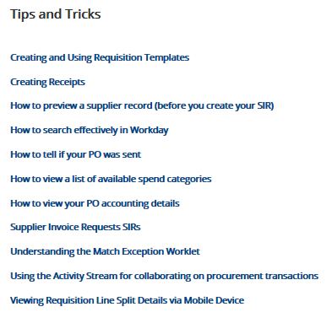
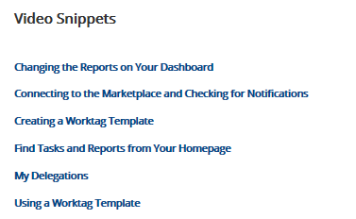
Tips & Tricks
20

Slide 21
P2P Training Options
Required Online training mini-courses available in MyPath
Offering monthly classroom instructor led monthly training option for:
Requisitioner
Supplier Invoice Requester
Job Aids, Quick Reference Cards, Video Snippets, Newsletters, Etc.
Daily post go-live calls include a Tips and Trick Training Topic
21

Slide 22
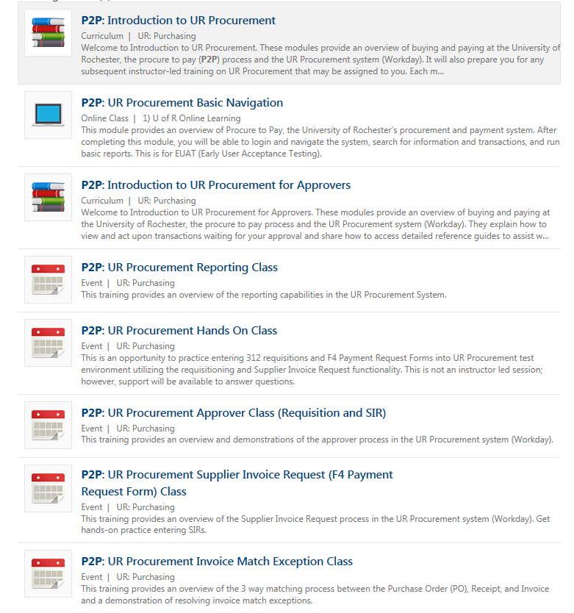
P2P Training – MyPath Courses
MyPath training courses now available to everyone. Search on P2P when in MyPath
P2P MyPath courses are available for all employees; however, P2P team will continue to send email to targeted users as part of roll out schedule
22

Slide 23
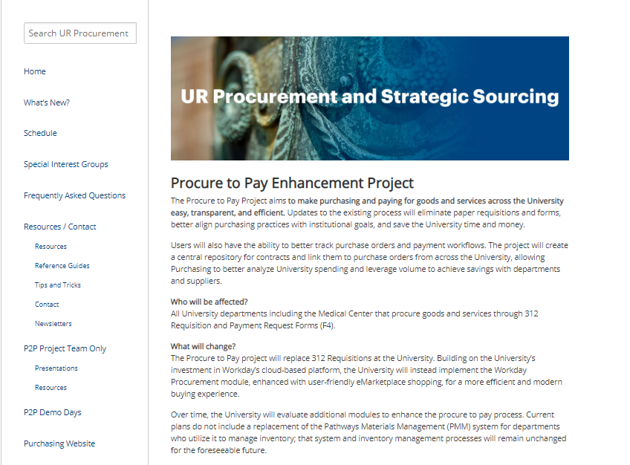
P2P Communications
Procure to Pay Website rochester.edu/adminfinance/urprocurement
Reference Guides
Newsletters
FAQs
Project Schedule and Status
Tips and Tricks
Video Snippets
Monthly P2P Demo Days
2 Sessions (Medical Center and Campus)
Project Updates, Demo of system functionality
23

Slide 24
Support Organization
Procure to Pay Customer Service Center is available to answer questions or provide assistance
UR Procurement website: rochester.edu/adminfinance/urprocurement
P2P Service Center: 275-2012
Email: URProcurement@rochester.edu
Service Desk Requests: https://service.rochester.edu/procurement
For System Access & Issues
Help Desk: UnivIT: 275 - 2000, UnivITHelp@ rochester.edu
Help Desk URMC: 275-3200, helpdesk_ISD@ urmc.rochester.edu
24
Notes:
Jill Brock

Slide 25
Next Steps
Monthly Demo Day Meetings
Medical Center
River Campus
Visit the P2P Website UR Procurement Website
Questions? Please reach out to:
URProcurement@Rochester.edu
Future Demo Day Topics
July: P2P Alternatives to Blanket Orders
25
Notes:
Jim

Slide 26
Appendix
26
Notes:
Jim

Slide 27
MyPath Training Curriculum - Required
Role | Required Module(s) | Duration (minutes)
Initiator Requisitioner (Blue 312 Reqs) SIR Requestor (F4 Payments) | Buying and Paying Guide Overview P2P: UR Procurement Basic Navigation P2P: Create Requisition Overview P2P: Marketplace Overview P2P: Supplier Invoice Request (SIR) Overview | 15 15 20 20 20
Approver | P2P: UR Procurement Basic Navigation P2P: UR Procurement Approver Overview | 15 15
27
Notes:
Jill Brock

Slide 28
Instructor Led Training (Optional)
Course | Description | Duration
UR Procurement Create Requisition (312) and Marketplace (SOLO) Class | This classroom training provides an overview of the procure to pay (P2P) process and the UR Procurement system (Workday). Get hands-on practice entering requisitions for goods and services as well as ordering from the Marketplace (previously SOLO). Register for the class in MyPath | 2.5 hours
UR Procurement Supplier Invoice Request (F4 Payment Request Form) Class | This classroom training provides an overview of the Supplier Invoice Request process in the UR Procurement system (Workday). Get hands-on practice entering SIRs. Register for the class in MyPath | 60 minutes
28
Notes:
Jill Brock

Slide 29
Enhanced MyPath Training
Course | Description | Duration
UR Reporting – Optional | This training provides an overview of the reporting capabilities in the UR Procurement System. Register for the class in MyPath | 20 minutes
UR Procurement Invoice Match Exception Class – Required for Requisitioners | This training provides an overview of the 3 way matching process between the Purchase Order (PO), Receipt, and Invoice and a demonstration of resolving invoice match exceptions. Register for the class in MyPath | 20 minutes
29
Notes:
Jill Brock

