Slide 1
Procure to Pay Project
Design Change Overview
July, 2019
Notes:
Jim Dobbertin – Introduction and Kick Off

Slide 2
Topics
Commodity Dimension (Requisition Checkout)
June Newsletter Topics:
Financial Approvals (<$500 not required except for MAG, ESM, SON, Warner; <$1,500 not required for Grants)
Internal memo field required for change orders
Non-catalog requisitions allowed for Marketplace Suppliers (cannot combine catalog and non-catalog lines on same requisition for Marketplace Suppliers)
Non-Standard Cost and Quantities
2
Notes:
Carl Tietjen and Liz Milavec

Slide 3
P2P Commodity Overview
Starting July 15th, we will be implementing a new field for Purchase requisitions
The purpose of the field is to enable more accurate routing of purchase requisitions to the appropriate purchasing team
The Commodity field will be required for all non-catalogued requisitions
3

Slide 4
Commodity Dimension
As a reminder, clinical supplies and internal purchases should continue to use existing purchase methods and NOT use P2P
4

Slide 5
Commodity Dimension
There are 3 choices for commodity value:
Capital and Equipment
Non Clinical
Services
Examples of what is in each commodity is available on the “Line Defaults” screen
5

Slide 6
Commodity Dimension
On the “Line Defaults” screen, a new field called “Commodity” appears and is the first one presented. Select one of the 3 options
The second field (“Additional Worktags”) is where you would enter your FAO
The commodity is a required field
If the transaction is for multiple commodities, select the one that has the largest dollar amount
6

Slide 7
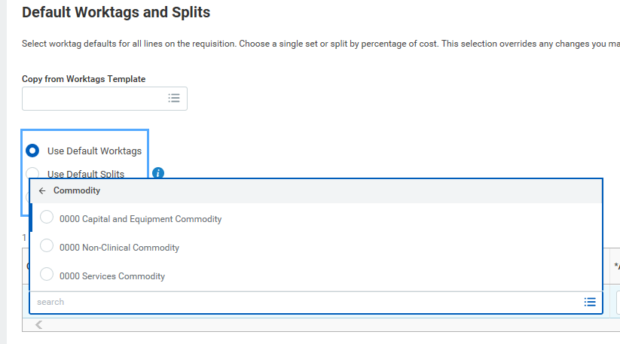
Commodity Dimension
Select the radio button for the commodity
7

Slide 8
Commodity Dimension
If no commodity is selected, you will get the following error message
If you enter more than one commodity on a single requisition (such as multi-line or single line with line splits), you will get an error message as well
8

Slide 9
P2P Commodity Dimension
9
Notes:
Debbie Flotteron

Slide 10
June Newsletter Topics
Financial Approvals <$ 500 - Not required for non-grants except for MAG, ESM, SON, Warner)
<$1,500 - Not required for Grants
Companies who have opted-in for the $500 threshold are still responsible for all charges and reconciliation. This does not affect the approval threshold for Supplier Invoice Requests, as all SIR’s require approval regardless of dollar value.
10

Slide 11
June Newsletter Topics
Internal Memo Field Required for Change Orders
The change order process has been updated in the Procure to Pay System to require an internal memo explaining the change(s) that were made to the purchase order. If you forget to add an explanation in the Internal Memo field, you will receive an error message reminding you to add this information. If you have any questions or need assistance with creating change orders, please contact the Procure to Pay Service Center.
11
Notes:
If you don’t see the Need Help button contact the IT helpdesk at 275-2000 or Univithelp@Rochester.edu

Slide 12
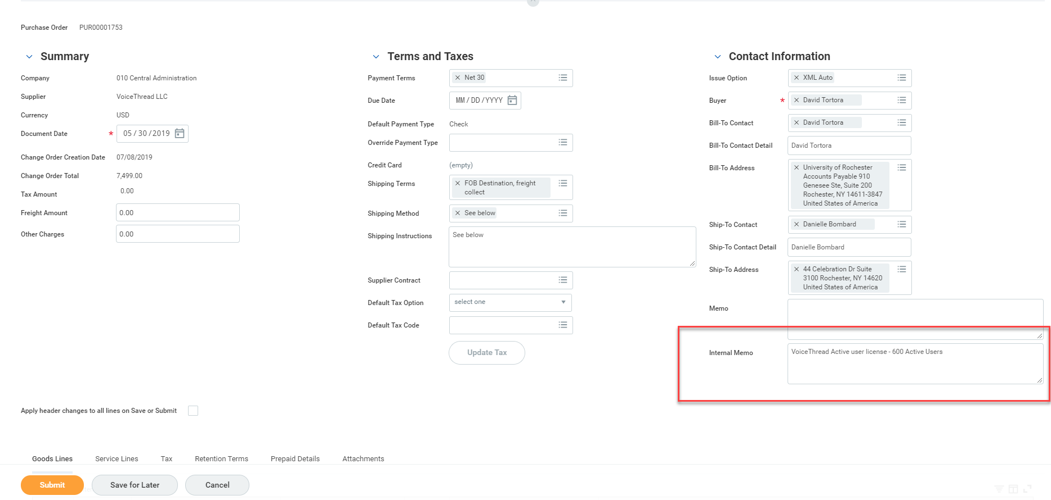
June Newsletter Topics
Internal Memo Field Required for Change Orders
12
Notes:
If you don’t see the Need Help button contact the IT helpdesk at 275-2000 or Univithelp@Rochester.edu

Slide 13
June Newsletter Topics
Non-catalog requisitions allowed for Marketplace Suppliers
When the P2P system was first implemented, if a supplier was enabled in Jaggaer (the Marketplace), Workday requisitioners could not create a non-catalogue requisition for that supplier. In June 209, non-catalogue orders have been enabled for Jaggaer suppliers. However, requisitioners cannot place both a catalogue AND a non-catalogue order for a Jaggaer supplier on the same requisition. They must be on separate requisitions.
13
Notes:
If you don’t see the Need Help button contact the IT helpdesk at 275-2000 or Univithelp@Rochester.edu

Slide 14
June Newsletter Topics
Non-Standard Costs and Quantities
Include a unit cost greater than $0 when creating line items on your requisition.
While Workday allows a negative unit cost, when the requisition is passed to Jaggaer, it does NOT allow for a negative unit cost. A validation has been added to Workday that will give the user an error message in the event that a negative unit cost is entered on a requisition.
Discounts
The preferred way to handle a discount is to reduce either all or one of the requisition line items by the amount of the discount, then list the discount in the Line Memo field. If the unit cost is listed as $0, the requisition will not route for financial approvals. Upon reaching Purchasing the requisition may not be able to be updated with a cost and could require it to be cancelled and a new requisition generated.
To avoid delays, please review the unit pricing prior to submitting your requisition.
Negative or Fractional Quantities
Keep in mind that listing a negative or fractional quantity will also stop your requisition from being processed—always use positive whole numbers!
.
14
Notes:
If you don’t see the Need Help button contact the IT helpdesk at 275-2000 or Univithelp@Rochester.edu

