Slide 1
Procure to Pay Project
Demo Days
July, 2019
Notes:
Jim Dobbertin – Introduction and Kick Off

Slide 2
Are You On the Zoom?
Information for Zoom Participants
For those joining the Zoom:
1) Phones will be muted. Due to the volume of content to be shared, we may not have time for questions.
Send your questions to URProcurement@Rochester.edu They will be summarized and posted to the UR Procurement Website
3) P2P Frequently Asked Questions can also be found on the UR Procurement Website.
2
Notes:
Jim Dobbertin Note: If we do not have time to address questions submitted, they will be summarized and posted to the UR Procurement Website.

Slide 3
Topics
Project Review
P2P Status Report
Blanket Purchase Order Options in P2P
Demonstration: Blanket Purchase Order Options - Goods
Draft Roll Out Schedule
Resources
Training
Support Organization
Next Steps
3
Notes:
Carl Tietjen and Liz Milavec

Slide 4
Procure to Pay Objectives
Transition from paper-based to electronic transactions
Provide full transparency and visibility into all P2P transactions from entry to payment (procure-to-pay!)
Streamline entry and approval activities to enable better internal controls
Standardize purchasing activity
Improve cycle and approval times
Enable data driven price negotiations and strategic sourcing
4
Notes:
Katherine Sadoff-Herrick Are we sure we want to include the P2P Video?

Slide 5
Prepare
User Acceptance Test 1, 2
Pilot Groups
1 and 2
System Roll Out
1, 2, 3, …
P2P Project Phases
Nov 2017 - May 2018 June - Dec 2018 Feb - June 2019 July – March 2020
June 11, 2018: Early Users - Workday for non-catalogue goods and services
November 19, 2018: Adds Marketplace (Jaggaer) for creating shopping carts for catalogue items and purchase order distribution (Amazon look and feel)
February 18, 2019: Pilot 1 – Add additional departments/users, refine P2P design
April 15, 2019: Pilot 2 – Add additional departments/users, refine P2P design
July/August 2019: Start phased roll out to remaining departments and users
5
Notes:
Katherine Sadoff-Herrick

Slide 6
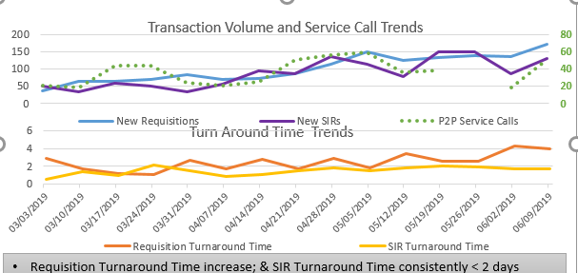
Metrics to Date – Reqs. / SIRs
Continue to increase number of requisitions (2,800) and SIRs (2,500)
Cumulative Requisition Turn Around Time at 3.57 days
Cumulative SIR Turn Around Time at 1.7 days
6

Slide 7
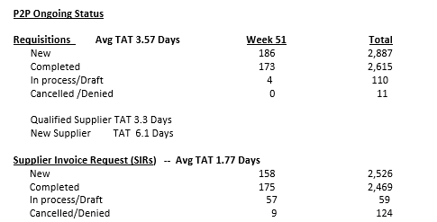
UR Procurement Update
7
Notes:
Jim Dobbertin

Slide 8
Lessons Learned from P2P Deployments to Date
Observation | Action Taken
Feedback on P2P processes and system design impact on departments | Focus Group to be developed
8

Slide 9
Rollout 1 Update
Wave 1 – July 15
Wave 2 – July 29
Wave 3 – August 12
300 New Initiators
140 New Approvers
1700 New FAOs enabled
9

Slide 10
BLANKET ORDERS IN WORKDAY
Goal:
Collect accurate purchase data for analysis to assist with contracting, cost savings, strategic decision-making and contract negotiation.
Step 1:
Determine if you need a Good (qty, unit of measure, item description, unit cost - i.e. equipment, supply) or Service (start date, end date, dollar value - i.e. Consultant/Independent Contractor, equipment maintenance agreement, software maintenance, etc) - Workday requisitions are created with goods or service lines
Step 2:
Determine the best requisition method based on the need (i.e. good or service) identified
2
10

Slide 11
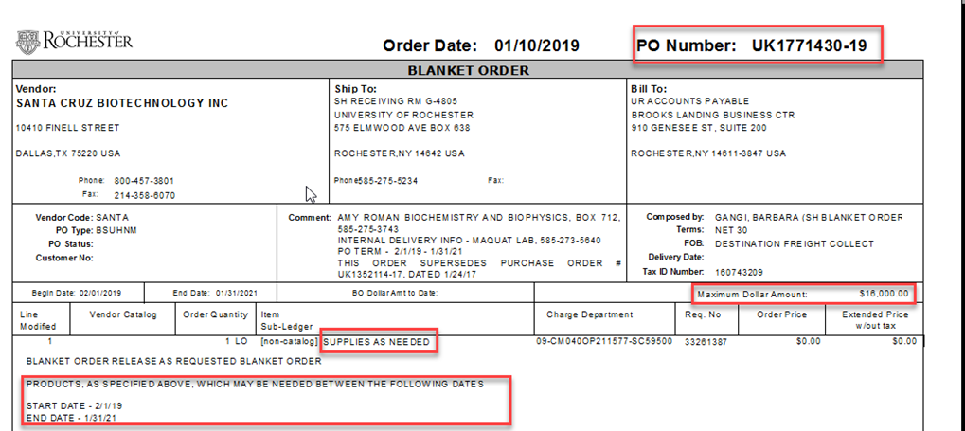
BLANKET ORDERS IN WORKDAY
Current PMM Blanket PO
Procure to Pay Goods Blanket Order Options
Workday Create Requisition Method | Purpose | Receipt Requirement
Catalog Requisition (Marketplace) | Order as needed from catalog suppliers | >$2,500 Non-Grant >$0 Grant (GR FAO)
Non-Catalog Goods Requisition | Order as needed from non-catalog suppliers not in the Marketplace | >$2,500 Non-Grant >$0 Grant (GR FAO)
Requisition Template (Goods) | If supplier is not in the Marketplace and you repeatedly order the same items, consider creating a requisition template to streamline ordering | >$2,500 Non-Grant >$0 Grant (GR FAO)
Non-Catalog Goods Requisition from prior non-catalog requisition | Utilize when you need to order an item(s) that was ordered previously to streamline the ordering process | >$2,500 Non-Grant >$0 Grant (GR FAO)
2
11

Slide 12
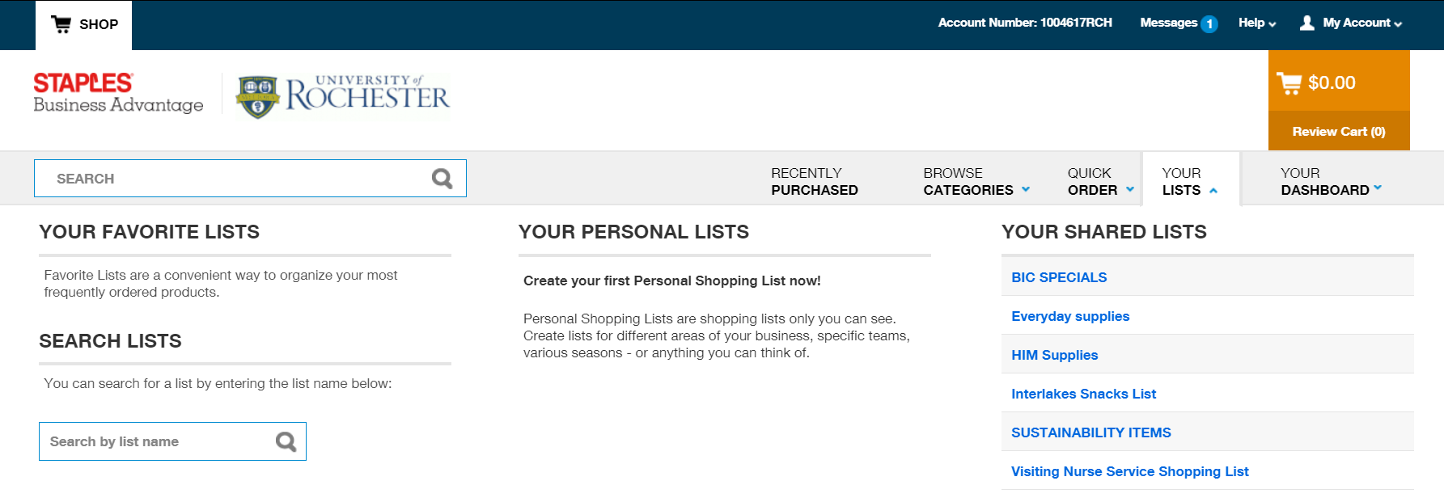
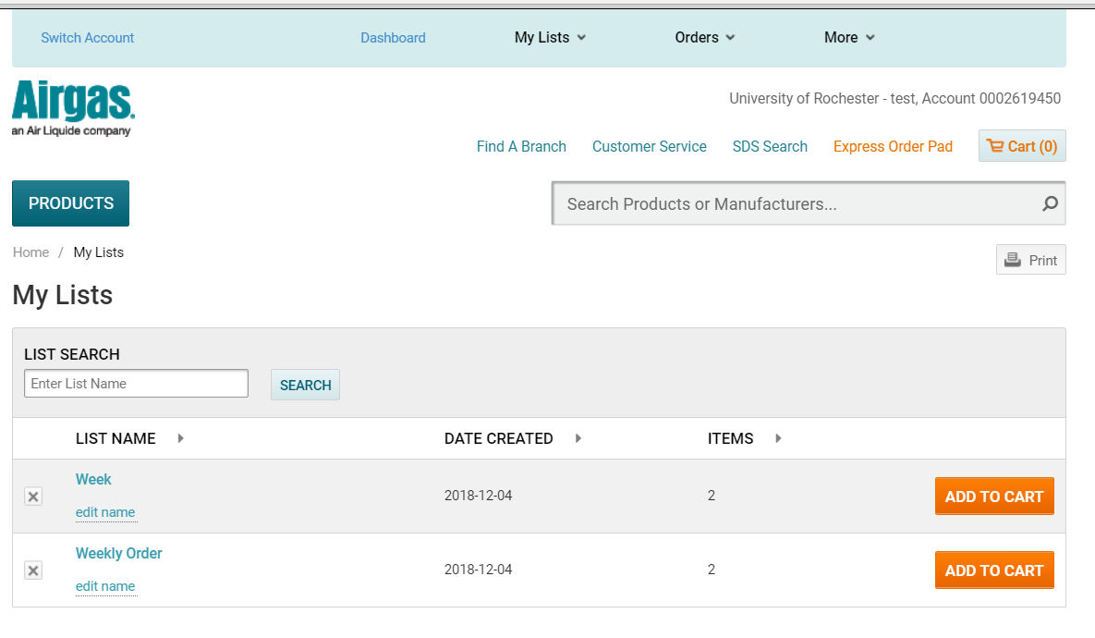
BLANKET ORDER OPTIONS – NEW REQUISITION (FAVORITES IN THE MARKETPLACE)
5
12

Slide 13
Blanket Order Supplies As Needed - Workday
Workday Options:
Non-Catalog Requisition or Marketplace (Catalog) Requisition
Requisition Template
Create from Another Requisition
6
13

Slide 14
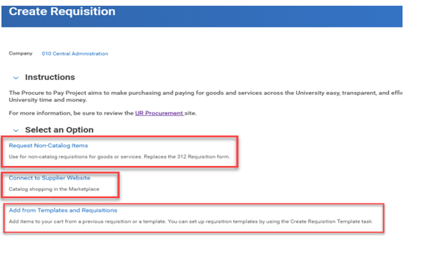
Blanket Order Supplies As Needed - Workday
Workday Options:
Non-Catalog Requisition or Marketplace (Catalog) Requisition
Requisition Template
Create from Another Requisition
6
14

Slide 15
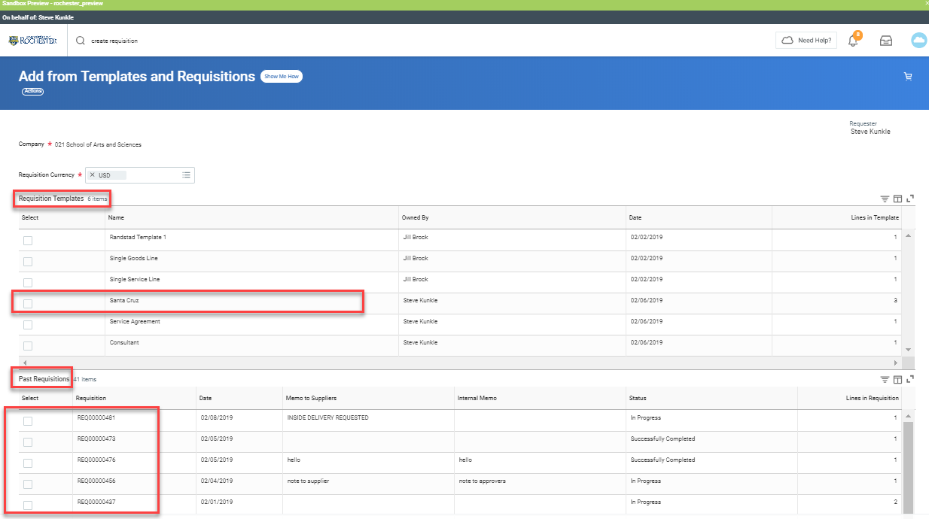
Blanket Order Supplies As Needed - Workday
Workday Options:
Requisition Template
Create from Another Requisition
6
15

Slide 16
P2P Demonstration – Goods Order Methods
16
Notes:
Debbie Flotteron

Slide 17
P2P Roll Out – High Level Schedule
Completed
SHIP (011), Warner (024), SON (060), MAG (070), Univ. Gen’l (080), EIOH (092)
Roll Out 1:
July 15^{th -} AS&E (020, 021, 022) - Live
July 29th – Complete Simon (023) and ESM (030)
August 12th – Start SMD (040)
Roll Out 2 – September 16th
SMD
Roll Out 3 – November 18th
Some SMD, SMH/MFG
Roll Out 4 – January 20th
SMH/MFG/HSD
Roll Out 5 – March 16th
SMH/MFG/HSD
Any remaining
Draft
17

Slide 18
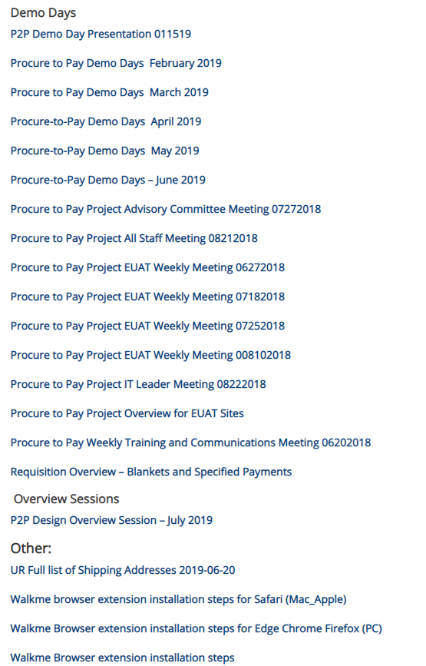
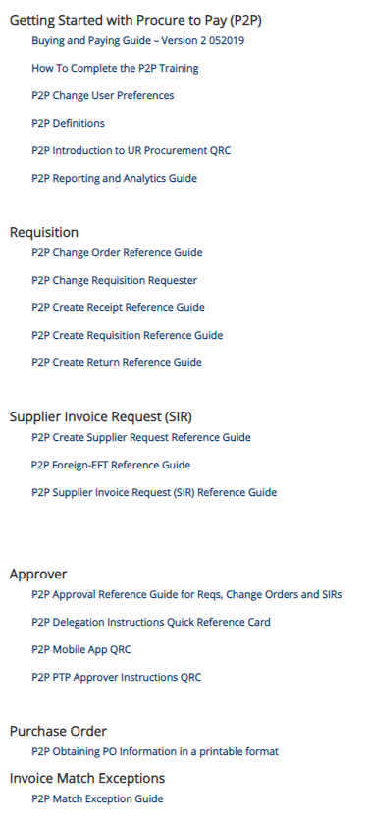
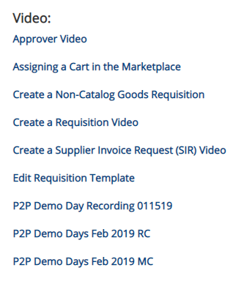
Resources
UR Procurement Website
https://www.rochester.edu/adminfinance/urprocurement/
18

Slide 19
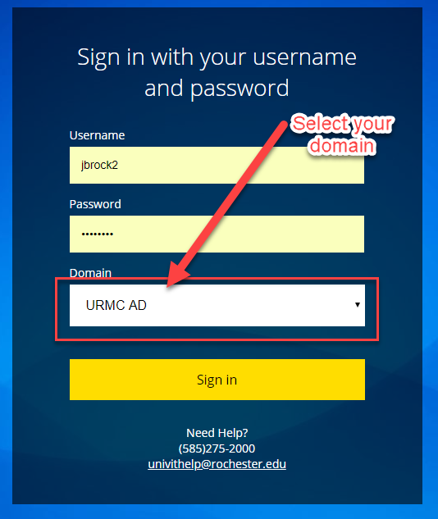
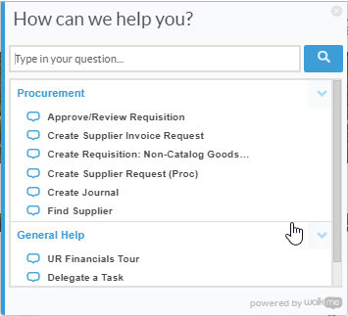
Resources cont’d
P2P Service Center
https://service.rochester.edu/procuement
Log in with your Domain Name, choose domain.
WalkMe
Select Need Help? for step-by-step on-screen help.
Smart Tips are also available
19
Notes:
If you don’t see the Need Help button contact the IT helpdesk at 275-2000 or Univithelp@Rochester.edu

Slide 20
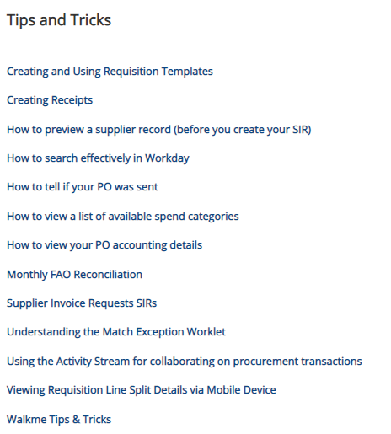
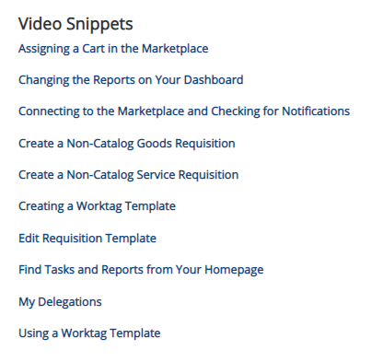
P2P - Tips & Tricks
20

Slide 21
P2P Training Options
Required Training
MyPath
Initiator (Requisitions, F4 Forms)
Approver
Optional Training
Classroom instructor led monthly training option for:
Requisitioner
Supplier Invoice Requester
Classes offered in Saunders Research Building Training Lab 1301
Classes offered in Gavett Hall 208 and Goergen Hall 102
Job Aids, Quick Reference Cards, Video Snippets, Newsletters, Etc.
Daily post go-live calls include a Tips and Trick Training Topic

Slide 22
MyPath P2P Training Curriculum - Required
Role | Required Module(s) | Duration (minutes)
Initiator Requisitioner (Blue 312 Reqs) SIR Requestor (F4 Payments) | Buying and Paying Guide Overview P2P: UR Procurement Basic Navigation P2P: Create Requisition Overview P2P: Marketplace Overview P2P: Supplier Invoice Request (SIR) Overview | 15 15 20 20 20
Initiator Requisitioner | P2P: Create Receipt and Invoice Match Exception Overview (Required after Go-Live) | 20
Approver | P2P: UR Procurement Basic Navigation P2P: UR Procurement Approver Overview | 15 15
P2P MyPath courses are available for all employees however, P2P team will continue to send email to targeted users as part of the rollout schedule
22
Notes:
Jill Brock

Slide 23
P2P Training Option – Non-Employees
New
Since most non-employees don’t have access to MyPath, we are developing an option to still have them perform the necessary prerequisites before gaining access to P2P:
Applies to students and contractors who initiate purchases
Approval roles are not allowed
An employee must “sponsor” the non-employee
Sponsor is responsible for verifying the non-employee has performed the required training
Sponsor is required to contact the P2P Customer Service Center to communicate the requested access
Detailed requirements forthcoming

Slide 24
MyPath P2P Training - Optional
Course | Description | Duration
UR Procurement: P2P Reporting and Analytics Overview | This Training provides an overview of the reporting capabilities in the UR Procurement System. | 20 minutes
24
Notes:
Jill Brock

Slide 25
Instructor Led Training (Optional)
Course | Description | Duration
UR Procurement Create Requisition (312) and Marketplace (SOLO) Class | This classroom training provides an overview of the procure to pay (P2P) process and the UR Procurement system (Workday). Get hands-on practice entering requisitions for goods and services as well as ordering from the Marketplace (previously SOLO). Register for the class in MyPath | 2.5 hours
UR Procurement Supplier Invoice Request (F4 Payment Request Form) Class | This classroom training provides an overview of the Supplier Invoice Request process in the UR Procurement system (Workday). Get hands-on practice entering SIRs. Register for the class in MyPath | 60 minutes
25
Notes:
Jill Brock

Slide 26
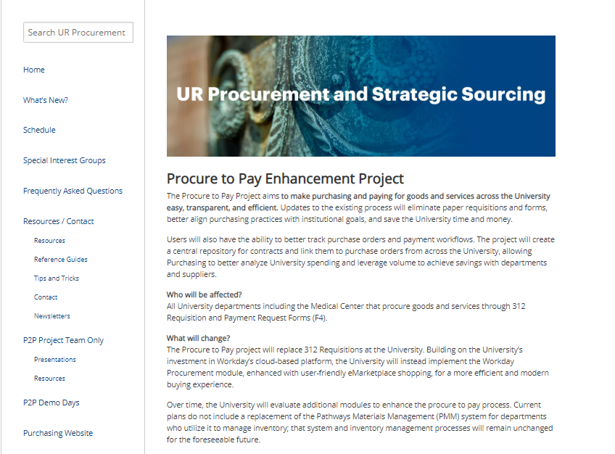
P2P Communications
Procure to Pay Website rochester.edu/adminfinance/urprocurement
Reference Guides
Newsletters
FAQs
Project Schedule and Status
Tips and Tricks
Video Snippets
Monthly P2P Demo Days
2 Sessions (Medical Center and Campus)
Project Updates, Demo of system functionality
26

Slide 27
P2P Support
Procure to Pay Customer Service Center
Service Desk Portal : service.rochester.edu/procurement
P2P Service Center: 275-2012
Email: Procurement_service_center@ur.rochester.edu
For System Access & Issues
Help Desk: UnivIT: 275-2000, UnivITHelp@ rochester.edu
Help Desk URMC: 275-3200, helpdesk_ISD@ urmc.rochester.edu
Quick Reference Guides
Quick Reference Videos
Walkme
27

Slide 28
Next Steps
Plan for Departmental Implementation:
Identify initiators (312 requisitions/SOLO Order placement/F4 Forms)
Identify approvers (approve requisitions and F4/SIR Transactions)
Participate in Monthly Demo Day Meetings
Medical Center
River Campus
Visit the P2P Website UR Procurement Website
Questions? Please reach out to:
URProcurement@Rochester.edu
Future Demo Day Topics
August: P2P Alternatives to Blanket Orders – Service Orders
28
Notes:
Jim

