Slide 1
Procure to Pay Project
Tips and Tricks – An introduction to Walkme.

Slide 2
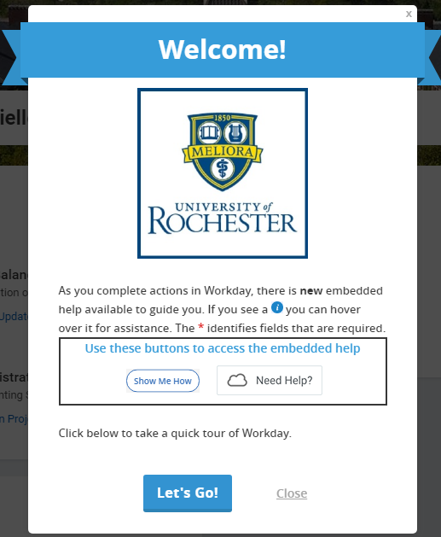
WalkMe for Workday​
Pilot participants can install and utilize an innovative inline help system (WalkMe) built within UR Financials / UR Procurement​
Two types of assistance offered that can be exited at any time​
Passive Help -Initiate help by selecting the on screen Need Help button when available ​
Active Help – wizard type guidance created to step users through an entire procedure​
Further information sent via email to capture user feedback​
User Support service.rochester.edu/procurement, or phone: 585-275-2012
Note: This help system will not be available for the Marketplace (Jaggaer).​
Notes:
Facilitator Note: We are utilizing an inline help feature called WalkMe within the UR Financials / UR Procurement systems. It offers on screen assistance for the processes in Workday including UR Financials Basic Tour, Delegate Task, Approve/Review Requisition, Create Requisition: Non Catalog Goods/Services, Create Supplier Request, Create SIR, Validate Supplier Name-SIR, and Find Supplier.
A requisitioner can initiate help by selecting the on screen Need Help button when available. In addition, there is also wizard type guidance which steps users through an entire procedure. You may find these tips helpful for the current functionality I just mentioned and as any new Workday functionality is deployed. There will be formal feedback mechanisms to ensure this help tool meets your needs and how we can improve upon it moving forward.
This help system will not be available for the Marketplace (Jaggaer), but will be available in the checkout process in Workday.

Slide 3
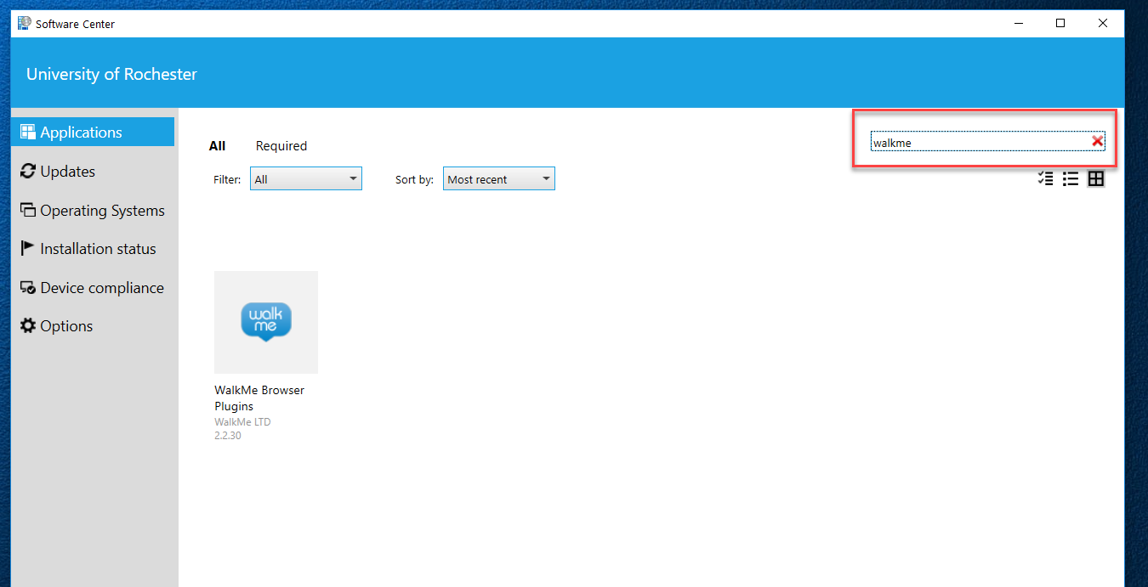
WalkMe for Workday
If you do not see the Need Help box you can search for the Software Center on your computer. Then search for Walkme and download the browser plugin.

Slide 4
WalkMe for Workday
If you have any questions on manually installing this plugin please contact UnivITHelp UnivITHelp@rochester.edu.
Direct questions regarding the use of Walkme once it is installed should be directed to service.rochester.edu/procurement, or call
585-275-2012.

