Slide 1

Procure to Pay Project
Tips and Tricks – Supplier Invoice Requests.

Slide 2
Tips and Tricks – Supplier Invoice Requests (SIRs)
  Be sure to select one of the following Handling Codes when initiating a SIR. Below are the guidelines for selection:
    Pickup: Select this if you want to be contacted to pick up the check when it is ready. Given the inherent urgency of this selection, Rush is implied, but only one special handling fee will be charged.
    Mail Back: Select this if you must have the check returned to a department for distribution.
    Enclosure: Select this if you think the payee will find it beneficial to receive documentation with their check payment so that they better understand what they are receiving the check payment for.

Slide 3
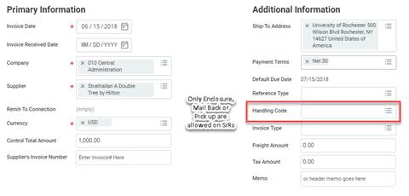
Tips and Tricks – SIRs cont’d
In the Create SIR screen, when no Handling code selected, the default payment type will apply. Example: Default Payment type of ACH or Check mailed directly to payee.

Slide 4
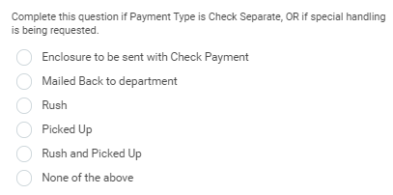
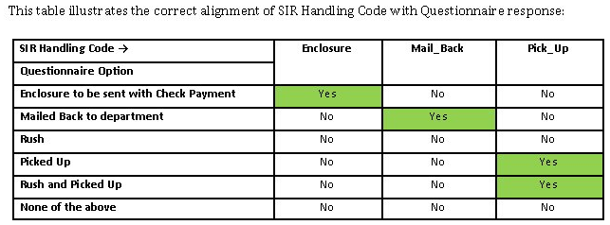
Tips and Tricks – SIRs cont’d
Remember that your response in the Acceptable Use Questionnaire to the Payment Type is Check Separate/Special Handling question should match the Handling Code selection you selected when creating your SIR.

Slide 5
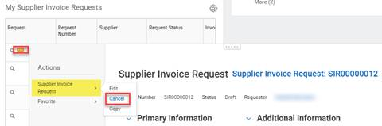
Tips and Tricks – SIRs cont’d
Cancelling a SIR: If you need a cancel a draft or in-progress SIR, locate the SIR from the Procurement Dashboard worklet called My Supplier Invoice Requests and select the Related Action [orange] button next to the magnifying glass. Under the Actions, hover your mouse over Supplier Invoice Request and select <Cancel>. Then select <OK> to confirm cancellation.

Slide 6
Tips and Tricks – SIRs cont’d
How to edit and submit a draft or In Progress SIR created by another user in your department. You can access, edit, and submit a draft SIR where you are a Supplier Invoice Requester for the same FAO or cost center.
  Enter the SIR number in the global search box and press Enter
  Select the Procurement search category
  Click on the SIR
  Access the Edit task via related action
  Note: the person editing the SIR becomes the Requester, however the questionnaire completion step is routed to the original initiator. Contact the P2P Service Center to have the questionnaire completion step reassigned to the new requester so the SIR submission can be completed.

Slide 7
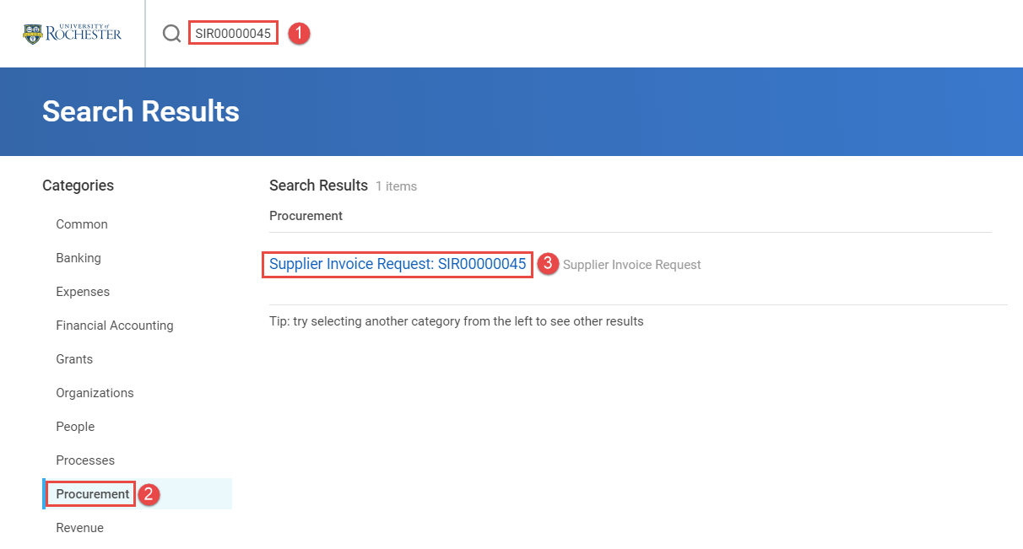
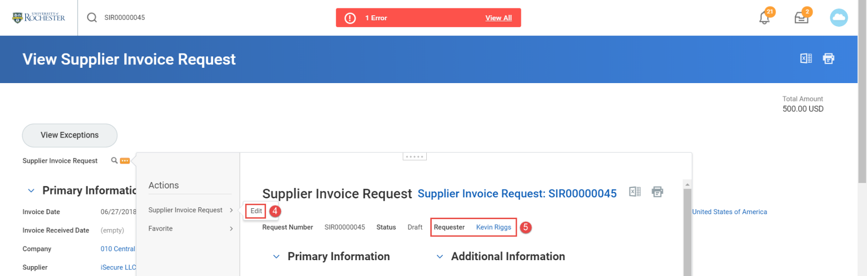
Tips and Tricks – SIRs cont’d

Slide 8

Questions?

