Slide 1
Procure to Pay Project
Tips and Tricks – Canceling a Draft or In Progress Requisition or SIR

Slide 2
Tips and Tricks – Canceling a Draft or In Progress Requisition or SIR.
If you have started a SIR or a Requisition that is in Draft status or is In Progress and you decide it is no longer needed, it is very easy to cancel the transaction.
The first thing to do is to find the document number. You can check your dashboard for My Requisitions or My Supplier Invoice Requests.
If using your Worklets it is a simple matter of using the action button and selecting Cancel.
If you know the number and you type it into the search bar you can also get to the action button to cancel the transaction

Slide 3
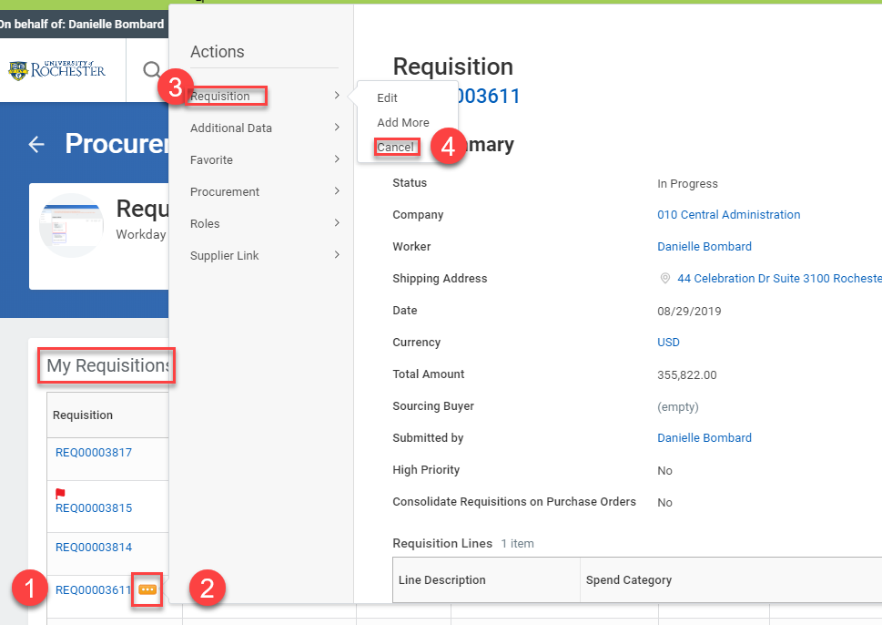
Tips and Tricks – Canceling a Draft or In Progress Requisition or SIR.
To use the My Requisitions or My Supplier Invoice Request Worklets on your dashboard simply find the correct transaction, hover, click on the Action button, hover over Requisition and select Cancel. Be sure to Click OK to complete the task.

Slide 4
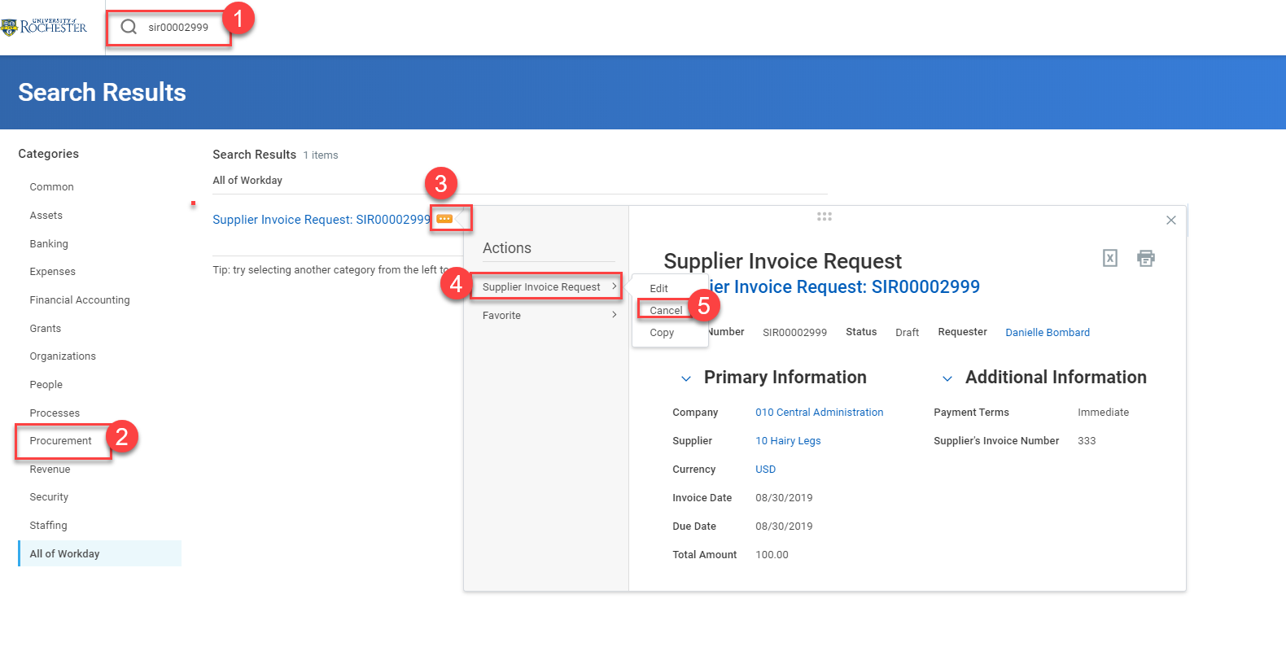
Tips and Tricks- Canceling a Draft or In Progress Requisition or SIR.
To use the global search bar type the full document number, including letters, into the search bar and hit enter. Then select All of Workday or Procurement and the blue number will appear. The action button is just to the right of the number if you hover there. Click the button, hover over Supplier Invoice Request or Requisition and select Cancel. Be sure to click OK to conclude the task.

Slide 5
Questions?

