Slide 1
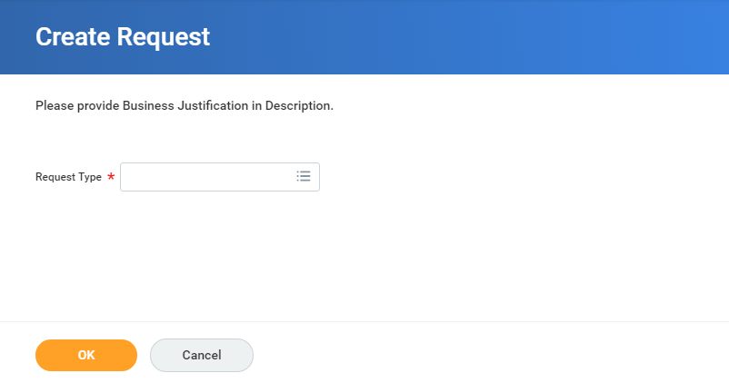
UR Procurement: Change Requisition Requester-Initiator
Reason:
This business process would take place in the event that a UR employee with requisitions leaves UR. Under these circumstances the requisitions can be reassigned to an active UR employee.
*** This process could also be used in the event an employee with requisitions will be absent for an extended period of time.
Rules:
Please take note of all requisitions being reassigned. See slide to 2 for directions on how to do this prior to initiating this request.
Anyone can be a Requisition Requester for an inactive employee.
The newly assigned requisition requester must be an active UR employee.
If a manager is the initiator this request, the request will be sent straight to P2P for processing, approval, and closing. Otherwise the request will be sent to the requester’s manager for approval first.
Type “Create Request” in the global search bar.
Type “Change Requisition Requester” in the Request Type field.
Click “Okay” when ready.
QRC UR Procurement Mass Change v1.0 12/14/2018

Slide 2
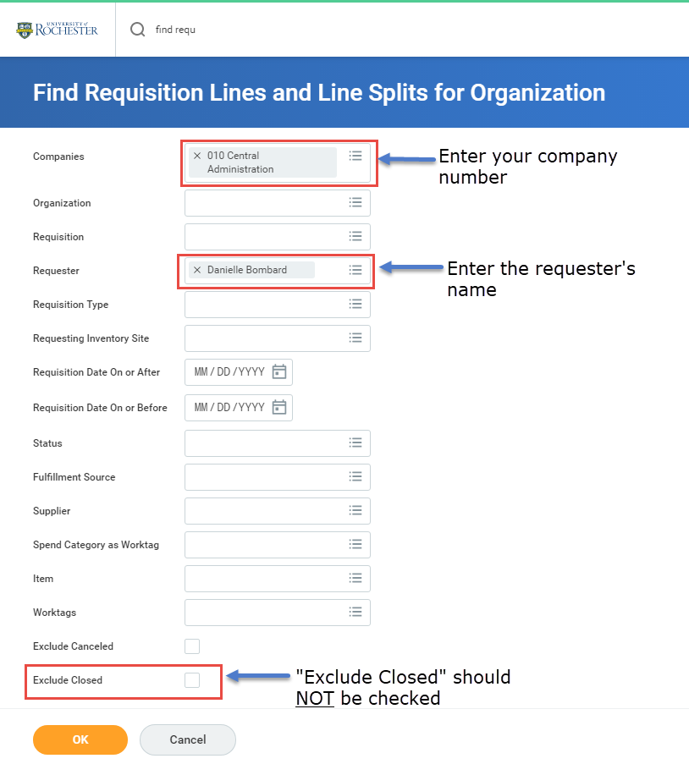
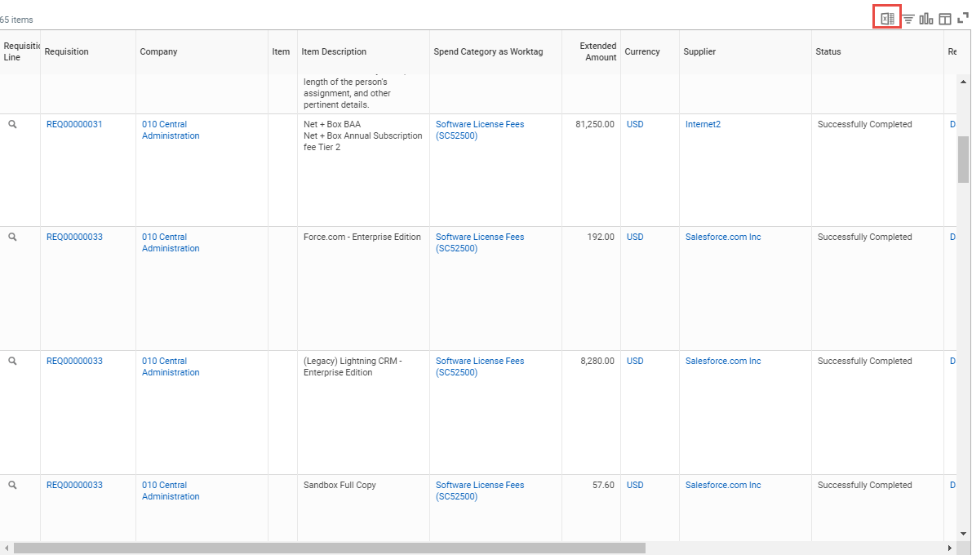
UR Procurement: Change Requisition Requester-Initiator
This slide shows how to look up the requisitions being reassigned. If the original owner of the requisitions is no longer an active UR employee than this step is NOT required.
Run the report “Find Requisition Lines and Line Splits for Organization” and then fill the identified fields, along with any other fields you choose to help narrow down the results.
The report provides a line item list of each requisition performed by the original requester. If you see the same requisition number more than once, this simply means there are multiple lines within a given requisition.
List of requisition numbers. Take note of the requisition numbers that are going to be reassigned.
Click the export button. This is the best option to keep track of the requisitions that will end up being reassigned to a different employee.

Slide 3
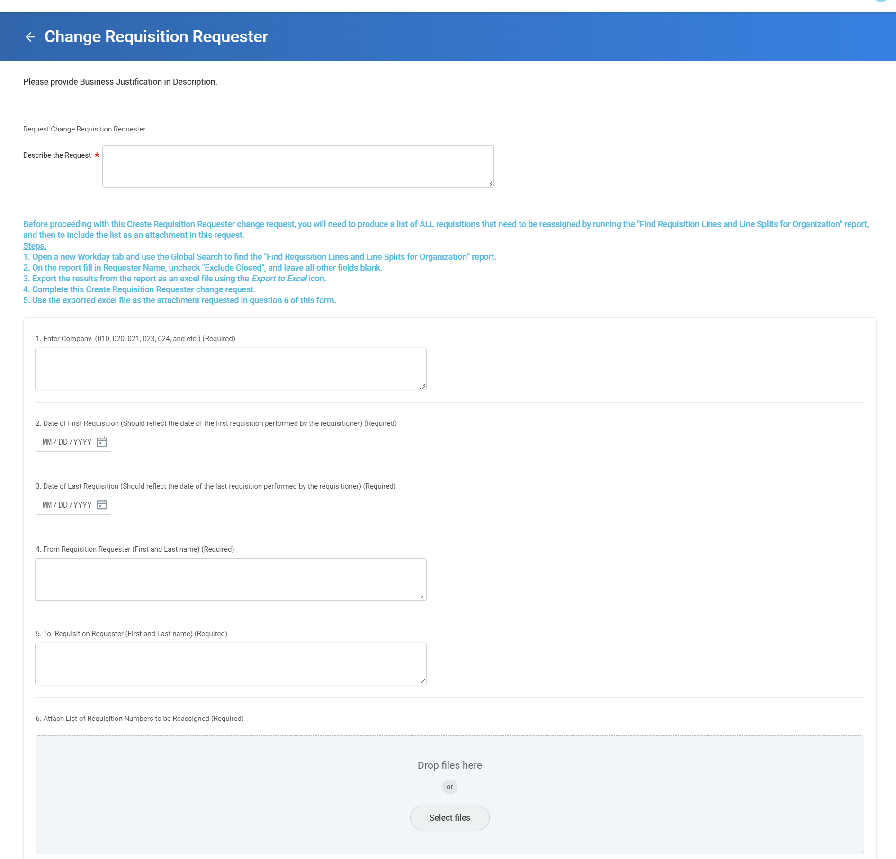
UR Procurement: Change Requisition Requester-Initiator
Describe why this request is being created.
Click “Submit” once all information is filled out correctly. After selecting “Submit” this request will be sent to your manager. In the event a manager is initiating this request, it be sent directly P2P for approval
Enter your company number
Date of First Requisition (Should reflect the date of
the first requisition performed by the requisitioner)
Date of Last Requisition (Should reflect the date of
the last requisition performed by the requisitioner)
Enter the name of the person who is no longer an active UR employee.
Enter the name of the active employee who is being assigned the requisition.
Attach List of Requisition Numbers to be Reassigned

Slide 4
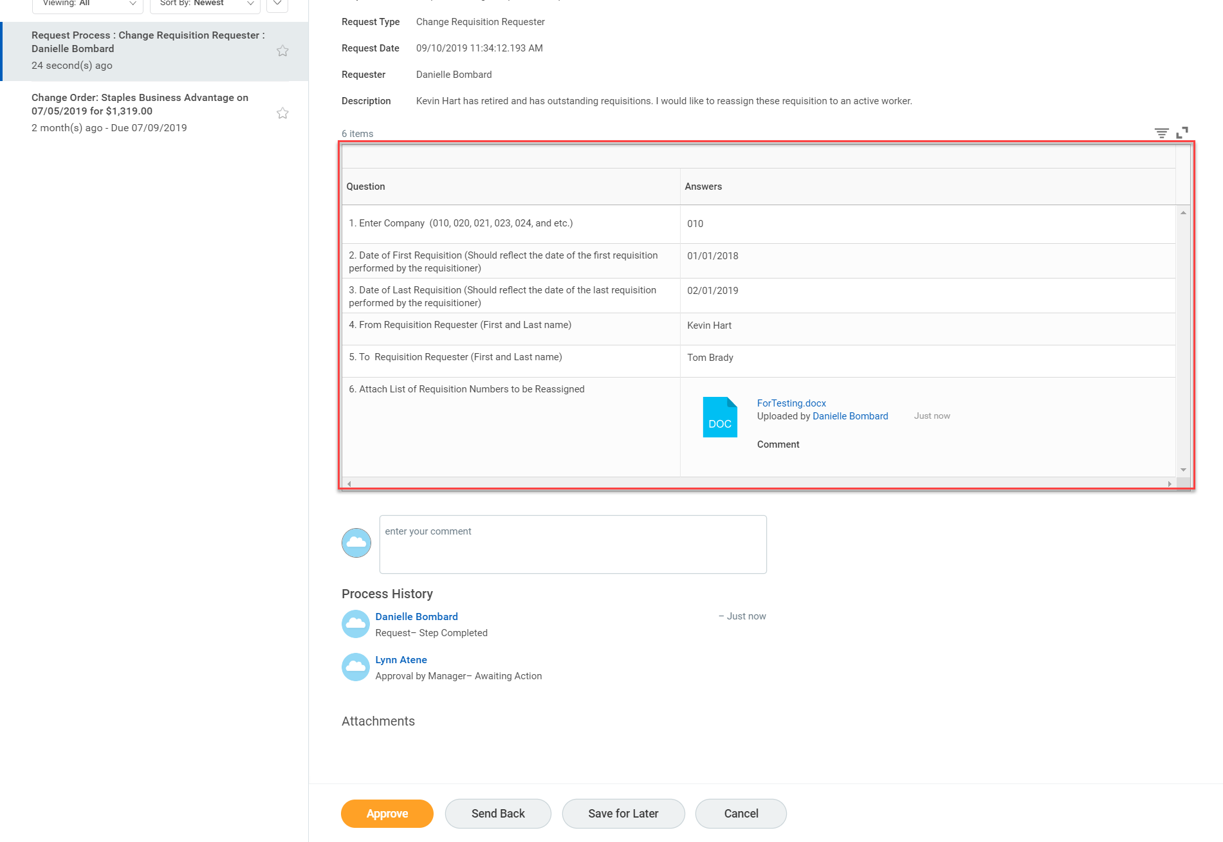
UR Procurement: Change Requisition Requester- Approver
The Approver’s responsibility is to verify the information is correct. If the manager initiates this process, the request is routed directly to the P2P Service Center for processing.
Rules:
The “From Requisition Requester” should reflect the name of the original owner of the requisitions that are being reassigned
The “To Requisition Requester” should reflect the name of an active UR employee
Once the information is validated click “Approve”
As the approver, your job is to validate that the information is correct. To expand the information table (the table above) click here.

