Slide 1
Procure to Pay Project
Demo Days
September, 2019
Notes:
Jim Dobbertin – Introduction and Kick Off

Slide 2
Are You On the Zoom?
Information for Zoom Participants
For those joining the Zoom:
1) Phones will be muted. Due to the volume of content to be shared, we may not have time for questions.
Send your questions to URProcurement@Rochester.edu They will be summarized and posted to the UR Procurement Website
3) P2P Frequently Asked Questions can also be found on the UR Procurement Website.
2
Notes:
Jim Dobbertin Note: If we do not have time to address questions submitted, they will be summarized and posted to the UR Procurement Website.

Slide 3
Topics
Project Review
P2P Status Report
Draft Roll Out Schedule
Tips and Tricks in P2P
Demonstration: Time Saving Tips and Tricks in P2P
Resources
Training
Support Organization
Next Steps
3
Notes:
Carl Tietjen and Liz Milavec

Slide 4
Procure to Pay Objectives
Transition from paper-based to electronic transactions
Provide full transparency and visibility into all P2P transactions from entry to payment (procure-to-pay!)
Streamline entry and approval activities to enable better internal controls
Standardize purchasing activity
Improve cycle and approval times
Enable data driven price negotiations and strategic sourcing
4
Notes:
Katherine Sadoff-Herrick Are we sure we want to include the P2P Video?

Slide 5
Prepare
User Acceptance Test 1, 2
Pilot Groups
1 and 2
System Roll Out
1, 2, 3, …
P2P Project Phases
Nov 2017 - May 2018 June - Dec 2018 Feb - June 2019 July – March 2020
June 11, 2018: Early Users - Workday for non-catalogue goods and services
November 19, 2018: Adds Marketplace (Jaggaer) for creating shopping carts for catalogue items and purchase order distribution (Amazon look and feel)
February 18, 2019: Pilot 1 – Add additional departments/users, refine P2P design
April 15, 2019: Pilot 2 – Add additional departments/users, refine P2P design
July/August 2019: Start phased roll out to remaining departments and users
5
Notes:
Katherine Sadoff-Herrick

Slide 6
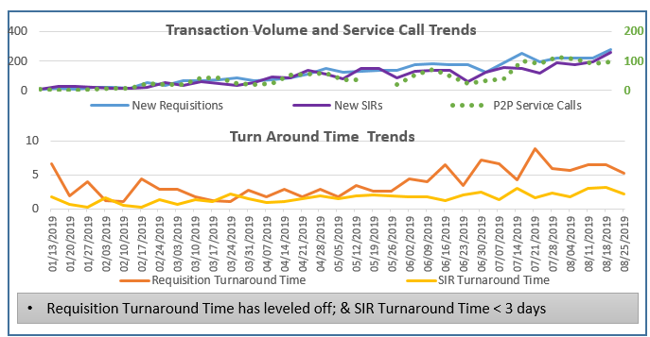
Metrics to Date – Reqs. / SIRs
Continue to increase number of requisitions (5,133) and SIRs (4,287)
Cumulative Requisition Turn Around Time at 4.59 days
Cumulative SIR Turn Around Time at 2.11 days
6

Slide 7
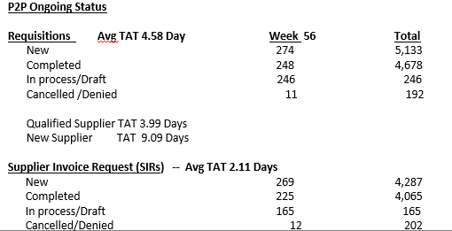
UR Procurement Update
7
Notes:
Jim Dobbertin

Slide 8
Rollout 2 - 9/23/19
Cost Center
31536 SMH DSRIP
11419 Anesthesiology
11423 Orthopaedic Surgery
14407 Fitness and Wellness Center
16020 Public Relations and Communications
17025 University Commission on Animal Research
17406 Medical Center Post Office
17447 Medical Center Marketing
17457 Inclusion & Culture Diversity
17468 MC Employee Health
17471 Senior Associate Dean for Clinical Research
17926 Strategic Planning
17929 URMC Special Patient Services
31503 SMH Patient Accounting
36540 SMH Operating Director
37501 SMH Ambulatory Svcs
11413 Public Health Science
11406 Neurology
12105 Center for Neurotherapeutics Discovery
920 FAO’s
179 Initiators
139 Approvers
23 Super Users
8

Slide 9
P2P Roll Out – High Level Schedule
Roll Out 2 – September 23, 2019
SMD
Roll Out 3 – November 18, 2019
Some SMD, SMH/MFG
Roll Out 4 – January 20, 2020
SMH/MFG/HSD
Roll Out 5 – March 16, 2020
SMH/MFG/HSD
Any remaining
Medical Center roll outs
to be based on readiness of
each department
9

Slide 10
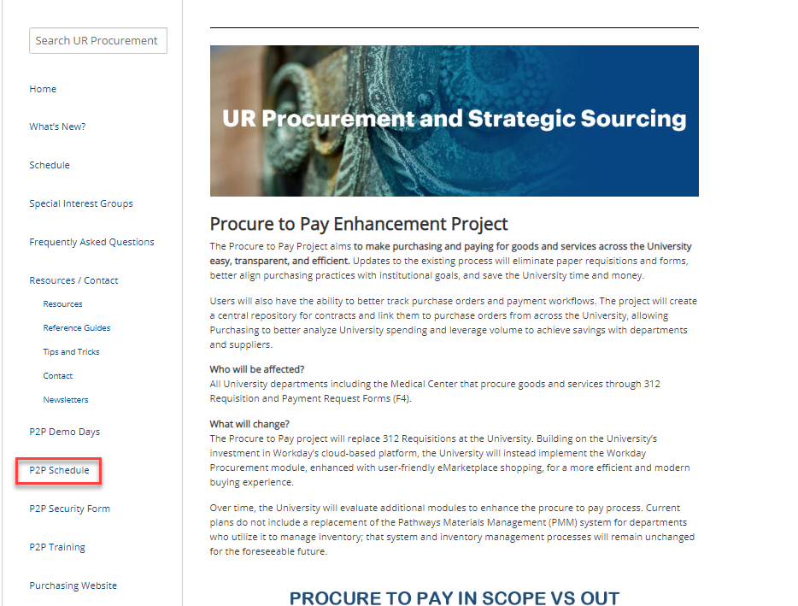
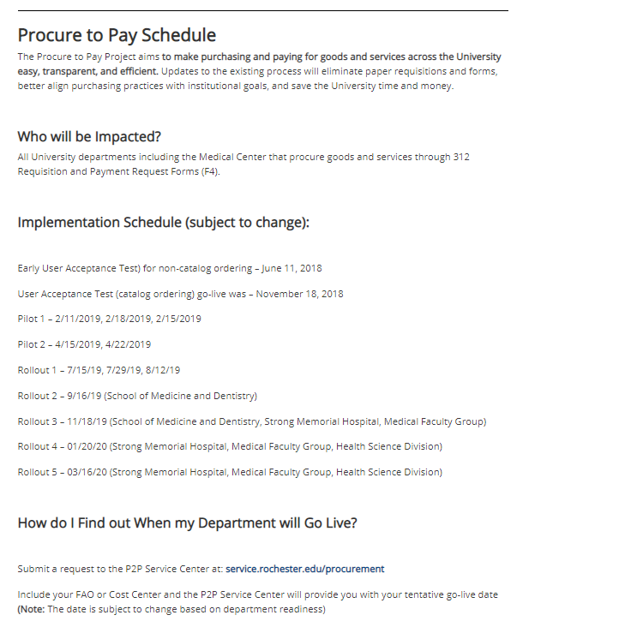
P2P Roll Out Process and Expectations
Review the Procure to Pay Website regarding detail on what to expect with the roll out process and implementation.
10

Slide 11
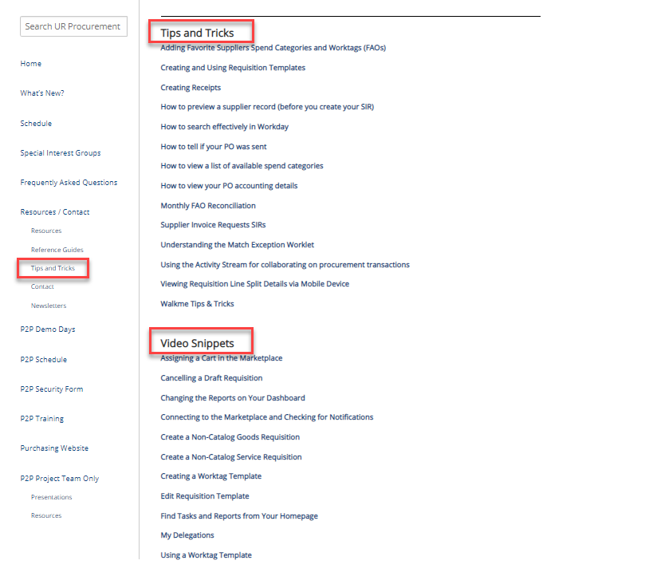
P2P Tips and Tricks
There are many tips and tricks available on the UR Procurement Website to assist with your use of P2P.
2
11

Slide 12
P2P Timesaving Tips and Tricks
Setting and Utilizing Favorites
Searching
Creating a requisition from a prior Non-Catalog Requisition
Utilizing Requisition and Worktag Templates
2
12

Slide 13
P2P Timesaving Tips and Tricks
Setting and Using Favorites
If you find there are items in Workday you frequently add to your Requisitions and SIRs, you can set them as favorites so you can quickly find and use them.
You can set any item in Workday as a favorite as long as you are able to search for the item in the global search bar. (For Spend Categories it works best to find it in a prior requisition or in a report. It is difficult to search for Spend Categories in the global search bar).
Examples of items that can be set as a favorite:
Suppliers
Spend Categories
Worktags (FAOs)
2
13

Slide 14
P2P Timesaving Tips and Tricks
Setting and Using Favorites
Suppliers
Worktags (FAOs)
2
14

Slide 15
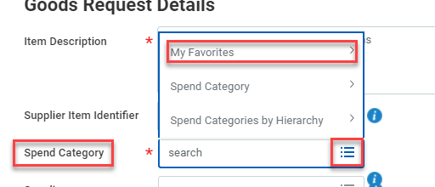
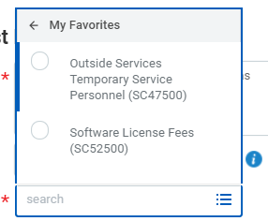
P2P Timesaving Tips and Tricks
Setting and Using Favorites
Spend Categories
2
15

Slide 16
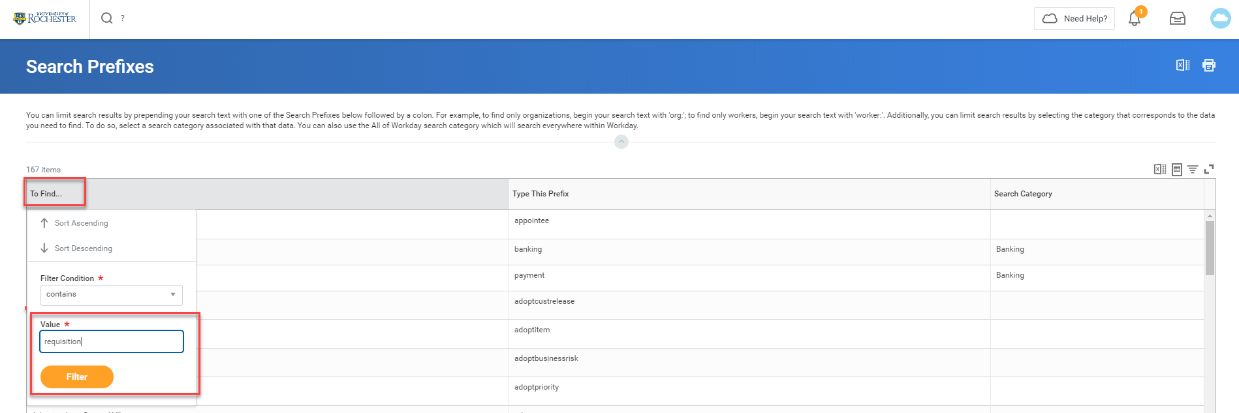
P2P Timesaving Tips and Tricks
Searching
If you would like to search for an item, but are not having much luck in getting results you can bring up a report to show you effective search terms.
In the global search box type a question mark and hit enter. This will bring up the Search Prefixes report. You can click on the To Find…box and filter depending on what you are searching for. Then click Filter
2
16

Slide 17
P2P Timesaving Tips and Tricks
Effectively Searching Using Prefixes
After filtering you will see a list of items that match.
The ‘Type This Prefix’ column tells you what to type in the global search bar when searching. Type that word followed by a colon
2
17

Slide 18
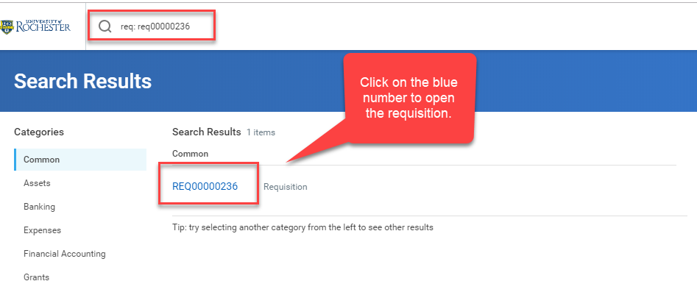
P2P Timesaving Tips and Tricks
Effectively Searching Using Prefixes
You will have to type the full number including REQ, SIR, or SPI when searching.
2
18

Slide 19
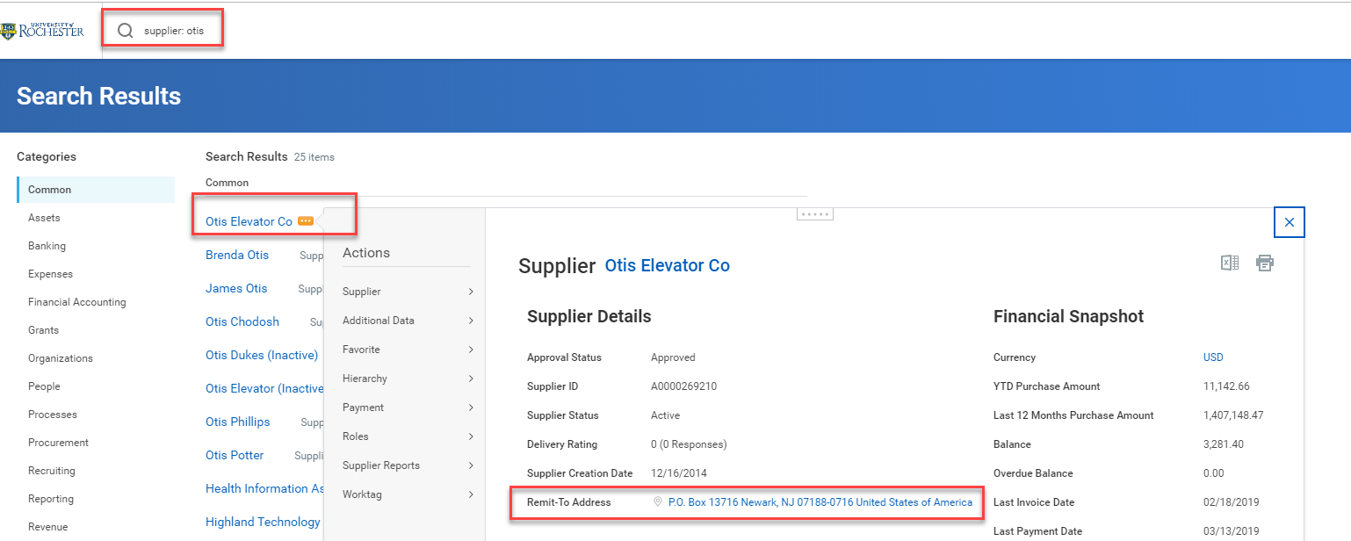
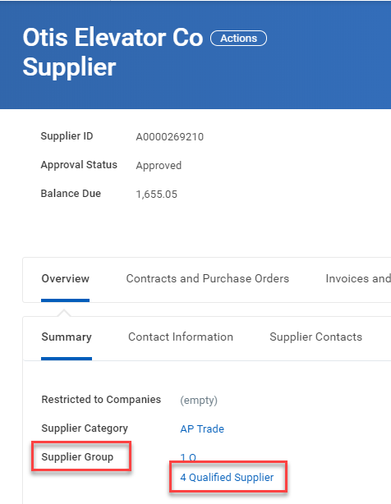
P2P Timesaving Tips and Tricks
When searching for a Supplier type supplier: followed by the supplier name. You can check the supplier remit to address to confirm you have the correct supplier. Click on the supplier name to open the full record and look to see if they are approved for requisitions.
An approved Purchasing supplier will have 4 Qualified Supplier for the Supplier Group.
19

Slide 20
P2P Timesaving Tips and Tricks
Workday allows you to quickly create a requisition from a prior non-catalog requisition. This will save time when you need to order the same items you ordered on a prior requisition.
In the global search bar type: Create Requisition, then select “Add From Templates and Requisitions”
2
20

Slide 21
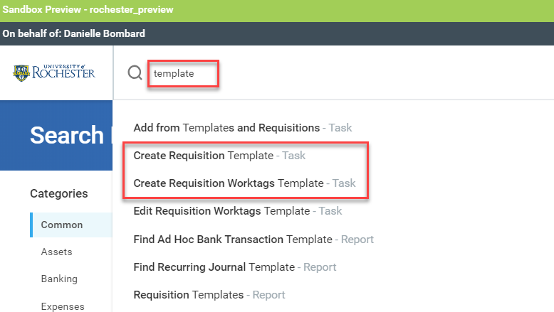
P2P Timesaving Tips and Tricks
Workday allows you to quickly create Templates for Requisition Worktags (FAOs), Worktag Splits, and Requisitions. This will save time when you need to order the same items or use the same worktags on a frequent basis.
In the global search bar type: Template
2
21

Slide 22
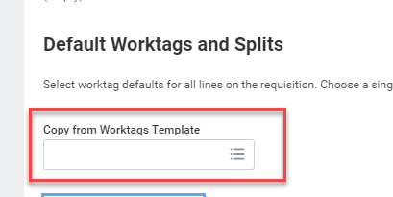
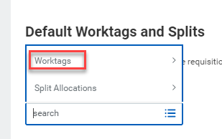
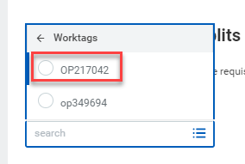
P2P Timesaving Tips and Tricks
When creating a requisition, instead of choosing Use Default Worktag on the Line Defaults Tab, click in the Copy from Worktags Template box. Select Worktags and click on the Worktag template you previously set up.
Using Worktag templates can be a big timesaver during the requisition checkout process.
22

Slide 23
P2P Demonstration – Tips and Tricks
Setting and Utilizing Favorites
Searching
Creating a requisition from a prior Non-Catalog Requisition
Utilizing Requisition and Worktag Templates
23
Notes:
Debbie Flotteron

Slide 24
P2P Training
Required Training
MyPath (before Go-Live)
Initiator (Requisitions, F4 Forms, SOLO)
Approver
MyPath (after Go-Live)
Create Receipt and Match Exception Overview (Initiators Only)
Optional Training
Classroom instructor led monthly training option for:
Requisitioner
Supplier Invoice Requester
Classes offered in Saunders Research Building Training Lab 1301
Classes offered in Gavett Hall 208 and Goergen Hall 102
MyPath (after Go-Live)
Reporting and Analytics Overview
Job Aids, Quick Reference Cards, Video Snippets, Newsletters, Etc.
Daily post go-live calls include a Tips and Trick Training Topic
Weekly Workshop

Slide 25
P2P Training Options
P2P Workshops
These Workshops will be held in College Town (CTown 3102 Training Room). They are "open", meaning that we will not be covering a specific topic, but will customize our training to your individual needs. Bring in your questions, concerns, and requisitions and we will walk-through the solutions together.
These will be 2 hour sessions alternating morning and afternoons.
You can register for a session in MyPath.

Slide 26
MyPath P2P Training Curriculum - Required
Role | Required Module(s) | Duration (minutes)
Initiator Requisitioner (Blue 312 Reqs) SIR Requestor (F4 Payments) | Buying and Paying Guide Overview P2P: UR Procurement Basic Navigation P2P: Create Requisition Overview P2P: Marketplace Overview P2P: Supplier Invoice Request (SIR) Overview | 15 15 20 20 20
Initiator Requisitioner | P2P: Create Receipt and Invoice Match Exception Overview (Required after Go-Live) | 20
Approver | P2P: UR Procurement Basic Navigation P2P: UR Procurement Approver Overview | 15 15
P2P MyPath courses are available for all employees however, P2P team will continue to send email to targeted users as part of the rollout schedule
26
Notes:
Jill Brock

Slide 27
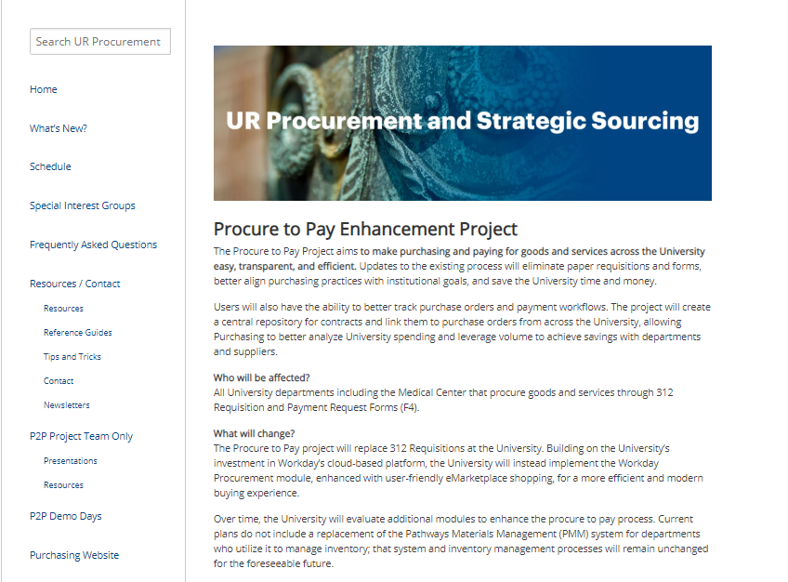
P2P Communications
Procure to Pay Website rochester.edu/adminfinance/urprocurement
Reference Guides
Newsletters
FAQs
Project Schedule and Status
Tips and Tricks
Video Snippets
Monthly P2P Demo Days
2 Sessions (Medical Center and Campus)
Project Updates, Demo of system functionality
27

Slide 28
P2P Support
Procure to Pay Customer Service Center
Service Desk Portal : service.rochester.edu/procurement
P2P Service Center: 275-2012
Email: Procurement_service_center@ur.rochester.edu
For System Access & Issues
Help Desk: UnivIT: 275-2000, UnivITHelp@ rochester.edu
Help Desk URMC: 275-3200, helpdesk_ISD@ urmc.rochester.edu
Quick Reference Guides
Quick Reference Videos
Walkme
28

Slide 29
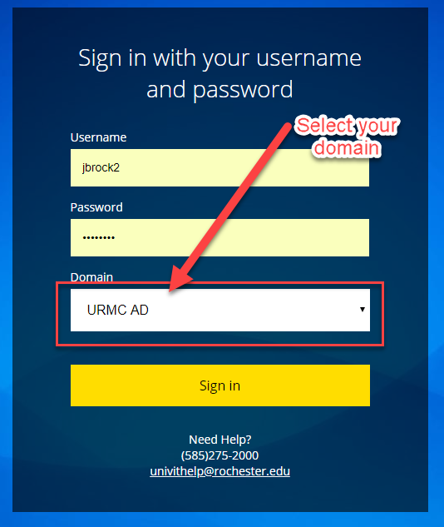
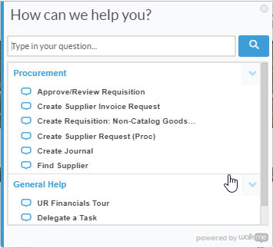
Resources cont’d
P2P Service Center
https://service.rochester.edu/procuement
Log in with your Domain Name, choose domain.
WalkMe
Select Need Help? for step-by-step on-screen help.
Smart Tips are also available
29
Notes:
If you don’t see the Need Help button contact the IT helpdesk at 275-2000 or Univithelp@Rochester.edu

Slide 30
Next Steps
Plan for Departmental Implementation:
Identify initiators (312 requisitions/SOLO Order placement/F4 Forms)
Identify approvers (Approve requisitions and F4/SIR Transactions)
Participate in Monthly Demo Day Meetings
Medical Center
River Campus
Visit the P2P Website UR Procurement Website
Questions? Please reach out to:
URProcurement@Rochester.edu
Future Demo Day Topics
October:
30
Notes:
Jim

Slide 31
Appendix
31
Notes:
Jim

Slide 32
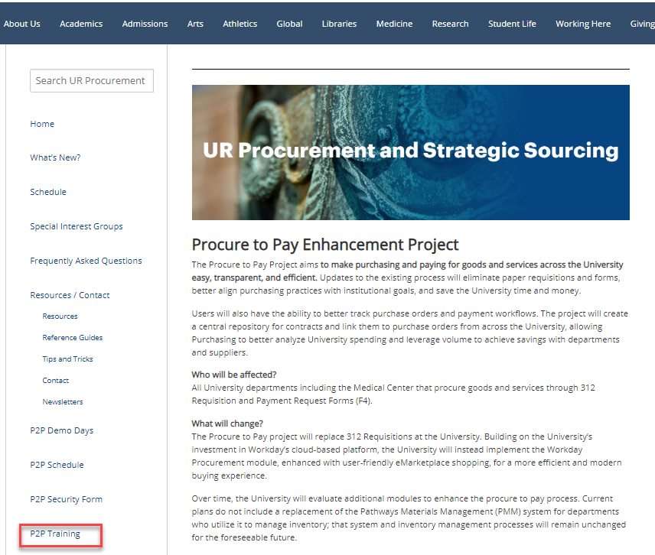
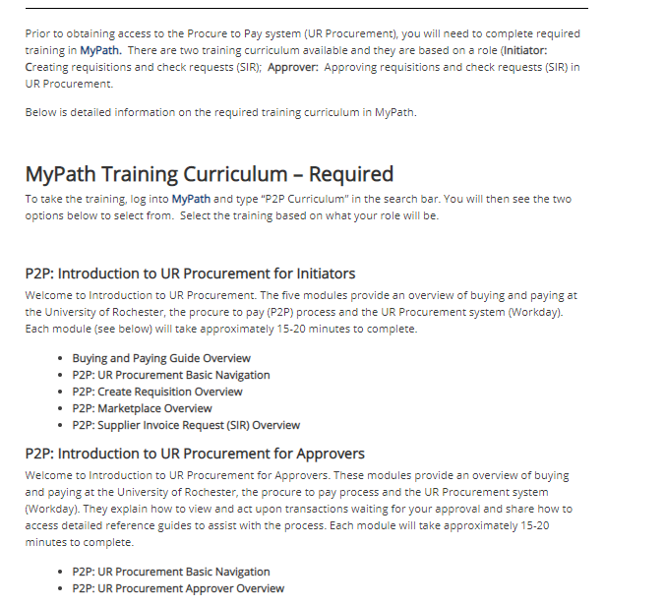
P2P Training Options
To learn more about P2P Training options, go to the UR Procurement Website

Slide 33
P2P Training Option – Non-Employees
New
Since most non-employees don’t have access to MyPath, we are developing an option to still have them perform the necessary prerequisites before gaining access to P2P:
Applies to students and contractors who initiate purchases
Approval roles are not allowed
An employee must “sponsor” the non-employee
Sponsor is responsible for verifying the non-employee has performed the required training
Sponsor is required to contact the P2P Customer Service Center to communicate the requested access
Detailed requirements forthcoming

Slide 34
Instructor Led Training (Optional)
Course | Description | Duration
UR Procurement Create Requisition (312) and Marketplace (SOLO) Class | This classroom training provides an overview of the procure to pay (P2P) process and the UR Procurement system (Workday). Get hands-on practice entering requisitions for goods and services as well as ordering from the Marketplace (previously SOLO). Register for the class in MyPath | 2.5 hours
UR Procurement Supplier Invoice Request (F4 Payment Request Form) Class | This classroom training provides an overview of the Supplier Invoice Request process in the UR Procurement system (Workday). Get hands-on practice entering SIRs. Register for the class in MyPath | 90 minutes
34
Notes:
Jill Brock

Slide 35
MyPath P2P Training - Optional
Course | Description | Duration
UR Procurement: P2P Reporting and Analytics Overview | This Training provides an overview of the reporting capabilities in the UR Procurement System. | 20 minutes
35
Notes:
Jill Brock

