Slide 1
Procure to Pay Project
Design Change Overview
October, 2019
Notes:
Jim Dobbertin – Introduction and Kick Off

Slide 2
Topics
Requisition Questionnaire
Requisition Commodity Field
October Newsletter Topics
Expedited SIR Pilot
Submitting Receipts
P2P Workshops
Fisher Live Price enabled
VWR Quote Feature
Freight Charges
2
Notes:
Carl Tietjen and Liz Milavec

Slide 3
P2P Requisition Questionnaire
Starting October 28th, we will be implementing a requisition questionnaire.
A preliminary questionnaire will be sent to the Requisitioner after the “Submit” button is pressed. These questions are essential to mitigate risk to the university and medical center. A similar questionnaire is currently in use for Supplier Invoice Requests (SIRs).
This questionnaire should help expedite requisitions in Purchasing rather than having them contact you via email or phone for answers to the questions. Answers to some of the questions will also be used to route the requisition to the appropriate individual to determine if additional analysis is required. Note that depending on the answer selected, additional attachments may be necessary.
The questionnaire will only be required for non-catalogued requisitions.
Additional questions will be added in the future.
3

Slide 4
P2P Requisition Questionnaire
In the event that you are uncertain how to answer any of these questions, please consult with the requestor for answers, or reach out to the P2P Customer Service Center for assistance.
The questions are based on the following topics:
Consultant/Independent Contractor transaction
Conflict of Interest
Lease Agreement or Arrangement
See the next slide for a draft of the questionnaire:
4

Slide 5
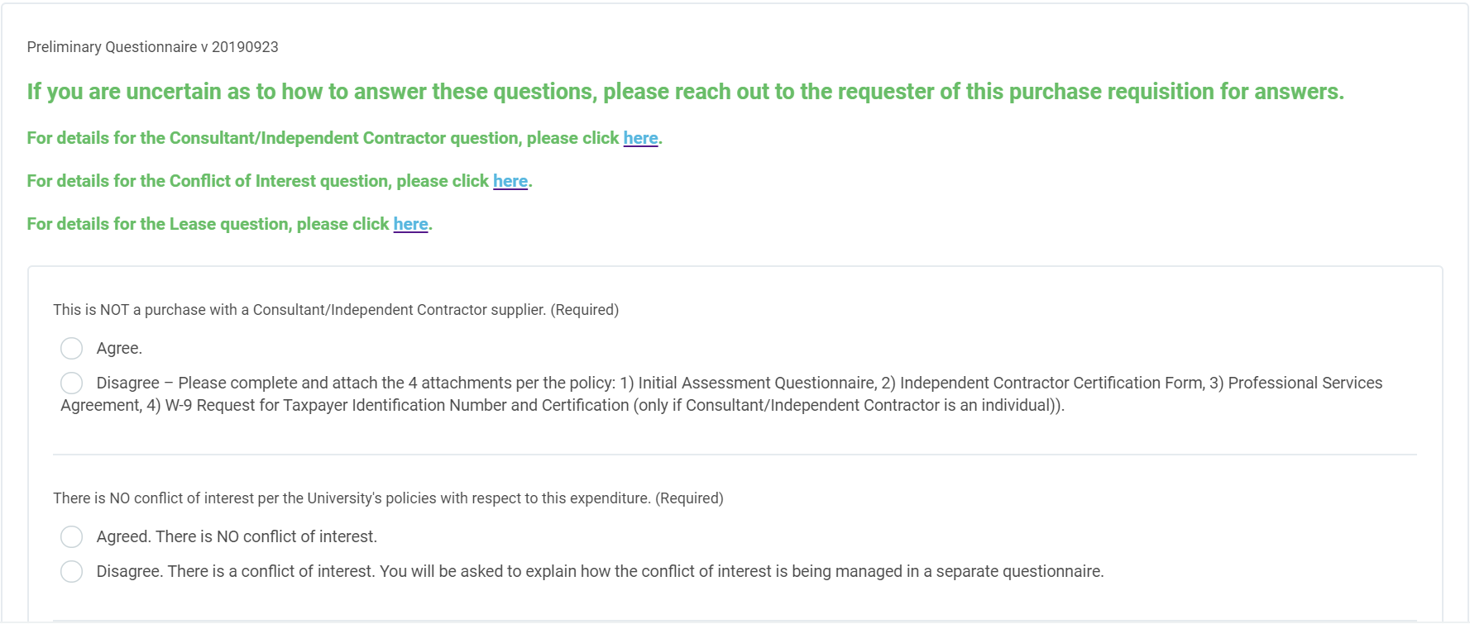
P2P Requisition Questionnaire
Note: SIR Questionnaire will be updated to align with Requisition questionnaire.
5

Slide 6
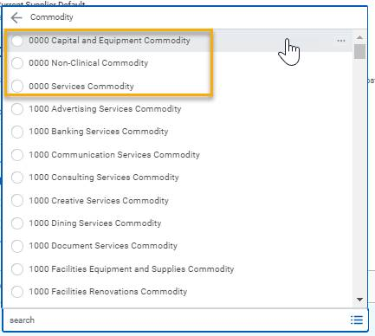
P2P Requisition Commodity Field
Additional commodities have been added to Commodity field (Requisition Checkout > Line Defaults tab).
Requisitioners will still need to select a single commodity for their requisition. It can still be the top-most Commodity group
(0000 Capital and Equipment Commodity, 0000 Non-Clinical or 0000 Services Commodity, which will always show at the
top of the Commodity list.
With this change requisitions have a choice: they can select the top-most Commodity Group or
they can select a sub-commodity, if they so choose. Either way, their non-catalog requisitions should still only have one commodity
per requisition. And if they have a multi-line requisitions, all lines still need to be the same Commodity or sub-commodity.
The sub-commodities will be utilized by the purchasing staff to better route and process your non-catalog requisitions.
The sub-commodities are also listed under the Active Commodity Organizations by Commodity Hierarchy section or can be searched by
typing a key word and pressing <enter>.
For Commodity details, visit the UR Procurement Website
6

Slide 7
P2P Overview Session
Requisition Questionnaire
Requisition Commodity Field
7
Notes:
Debbie Flotteron

Slide 8
October Newsletter Topics
Expedited SIR Pilot
New functionality is being piloted with Payroll SIR Initiators whereby they will select a Spend Category that has been configured for Expedited
processing. Expedited processing allows for a single Special Category Approval prior to payment. This process has been designed similar to
the paper/email process today and is limited to a very few central activities (primarily Payroll and Human Resources).
It is important to note that Expedited processing is very different from Rush processing. Most P2P users should never use the Expedited
process. If you accidentally use one of these expedited spend categories, you’ll need to Cancel your SIR and start a new SIR with the correct
Spend Category. Editing the SIR for the correct SC will not work because there will be no Special Category Approver designated and the
SIR cannot be re-assigned to follow the proper approval path. The SIR must be Canceled.
8

Slide 9
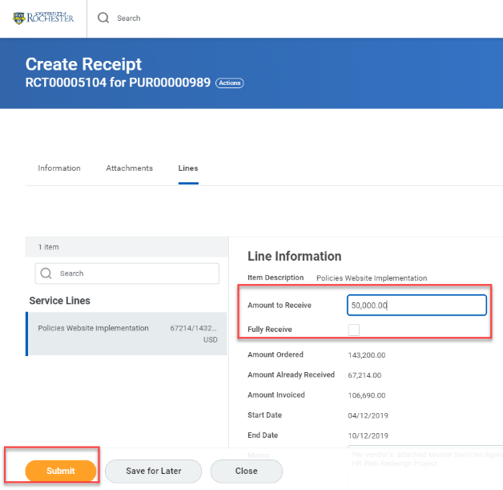
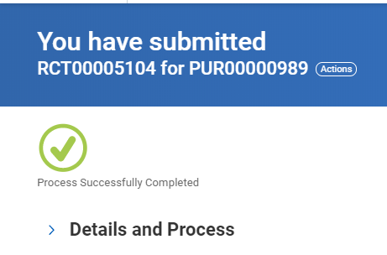
October Newsletter Topics
Submitting Receipts
Many people have been creating receipts, but not fully submitting them. This results in a Draft Receipt that will not resolve a match exception. When this happens the receipt will need to be edited and submitted. When creating a receipt remember to hit submit after filling in the amount or quantity you wish to receive. Even if you check the Fully Receive box you still need to click on submit. Your receipt is not complete unless you see a message stating you have successfully submitted a receipt.
9

Slide 10
October Newsletter Topics
P2P Workshops
In addition to the P2P Service Center for support after go-live, the P2P Team is offering P2P Workshops. These are not instructor led sessions; however, they are hands on sessions to assist with answering questions (i.e. Resolving Invoice Match Exceptions, How to Transition your Blanket Order to P2P, How to run reports, etc) or issues you may be experiencing. Registration for these sessions will be in MyPath and will be limited to 10 per session. They will be conducted in the College Town Training Classroom 3-3102, 44 Celebration Drive
Friday, October 25, 2019 1:00 – 3:00pm College Town Rm 3102
Friday, November 1, 2019 8:30 – 10:30am College Town Rm 3102
Friday, November 8, 2019 1:00 – 3:00pm College Town Rm 3102
Wednesday, November 20, 2019 1:00 – 3:00pm College Town Rm 3102
Fisher Live Price enabled
This functionality allows you to check the current (real-time) price of an item when shopping within the Marketplace
10

Slide 11
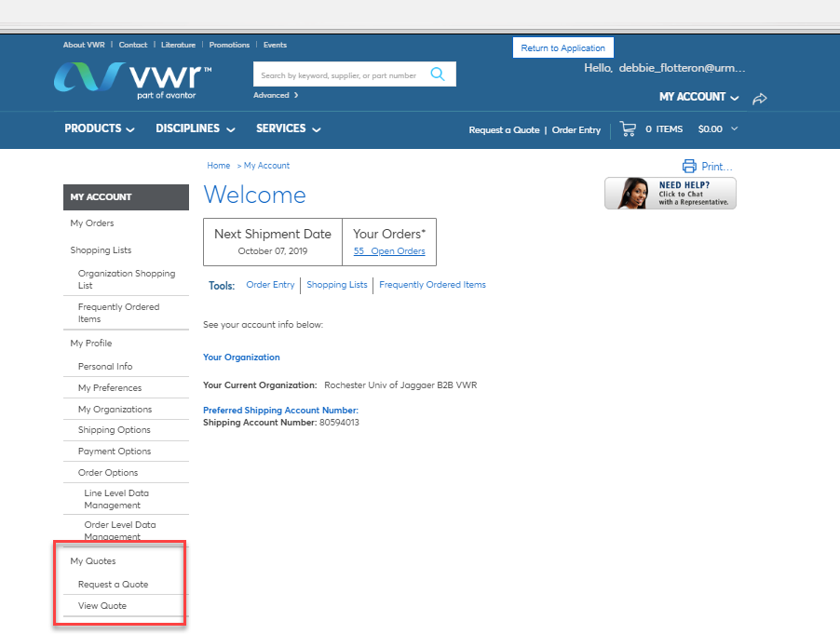
October Newsletter Topics
VWR Quote Feature
There is a quoting feature now available in P2P for VWR. If you ordered from VWR in the past, you may be familiar with “My Quotes” that was available prior to P2P. After logging in, select the My Quotes link located on the left-hand side of the screen.
Any quotes that were requested and prepared are listed. Clicks on the quote# and it opens up in the shopping basket at the prices quoted. You are able to order any item off the quote and/or change quantity.
11

Slide 12
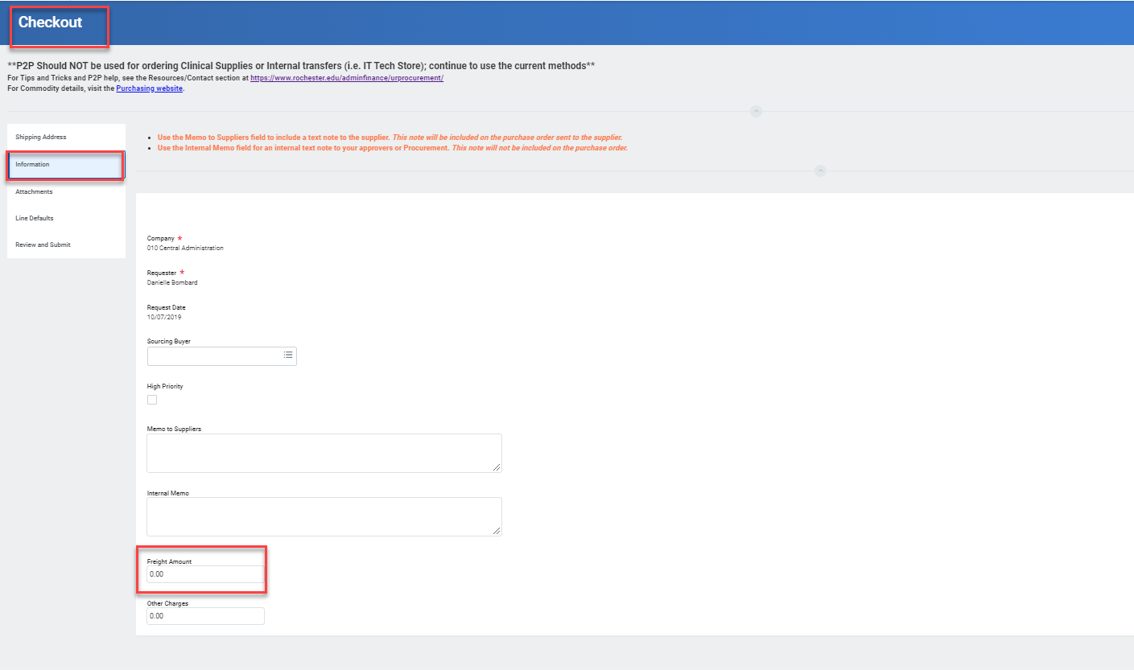
October Newsletter Topics
Freight Charges
When you are placing an order for goods and you know you will be charged freight, please be sure to enter it in the Freight Amount field in the Information tab of the checkout process.
.
By entering freight charges when they are known, it will alleviate Invoice Match Exception discrepancies and delayed payment to suppliers due to freight.
12

Slide 13
P2P Overview Session
.
13

