Slide 1
Procure to Pay Project
Demo Days
October, 2019
Notes:
Jim Dobbertin – Introduction and Kick Off

Slide 2
Are You On the Zoom?
Information for Zoom Participants
For those joining the Zoom:
1) Phones will be muted. Due to the volume of content to be shared, we may not have time for questions.
Send your questions to URProcurement@Rochester.edu They will be summarized and posted to the UR Procurement Website
3) P2P Frequently Asked Questions can also be found on the UR Procurement Website.
2
Notes:
Jim Dobbertin Note: If we do not have time to address questions submitted, they will be summarized and posted to the UR Procurement Website.

Slide 3
Topics
Project Review
P2P Status Report
Draft Roll Out Schedule
Design Changes
Demonstration: Design Changes and Tips and Tricks
Resources
Training
Support Organization
Next Steps
3
Notes:
Carl Tietjen and Liz Milavec

Slide 4
Procure to Pay Objectives
Transition from paper-based to electronic transactions
Provide full transparency and visibility into all P2P transactions from entry to payment (procure-to-pay!)
Streamline entry and approval activities to enable better internal controls
Standardize purchasing activity
Improve cycle and approval times
Enable data driven price negotiations and strategic sourcing
4
Notes:
Katherine Sadoff-Herrick Are we sure we want to include the P2P Video?

Slide 5
Prepare
User Acceptance Test 1, 2
Pilot Groups
1 and 2
System Roll Out
1, 2, 3, …
P2P Project Phases
Nov 2017 - May 2018 June - Dec 2018 Feb - June 2019 July – March 2020
June 11, 2018: Early Users - Workday for non-catalogue goods and services
November 19, 2018: Adds Marketplace (Jaggaer) for creating shopping carts for catalogue items and purchase order distribution (Amazon look and feel)
February 18, 2019: Pilot 1 – Add additional departments/users, refine P2P design
April 15, 2019: Pilot 2 – Add additional departments/users, refine P2P design
July/August 2019: Start phased roll out to remaining departments and users
5
Notes:
Katherine Sadoff-Herrick

Slide 6
Metrics to Date – Reqs / SIRs
Transaction Volume and Turn Around Time Trends
Invoice Matching Trends
Turnaround Time increasing with transaction volume
Discrepant Invoice Average of 34% for week
97% of total Match Exceptions for week due to Missing Receipt
Catalog / Non Catalog Trends
73% Marketplace Requisitions
23% Qualified Supplier (Non-Catalog)
4% New Supplier (Non-Catalog)
Service Calls increasing as expected with Rollout
Continue to increase number of requisitions (6,235) and SIRs (5,345)
Cumulative Requisition Turn Around Time at 4.99 days
Cumulative SIR Turn Around Time at 2.28 days
6

Slide 7
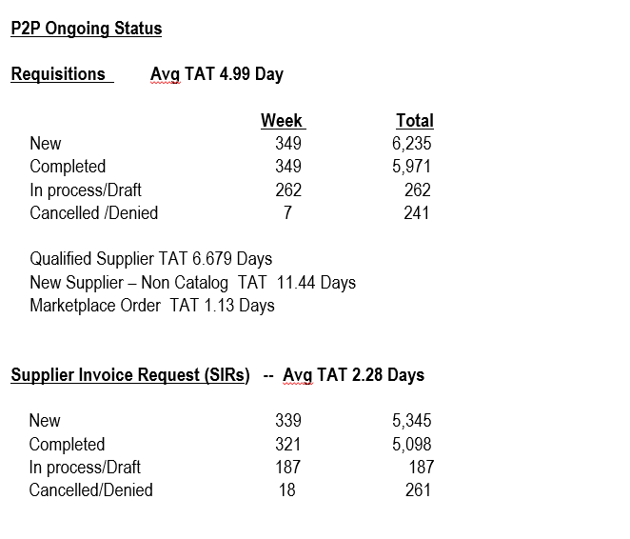
UR Procurement Update
7
Notes:
Jim Dobbertin

Slide 8
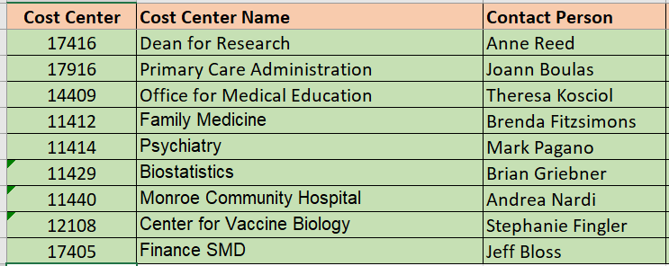
Rollout 2 Wave 2 - 10/28/19
8

Slide 9
P2P Roll Out – High Level Schedule
Roll Out 2 – Wave 2 – October 28th
School of Medicine & Dentistry (SMD)
Roll Out 3 – November 18th
SMD
Strong Memorial Hospital (SMH)
Medical Faculty Group (MFG)
Roll Out 4 – January 20, 2020
SMH/MFG
Health Science Division (HSD)
Roll Out 5 – March 16, 2020
SMH/MFG/HSD
Any remaining
Medical Center roll outs
to be based on readiness of
each department
9

Slide 10
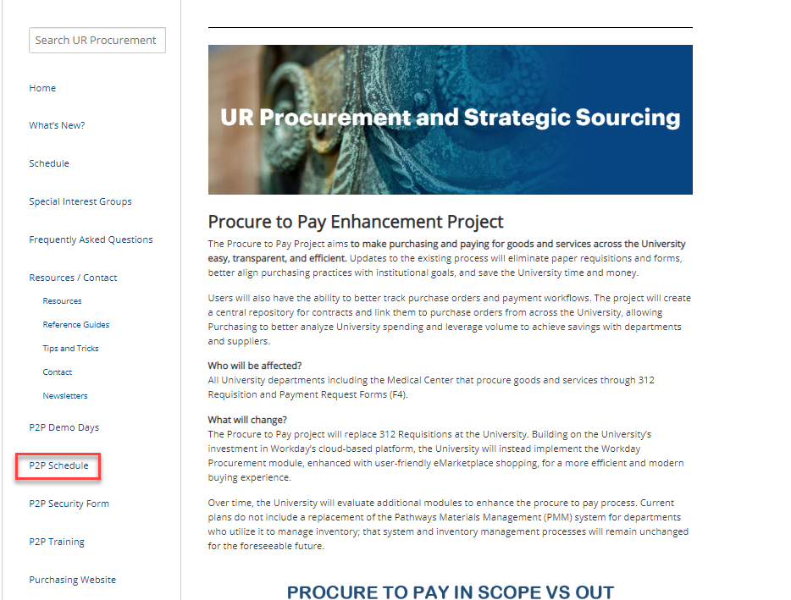
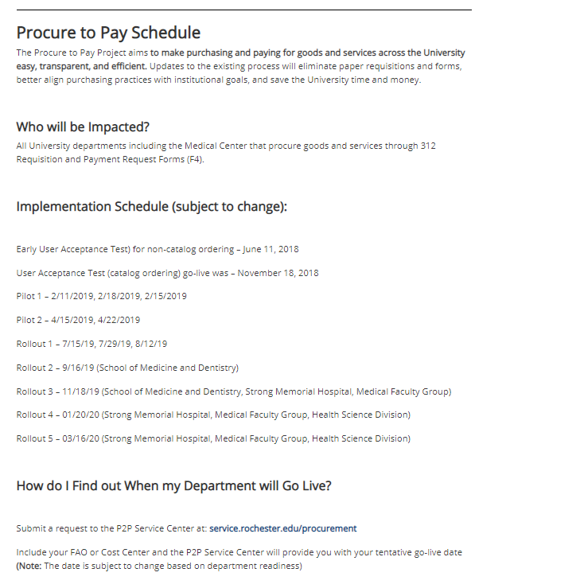
P2P Roll Out Process and Expectations
Review the Procure to Pay Website regarding detail on what to expect with the roll out process and implementation.
10

Slide 11
P2P Design Changes – Requisition Questionnaire
Starting October 28th, we will be implementing a requisition questionnaire.
A preliminary questionnaire will be sent to the Requisitioner after the “Submit” button is pressed. These questions are essential to mitigate risk to the university and medical center. A similar questionnaire is currently in use for Supplier Invoice Requests (SIRs).
This questionnaire should help expedite requisitions in Purchasing rather than having them contact you via email or phone for answers to the questions. Answers to some of the questions will also be used to route the requisition to the appropriate individual to determine if additional analysis is required. Note that depending on the answer selected, additional attachments may be necessary.
The questionnaire will only be required for non-catalogued requisitions.
Additional questions will be added in the future.
11

Slide 12
P2P Design Changes - Requisition Questionnaire
In the event that you are uncertain how to answer any of these questions, please consult with the requestor for answers, or reach out to the P2P Customer Service Center for assistance.
The questions are based on the following topics:
Consultant/Independent Contractor transaction
Conflict of Interest
Lease Agreement or Arrangement
See the next slide for a draft of the questionnaire:
12

Slide 13
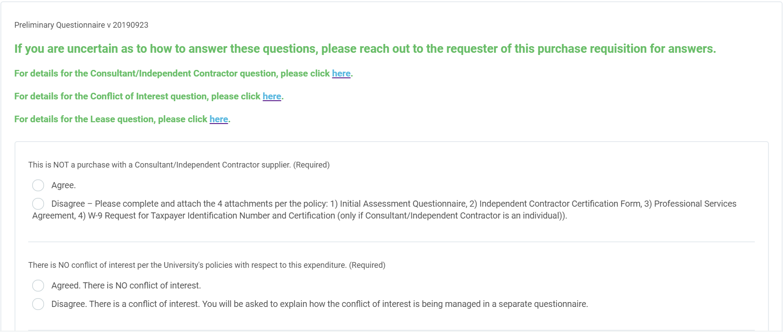
P2P Design Changes - Requisition Questionnaire
Note: SIR Questionnaire will be updated to align with Requisition questionnaire.
13

Slide 14
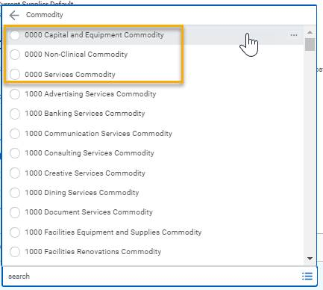
P2P Design Changes – Requisition Commodity Field
Additional commodities have been added to Commodity field (Requisition Checkout > Line Defaults tab).
Requisitioners will still need to select a single commodity for their requisition. It can still be the top-most Commodity group
(0000 Capital and Equipment Commodity, 0000 Non-Clinical or 0000 Services Commodity, which will always show at the
top of the Commodity list.
With this change requisitions have a choice: they can select the top-most Commodity Group or they can select a sub-commodity, if they so choose. Either way, their non-catalog requisitions should still only have one commodity per requisition. And if they have a multi-line requisitions, all lines still need to be the same Commodity or sub-commodity.
The sub-commodities will be utilized by the purchasing staff to better route and process your non-catalog requisitions.
The sub-commodities are also listed under the Active Commodity Organizations by Commodity Hierarchy section or can be searched by
typing a key word and pressing <enter>.
For Commodity details, visit the UR Procurement Website
14

Slide 15
P2P Demonstration – Design Changes
Requisition Questionnaire
Requisition Commodity Field
15
Notes:
Debbie Flotteron

Slide 16
P2P Training
Required Training:
MyPath (before Go-Live)
Initiator (Requisitions, F4 Forms, SOLO)
Approver
MyPath (after Go-Live)
Create Receipt and Match Exception Overview (Initiators Only)
Optional Training:
Classroom instructor led monthly training option for:
Requisitioner
Supplier Invoice Requester
Classes offered in Saunders Research Building Training Lab 1301
Classes offered in Gavett Hall 208 and Goergen Hall 102
MyPath (after Go-Live)
Reporting and Analytics Overview
Other Training/Support:
Job Aids, Quick Reference Cards, Video Snippets, Newsletters, Etc.
Daily post go-live calls include a Tips and Trick Training Topic
Weekly Workshop

Slide 17
P2P Training Options
P2P Workshops
These Workshops will be held in College Town (CTown 3102 Training Room). They are "open", meaning that we will not be covering a specific topic, but will customize our training to your individual needs. Bring in your questions, concerns, requisitions and invoices and we will walk-through the solutions together.
These will be 2 hour sessions alternating morning and afternoons.
You can register for a session in MyPath.

Slide 18
MyPath P2P Training Curriculum - Required
Role | Required Module(s) | Duration (minutes)
Initiator Requisitioner (Blue 312 Reqs) SIR Requestor (F4 Payments) | Buying and Paying Guide Overview P2P: UR Procurement Basic Navigation P2P: Create Requisition Overview P2P: Marketplace Overview P2P: Supplier Invoice Request (SIR) Overview | 15 15 20 20 20
Initiator Requisitioner | P2P: Create Receipt and Invoice Match Exception Overview (Required after Go-Live) | 20
Approver | P2P: UR Procurement Basic Navigation P2P: UR Procurement Approver Overview | 15 15
P2P MyPath courses are available for all employees however, P2P team will continue to send email to targeted users as part of the rollout schedule
18
Notes:
Jill Brock

Slide 19
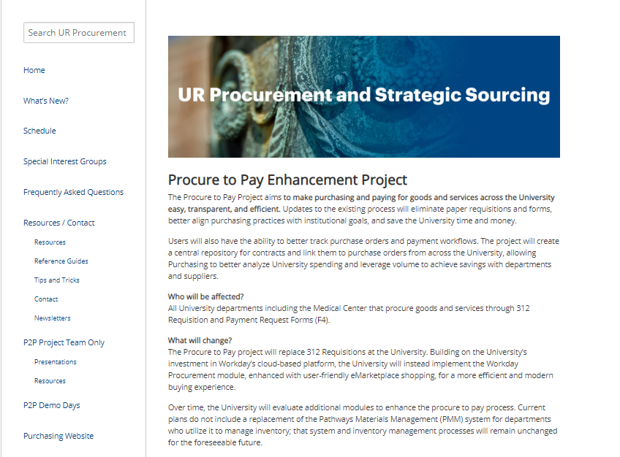
P2P Communications
Procure to Pay Website rochester.edu/adminfinance/urprocurement
Reference Guides
Newsletters
FAQs
Project Schedule and Status
Tips and Tricks
Training Schedule and Information
Video Snippets
Monthly P2P Demo Days
2 Sessions (Medical Center and Campus)
Project Updates, Demo of system functionality
19

Slide 20
P2P Support
Procure to Pay Customer Service Center
Service Desk Portal : service.rochester.edu/procurement
P2P Service Center: 275-2012
Email: Procurement_service_center@ur.rochester.edu
For System Access & Issues
Help Desk: UnivIT: 275-2000, UnivITHelp@ rochester.edu
Help Desk URMC: 275-3200, helpdesk_ISD@ urmc.rochester.edu
Quick Reference Guides
Quick Reference Videos
Walkme
20

Slide 21
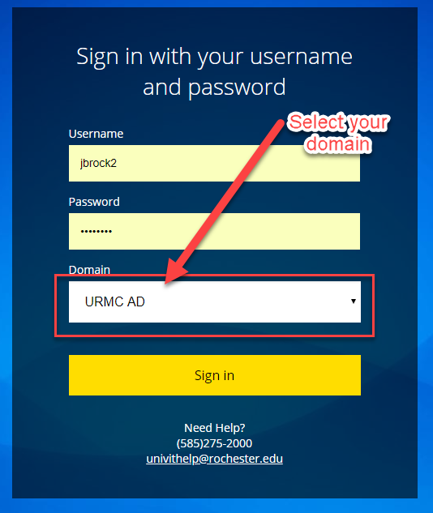
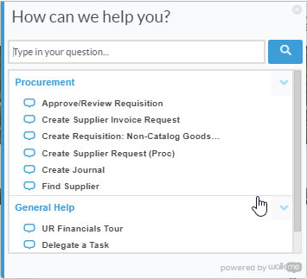
Resources cont’d
P2P Service Center
https://service.rochester.edu/procuement
Log in with your Domain Name, choose domain.
WalkMe
Select Need Help? for step-by-step on-screen help.
Smart Tips are also available
21
Notes:
If you don’t see the Need Help button contact the IT helpdesk at 275-2000 or Univithelp@Rochester.edu

Slide 22
Next Steps
Plan for Departmental Implementation:
Identify initiators (312 requisitions/SOLO Order placement/F4 Forms)
Identify approvers (Approve requisitions and F4/SIR Transactions)
Participate in Monthly Demo Day Meetings
Medical Center
River Campus
Visit the P2P Website UR Procurement Website
Questions? Please reach out to:
URProcurement@Rochester.edu
Future Demo Day Topics
November: TBD
22
Notes:
Jim

Slide 23
Appendix
23
Notes:
Jim

Slide 24
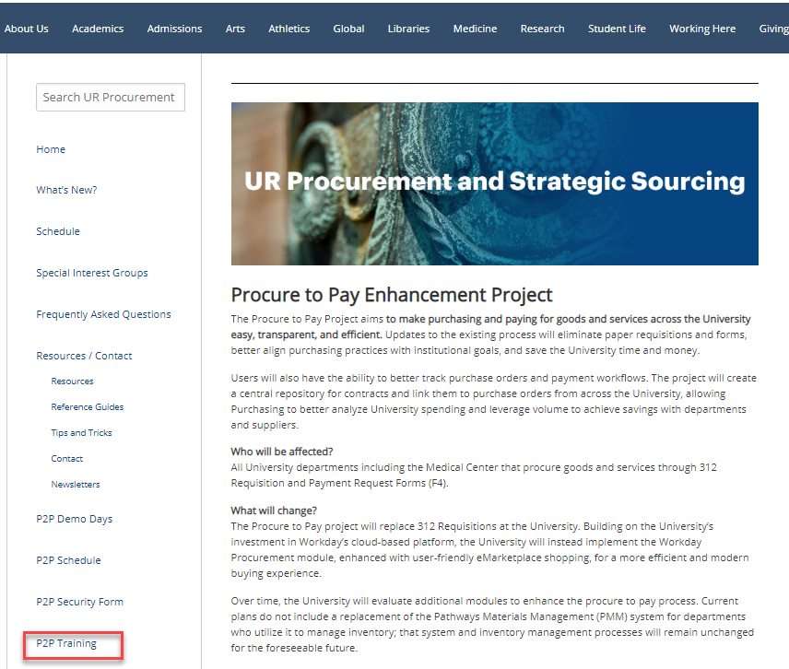
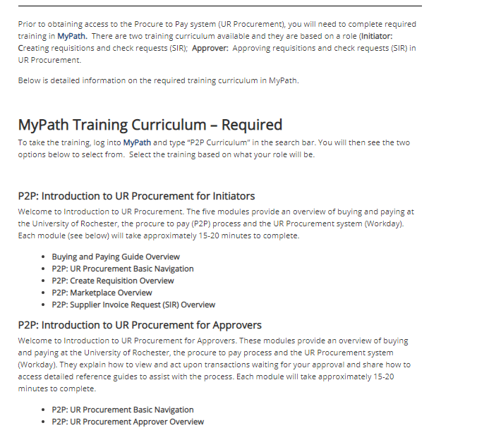
P2P Training Options
To learn more about P2P Training options, go to the UR Procurement Website

Slide 25
P2P Training Option – Non-Employees
New
Since most non-employees don’t have access to MyPath, we are developing an option to still have them perform the necessary prerequisites before gaining access to P2P:
Applies to students and contractors who initiate purchases
Approval roles are not allowed
An employee must “sponsor” the non-employee
Sponsor is responsible for verifying the non-employee has performed the required training
Sponsor is required to contact the P2P Customer Service Center to communicate the requested access
Detailed requirements forthcoming

Slide 26
Instructor Led Training (Optional)
Course | Description | Duration
UR Procurement Create Requisition (312) and Marketplace (SOLO) Class | This classroom training provides an overview of the procure to pay (P2P) process and the UR Procurement system (Workday). Get hands-on practice entering requisitions for goods and services as well as ordering from the Marketplace (previously SOLO). Register for the class in MyPath | 2.5 hours
UR Procurement Supplier Invoice Request (F4 Payment Request Form) Class | This classroom training provides an overview of the Supplier Invoice Request process in the UR Procurement system (Workday). Get hands-on practice entering SIRs. Register for the class in MyPath | 90 minutes
26
Notes:
Jill Brock

Slide 27
MyPath P2P Training - Optional
Course | Description | Duration
UR Procurement: P2P Reporting and Analytics Overview | This Training provides an overview of the reporting capabilities in the UR Procurement System. | 20 minutes
27
Notes:
Jill Brock

