Slide 1
Procure to Pay Project
Tips and Tricks – Editing a Draft Receipt

Slide 2
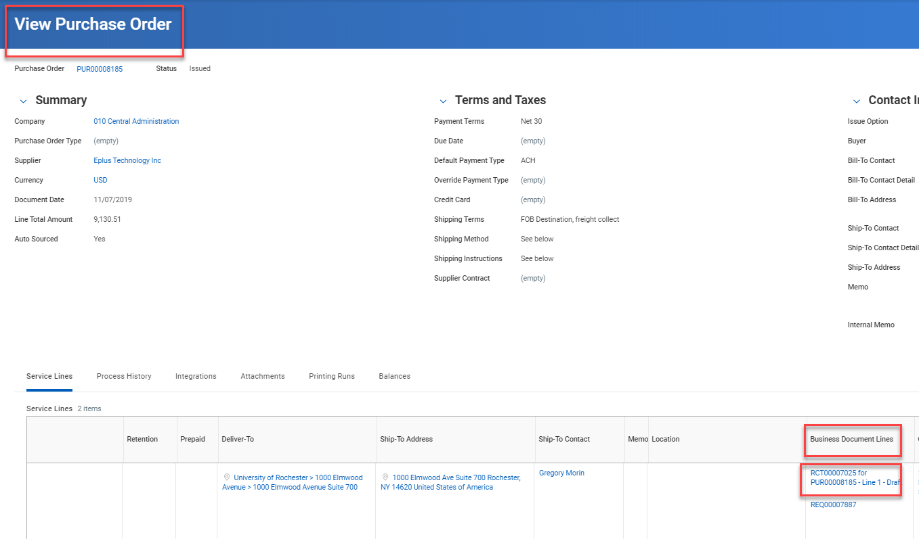
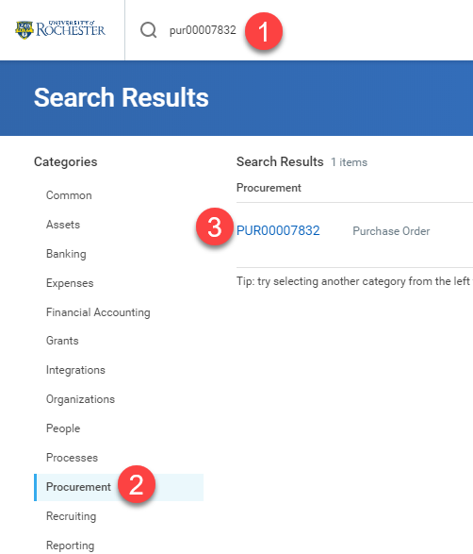
Tips and Tricks – Editing a Draft Receipt
In order to Edit a receipt that is in draft status you have to find the receipt number on the line of your PO. Type the PO number in the global search bar, click on Procurement, then click on the blue PO number.

Slide 3
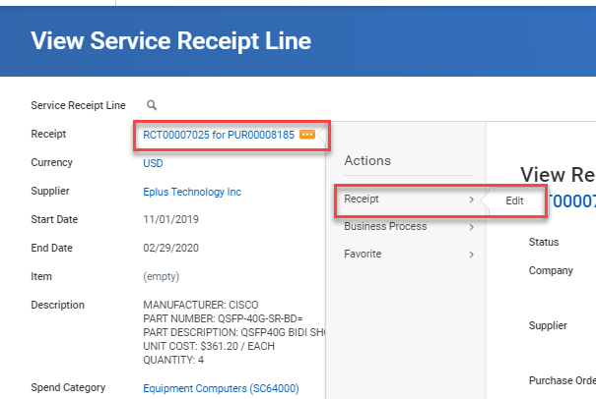
Editing a Draft Receipt
Click on the receipt number on the PO line and then click on the action button next to the receipt number when you get to the View screen.
Hover over the word Receipt and click Edit.

Slide 4
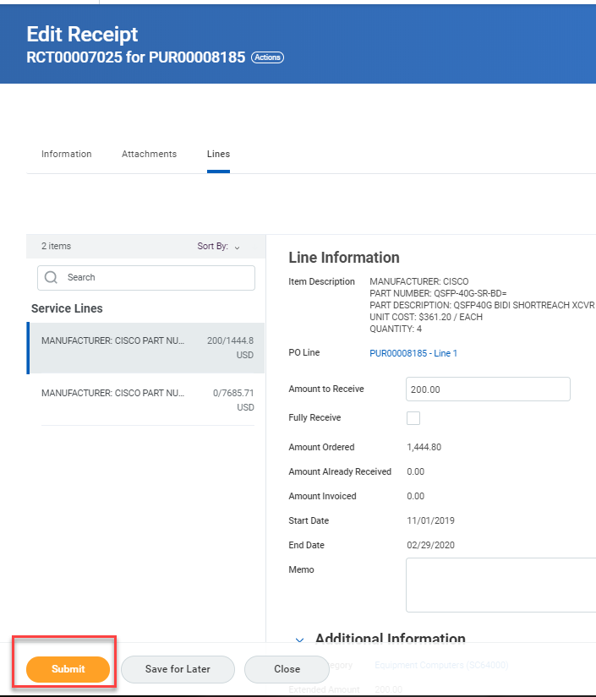
Editing a Draft Receipt
Now you can Correct and/or Submit your receipt.
You must always submit a receipt for it to be approved and clear Match Exceptions.

Slide 5
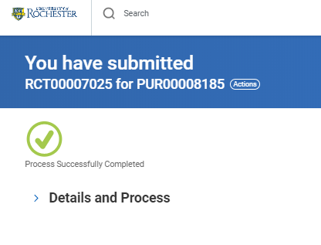
Editing a Draft Receipt
You know you have been successful when you see a green check mark and can read that you have submitted the receipt.

Slide 6
Questions?

