Slide 1
Procure to Pay Project
Tips and Tricks – How to tell if your PO was sent

Slide 2
Tips and Tricks – How to tell if your PO was sent. when.
If you would like to confirm whether or not a Purchase Order was actually sent to the supplier you can look it up easily. You will also be able to tell how and when it was sent.
In the global search box, type the word CONNECT.
Choose Connect to the Supplier Website.
Click OK under your name and then click on the Connect Button.

Slide 3
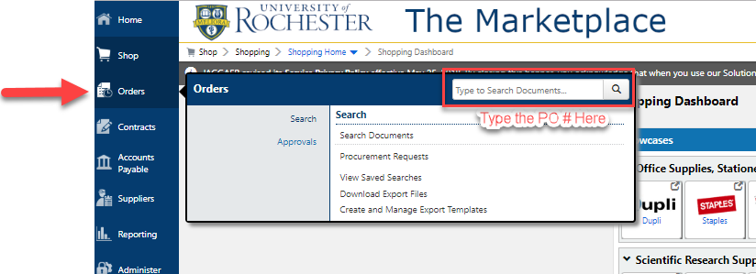
Tips and Tricks – How to tell if your PO was sent.
Once you connect to the Marketplace you can click on the Orders tab and search for the PUR number.

Slide 4
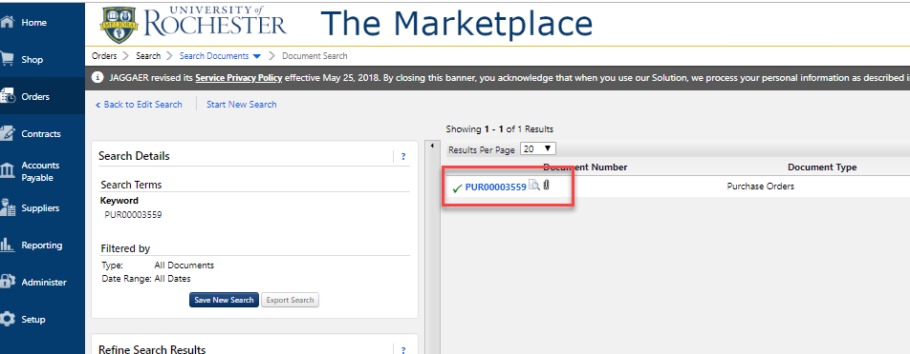
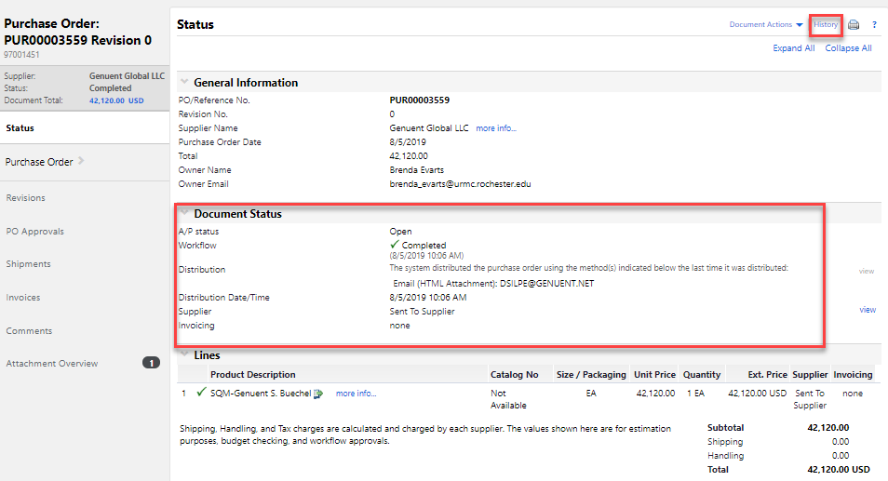
Tips and Tricks How to tell if your PO was sent.
When your PO, appears, click on the number and then look for the Document Status information to show the distribution method (i.e. email, fax, cXML) and date/time. You can also select the History link in the upper right to see distribution information as well.

Slide 5
Questions?

