Slide 1
Procure to Pay Project
Tips and Tricks – How To Tell Which ACM Is Working On Your Requisition

Slide 2
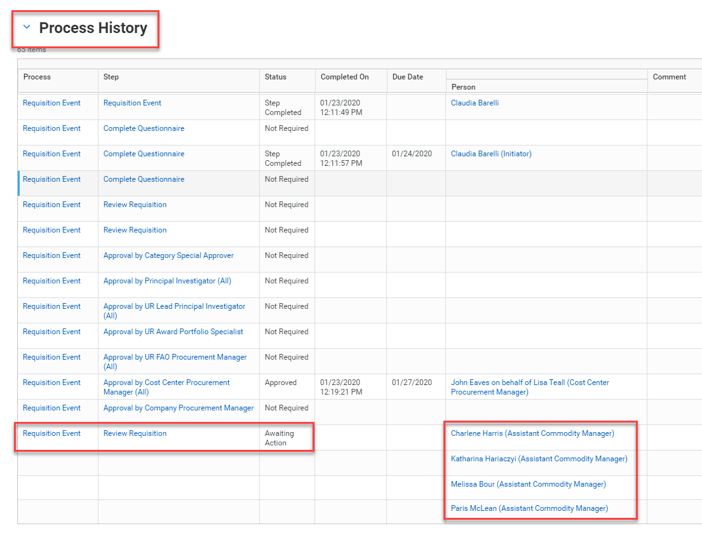
Tips and Tricks – How To Tell Which ACM Is Working On Your Requisition
If you look at the Process History of a Requisition and see it is in Purchasing, but there is a list of names, you can check to see if it is being worked on by a particular ACM.

Slide 3
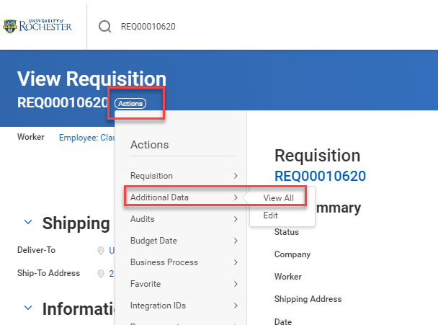
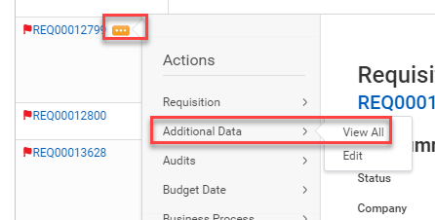
Tips and Tricks How To Tell Which ACM Is Working On Your Requisition
On the View Requisition tab, or next to the Requisition number on your My Requisitions Worklet, click on the Action Button.
Then hover over Additional Data and select View All.

Slide 4
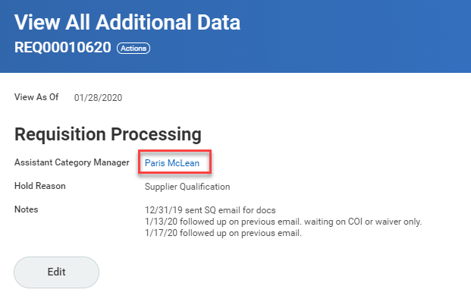
Tips and Tricks- How To Tell Which ACM Is Working On Your Requisition
This screen will show the name of the ACM working on your requisition in addition to any information on whether or not the requisition is temporarily on hold and why. If there is no name listed the requisition has not yet been reviewed by the ACM pool.

Slide 5
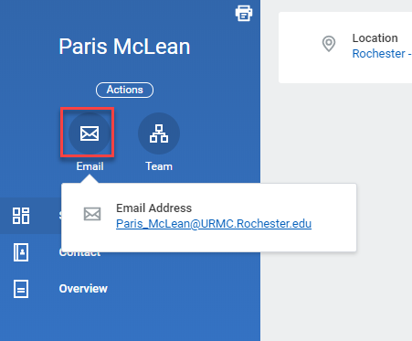
Tips and Tricks- How To Tell Which ACM Is Working On Your Requisition
If you click on the ACM’s name it will take you to a screen that will provide you with that ACM’s email address. You can reach out to them directly if you have further questions.

Slide 6
Questions?

