Slide 1
Procure to Pay Project
Tips and Tricks – Looking for Shipment Notification on Orders

Slide 2
Tips and Tricks – Looking for Shipment Notification on Orders
Not all of the Marketplace suppliers send shipment notification emails to the end user. They do, however, post shipment notification in the Marketplace.
The first thing you need to do is type Connect in the Global Search bar and Connect to the Supplier Website. Once there you should click on orders in the blue bar and type in your Purchase Order number. Click the magnifying glass.

Slide 3
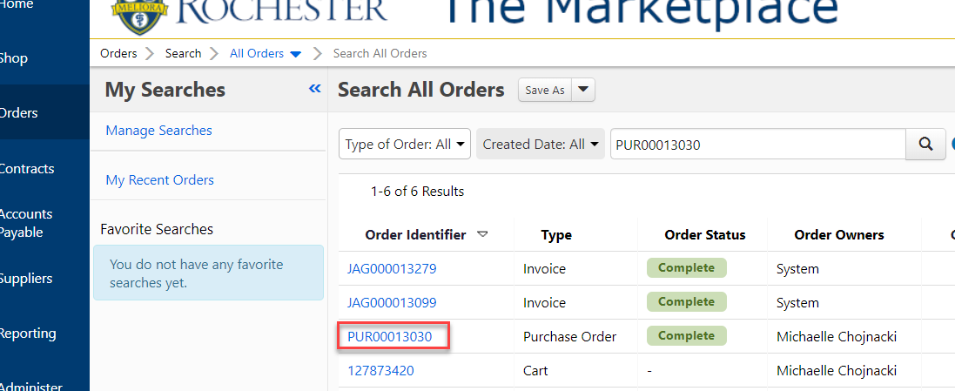
Tips and Tricks – Looking for Shipment Notification on Orders
Look for your Purchase Order number in the list that pops up. Click on the correct number to open the Purchase Order details.

Slide 4
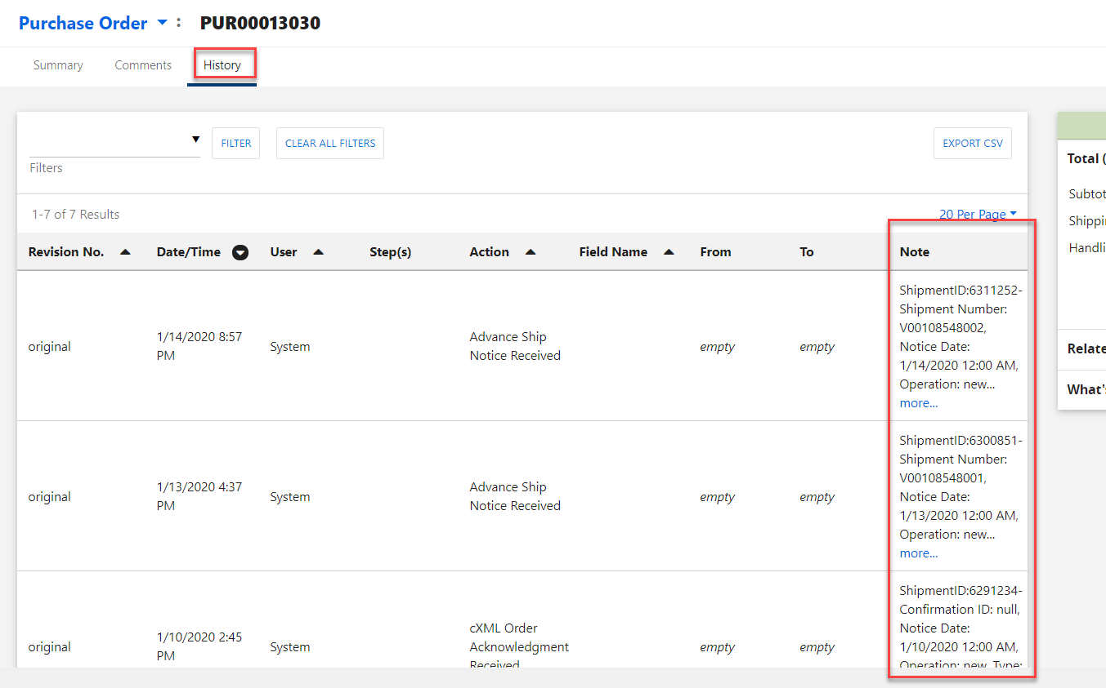
Tips and Tricks- Looking for Shipment Notification on Orders
Click on the History tab and slide the information to the right so you can see all of the Notes column. Your Shipment details will be located in the column, including the date of the shipment.

Slide 5
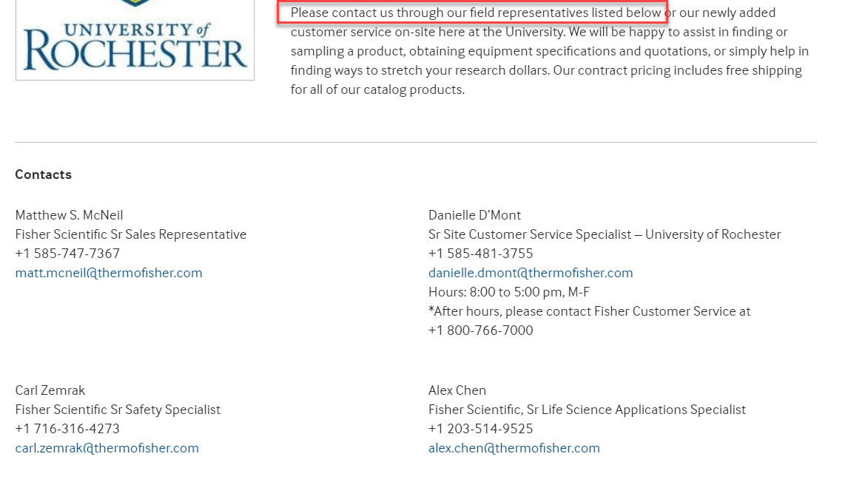
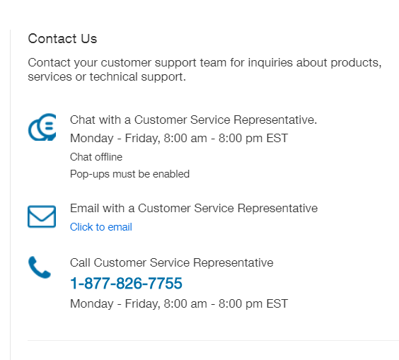
Tips and Tricks- Looking for Shipment Notification on Orders
If you have additional questions and need to reach out to the supplier most of the Marketplace sites have posted contact information.

Slide 6
Questions?

