Slide 1
Procure to Pay Project
Design Change Overview
January 2020
Notes:
Jim Dobbertin – Introduction and Kick Off

Slide 2
Topics
Multi-Company Requisition Functionality
Capital Requisition Routing-Strong Memorial Hospital (SMH)/Medical Faculty Group (MFG)
* Only for Company 050 and 091
Requisition Questionnaire Enhancement
Personably Identifiable Information (PII)
Protected Health Information (PHI)
CLEAR Routing (Clinical Lab Equipment Acquisition Review Committee) * Only for Company 050 and 091
2
Notes:
Carl Tietjen and Liz Milavec

Slide 3
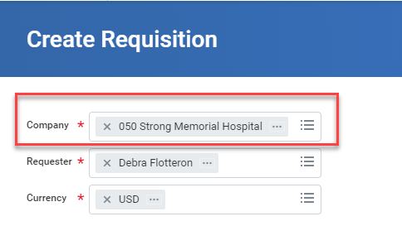
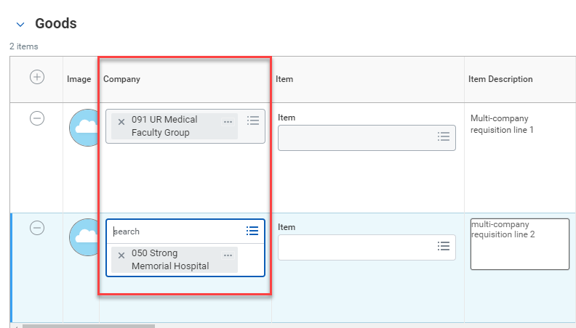
Multi-Company Requisitions
Multi-Company Requisitions
Enables requisitioner to create a requisition that contains multiple FAOs in different companies
Each line can be assigned to a different company
Cannot split a single line to multiple companies
The requisition header company must match one the company associated to an FAO at the line level
3

Slide 4
SMH/MFG Capital Routing
Automate routing of SMH/MFG capital requisitions for company 050 and 091
Additional question added to the Requisition Questionnaire
4

Slide 5
SMH/MFG Capital Routing
Approved Capital Requisition Approval Steps
FAO Procurement Manager approval
Company 050 $500 - $24,999
Company 091 $500 - $49,999
Cost Center Procurement Manager approval, if applicable
Company 050 $25,000- $499,999
Company 091 $50,000 -$ 99,999
Clear Coordinator Approval (Clinical Lab Equipment Acquisition Review) *
Company Capital Initiator (for review)
Change FAO to PRXXXXXX
Company Capital Approval <=$25,000
Company Chief Financial Officer Approval >=$50,000
Purchasing review and approval
*If answer yes to CLEAR question in the questionnaire.
Note: Change orders need to be initiated by the Company Capital Initiator role so you will need to work with that person to initiate a change.
5

Slide 6
SMH/MFG Capital Routing
Emergency Capital Requisition Approval Steps
FAO Procurement Manager approval
Company 050 $500 - $24,999
Company 091 $500 - $49,999
Cost Center Procurement Manager approval, if applicable
Company 050 $25,000- $499,999
Company 091 $50,000 -$ 99,999
Clear Coordinator Approval (Clinical Lab Equipment Acquisition Review)*
Company Capital Initiator (for review)
Change FAO to PRXXXXXX
Company Emergency Capital Approval
Company Chief Financial Officer Approval >=$50,000
Purchasing review and approval
*If answer yes to CLEAR question in the questionnaire.
Note: Change orders need to be initiated by the Company Capital Initiator role so you will need to work with that person to initiate a change.
5

Slide 7
Requisition Questionnaire Enhancements
Personally Identifiable Information (PII) and Protected Health Information (PHI)
6

Slide 8
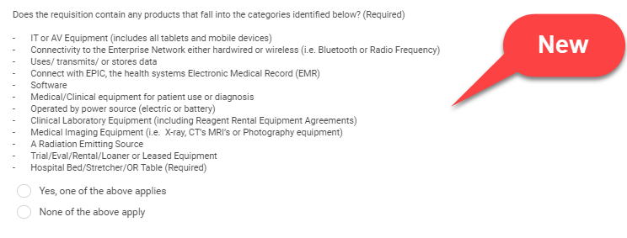
Requisition Questionnaire Enhancements
CLEAR (Clinical and Lab Equipment Acquisition Review)
Only requisitions in company 050 and 091 will be asked this question.
If yes, is selected, the requisition will route to the CLEAR Committee for review after FAO and Cost Center Procurement Manager financial approvals but before capital financial approvals.
The function of the CLEAR Committee is as follows:
Value Analysis - Reviews all products (disposable) related to the capital purchase.
Information Security Risk and Compliance – Reviews the following: current operating system and support, type of data being entered and/or accessed, antivirus, network access, authentication, removable storage.
Clinical Engineering – Investigates the support and service terms for equipment purchases. Decides whether the vendor or clinical engineering will be servicing the equipment.
Imaging Sciences – Does the product/service capture patient imaging? If yes, reviews licensing, storage of imaging, replacement or new, trials.
Networking/Frequency Allocation – That the device meets our minimum requirements, that it is not harmful to our Enterprise network, and that it conforms to Enterprise networking standards. RF Technology: That it does not interfere with any existing technology, that it will actually function in our environment, That we don’t already have an Enterprise solution for the request that is being reviewed.
Integrated Clinical Systems – Reviews the following: potential integration with other systems, data implications, ISD support requirements, SMA & HMA.
7

Slide 9
P2P Requisition Questionnaire
Starting February 3rd, we will be implementing these changes.
The questionnaire sent to the Requisitioner after the “Submit” button is pressed will be updated with the Capital, PHI, PII and CLEAR questions referenced on the prior screen. These questions are essential to mitigate risk to the university and medical center.
The questionnaire will only be required for non-catalogued requisitions (except SMH/MFG).
SMH/MFG questionnaire will be required for non-catalog requisitions and catalog requisitions with any unit cost >=$1,000
We will be enhancing the questionnaire in the future to incorporate the Supplier Price Justification Conflict Information (SPJCI) Form.
8

Slide 10
P2P Overview Session
Multi-Company Requisition Functionality
Requisition Questionnaire Enhancements
9
Notes:
Debbie Flotteron

Slide 11
P2P Overview Session
.
10

