Slide 1
Procure to Pay Project
Tips and Tricks – Supplier Invoice Requests.
Revised 01/2020

Slide 2
Tips and Tricks – Supplier Invoice Requests (SIRs)
It is best practice to search for an invoice/payment prior to creating a Supplier Invoice Request to prevent duplicate payment
Find Supplier Invoice Lines (NCL) URF0992
Find Supplier Invoice Requests
Internal Memo – enter the business purpose for the request. Can also be used to enter tracking information for your department’s internal reporting (e.g. 4th digit of the subcode)
Attachments are almost always required. The only exception is for study participation payments when a W9 is not required.
Before initiating the Supplier Invoice Request, be sure you are familiar with Acceptable Usage.

Slide 3
Tips and Tricks – Supplier Invoice Requests (SIRs)
Employee Acceptable Use
Employees can only receive a limited list of payments via the Supplier Invoice Request (SIR):
Royalty Payments
*Study subject payments
Performance fees
*Departments can chose to do study participant payments as SIRs or F4s (See Acceptable Use – on F4s slide)

Slide 4
Tips and Tricks – Supplier Invoice Requests (SIRs)

Slide 5
Tips and Tricks – Supplier Invoice Requests (SIRs)

Slide 6
Tips and Tricks – Supplier Invoice Requests (SIRs)
Be sure to select one of the following Handling Codes when initiating a SIR. Below are the guidelines for selection:
Pickup: Select this if you want to be contacted to pick up the check when it is ready. Given the inherent urgency of this selection, Rush is implied, but only one special handling fee will be charged.
Mail Back: Select this if you must have the check returned to a department for distribution.
Enclosure: Select this if you think the payee will find it beneficial to receive documentation with their check payment so that they better understand what they are receiving the check payment for.

Slide 7
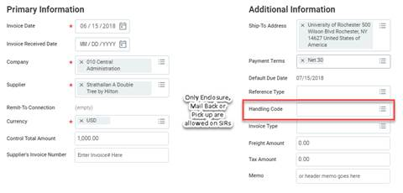
Tips and Tricks – SIRs cont’d
In the Create SIR screen, when no Handling code selected, the default payment type will apply. Example: Default Payment type of ACH or Check mailed directly to payee.

Slide 8
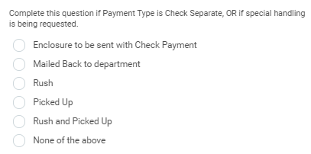
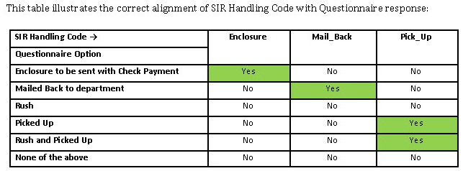
Tips and Tricks – SIRs cont’d
Remember that your response in the Acceptable Use Questionnaire to the Payment Type is Check Separate/Special Handling question should match the Handling Code selection you selected when creating your SIR.

Slide 9
Questions?

