Slide 1
Procure to Pay Project
Demo Days
February, 2020
Notes:
Jim Dobbertin – Introduction and Kick Off

Slide 2
Are You On the Zoom?
Information for Zoom Participants
For those joining the Zoom:
1) Phones will be muted. Due to the volume of content to be shared, we may not have time for questions.
Send your questions to URProcurement@Rochester.edu They will be summarized and posted to the UR Procurement Website
3) P2P Frequently Asked Questions can also be found on the UR Procurement Website.
2
Notes:
Jim Dobbertin Note: If we do not have time to address questions submitted, they will be summarized and posted to the UR Procurement Website.

Slide 3
Topics
Project Review & Scope
Buying and Paying Guide
P2P Status Report
Workday Upgrade Changes
Project Updates
Demonstration: Design Changes
P2P Transition and Adoption
Super User Meetings
Resources
Training
Support Organization
Next Steps
3
Notes:
Carl Tietjen and Liz Milavec

Slide 4
Procure to Pay Objectives
Transition from paper-based to electronic transactions
Provide full transparency and visibility into all P2P transactions from entry to payment (procure-to-pay!)
Streamline entry and approval activities to enable better internal controls
Standardize purchasing activity
Improve cycle and approval times
Enable data driven price negotiations and strategic sourcing
4
Notes:
Katherine Sadoff-Herrick Are we sure we want to include the P2P Video?

Slide 5
Prepare
User Acceptance Test 1, 2
Pilot Groups
1 and 2
System Roll Out
1, 2, 3, …
P2P Project Phases
Nov 2017 - May 2018 June - Dec 2018 Feb - June 2019 July – March 2020
June 11, 2018: Early Users - Workday for non-catalogue goods and services
November 19, 2018: Adds Marketplace (Jaggaer) for creating shopping carts for catalogue items and purchase order distribution
February – April 2019: Pilot 1 &2 – Add additional departments/users, refine P2P design
July 2019 – February 2020: Phased roll out to remaining departments and users
March 2020 – June 2020 Stabilization and Adoption
5
Notes:
Katherine Sadoff-Herrick

Slide 6
P2P Scope
Included in This Project
Excluded from This Project
Blue Requisitions
Ordering (currently in PMM): Administrative/Non-catalog requisitioning
Catalog and Non-catalog items
Goods and Services
University Divisions 10 through 92
Supplier Online Ordering (SOLO)
Highland Hospital and Affiliates
PMM Inventory Locations, Par Forms, Custom Requisitions, item file requisitions
Internal Transfers (i.e. UR Tech Store, internal catering, Barnes and Noble, Biological Supply Center)
Patient Care Supplies
6

Slide 7
P2P Buying and Paying Guide
The Buying and Paying Guide will assist with……
Determining the Preferred Procurement Method
UR Procurement Non-Catalog (Workday) Requisition (Formerly 312 Requisition)
UR Procurement Marketplace Catalog (Workday/Jaggaer) Requisition (Formerly 312 Requisition or SOLO Order)
Pcard
Payroll
Supplier Invoice Request (SIR) – Formerly F4 Payment
Travel
Identifying Marketplace Supplier Catalogs
Identifying Suppliers Not Acceptable on a SIR
Definitions of Supplier Groups
Listing of Procurement and Capital Spend Categories
7
Notes:
Katherine Sadoff-Herrick

Slide 8
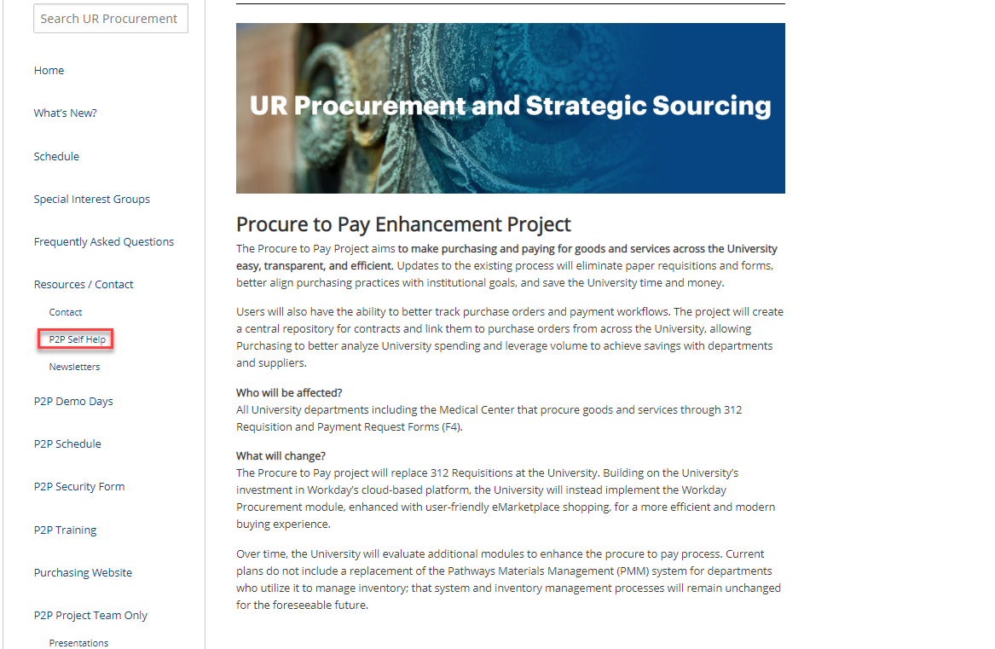
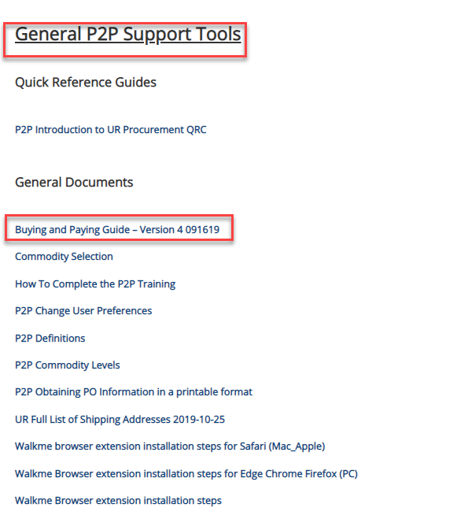
P2P Buying and Paying Guide
8
Notes:
Katherine Sadoff-Herrick

Slide 9
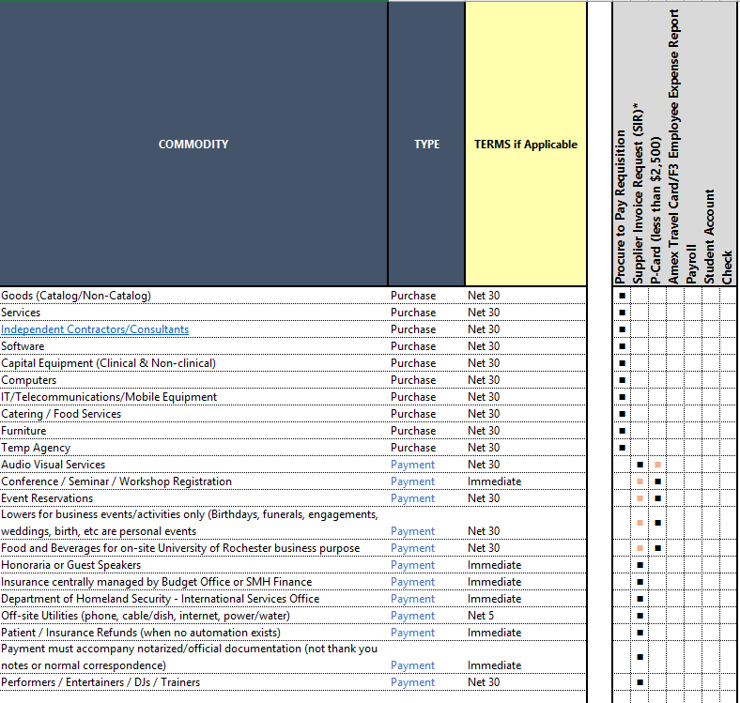
P2P Buying and Paying Guide
9
Notes:
Katherine Sadoff-Herrick

Slide 10
P2P Current Status
P2P Ongoing Status
Requisitions Avg TAT 6.11 Day
Week Total
New Requisitions 1,044 18,039
Qualified Supplier TAT 7.88 Days
New Supplier – Non Catalog TAT 12.2 Days
Marketplace Order TAT 1.73 Days
Supplier Invoice Request (SIRs) -- Avg TAT 2.80 Days
Week Total
New 571 14,375
10

Slide 11
P2P Marketplace Update
Marketplace Catalog Update
14.100 orders ($4,368,152) placed since Go-Live (11/19/18)
Implemented Suppliers
1. Airgas USA LLC | 11. Integrated DNA Technologies, Inc | 21. Workplace Interiors
2. Beckman Coulter | 12. Johnston Paper | 22. Qiagen
3. Bio-Rad Laboratories | 13. Krackeler Scientific | 23. Anixter
4. EMD Millipore Corp | 14. Laboratory Product Sales | 24. Wesco
5. Dupli Graphics | 15. Life Technologies | 25. Grainger
6. Fisher Scientific | 16. McMaster-Carr Supply Company | 26. WB Mason
7. Graybar Electronics | 17. Sedgwick | 27. BSN Sports
8. Henry Schein | 18. Sigma-Aldrich
9. Hill and Markes, Inc. | 19. Staples
10. Illumina | 20. VWR International
Suppliers in Process | Suppliers Requested
Agilent | Dharmacon
Amazon Business | Genescript
B&H Photo | GE Life Science
Charles River Laboratories | Hampton Research
Perkin Elmer Health Science | Partssource
Thorlabs
11

Slide 12
Project Updates
Recent Design Changes
The Delivery Date Field in requisition checkout is no longer required for catalog and non-catalog orders. If you desire to add a delivery date, you can add it during the requisition checkout process.
Notifications to requisitioners have been enabled to provide an email confirmation when a PO has been sent to the supplier.
Upcoming System Changes
Supplier Price Justification Questionnaire
System Design Under Review
Delegates can be one of three types under the current Delegation Design:
Peers – anyone that reports to the same manager as you
Superiors – anyone from your manager and up in the same management chain of command
Subordinates – anyone that reports to you or anyone that reports to any of your peers
Feedback received some delegations are unable to be assigned because the delegate does not meet the criteria
12

Slide 13
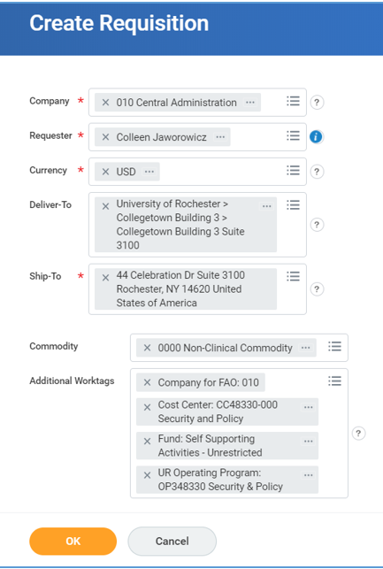
Workday 2020 R1 Upgrade
UR Procurement will be upgraded on March 7.
Enhancements have been made to the Create Requisition and checkout screen.
Following is a preview to the upcoming changes.
Current Available March 9
13

Slide 14
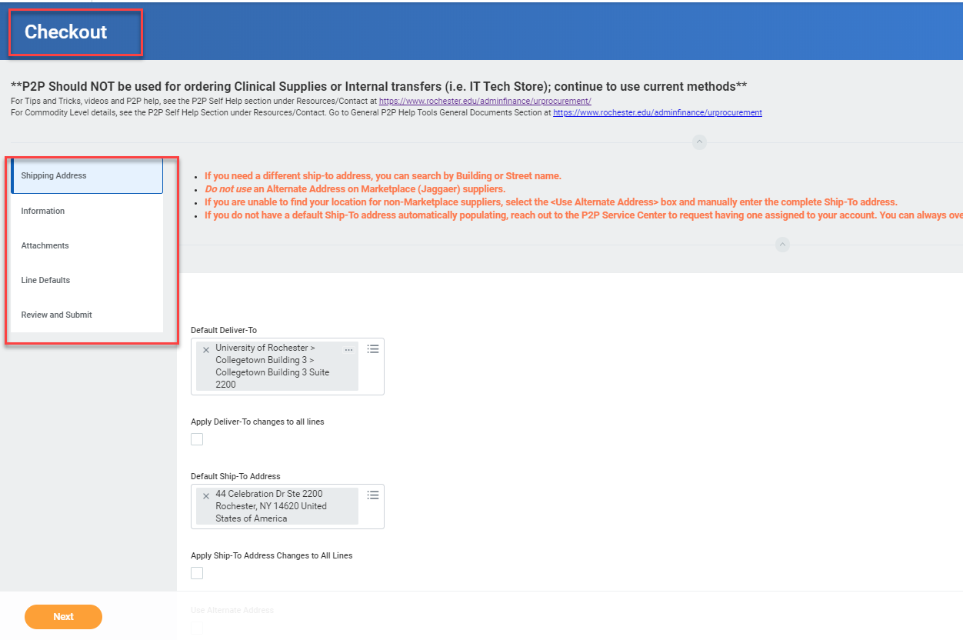
Workday 2020 R1 Upgrade
The new checkout screen will be one page.
Current Requisition Checkout Process
14

Slide 15
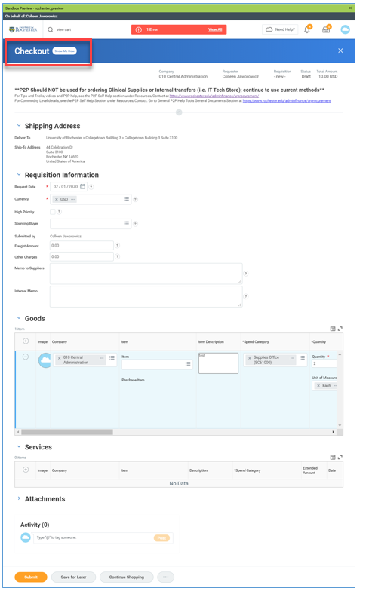
Workday 2020 R1 Upgrade
Requisition Checkout Screen as of March 9 – single page
15

Slide 16
Final P2P Rollout - 2/24/2020
Cost Center Name
11049 Anthony Center for Women's Leadership
11421 Neurosurgery
11422 Ophthalmology
12193 Development Center for Aids Research
12205 Center for RNA Biology
15013 Central Utilities Administration
15021 Construction Receivable
15420 Medical Center Physical Plant
16009 Vice President Communications
17003 Office of University Counsel
17004 Provosts Office
17009 Presidents Office
17016 University Architect
17021 Vice President Senior Advisor to the President and University Dean
17036 Office of Research and Project Administration
17039 Senior Vice President Institutional Resources
17051 Associate Vice President Human Resources
17089 Human Subject Protection
17090 Transportation Department
17123 Senior Vice President for Research
17129 Academic Affairs
17404 Vice President Health Affairs
17428 Medical Center Information Systems
17435 Medical Center Finance
17464 URMC Web Core Group
17469 Medical Center Technology Transfer
Payer Contracting Reimbursement
17488 Federal State and Government Relations
17905 URMFG Administration
Cost Center Name
17917 Compliance Office
31504 SMH Information Systems
31510 SMH Capital Investment
31515 SMH Reimbursement
33504 SMH Facilities
36502 SMH Clinical Engineering
36528 SMH Medical Education Office
36592 SMH Organ Procurement
40404 Medical Center Parking
43319 Copy Centers
43335 Medical Center Directors Office
43387 Photography Services
45150 UR Ventures
16

Slide 17
P2P Transition and Adoption
Transitioning of Transactions to P2P
Current participants in the Procure to Pay (UR Procurement) system are required to convert transactions to the UR Procurement system. After you go live you should no longer submit 312 requisitions to Purchasing or F4 Forms to Accounts Payable and should no longer be placing orders via the SOLO process except for RR Donnelly and Medline Industries. SOLO accounts will be given a 30 day grace period notification prior to being decommissioned.
If you have any blanket purchase orders in effect, you should work to convert those to P2P. Below is additional information regarding conversion of blanket purchase orders.
Determine if your blanket PO need is for a good or service and then review the options below on what method to use to convert that order to the UR Procurement system. If you require assistance, please contact the P2P Service Center at urprocurement_service_center@ur.rochester.edu. You can also sign up for a P2P Workshop to walk through how to create your blanket order requisition in Workday. You can register for a P2P Workshop in MyPath. Search for “P2P Workshop” to find the next available dates.
17

Slide 18
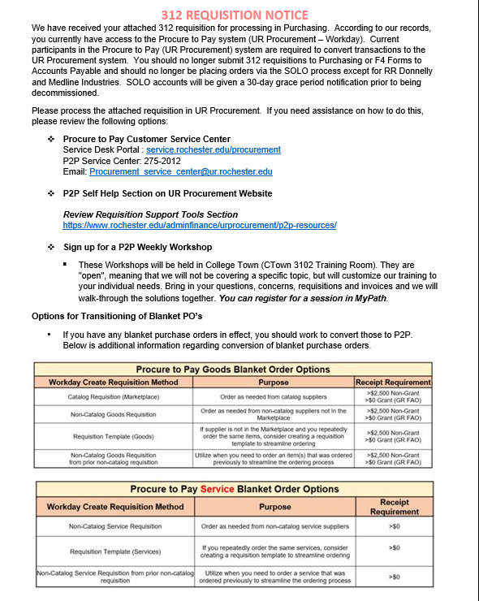
P2P Transition and Adoption
Sample notification with returned 312 Requisitions
18

Slide 19
P2P Transition and Adoption
A Super User Group has been formed to assist departments with transition and adoption.
Departmental Support
Be able to answer basic P2P questions from departmental users
Direct department users to P2P Customer Service Center if unable to answer their questions
Provide pertinent information to department users FROM the P2P team
Provide feedback from department users TO the P2P team
Information Sharing
Sharing best practices from either the P2P team, or from each other
Review new design considerations that will be delivered (and estimated timeline)
New suppliers enabled in P2P Marketplace
New job aids or training opportunities
What is/is not working well
Opportunity to let the P2P Team know where departments are having issues
Opportunity to let the P2P team know IS working well
P2p team sharing the rationale for why certain design components work the way they were designed.
Enhancement Priorities
Opportunity to review enhancement requests and provide recommendations for prioritizing them
Discuss options for enhancements and provide feedback.
19

Slide 20
P2P Training after Final Deployment
Instructor Led Training Sessions:
Create Requisition and Supplier Invoice Request sessions
February 27, 2020 Saunders Research Building Rm 1301
March 4, 2020 Saunders Research Building Rm 1301
March, 12, 2020 Saunders Research Building Rm 1301
March 25, 2020 Saunders Research Building Rm 1301
Ongoing monthly training based on demands
Weekly Workshops:
Customized to your individual needs. Bring in your questions, concerns, requisitions and invoices and we will walk-through the solutions together.
Wednesday, February 26 8:30 – 10:30am College Town Rm 3102
Thursday, March 5 1:00 – 3:00pm College Town Rm 3102
Wednesday, March 11 9:00 – 11:00am College Town Rm 3102
Monday, March 16 9:00 – 11:00am College Town Rm 3102
Thursday, March 26 9:00 – 11:00am College Town Rm 3102
Other Training/Support:
Quick Reference Guides
Video Snippets
Monthly Newsletters

Slide 21
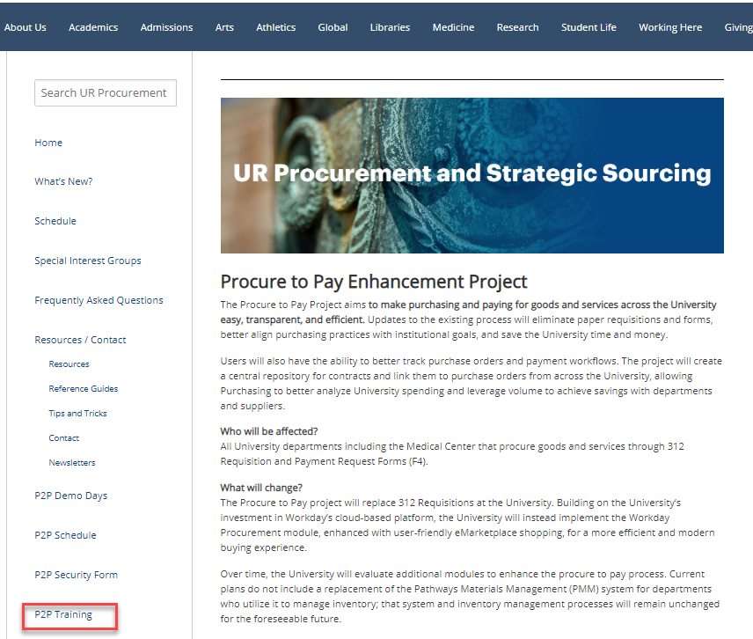
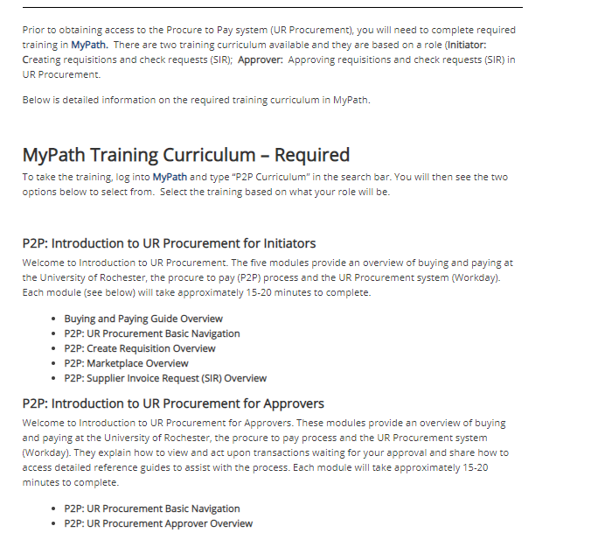
P2P Training Options
To learn more about P2P Training options, go to the UR Procurement Website

Slide 22
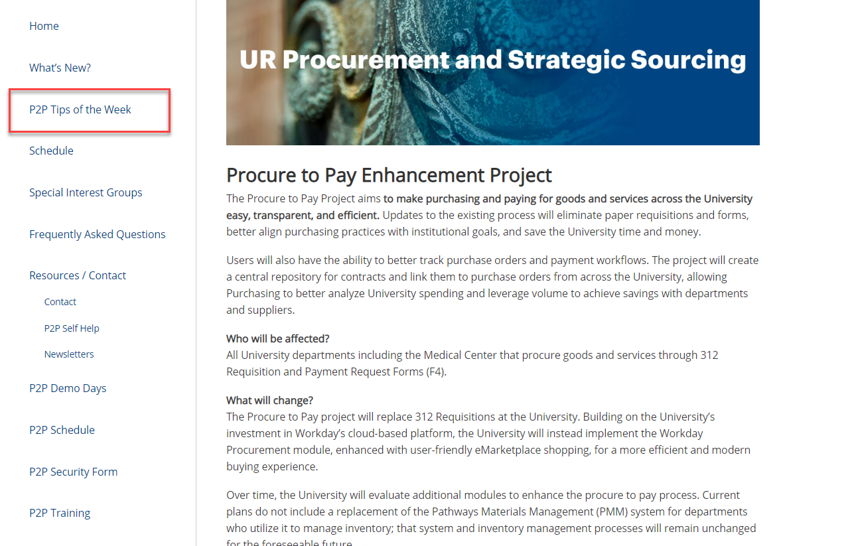
P2P Communications
Procure to Pay Website www.rochester.edu/adminfinance/urprocurement
P2P Self Help
Reference Guides
Tips and Tricks
Videos
FAQs
P2P schedule
P2P Training
New: P2P Tips of the Week
22

Slide 23
P2P Support
Procure to Pay Customer Service Center
Service Desk Portal : service.rochester.edu/procurement
P2P Service Center: 275-2012
Email: Procurement_service_center@ur.rochester.edu
For System Access & Issues
Help Desk: UnivIT: 275-2000, UnivITHelp@ rochester.edu
Help Desk URMC: 275-3200, helpdesk_ISD@ urmc.rochester.edu
Quick Reference Guides
Quick Reference Videos
Walkme
23

Slide 24
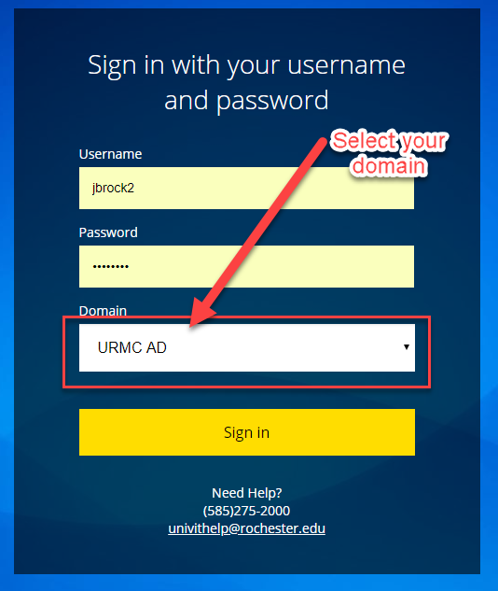
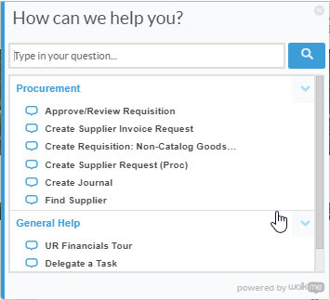
Resources cont’d
P2P Service Center
https://service.rochester.edu/procuement
Log in with your Domain Name, choose domain.
WalkMe
Select Need Help? for step-by-step on-screen help.
Smart Tips are also available
24
Notes:
If you don’t see the Need Help button contact the IT helpdesk at 275-2000 or Univithelp@Rochester.edu

Slide 25
Next Steps
Transition Transactions to P2P System
312 Requisitions
SOLO Orders
Blanket Purchase Orders
F4 Forms
Request Security Access or Changes
https://www.rochester.edu/adminfinance/urfinancials_permission_form/?app=procurement
Visit the UR Procurement Website
P2P Tips of the Week
P2P Self Help
Questions? Please reach out to:
URProcurement@Rochester.edu
25
Notes:
Jim

Slide 26
P2P Demonstration
Supplier Price Justification Questionnaire
Workday 2020R1 Features
26
Notes:
Debbie Flotteron

Slide 27
P2P Demo Days
27
Notes:
Jim

