Slide 1
Procure to Pay Project
Tips and Tricks – COVID-19 Worktag

Slide 2
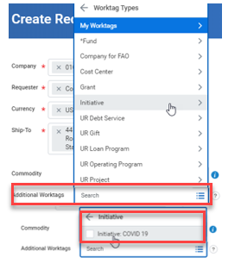
Tips and Tricks – COVID 19 Worktag
When creating requisitions or supplier invoice requests for purchases and expenses associated with coronavirus, P2P Initiators can assist in the tracking of financial transactions associated with coronavirus expenses or disruptions by adding the Initiative > COVID 19 worktag wherever you add your FAO.
On Requisitions, in the Additional Worktags field, select Initiative, then COVID 19:

Slide 3
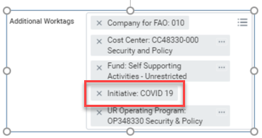
Tips and Tricks – COVID 19 Worktag
After entering both your FAO and the COVID 19 worktags, the COVID 19 worktag is listed among your
financial worktags:
The same entry is used on Supplier Invoice Requests. In the Additional Worktags field select Initiative, then COVID 19:
After entering both your FAO and the COVID 19 worktags the result will appear with both listed:

Slide 4
Questions?

