Slide 1
Procure to Pay Project
Tips and Tricks – Selecting A Commodity on A Non-Catalog Requisition.

Slide 2
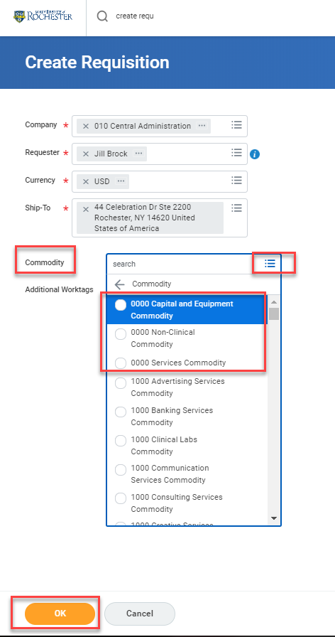
Tips and Tricks – Choosing A Commodity on A Non-Catalog Requisition
When Creating a Non-Catalog Request you will have to select a Commodity when you begin the Create Requisition task.
* Commodity is required for non-catalog requests and should be the same for all lines/line splits. If there are multiple lines on the requisition, select the commodity that most closely relates to the highest dollar value for all lines. If you enter your commodity at this time it will default to all lines.

Slide 3
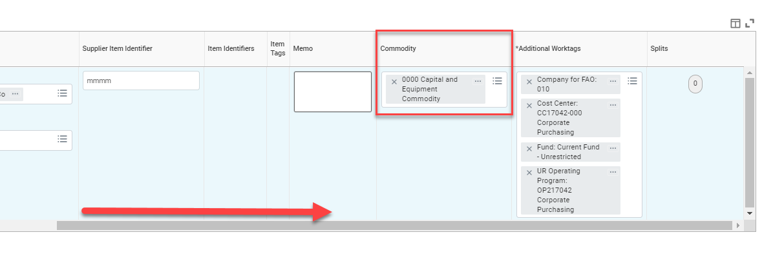
Tips and Tricks-Choosing A Commodity on A Non-Catalog Requisition (cont’d)
If you decide to change the commodity you can do so during checkout by dragging the bottom bar to the right and removing what is there. Enter the correct commodity. Remember that the commodity on all lines must be the same. Decide by choosing the commodity that best matches the highest dollar value line.

Slide 4
Questions?

