Slide 1
Procure to Pay Project
Tips and Tricks – Selecting A Ship-To Address.

Slide 2
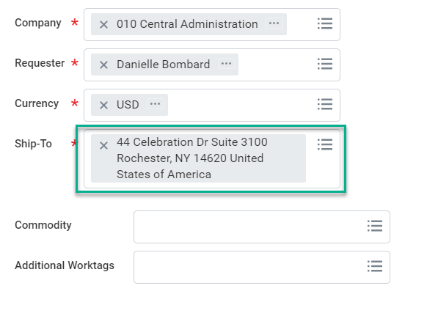
Tips and Tricks – Selecting a Ship-To Address
When Creating a Non-Catalog Requisiton or a Marketplace order, you will need to verify your information.
The Company, Requester, and Currency will be defaulted upon you first using P2P.
The Ship-To Address will not initially be set up. To search for your address enter your room # with no special characters (no -, or . ). Once you find your address select it to fill in the field.
Once you have found your address you can get it added as your default by contacting the P2P Service Center and entering in a Service Ticket.
If you are having difficulty finding your address contact the P2P Service Center and they can assist.

Slide 3
Tips and Tricks – Selecting a Ship-To Address
Once you have found your address you can get it added as your default by contacting the P2P Service Center and entering in a Service Ticket.
https://service.rochester.edu/procurement
If you are having difficulty finding your address contact the P2P Service Center and they can assist. 275-2012
The Ship-To Address Can be changed to a different UR address on file, if needed.

Slide 4
Questions?

