Slide 1
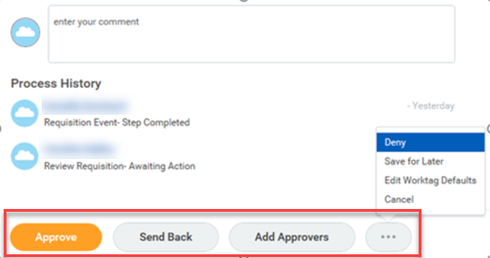
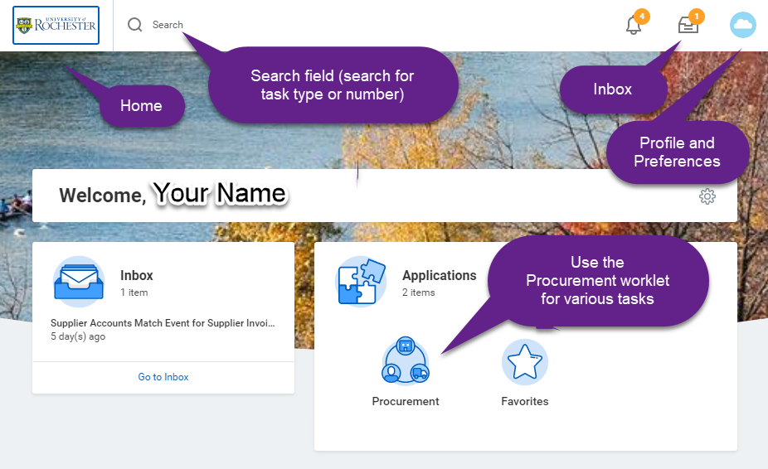
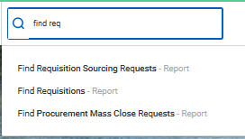
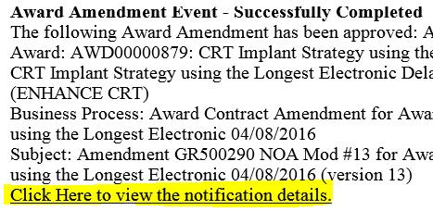
P2P UR Procurement for Approvers
Accessing UR Procurement
Using any web browser, go to:
www.rochester.edu/adminfinance/urprocurement
Click Procure to Pay Login
Note: Log in with your NetID credentials.
Transaction Approval
To review and approve, go to the Inbox.
Select the appropriate action:
If the requisition meets all requirements, select <Approve>.
If additional information is required, select <Send Back> and enter the reason. Prior approvers must re-approve when initiator re-submits.
To exit and review later, select <…> then <Cancel>.
Use with caution: If the requisition should not be completed, select <…> then <Deny> to deny the entire transaction.
Email Notification
You will receive an email notification if you have a transaction waiting for approval.
Open the email and click on the link to launch UR Procurement.
Enter your NetId and password if prompted.
The transaction that requires your approval will be displayed.
Review and take action.
Home Page
Search - The system allows smart lookup using the first three characters of a word or the transaction type and number to easily locate tasks and items.
Sample keywords:
My delegations
Create req
Find req
Cart
REQxxxxxxxx <for Requisitions>
PURxxxxxxxx <for Purchase Orders>
RCTxxxxxxxx <for Receipts>
P2P Approver Quick Reference Card-v20190503

Slide 2
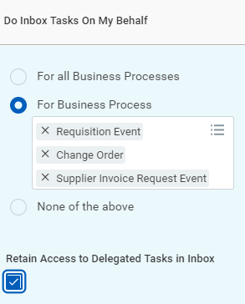
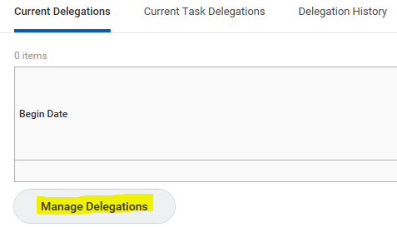
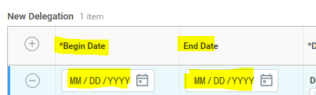
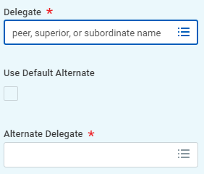
Delegation
You are fiscally accountable for transactions even when delegating. Delegate to users with the same role. Delegates will start receiving the delegated tasks only when new transactions are initiated. Both you and delegates receive confirmation notifications when delegations are in effect. Refer to the P2P Approval Reference Guide for details.
My Delegations
To view current or create new delegations, search “My Delegations.”
Click “Manage Delegations.”
Enter the start and end date.
Enter a delegate.
My Delegations (continued)
Select “For all” or the business process that you want to delegate. Select “Retain Access to Delegated Tasks” in Inbox if you want to get notifications and access the tasks from your own Inbox as usual. If you retain access, then either you or your delegate can complete each task.
Press “Submit.”
Delegations can be adjusted by choosing Manage Delegations and clicking on the Current Task Delegations tab.
For Procurement tasks, select the processes shown.
Check “Retain Access to Delegated Tasks” if you want to get notifications and access the tasks from your inbox allowing either you or your delegate to complete each task.
To delegate for a single day, enter the same Begin Date and End Date. Delegations cannot be more than one year.
Resources
For more information and additional help, refer to the following:
UR Procurement website:
rochester.edu/adminfinance/urprocurement
P2P Service Center:
https://service.rochester.edu/procurement
email: procurement_service_center@ur.rochester.edu
phone: 275-2012
For System Access & Issues, Help Desk:
è UnivIT: 275-2000, UnivITHelp@ rochester.edu
è URMC: 275-3200, helpdesk_ISD@ urmc.rochester.edu
Peers report to the same manager as you
Superiors include your manager and up in the same management chain
Subordinates report to you or report to a peer
Uncheck “Use Default Alternate” unless you wish for your tasks to be sent to the Alternate Delegate listed.

