Slide 1
Procure to Pay Project
Tips and Tricks – Visibility to Capital Requisitions

Slide 2
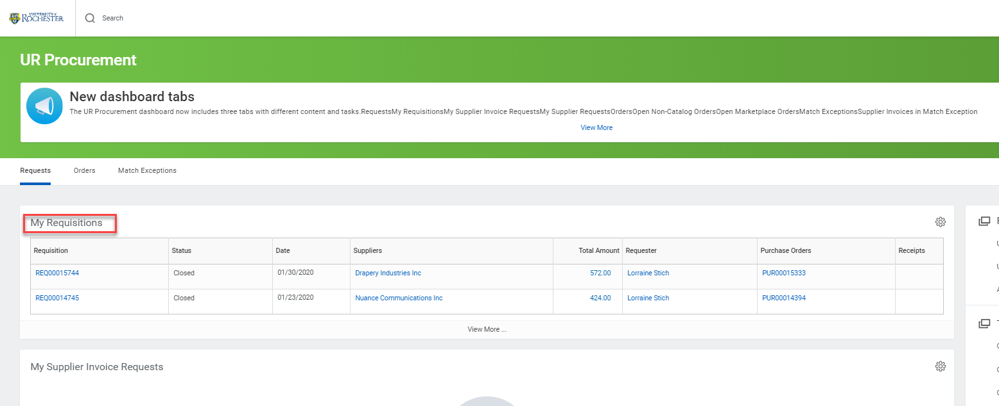
Tips and Tricks – Visibility to Capital Requisitions
You may have Capital requisitions that you have typed, but you are unable to see in your My Requisitions Worklet. This likely means the FAO number was changed to a Project FAO that you do not have access to. You can run a report to give yourself visibility to these requisitions.

Slide 3
Visibility to Capital Requisitions
The My Requisitions Worklet on your dashboard is actually a custom report created by our I.T. team. If you search for My requisitions you will see two reports with that name. The NCL report is the one you see on your dashboard. The other My Requisitions report can be run to show you all of your requisitions, even if the FAO has been changed.
Type My Requisitions in the global search bar and hit enter in order to see the two reports.

Slide 4
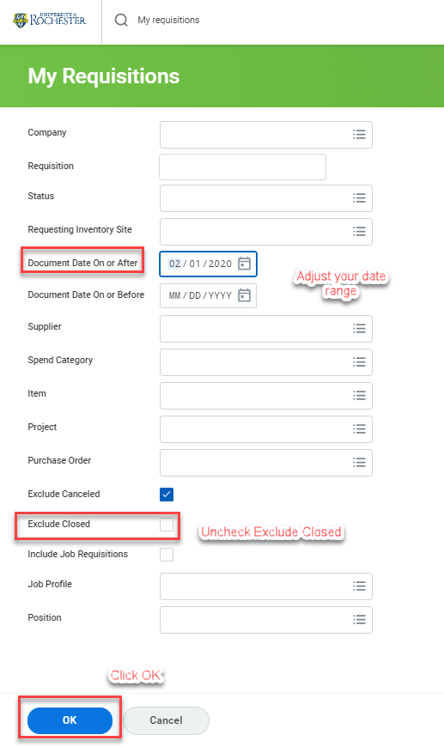
Visibility to Capital Requisitions
Select the My Requisitions report that DOES NOT say NCL. When the report opens select the date range for the requisition you seek, uncheck Exclude Closed and click OK.

Slide 5
Visibility to Capital Requisitions
The report will return showing you the requisition that was not visible on your dashboard. You can click on the Purchase Order or Requisition number (if there is no Purchase Order number) to view details. If you need to do a receipt, hover over the Purchase Order number and click on the action button. Hover over the word Receipt and click Create.

Slide 6
Questions?

