Slide 1
Procure to Pay Project
Tips and Tricks – Editing a Requisition

Slide 2
Tips and Tricks – Editing a Requisition.
After a requisition has been submitted you do have the ability to recall it and edit it. Doing so will cause the requisition to reroute for financial approvals again.
In your Procurement Dashboard look at your My Requisitions Worklet. Find the requisition number you would like to edit. The requisition should be In Progress or Draft. Do not edit a requisition that has a PUR number. In those cases you would initiate a change order on the PO.

Slide 3
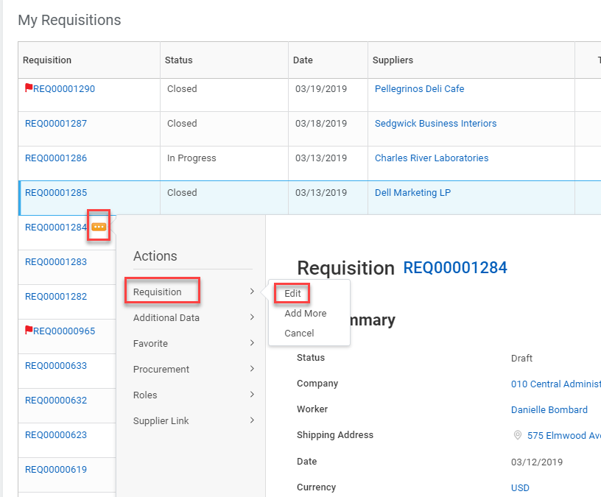
Tips and Tricks – Editing a Requisition
Click on the action button next to the Requisition number. When the window opens up you can hover over Requisition and then click on Edit.

Slide 4
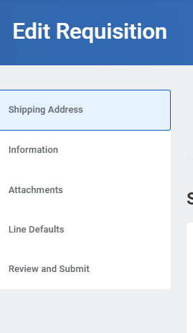
Tips and Tricks- Editing a Requisition
You can click through any of the tabs and edit the information. The Worktags (FAOs) are found on the Review and Submit tab.
To access the Worktag go to the line and pull the bar all the way to the right.
Clicking your mouse in the box with the Worktag details will activate them so you can remove the Worktag and replace it with a different one. Make sure you remove all four items before adding a new Worktag.

Slide 5
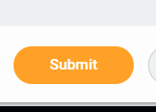
Tips and Tricks- Editing a Requisition
Once you have completed making your changes, click on the Submit button.

Slide 6
Questions?

